Slide 1
TOMMI RAIVIO
PROJECT MANAGER, CSR EUROPE
tr@csreurope.org

Slide 2
THE EUROPEAN CSR BUSINESS NETWORK
COLLABORATIVE PLATFORMS
Learn and act together
+45
Corporate Members
DIALOGUE
With EC
+10,000 companies
through network of multinationals
and national partner associations
+ 41
National Partner Organisations
across 31 countries
6
Regional Organisations
China – Japan – India – Iran – Canada Latin America

Slide 3
BUSINESS PLATFORM ON THE FUTURE OF WORK
2018 - 2020
CURRENT WORKSTREAMS:
Corporate Digital Responsibility at the workplace
Life-long job transitions for
changing occupations

Slide 4
CREATING INCLUSIVE LABOUR MARKETS
①
Revisited social contract
Techno-socially balanced
employment & competition policies
②
Inclusive & competitive
labour markets
Technological disruption
Responsible business transformation
Current employment
③
Future employment
④
Continuous training
⑤
Flexible safety nets

Slide 5
EMPLOYABILITY CHALLENGE:
FITTING THROUGH THE NARROW DOOR
Marginalised groups
“lack of work experience as most commonly cited issue”
Personal life
education
HR
training
Sustainable employment
coaching
work placements

Slide 6
SUSTAINABILITY QUESTION:
CAN WE ENLARGE THE DOOR?
Need to ‘societally responsibilize’ the HR function
Marginalised groups
Personal life
HR
education
training
Sustainable employment
coaching
work placements

Slide 7
EXAMPLES OF COMPANY ACTIONS TO
SUPPORT MARGINALISED GROUPS
´School diplomas & scholarships offered by the Volkswagen Group, internship program at Volkswagen Passenger Cars, language courses “Deutsch 360°”, internships at Porsche’s etc.
Bridgestone in Spain runs a series of comprehensive workshops (400h of learning) on tire and car maintenance, together with the Pardo-Valcarce Foundation for people with intellectual disabilities
“Opportunity for Youth” is an industry-leading programme, whereby Starbucks recruits, trains and retains young talent for the business – while partners earn qualifications up to Level 6, as well as transferable skills needed to further their individual goals.

Slide 8
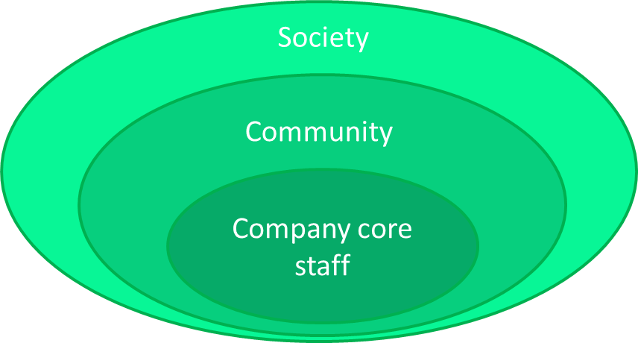
SOCIETALLY RESPONSIBLE HR
Role of CSR: 1) Highlight societal risk 2) Make new practice competitive & viable
Societal responsibility Open up HR processes
Philatrophy Invest in marginalized groups
Social responsibility Take care of your staff

Slide 9
COMPANY ACTIONS FOR FOSTERING
INCLUSIVE EMPLOYMENT
Entering labour markets:
Move from qualifications to skills based hiring
Value ability to learn vs. past achievements
Recognise self taught capabilities (e.g. udacity courses)
Deploy new technologies like AI, to remove human biais (be transparent!)
Look beyond stereotypes of a ‘perfect candidate’
Staying in labour markets:
Make life-long job transitions top social & inclusion responsibility
Make workplace training the new norm
Support people emotionally to re-invent themselves
Foster a culture of age & ‘working carer’ inclusion

Slide 10
TOMMI RAIVIO
PROJECT MANAGER, CSR EUROPE
tr@csreurope.org

