Slide 1
the not-so-new EU Industrial Strategy
A critical perspective from the civil society point of view

Slide 2
Key remarks from EEB
Improved narrative: We welcome the emphasis on the circular economy business models being at the heart of the industrial transformation.
But it fails to square the circle of the current linear production model by placing material consumption as a key driver for emissions.
Fails to walk the talk on the industrial depollution: no link with the EGD Zero Pollution objective
Does not improve the governance gaps

Slide 3
Why embedded emissions matter
At the current pace, material production alone will be responsible for 900 bn tCO2eq by 2100 worldwide, which is more than what IPCC has estimated as a total budget for this century (800 bn tCO2eq).
Source : Material Economics - Industrial transformation 2050

Slide 4
Why embedded emissions matter
The largest share of responsibility lies with the building construction sector:
The sector (including material manufacturing, transport, etc.) accounted for 36% of global final energy use and 39% of energy-related CO2 emissions in 2017
According to our calculations, the sectors analysed in this document must decrease from 2250TWh consumption of 2015 to 1434TWh (-37%) in 2050 to be compatible with the Paris Agreement

Slide 5
“Circular Economy first” mantra
Already today up to 58% of the total amount of CO2 emissions the most relevant industry sectors (steel, cement, plastics) can be cut with a pathway focused on Circular Economy available measures and technologies.
On average CE measures cost less than 50 euro per ton CO2eq, thus making their results comparable to measures that are now prioritised on the supply-side for industry
Source : Material Economics – The Circular Economy: a power force for climate mitigation

Slide 6
This is where IS falls short
Renewable energy and green hydrogen can only go so far towards making European industry climate-neutral.
Without considerably reducing resource use, the EU’s transition to a circular economy is little more than a pipedream.
To fully achieve the European Green Deal goals the industrial transformation must go beyond technical feasibility measures
Transformative actions must be extended through the value chain and engage skilled workforces, new business models based on quality, rethinking products as services, improving ecodesign and transparency
The aim to prioritise resource use as a strategic tool to reduce emissions in industrial processes and as an enabler of decarbonisation of processes is not clearly there.

Slide 7
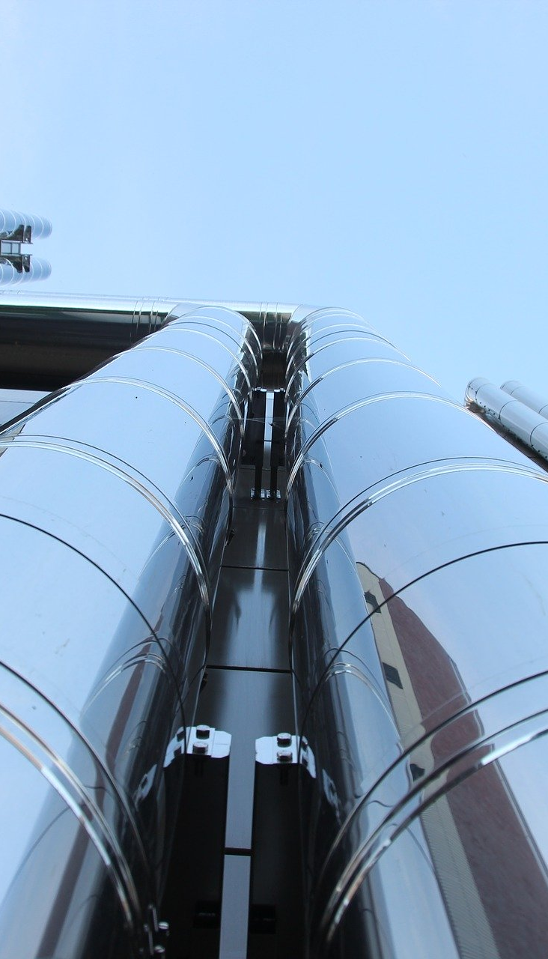
Zero pollution?
IS should be instrumental to achieving all of the EGD goals not only climate targets.
EU is revising the Industrial Emissions Directive, the main emissions tool related to this economical sector
The invisible hand of the carbon market needs a combined carrot-and-sticks approach, including binding pollution prevention and energy efficiency standards at permitting phase.
The IED should be setting the minimal requirements for the decarbonisation and depollution of industrial processes, in particular for energy-intensive industries
There should be – and it’s not at all there – a strong bond between this IS and the IED revision for a real synergy of policies.

Slide 8
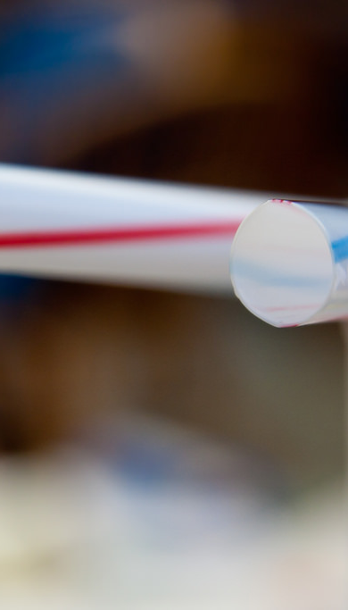
Who, How, When?
When it comes to good governance, the revised Industrial Strategy fails to upgrade the existing one.
The confirmed framework of ecosystems and alliances is, for now, only being used to highlight the needs and capacity of the different industrial ecosystems but there are no sectoral roadmaps and clear intermediate steps for these ecosystems.
The new Industrial Strategy, therefore, fails to define a more general framework to achieve the European Green Deal’s objectives and does not put in place a steering mechanism that can make sure that all efforts carried out within these pathways are aligned with both the pace of action that is required and fair burden-sharing among the different sectors of the economy.

Slide 9
Thanks davide.sabbadin@eeb.org
More on EEB’s positions on industry at www.eeb.org/library

