Slide 1
Lifelong Learning Entitlements: a European solution to upskilling and reskilling
Susana Oliveira, Vice-president - Lifelong Learning Platform
European Economic and Social Committee
Civil Society Days 2022
15th March 2022 – Workshop 1- Upskilling opportunities for all

Slide 2



“Promote a holistic vision to lifelong learning, from cradle to grave, by facilitating European-wide cross-sector cooperation among civil society organisations in the field of education & training and voicing citizens’ concerns”
WHO WE ARE
Founded in 2005
40+ European networks (CSOs)
50.000+ education & training institutions

Slide 3
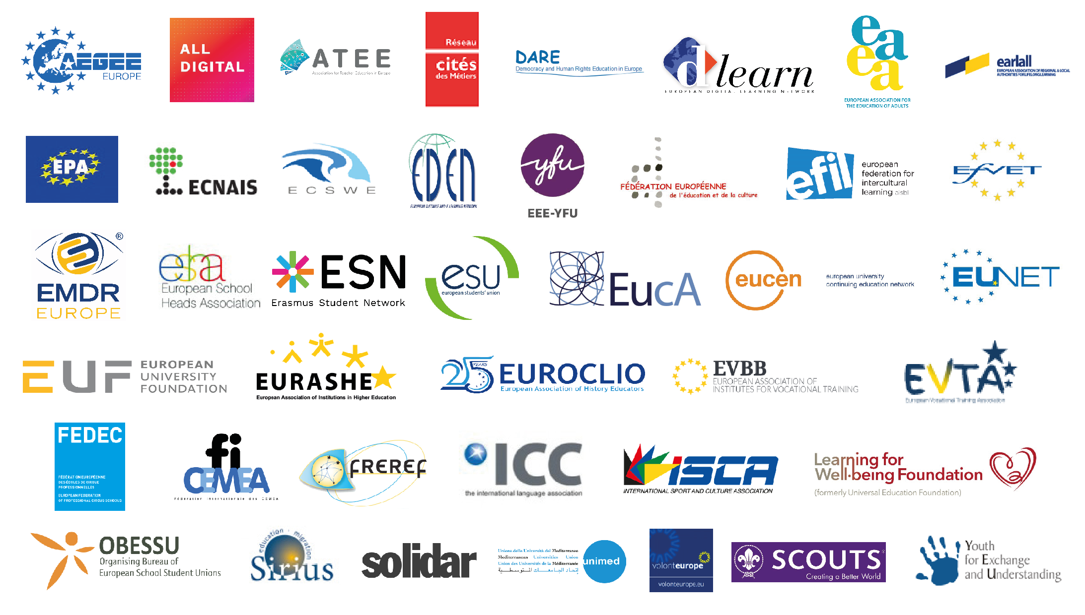

Slide 4

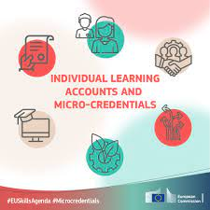
From the ambitions of the EU to Education as a human right…
Individual Learning Accounts
Micro - credentials
See LLLP’s reaction published today!
Notes:
New EU actions to improve lifelong learning: are these 2 a first step to learning entitlements and to reach Education as a public good, as we see it?

Slide 5
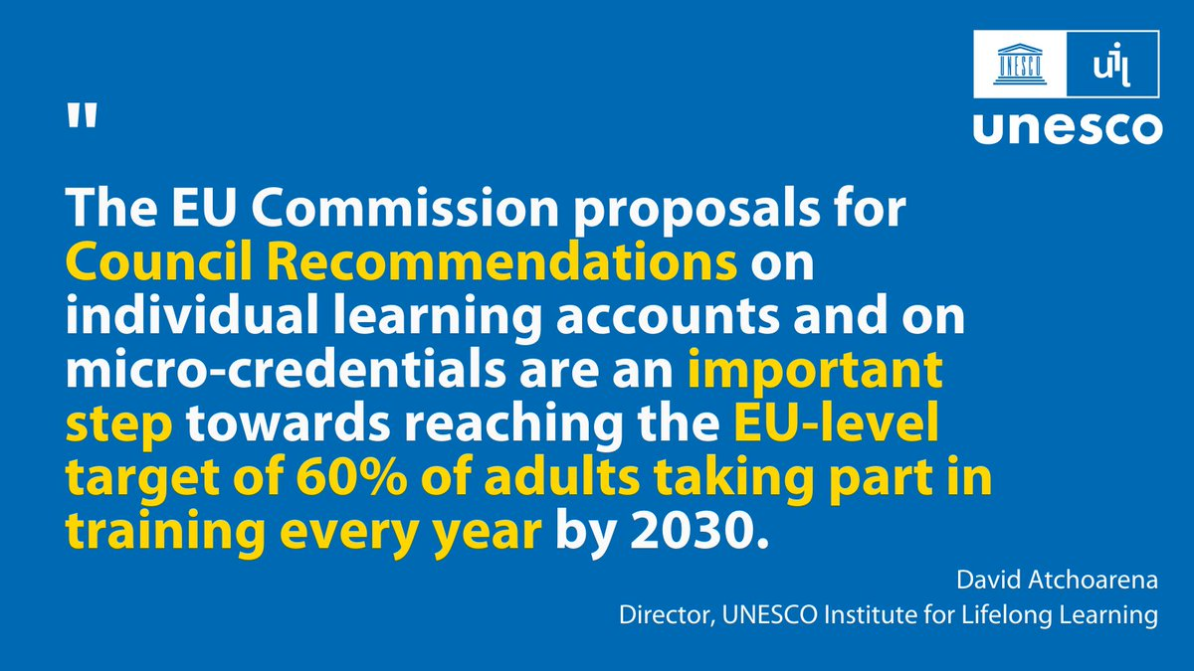
Notes:
The European Union has put forward some serious ambitions in the field of education and training, particularly with regard to upskilling and reskilling the European adult population for the Twin Transitions, aiming at achieving a target of 60% of adults in education or training by 2030 (European Pillar of Social Rights Action Plan). Two major tools are being proposed to achieve this endeavour: individual learning accounts, and micro-credentials.

Slide 6

Individual Learning Accounts – what is already there?
individuals should have full ownership over their accounts
universal but differentiated approach to the ILAs
involvement of civil society organisations to reach those who are less motivated and still not engaged in LLL.
the importance of validation and recognition
Notes:
As mentioned in our position paper (launched today, available on our website) we believe that individuals should have full ownership over their accounts which we are pleased to see reflected in the final EC proposal. We support a universal but differentiated approach to the ILAs, as everybody should benefit from an entitlement to learn but targeted support is needed for those individuals who are underrepresented in learning and usually with low skills.
Related to the issue of engaging and motivating marginalised adults in lifelong learning, we are glad to see that the involvement of a wide range of stakeholders has been considered in the Proposal - such as civil society organisations as we have reiterated often that these organisations can sometimes be best placed to reach them.
We are pleased to see the Commission stresses the importance of validation and recognition this is a common point with the MCs. Equally valuable and aligned with our wishes is the portability and transferability of ILAs across Member States which has been considered in the proposal and has a strong potential to encourage further learning mobility for all, therefore, ensuring a European dimension.

Slide 7

Micro-Credentials - what is already there?
The synergy between ILAs and MC are key to broad learning opportunities in Europe;
Strong emphasis on higher education and VET which must improve accessibility to a more diverse learners' population;
It can boost access and participation to LLL thanks to the modular approach and portability of credits
Notes:
Micro-credentials - broadening learning opportunities for lifelong learning and employability
There is a strong emphasis on higher education and VET . While higher education institutions must extend their learning offer and improve accessibility to a more diverse learners population to become more inclusive and support societal challenges, this must not be seen as the only alternative for new learners to undertake new learning opportunities.
The effects of this direction on individual learners are still unknown and therefore represent a risk. As the Lifelong Learning Platform we believe that MCs could boost access and participation to lifelong learning by bringing more flexibility to the learning pathways and personalised learning thanks to the modular approach and portability of credits. if I remember correctly, it also mentions VET but says very little about AE and NFE, its worth to explore how they can provide MC opportunities, especially for disadvantaged groups that might not fit in the HE context.
We stress that certain conditions have to be met and encourage more cross fertilization among different learning providers and education levels. For example, better cooperation with non-formal education providers and / or with adult education and professional education providers. Overall this must not be seen as a way out of continuing public funding to higher education.

Slide 8

ILA’s and MC – Shifts are needed
Towards a lifelong learning paradigm !
Improve participation in democracy, resilience, personal wellbeing, among other challenges;
Focus on the digital and green transitions, and the role of education on it;
Put resources into LLL guidance, community-based learning and diverse types of offer, depending on learners’ needs.
Notes:
the Commission’s proposal requires a shift towards a lifelong learning paradigm where supporting the individual’s potential is the key guiding principle. This means that individuals have the freedom to choose training of their choice whether related to the specific labour market needs or not and equal recognition and value for all types of learning environments (formal, non-formal, informal) and the possibility to move seamlessly between them
The over-emphasis on the labour-market needs can be a missed opportunity to consolidate and proliferate a culture of lifelong learning across Europe
twin transitions: digital and green where a culture shift will be necessary and learning can be a vehicle to support a smooth and just transition for all. To this end, we encourage Member States to not limit ILAs to labour-market related learning solely, but extend it to encompass learning skills for life and transversal skills - which include emotional and social skills more and more needed in our contemporary societies - as well as learning for the joy of learning
A culture-shift towards learning is required and resources must be put into lifelong learning guidance (beyond career guidance) both online and offline that are closer to those in need, community-based learning and in the different richness of learning environments and diversifying the type of offer and its providers to learners’ need.

Slide 9
ILA’s and MC – Reccommendations:
Synergies should be built with other EU and national ongoing initiatives such as European Higher Education Strategy, European Education Area;
Synergies also with national and regional policies on education;
Learners must be central to the initiative, so the development of MCs must depart from the concept of the learner centered approach;
MCs could also serve as a tool for the recognition and valorization of all the knowledge, skills and competences acquired outside the formal education system;
Notes:
The synergy between ILAs and Micro-credentials are key to support the broadening of learning opportunities, however, similar synergies should be build with other EU and national ongoing initiatives such as European Higher Education Strategy, European Education Area
Learners must be central to the initiative, so the development of MCs must depart from the learner centered approach.
MCs must clearly state the value of the certificates and should be seen as complementary to larger scale quality educational programmes of a longer duration and not replacing them.
How can micro-credentials also serve as a tool for the recognition and valorisation of all the knowledge, skills and competences acquired by learners outside the formal education system.
We wish to see stringent conditions applied to private providers and support to publicly-funded providers. We must acknowledge the fact that MCs could potentially disrupt the governance system in which education systems operate (particularly public institutions), and thus the Commission should provide guidance to Member States to develop a system which prioritises the public offer and has learners’ needs at the centre.

Slide 10
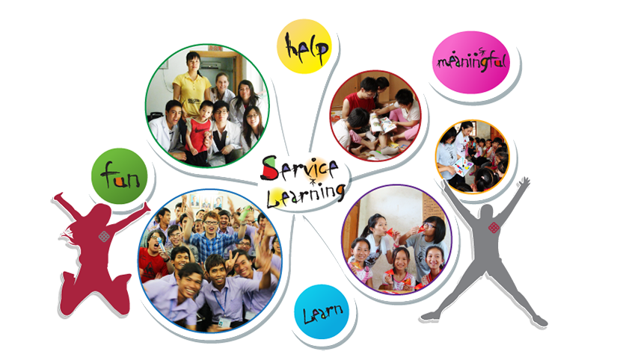
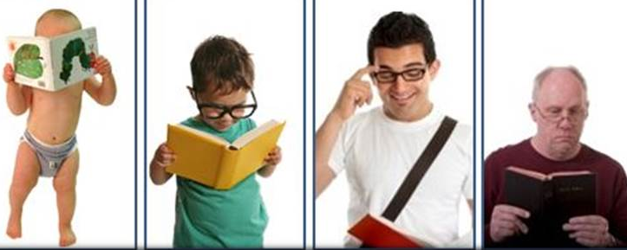
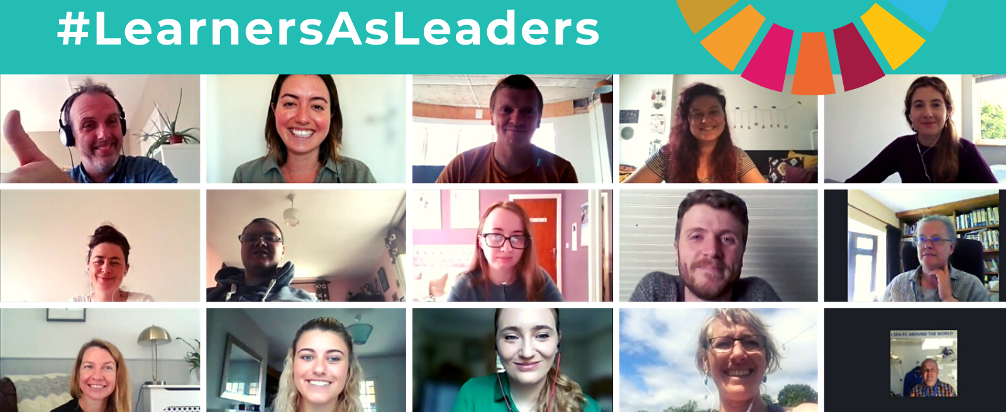
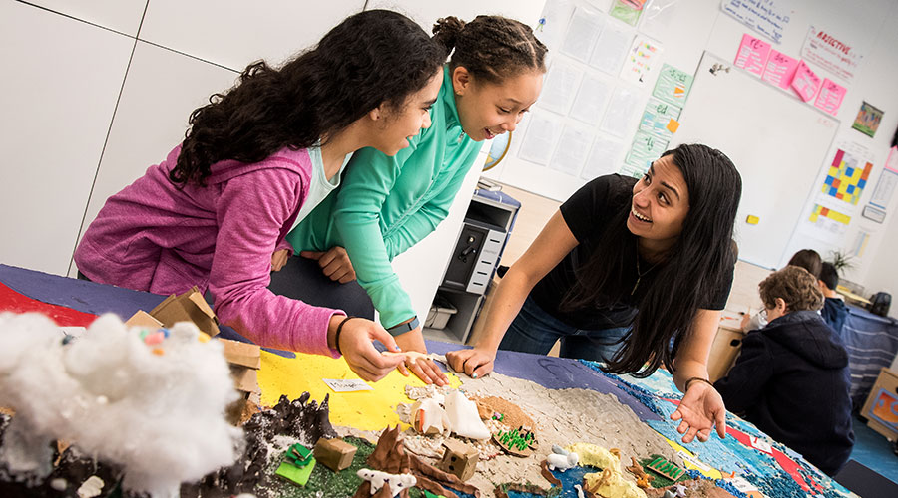
All learning is valuable for a prosperous and just society
Notes:
Investing in lifelong learning is not only allocating funds towards improving employability.
While this is no doubt important, particularly for increasing lifelong learning participation rates for adults with lower skills who are still less likely to participate of education and training opportunities, it is equally important to consider lifelong learning in a broader sense.
Moreover, it is short-sighted to assume that the ability to ‘learn to learn’ is not an essential requirement for furthering skills and competencies throughout life – which subsequently improves employment prospects regardless. Investing in lifelong learning demands a recognition of personal needs and aspirations and not solely a reflection of job demand on the labour market.
A more holistic idea of lifelong learning considers all education and training during a lifetime, including both initial education and training and adult learning. It is, in this sense, ‘lifelong’ and ‘life wide’, covering learning in institutions, families, communities and workplaces. It is also considered ‘life-deep’, assuming the ongoing and active assimilation and mobilization of knowledge.
This notion of lifelong learning imagines a sort of ‘universalization’ of life, wherein learning can always occur selectively and broadly. It is as much concerned with building the capacity of people to actively engage and construct meaning as it is with operating as an employment tool fit for the 21st century.

Slide 11
Thank you for your attention
Contact at:
susana.oliveira@eaea.org
policy@lllplatform.eu
www.lllplatform.eu

