Slide 1
Strategy for Financing the Transition to a Sustainable Economy
European Economic and Social Committee
15 September 2021

Slide 2
The foundations of the EU sustainable finance framework

Slide 3
Recent developments in Sustainable Finance
April package
July package
Taxonomy (first) climate delegated act
Taxonomy delegated act under Article 8 (specifying disclosure requirements)
Proposal for a Corporate Sustainability Reporting Directive (CSRD)
Proposal for a Regulation on European green bonds
Amending delegated acts on Sustainability preferences and fiduciary duties
Strategy for Financing the Transition to a Sustainable Economy

Slide 4
Objectives of the Strategy
The European Green Deal announced a ‘Renewed Sustainable Finance Strategy’
Complete the work started under the 2018 Action Plan on Financing Sustainable Growth
An evolved context provides need for additional measures in four key areas
Facilitate the financing of credible transition efforts
Improve inclusiveness for citizens, SMEs and public authorities to take advantage of opportunities
Strengthen resilience of the financial sector to climate and environmental degradation risks, and improve its impact sustainability
Set a high level of ambition and convergence in all international forums

Slide 5
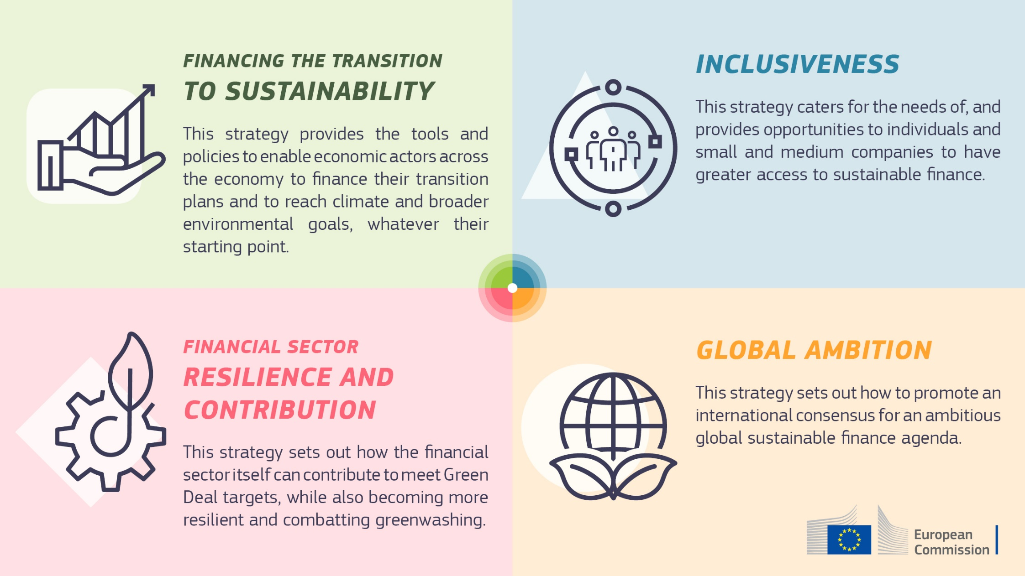
Four key policy areas

Slide 6
Financing the transition and improving inclusiveness
Financing the transition of the real economy towards sustainability
Action 1: Develop a more comprehensive framework and help the financing of intermediary steps towards sustainability
Recognise transition efforts
Include additional sustainable activities in the EU Taxonomy
Extend the framework of SF standards and labels
II. Towards a more inclusive sustainable finance framework
Action 2: Improve the inclusiveness of sustainable finance
Empower retail investors and SMEs to access sustainable finance
Leverage the opportunities digital technologies offer for sustainable finance
Offer greater protection from climate and environmental risks
Publish a report on a social taxonomy
Support green budgeting and risk-sharing mechanisms

Slide 7
Strengthening financial sector’s resilience and contribution to sustainability
III. Improving the financial sector’s resilience and contribution to sustainability: the double materiality perspective
Action 3: Enhance economic and financial resilience to sustainability risks
Reflect sustainability risks in financial reporting standards and accounting
Identify and managing sustainability risks by banks and insurers
Manage sustainability risks at system level
Action 4: Increase the contribution of the financial sector to sustainability
Improve science-based target setting, disclosure and monitoring of the financial sector’s commitments
Clarify the fiduciary duties and stewardship rules of investors to reflect sustainability impacts
Improve the availability, integrity and transparency of ESG market research and ratings
Action 5: Monitor an orderly transition and ensure the integrity of the EU financial system
Monitor greenwashing risks and assess and review the current supervisory and enforcement toolkit to address greenwashing
Monitor an orderly transition of the EU financial system and develop a robust monitoring framework to measure capital flows and assist Member States in assessing the investment gap

Slide 8
Fostering global ambition
IV. Fostering global ambition
Action 6: Set a high level of ambition in developing international sustainable finance initiatives and standards and to support EU partner countries
Seek an ambitious consensus in international forums
Seek an ambitious consensus in international forums, mainstream the concept of double materiality, stress the importance of disclosure frameworks, and agree on objectives and principles for taxonomies.
Advance and deepen the work of the IPSF
Propose to expand the work of the IPSF to new topics and strengthen its governance.
Support low- and middle-income countries in scaling up their access to sustainable finance
Support our low- and middle-income partner countries in scaling up their access to sustainable finance by developing a comprehensive strategy and by promoting sustainability-related financial instruments.

Slide 9
Conclusion and discussion
Based on the 2018 action plan on sustainable finance, the Commission has taken unprecedented steps to establish the foundations for sustainable finance.
This strategy sets how the objectives of the European Green Deal are translated throughout the financial system and ensures actors across all sectors of the economy are able to finance their transition regardless of their starting point.
The Commission will report on this strategy’s implementation by the end of 2023 and will actively support Member States in their efforts.

Slide 10
Thank you
© European Union 2020
Unless otherwise noted the reuse of this presentation is authorised under the CC BY 4.0 license. For any use or reproduction of elements that are not owned by the EU, permission may need to be sought directly from the respective right holders.
Slide xx: element concerned, source: e.g. Fotolia.com; Slide xx: element concerned, source: e.g. iStock.com

