Slide 1
EU-Russia Cooperation
in Higher Education
27 September 2017
Kamila Partyka
European Commission
DG EAC

Slide 2


Quality and relevance
Pan-European cooperation
Employability and competences
Internationalisation
More inclusive systems
Mobility and recognition
Quality assurance

Slide 4
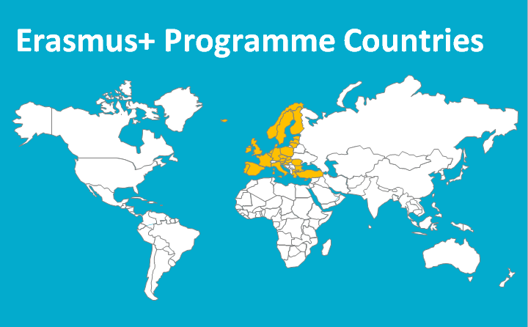
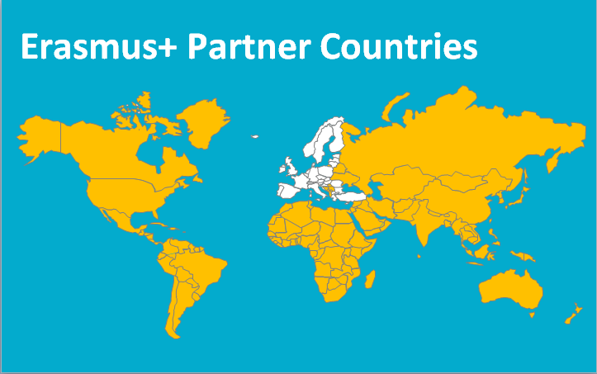
Over €20 million/year for cooperation with Russia

Slide 5
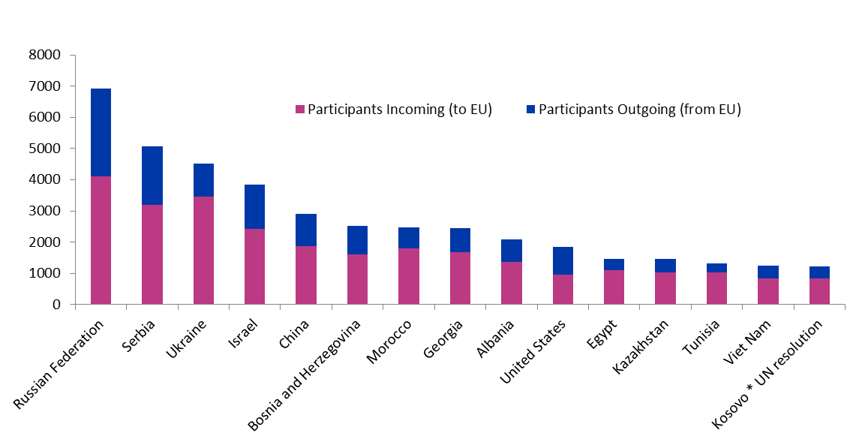
Russia is the leading country for short-term academic exchanges

Slide 6
142 Erasmus Mundus scholarships for students from Russia

Slide 7




40 Capacity building projects
150 Russian institutions involved

Slide 8
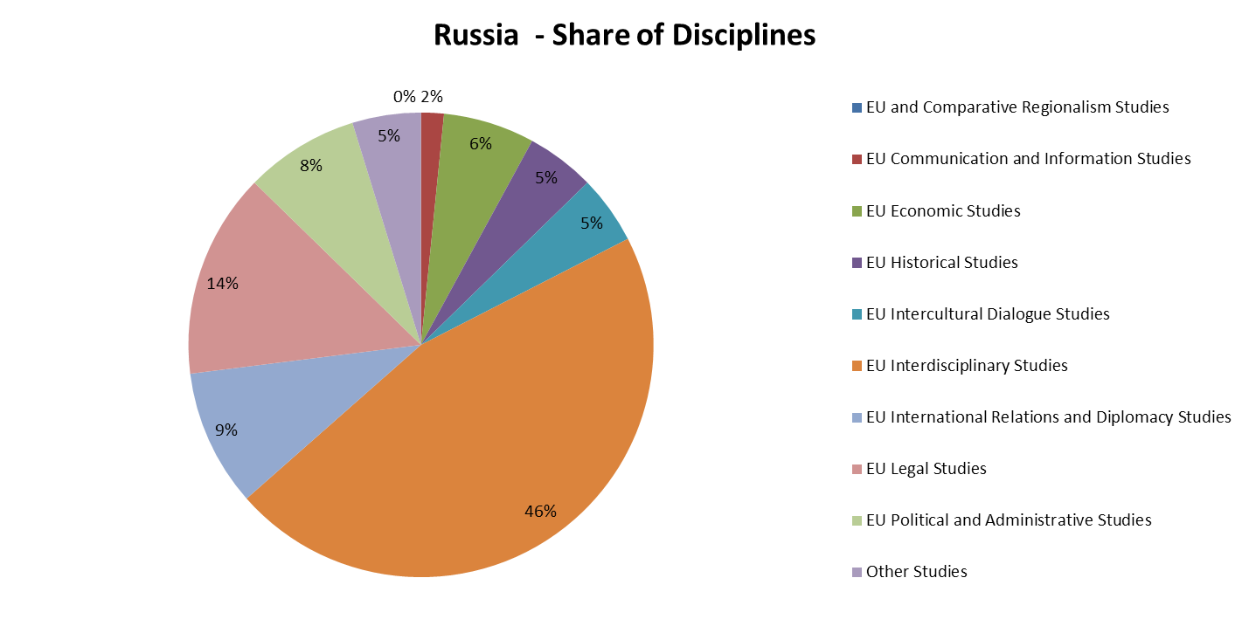
Strong network of Jean Monnet professors and students

Slide 9

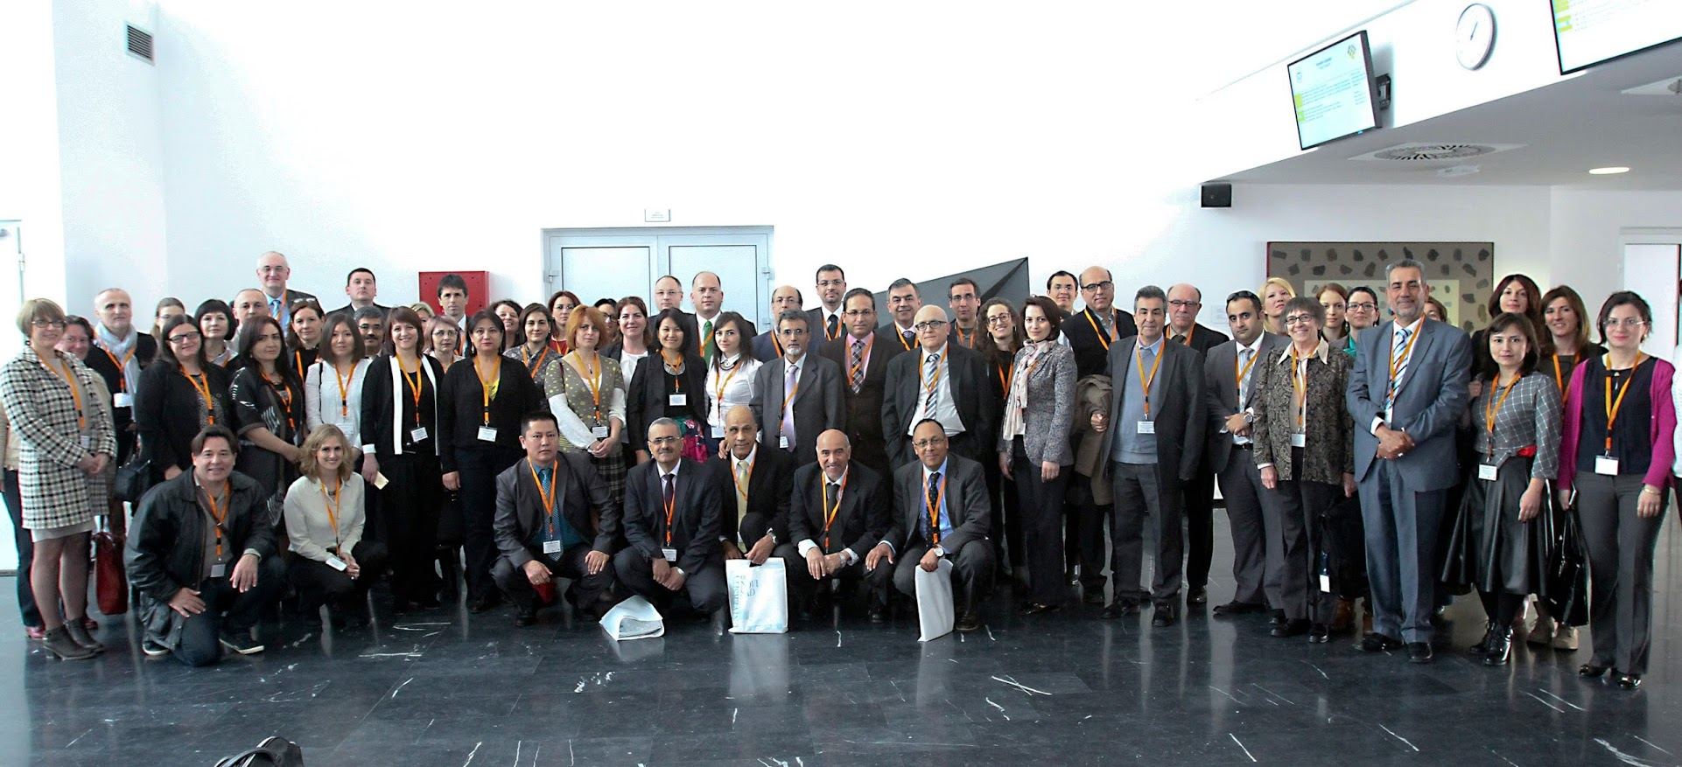
Working with experts and alumni
NEO and HEREs

Slide 10


