Slide 1
Artificial Intelligence (AI), the liberal professions and the law with a special focus on the medical profession
Day of the liberal professions 2019
Professor Dr. Karl Stöger, MJur (Oxford)
Institute of Public Law and Political Science
University of Graz

Slide 2
Definition of "liberal" professions
"free" from the state, but also from third parties
Performing an intellectual task
due to special competence
personally (predominantly in a special relationship of trust)
self-reliant
and professionally independent.

Slide 3
Definition of "liberal" professions
"free" from the state, but also from third parties
Performing an intellectual task
due to special competence
personally (predominantly in a special relationship of trust)
self-reliant
and professionally independent.

Slide 4
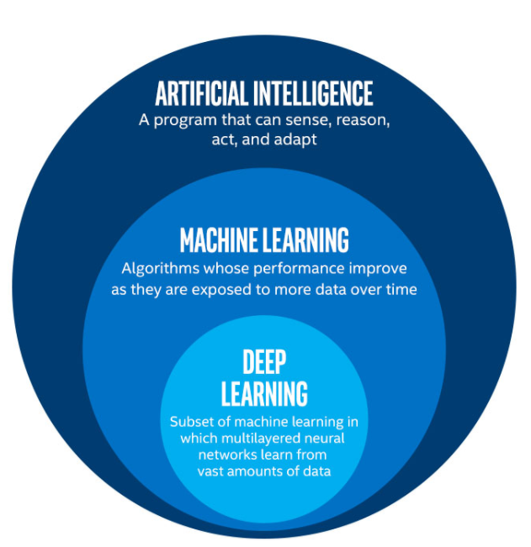
McCarthy: „[…] every aspect of learning or any other feature of intelligence can in principle be so precisely described that a machine can be made to simulate it.“
McCarthy: „[…] Jeder Aspekt des Lernens oder jedes andere Merkmal der Intelligenz kann im Prinzip so genau beschrieben werden, dass eine Maschine zur Simulation eingesetzt werden kann.“
Translated by DeepL
Differentiation of AI, ML und DL
(picture source: Singh, Cousins of AI <https://towardsdatascience.com/cousins-of-artificial-intelligence-dda4edc27b55>)
Notes:
Bildquelle: https://towardsdatascience.com/cousins
-of-artificial-intelligence-dda4edc27b55

Slide 5
Core aspects of Machine Learning (ML)
Recognition of patterns/rules
in a large amount of data
Transfer of these rules to
unknown situations
ML works with statistical tools
a form of pattern recognition
correlation instead of causality

Slide 6
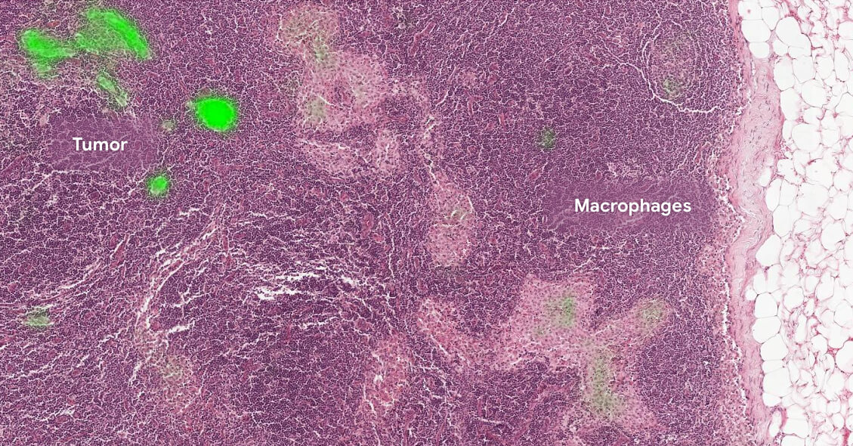
State of development - medicine
Image evaluation as a leading field of application for ML
Decision support as the most promising market
Lymph node biopsy, identification of a tumor (marked green) by means of AI
(picture source: Google AI <https://ai.google/healthcare/>)
Notes:
Bildquelle: https://ai.google/healthcare/
https://ec.europa.eu/digital-single-market/en/news/eu-invests-eu35-million-develop-artificial-intelligence-solutions-cancer-prevention-and

Slide 7
AI changes the job profiles of the liberal professions
"Standard applications" for trainees will become less frequent (e.g. data checking) → reduction of training positions?
(Expenditure-based) fee calculation will have to adapt - but there will be new costs for AI infrastructure
Partial replacement and further delegation of tasks: e.g. health apps, contract preparation on the Internet
Potential dependency on a few providers

Slide 8
Who can regulate the use of AI?
European law: if there is a reference to the internal market and thus a need for legal harmonisation: e.g. differences between national AI regulations make cross-border activities more burdensome
International law (e.g. "European Ethical Charter on the use of AI in judicial systems and their environment" of the Council of Europe)
National law
Professional codes - self-regulation as a "privilege" of the liberal professions

Slide 9
Where does the European law stand?
No comprehensive codification, only single provisions (e.g. Art 22 GDPR – automated individual decision-making, including profiling)
Awareness: given, implementation: work in progress
High-Level Expert Group on AI: AI Definition, Ethics Guidelines (currently in practical pilot phase until early 2020), Policy and Investment Recommendations
Announcement von der Leyen: legislative proposals within 100 days
→ No specific rules for the liberal professions

Slide 10
High-Level Expert Group on AI: Ethics Guidelines
4 ethical principles: | 7 core requirements:
Respect for human autonomy Prevention of harm Fairness Explicability (source: https://ec.europa.eu/futurium/en/ai-alliance-consultation/guidelines) | Human agency and oversight Technical robustness and safety Privacy and Data Governance Transparency Diversity, non-discrimination and fairness Societal and environmental wellbeing Accountability
Notes:
https://www.coe.int/en/web/cepej/cepej-european-ethical-charter-on-the-use-of-artificial-intelligence-ai-in-judicial-systems-and-their-environment

Slide 11
AI and human rights: Charter of Fundamental Rights, ECHR, constitutions
Responsibility for the consequences of innovation:
The state guarantees protection from negative effects of technological innovation
Principle of non-discrimination – Attention: correlation instead of causality
Freedom of innovation: Securing the freedom for technical development - Freedom to conduct business, right to (intellectual) property
Necessary standard of medical treatments: Obligation to use AI? (e.g. ECHR 30.8.2016, 40448/06 Aydoğdu/Turkey: functioning hospital system)

Slide 12
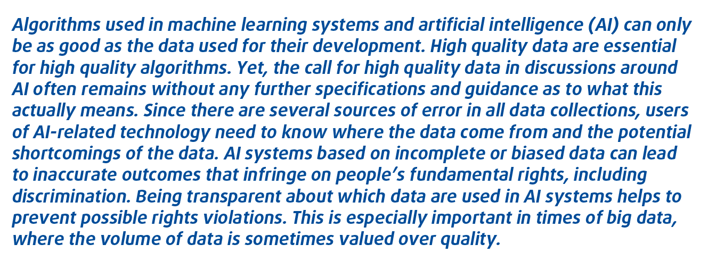
Quality of the database of AI-applications: European Union Agency for Fundamental Rights
Source: FRA, Data quality and artificial intelligence – mitigating bias and error to protect fundamental rights (2019)

Slide 13
„Personal intellectual care“ as a core element of all liberal professions → Mutual trust
Explainable AI is an important topic, in particular for medical professionals in the area of informed consent
Justification of decisions is particularly essential for members of the liberal professions as they work as „advisors and companions“
Blueprint of a black box in systems theory
(picture source: Krauss, Blackbox3D <https://de.wikipedia.org/wiki/Black_Box_
(Systemtheorie)#/media/Datei:Blackbox3D.png> CC BY-SA 4.0)
Notes:
Bildquelle: https://de.wikipedia.org/wiki/Black_Box_ (Systemtheorie)#/media/Datei:Blackbox3D.png

Slide 14
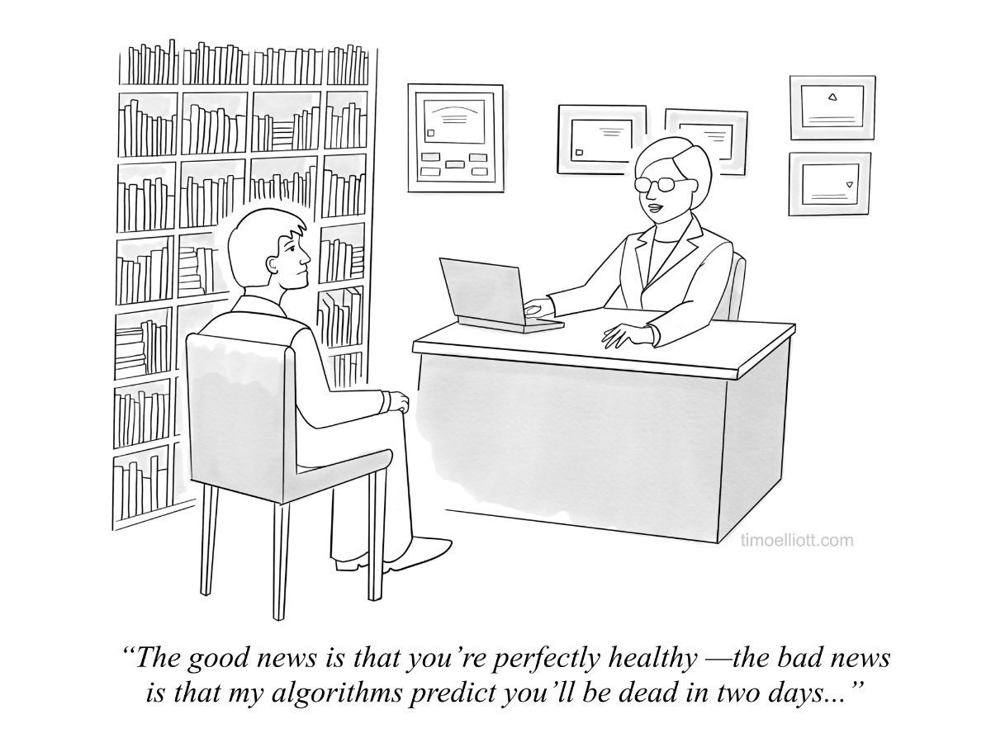
(picture source: Elliott, AI Cartoons <https://timoelliott.com/blog/cartoons/artificial-intelligence-cartoons>)
Notes:
Bildquelle: https://image-store.slidesharecdn.com/e19171e4-fab0-4bb6-bdf4-f794ca4a0c58-original.jpeg

Slide 15
Personal and trustful provision of services (I)
Protection of privacy of patients
“[…] Black-box medicine — the use of big data and sophisticated machine-learning techniques for health-care applications — could be the future of personalized medicine. Black-box medicine promises to make it easier to diagnose rare diseases and conditions, identify the most promising treatments, and allocate scarce resources among different patients. But to succeed, it must overcome two separate, but related, problems: patient privacy and algorithmic accountability. […]”
Source: Ford/Price, Privacy and Accountability in Black-Box Medicine, Michigan Telecommunications and Technology Law Review 2016, 1 (1)
Notes:
Dazu gäbe es noch weitere Artikel von Price II: Black Box Medicine, Harvard Journal of Law & Technology 2015, 420 und Regulating Black-Box Medicine, 116 Mich. L. Rev. 421 (2017).

Slide 16
Personal and trustful provision of services (II)
“[…] Privacy is a problem because researchers need access to huge amounts of patient health information to generate useful medical predictions. And accountability is a problem because black-box algorithms must be verified by outsiders to ensure they are accurate and unbiased, but this means giving outsiders access to this health information. […]”
Source: Ford/Price, Privacy and Accountability in Black-Box Medicine, Michigan Telecommunications and Technology Law Review 2016, 1 (1)
Notes:
Dazu gäbe es noch weitere Artikel von Price II: Black Box Medicine, Harvard Journal of Law & Technology 2015, 420 und Regulating Black-Box Medicine, 116 Mich. L. Rev. 421 (2017).

Slide 17
Professional independence: conflicts of interest
Duty to declare potential conflicts of interest (duty of loyalty)
→ Client/patient can search for alternatives
However:
Financial and not altruistic motives shape the development of AI: „hunger” for more data
To renounce AI-support is not a viable alternative because AI is to useful (e.g. diagnostic accuracy)
Dominance of few providers prevents realistic alternatives

Slide 18
Thank you for your attention!
Professor Dr. Karl Stöger, MJur (Oxford)
Institute of Public Law and Political Science
University of Graz

