Slide 1
European Citizens’ attitudes to fighting climate change and the transition to clean energies
« Climate Change and Energy Transition », 2 March 2022 European Economic and Social Committee, Group III – Diversity Europe Group
Laura Maanavilja, Directorate-General for Climate Action, European Commission

Slide 2
Ingredients for climate action?
Vision: European Green Deal (climate neutrality by 2050)
Mid-term targets: -55% by 2030 as compared to 1990
Legislation: being updated / newly drafted (e.g. Climate Law, “Fit for 55”)
Policy: new/updated policies and strategies (e.g. Adaptation Strategy)
Support and engagement of European citizens

Slide 3
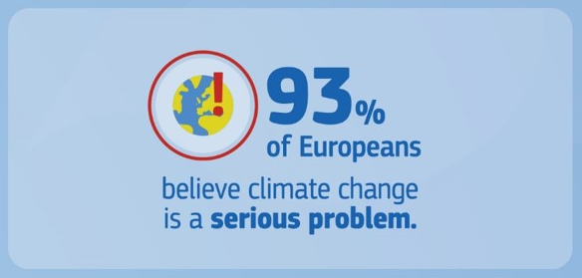
1. Europeans worry about climate change
More than 9 in 10 Europeans (93%) believe that climate change is a serious problem (Special Eurobarometer on Climate Change, July 2021)
Almost every second European (49%) sees climate change as the main global challenge for the future of the EU (Special Eurobarometer on the Future of Europe, January 2022)

Slide 4
2. Who should tackle climate change?
63% of Europeans believe that, within the EU, national governments are responsible for tackling climate change, ahead of business & industry (58%) and the EU (57%)
Over 4 in 10 Europeans answer regional and local authorities (43%) or ‘you personally’ (41%)
(Special Eurobarometer on Climate Change, July 2021)

Slide 5
3. Europeans are taking personal action
64% of Europeans say they have personally taken action to fight climate change over the past 6 months
When asked to choose from a list, 96% mention at least one action
Reducing & recycling waste
Cutting down on disposables
Considering energy efficiency when buying appliances

Slide 6
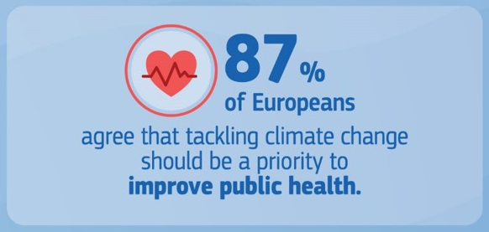
4. Europeans see benefits from climate action
78% agree that taking action on climate change will lead to innovation that will make EU companies more competitive
70% agree that reducing fossil fuel imports from outside the EU can increase energy security and benefit the EU economically
87% agree that tackling climate change and environmental issues should be a priority to improve public health

Slide 7
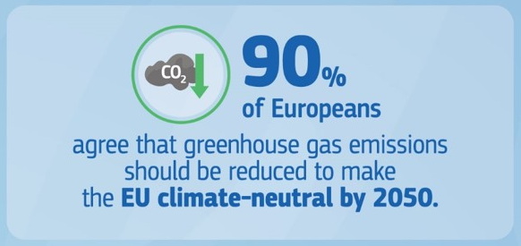
6. Europeans expect even stronger action from their national government and EU
90% agree emissions should be reduced to a minimum while offsetting remaining emissions to make the EU climate-neutral by 2050
75% think their national government is not doing enough to tackle climate change
Support targets & support to increase renewable energy use and energy efficiency

Slide 8
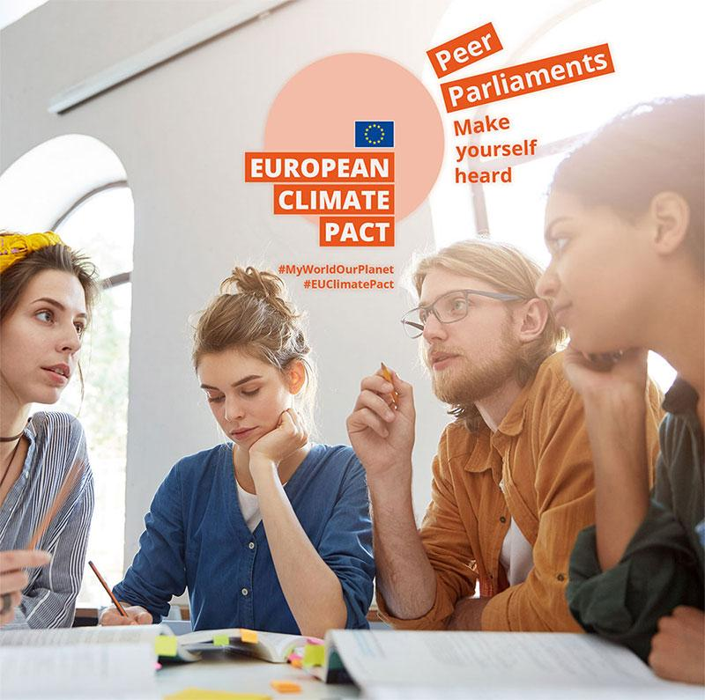
European Climate Pact
Inviting people, communities and organisations to participate in climate action and building a greener Europe
Ambassadors
Pledges – individual & organisation
Citizen engagement – e.g. Peer Parliaments
Youth engagement

Slide 9
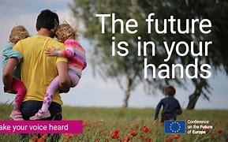
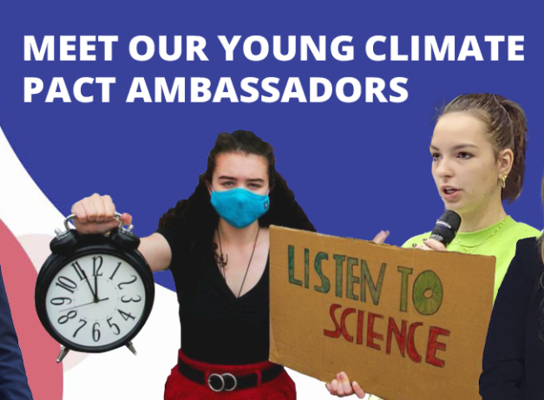
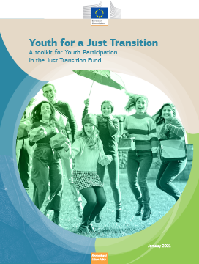
Engaging citizens in shaping the transition

Slide 10
Thank you
© European Union 2020
Unless otherwise noted the reuse of this presentation is authorised under the CC BY 4.0 license. For any use or reproduction of elements that are not owned by the EU, permission may need to be sought directly from the respective right holders.
Slide xx: element concerned, source: e.g. Fotolia.com; Slide xx: element concerned, source: e.g. iStock.com
Notes:
Update/add/delete parts of the copy right notice where appropriate.
More information: https://myintracomm.ec.europa.eu/corp/intellectual-property/Documents/2019_Reuse-guidelines%28CC-BY%29.pdf

