Slide 1


Slide 2
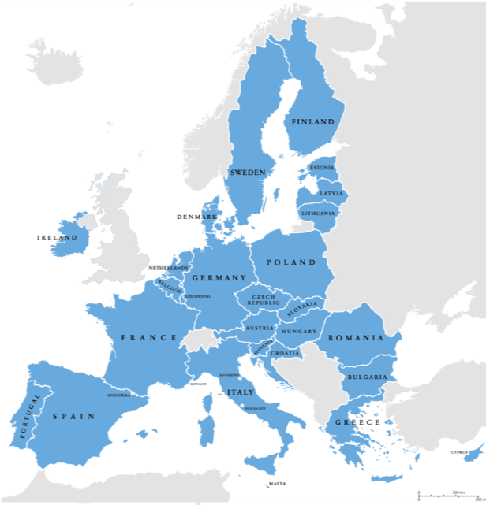
What is the EU?
?
?
?
?
?
?

Slide 3

5 candidate countries*
27 Member States
More than 500 million citizens
* Albania, North Macedonia, Montenegro, Serbia and Turkey

Slide 4

What does the EU do?
Ensures lasting peace through common solutions to common problems
Ensures the wellbeing of its people
Ensures the respect for human rights, freedom and the rule of law: democracy, pluralism, non-discrimination, tolerance, justice, solidarity
4 freedoms: free movement of people, goods, services and capital
The EU’s motto: United in diversity

Slide 5

What does the EU do for young people?

Slide 6





Work
You can apply for jobs within the European Union when you turn 18 years old.
The EURES scheme connects you with employers across Europe, Norway and Iceland.
Explore
Thinking about a job at EU level or in another EU country?
Each year, the EU offers paid traineeships to young university graduates.
Speak
You can participate in youth events like the ones organised as part of the CoFoE, the European Youth Event (EYE) hosted by the European Parliament,
or the "Your Europe, Your Say!" event
by the European Economic
and Social Committee.
There, you can make your voice heard!
Study
You are entitled to study at any EU university
under the same conditions as nationals.
The ERASMUS program allows you to do part
of your university studies abroad.
Travel
The border-free Schengen Area guarantees free movement
to more than 400 million EU citizens.
For instance, the INTERRAIL train pass allows you to reach
over 40,000 destinations in 30 countries.

Slide 7



#CoFoE
#TheFutureIsYours
What is the CoFoE?
The Conference on the Future of Europe (CoFoE) is a unique opportunity for European citizens to debate on Europe’s challenges and priorities.
The CoFoE is a multilingual digital platform (hub) where citizens can share ideas and send online submissions.
The topics concern European democracy, health, digital transformation, education, culture, youth, climate change and migration, among others.
By spring 2022, the Conference is expected to reach conclusions and provide guidance on the future of Europe.
This year YEYS is taking place in connection
with the CoFoE.
Young people are invited to play a central role
in the process.

Slide 8
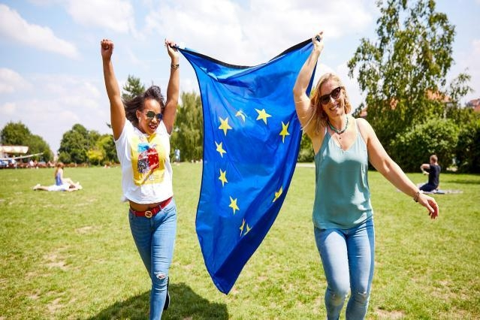
2022 is the European Year of Youth
During the European Year of Youth,
the EU institutions cooperate to:
honor, support and encourage the young generation
promote EU opportunities provided by EU policies for young people
draw inspiration from young people, from their actions, visions and insights, to strengthen the common EU project.
Europe needs the vision, engagement and participation of all young people to build a better future that is greener, more inclusive and digital.

Slide 9
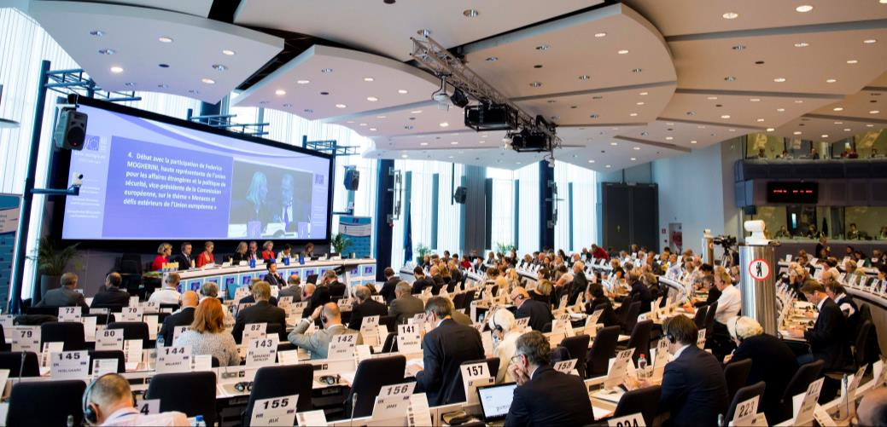
What is the European Economic
and Social Committee? (EESC)

Slide 10




What is the EESC?
An advisory body set up by the Treaty of Rome (1957)
Represents organised civil society
Council of the European
Union

Slide 11

What does the EESC’s membership look like?
3 Groups
329 members (appointed for 5 years) from the 27 Member States of the EU
± 200 opinions per year
Employers
Workers
Diversity Europe
Employers federations,
chambers of commerce,
SME organisations…
Trade unions
Farmers, consumers,
NGOs, professions, disability organisations, academics, cooperatives,…

Slide 12
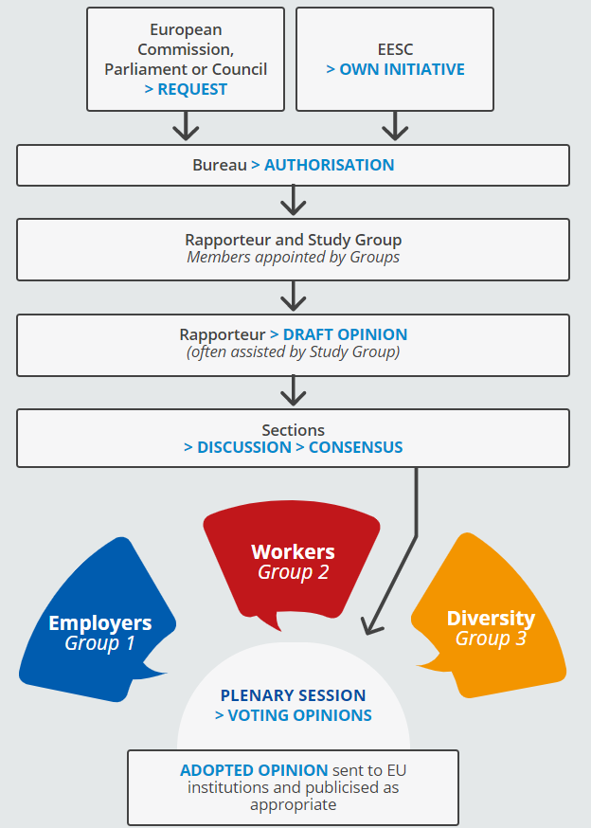
What is an opinion?
The European Parliament, the Council of the EU or the European Commission can ask the EESC for recommendations regarding legislation on a particular topic.
The EESC members representing all 3 Groups prepare a single document, called ‘EESC opinion’, on the proposed legislation.
After a consensus is reached, the EESC opinion is sent to the EU institutions to be taken into account and published in the EU’s Official Journal (24 languages).
The Rapporteur presents key findings and promotes the opinion at EU, Member State and local level.

Slide 13
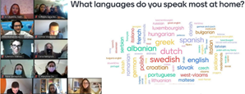

Your Europe, Your Say!
(YEYS)
The EESC is hosting the 13th "Your Europe, Your Say!" youth plenary
Every year, young people from all EU Member States, and the 5 candidate countries, take part in a debate on a topical issue that concerns them
The YEYS 2022 will take place fully online

Slide 14

#YEYS2022 The Truth about lies
Youth Challenging Disinformation
  📅 31 March – 1 April 2022
  📌 ONLINE
  👩‍ 👨‍ 33 schools from:
  the 27 EU countries, a European school from Brussels + the 5 candidate countries
YEYS 2022’s objectives :
1. Raising awareness about the challenges of disinformation
2. Making young people think about how to develop their skills and encouraging
critical thinking to combat disinformation

Slide 15



Youth challenging Disinformation
Online Workshops
Are you ready to identify and combat fake news?
Step 1. You will be equipped with the necessary theoretical background by playing the ‘Under Pressure’ game.
Step 2. You will be divided into groups, and participate in an interactive workshop to create a disinformation campaign
Step 3. You will design an information campaign to counter your disinformation campaign
Step 4. You will draw policy recommendations on how to combat disinformation
Outcome:
Your recommendations will be announced in the plenary to EU high-level officials and discussed at various events and occasions around Europe all year.

Slide 16

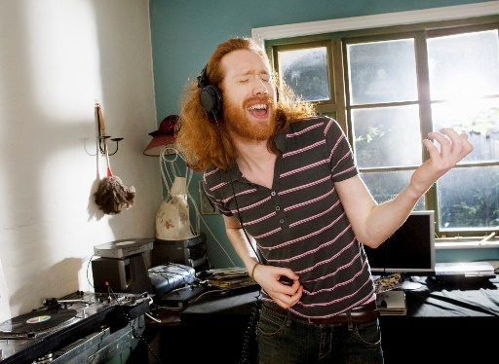
In addition this year… a CULTURAL element
All participants will participate in an interactive cultural activity to co-create the YEYS 2022 cultural memorabilia.
At the end, you will all share this creative time by taking the work and ‘artistic’ memories back with you.
Music?
Theatre? Dance?
Which one would you go for?

Slide 17


What will you gain from this experience?
You will have fun and inspiring exchanges with students from all across Europe online.
You will gain knowledge and insights on how to easily detect disinformation and get equipped with the tools to map fake news online.
Together with other students, you will find creative solutions to fight disinformation and spot fake news.
After YEYS, you will also receive a YEYS diploma. You will be able to use the educational material further and share it with your class, friends and family.

Slide 18



For further information:
Email: youreurope@eesc.europa.eu
Website: www.eesc.europa.eu/YEYS2022
Take quizzes & find out more about disinformation on our social media channels:
#YEYS2022
https://www.facebook.com/youreuropeyoursay
https://twitter.com/youreurope
https://www.instagram.com/youreurope/

Slide 19

Stay in touch with us!

