Slide 1
European Semester
2023 Autumn Package
Adopted by the Commission on 22 November 2022

Slide 2
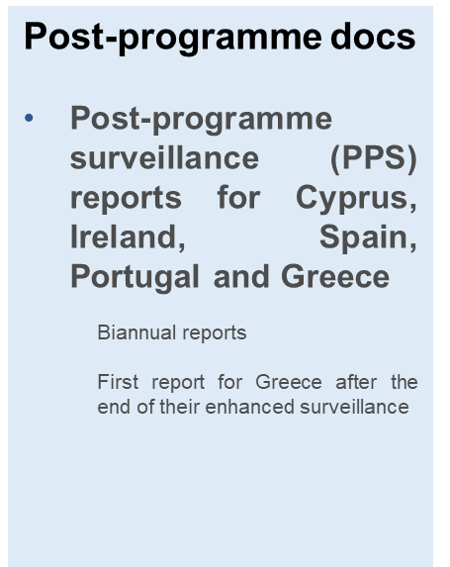
The 2023 Autumn Package
2023 Annual Sustainable Growth Survey
Chapeau document: Outlines main economic and employment policy priorities for next year
Economic and Employment Policy Coordination
2023 Alert Mechanism Report
  Identifies countries that may be experiencing macroeconomic imbalances, and themes that will be analysed in more detail
2023 Recommendation for the euro area
  Identifies critical issues for euro area economies and suggests concrete measures for joint action
Proposal for 2023 Joint Employment Report
  Analyses the employment and social situation in Europe
Fiscal Coordination
Commission Opinions on Draft Budgetary Plans for 18 euro area countries and Croatia, and horizontal Communication
    Outlines how budget plans for the coming year comply with latest fiscal recommendations

Slide 3
Annual Sustainable Growth Survey

Slide 4

Annual Sustainable Growth Survey
The 2023 Annual Sustainable Growth Survey outlines the policy priorities in the coming year and for the 2023 European Semester cycle.
An economic and employment policy agenda both with a view to addressing short- and medium-term challenges:
  Mitigating the negative impacts of the energy and economic shocks in the short-term
  Keeping up efforts to foster sustainable growth and the green and digital transition, as well as increase social and economic resilience over the medium run.
The policy priorities are structured around the four dimensions of competitive sustainability and in line with the Sustainable Development Goals.
Within the European Semester, the implementation of the Recovery and Resilience Facility (including its additional REPowerEU angle) will continue to be at the core of the transformative process towards achieving competitive sustainability.

Slide 5
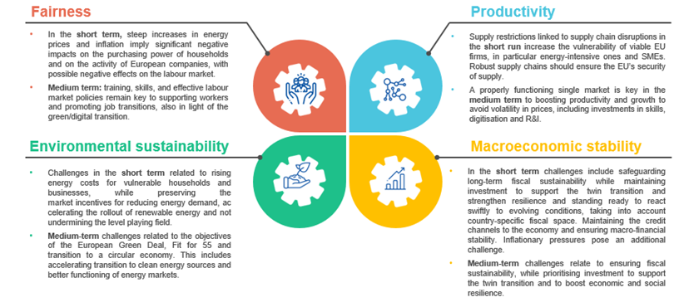
The four dimensions of competitive sustainability – addressing short- and medium-term challenges

Slide 6
The 2023 European Semester cycle
The adoption of the Autumn Package officially kick-starts the 2023 European Semester cycle.
Publication of country reports, in-depth reviews and proposals for country-specific recommendations in Spring 2023:
    Succinct, but holistic overview of economic and social developments and of challenges that MS are facing
    Overview on the state of implementation of the recovery and resilience plans
    Parsimonious approach to the CSRs to be continued

Slide 7
Draft Budgetary Plans for 2023
(Euro Area Member States)

Slide 8
Fiscal policy recommendations for 2023
Recommendation to all Member States:
    Fiscal policy should take into account continued temporary and targeted support to households most vulnerable to energy price hikes and to people fleeing Ukraine.
    Expand public investment for the green and digital transition and for energy security.
    All Member States should stand ready to adjust current spending to the evolving situation.
Low/medium term debt Member States: In 2023, current expenditure should be in line with an overall neutral policy stance.
High debt Member States: In 2023, ensure prudent fiscal policy, in particular by limiting the growth of nationally-financed current expenditure below medium-term potential output growth.

Slide 9
Energy measures taken so far are of sub-optimal quality
Energy measures in 2022
Source: Calculations underlying Commission AF2022

Slide 10
2023 Euro Area Recommendations

Slide 11
Five euro area recommendations for 2023
Coordinate fiscal policy
  Refrain from broad-based fiscal expansion as this would fuel inflation. Agree a more common approach to targeted energy supports via a two-tier energy pricing system
Sustain public investment
  High level of public investment needed for the green and digital transitions and energy security, and the crucial implementation of the RRF and RepowerEU
Monitor wage and social policies
  Nominal wages increases to strike a balance between averting second-round effects on inflation, while avoiding significant losses of purchasing power. Adapted social policies
Improve the business environment
  Cost-effective, temporary, and targeted energy support to businesses . Improve the business environment, e.g. insolvency frameworks, CMU.
Preserve macro-financial stability
  Preserve macro-stability and monitor risks. Actively engage in preparatory work on the digital euro

Slide 12
Alert Mechanism Report

Slide 13
Alert Mechanism Report 2023
The Alert Mechanism Report (AMR) identifies countries for an In-Depth Review (IDR) in spring, to assess existence of macroeconomic imbalances
2023 IDRs will be undertaken for Member States with existing (excessive) imbalances and those with particular risks of newly emerging imbalances
The Commission will carry out three in-depth thematic assessments dealing with the issues most relevant at the current juncture (to be presented to EPC, with input by Member States):
  Housing market looking at the risks and drivers associated with house price developments, mortgage markets and household debt (CZ, DE, EE, HU, LV, LT, LU, NL, PT, SK, SE)
  Competitiveness dynamics assessing the extent and impact of the pass-through of energy costs to inflation, and the evolution of wages (CZ, EE, HU, LV, LT, RO, SK)
  External sustainability and balances looking at the reduction in trade balances (CY, DE, EL, HU, LV, LT, NL, PT, RO, SK)
  * In bold: MS not subject to IDR in previous round

Slide 14
Post-programme surveillance

Slide 15
Main findings of the five PPS reports
Post-programme surveillance (PPS) reports for Ireland, Greece, Spain, Cyprus and Portugal were published on 22 November.
All five Member States retain the capacity to repay their debt.
First PPS report for Greece (after end of enhanced surveillance in August).
  Report could serve as a basis for the Eurogroup to decide on the final tranche of policy-contingent debt measures agreed in June 2018 (total amount to be decided: EUR 6 billion)
  It finds that Greece has taken the necessary actions to complete its specific commitments (e.g. end-to-end IT tax collection system, completion of forecast map and good progress with cadastral mapping, digital reforms in the justice system, governance of state-owned enterprises)

Slide 16
Proposal for a
Joint Employment Report 2022

Slide 17
Joint Employment Report 2023
Mandated by Art. 148 TFEU to monitor the implementation of the Employment Guidelines
  Key employment and social developments in the EU and in Member States;
  Priority areas for employment, skills and social policy action.
Maintaining
  Stronger focus on Pillar implementation, notably addressing a series of key challenges;
  Analysis based on a wider set of agreed Social Scoreboard headline indicators that more comprehensively monitor the Pillar principles.
Novelties of the 2023 edition: Integration of national targets
to achieve the EU headline targets by 2030:
    an employment rate of 78%,
    60% of the adult population participate in training every year,
    15 million people less in poverty and social exclusion.

Slide 18
Strong labour market outcomes
- but heightened uncertainty
By Q2-2022, in the EU
  the employment rate reached 74.8%, a record high,
  and the unemployment rate, at 6.1%, a record low.
Despite improvements, youth, women and the non-EU born still face greater challenges with labour market integration, as do persons with disabilities and older workers.
  Young NEETs at 11.7% (EU; Q2-2022)
  Gender employment gap at 10.7 pps (EU; Q2-2022)
Labour shortages have been on the rise since Q2 2020.
High uncertainty: employment reacts with a lag to economic slowdown – strong deceleration in 2023.
Key labour market indicators in the EU 27 (%, quarterly)

Slide 19

Thank you
© European Union
Unless otherwise noted the reuse of this presentation is authorised under the CC BY 4.0 license. For any use or reproduction of elements that are not owned by the EU, permission may need to be sought directly from the respective right holders.

