Slide 1

Organisational update for EMN REG Meeting
Th.
M. Papaioannou, Information and Analysis Officer, EUAA

Slide 2

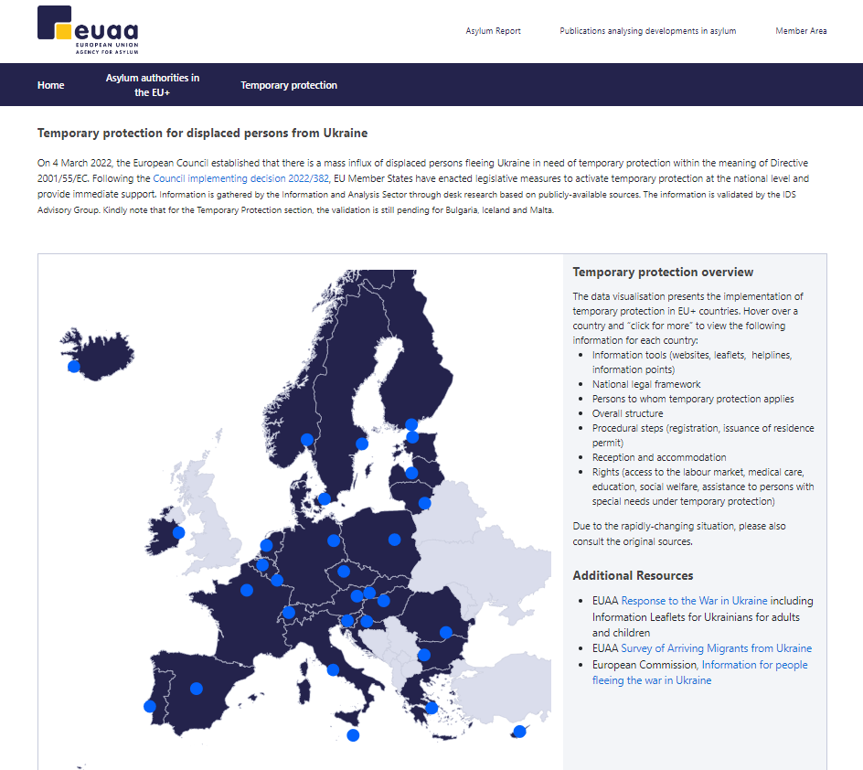
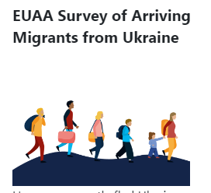
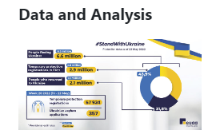
Temporary Protection
Entry point EUAA webpage for Ukraine https://euaa.europa.eu/euaa-response-war-ukraine-0
In March 2022, EU+ countries Who is who - Temporary protection for displaced persons from Ukraine
Notes
Notes:
On 11 April, the EUAA in partnership with OECD launched the Surveys of Arriving Migrants from Ukraine (SAM - UKR). The goal of this project is to collect data directly from displaced people fleeing the war in Ukraine into the EU, on their journey, vulnerability, needs, future aspirations, registration process, family situation and current situation. The survey is voluntary and anonymous and is available in English, Ukrainian and Russian. Displaced people participate online, using their own mobile phones. Data collected will be used to providesituational updates to European policymakers and will enable services to be better tailored for refugees from Ukraine.
Key findings: Most respondents are highly educated and were employed before the war started
Most respondents have reached their preferred destination country when they participated in this survey : The main relevant factor in choosing a destination country were work opportunities and family and friends . The majority live in private housing hosted by a national family or by family members or friends .
Some 66 % of respondents registered for Temporary Protection in their preferred destination country .
WHO IS WHO online platform with analytical information per country on the TP implementation incl info tools/registration/issuance of residence cards/access to TP rights.
Upcoming report to take stock of the first 100 days of war in Ukraine and how EU+ countries responded to the protection needs of displaced persons during the period 24 February to 3 June 2022. It presents measures which were implemented at the national level and the activation of the EU Temporary Protection Directive.

Slide 3

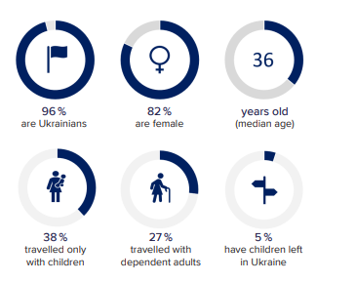

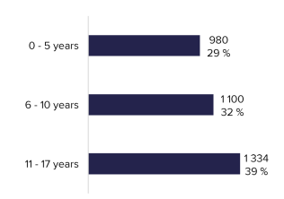
EUAA Survey of Arriving Migrants from Ukraine (SAM - UKR)
Joint Report on profiles, experiences, and aspirations of affected populations
https://euaa.europa.eu/publications/forced-displacement-and-within-ukraine
Notes:
Between its launch on 11 April 2022 and 15 August 2022, almost 4000 adult respondents participated in the SAM-UKR survey. Of these, 82 % were female with a mean age of 38 years (median age of 37). The sample is almost exclusively Ukrainian citizens (96 %) with just 4 % (161) being non-Ukrainian residents of Ukraine prior to 24 February 2022
Importantly, 9 in 10 respondents were travelling with family members (86 %), including 38 % who travelled with children only. In total, the 4 000 or so adult respondents reported travelling with at least 3 400 children, of whom 29 % were very young (0-5 years), a third (32 %) were primary school age (6-10 years) and 39 % were secondary school age (11-17 years).

Slide 4
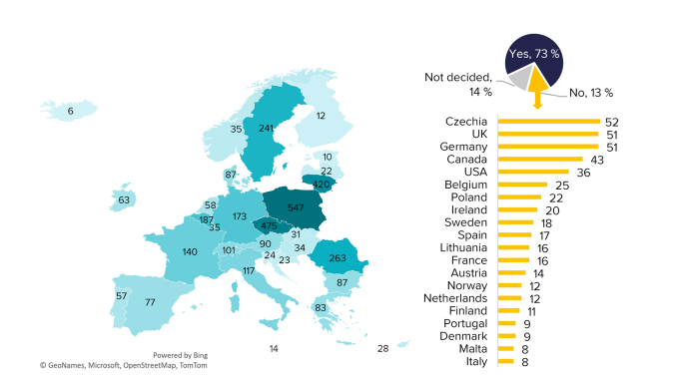
EUAA Survey of Arriving Migrants from Ukraine (SAM - UKR)
Notes:
The map (left) presents the current location of respondents of the SAM-UKR survey (where they were when they participated in the survey). The pie chart (top right) presents whether respondents of SAMUKR are at their preferred destination country, or are undecided, with the bar chart (right) presenting the top 20 intended destinations for those who are not yet at their preferred destination (Source: SAM-UKR Survey) Note: 68 respondents chose a country outside the top 20 intended destinations

Slide 5
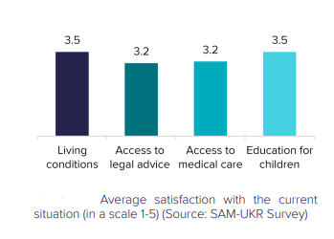
EUAA Survey of Arriving Migrants from Ukraine (SAM - UKR)
Notes:
Over a quarter of all respondents were hosted by a private household (27 %). One ffth were hosted by family members (19 %) and another ffth (18 %) were in their own private rented housing. Just 14 % were housed in a reception centre. Half of all respondents met their living expenses with their personal savings (54 %), followed by a third who received direct support from authorities, and another third who received support from families. A quarter (24 %) received income from employment (local or teleworking), while others were supported by NGOs (15 %) or borrowed money (13 %) (multiple responses were possible). Figure 10 illustrates satisfaction levels with the host country reception conditions in terms of general living conditions and access to services.

Slide 6
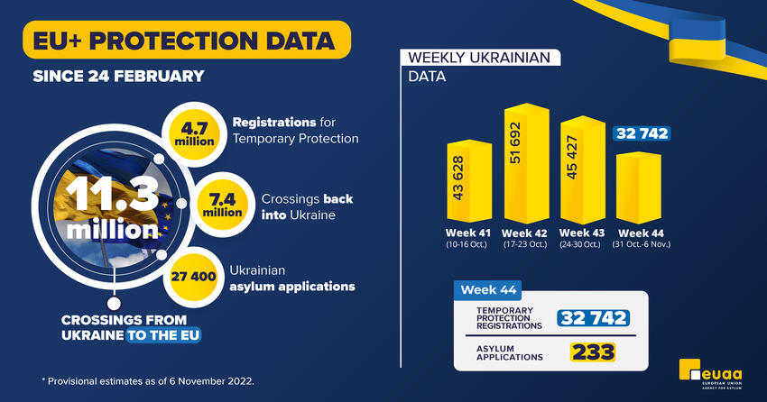
EUΑΑ Data and Analysis
Ukraine Crisis: Data and Analysis | European Union Agency for Asylum (europa.eu)

Slide 7
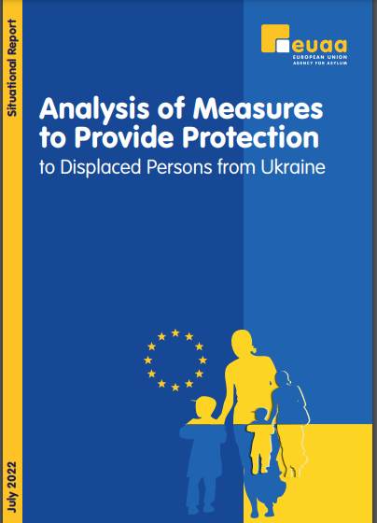

EUAA Situational Updates system (IAS) on Ukraine
Periodic Situational Updates to enable informed
decision making and coordination
  Situational Update no 9, 4 March
  Situational Update no 10, 11 March
  Situational Update no 12, 17 March
  Situational Update no 13, 24 March
  Situational Update no 14, 07 April
  Situational Update no 15, 21 April
  Situational Report:
  Analysis of Measures to Provide Protection to
  Displaced Persons from Ukraine.
Notes:
EUAA Situational Updates provide key information on immediate measures which are being implemented to accommodate the arrival of displaced persons from Ukraine as well as the implementation of TP in the EU+countries. The updates cover EU Member States bound by the Temporary Protection Directive, as well as Denmark, Iceland, Norway and Switzerland which have introduced similar provisions. Reference is made to key developments by EU, IOM, UNHCR

Slide 8
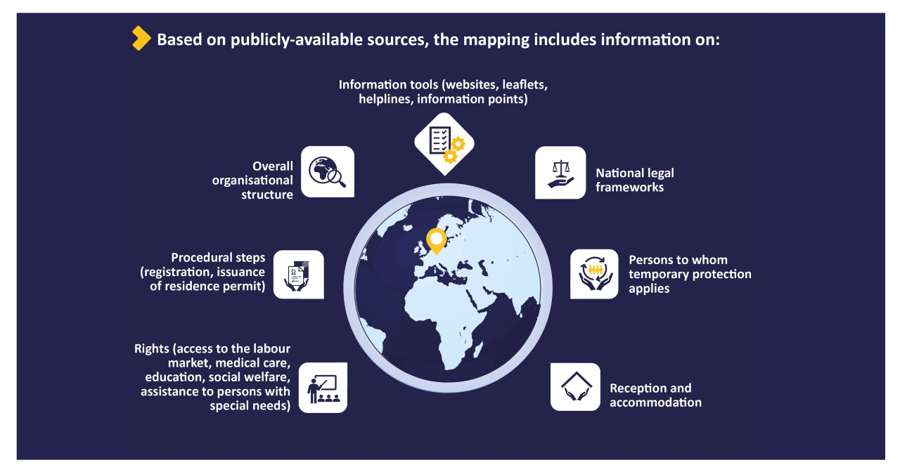
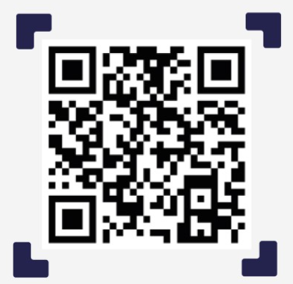
Who is Who: Temporary Protection for Displaced Persons from Ukraine
Link: https://whoiswho.euaa.europa.eu/temporary-protection ​
Notes:
Continuous work and updates on the implementation of TP on Who is Who- Temporary protection platform.
The Who is Who in International Protection: Temporary Protection for Displaced Persons from Ukraine will serve as a public info EUAA tool in line with the COM 10 points Action plan.
Description:
The Who is Who in International Protection: Temporary Protection for Displaced Persons from Ukraine provides a current and comprehensive overview of the measures used by EU+ countries to provide temporary protection to persons fleeing the war. The goal is to:
Enhance the exchange of information between EU+ countries on practical aspects and procedures in place which can serve as a point of reference for national practices.
Present current information in one platform.
Methodology:
Information is gathered by EUAA (Information and Analysis Sector) through desk research based on publicly-available sources. The information is validated by the IDS Advisory Group. (A disclaimer is included on Who is Who platform regarding countries pending validation – 3 as of 12 May)
Target audience:
EU+ countries, Info providers, beneficiaries of temporary protection, any relevant stakeholders
Scope (info presented in the infograph)
Based on publicly available sources, the mapping includes information on:
Information tools (websites, leaflets, helplines, information points)
National legal frameworks
Persons to whom temporary protection applies
Overall organisational structure
Procedural steps (registration, issuance of residence permit)
Reception and accommodation
Rights (access to the labour market, medical care, education, social welfare, assistance to persons with special needs under temporary protection, etc.).
For any queries please contact ids@euaa.europa.eu. Contact information is available on the platform

Slide 9
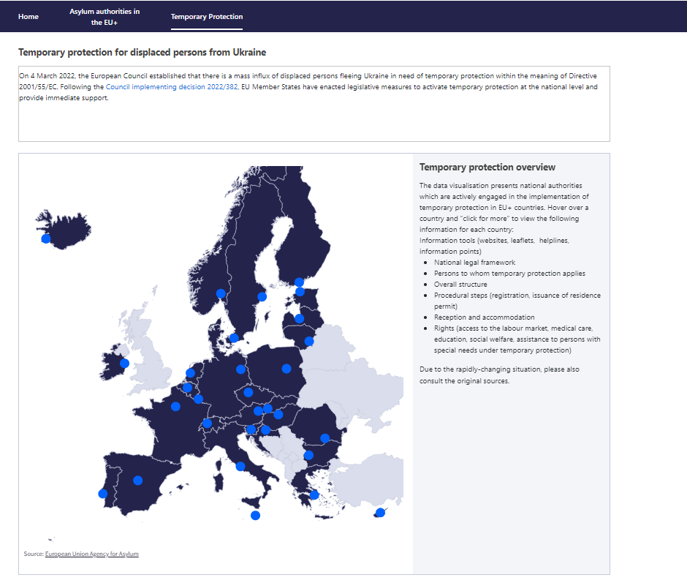
EUAA Who is Who – Temporary protection in EU+ countries
Overview of the following information:
Information tools (websites, leaflets, helplines, information points)
National legal framework
Persons to whom temporary protection applies
Overall structure
Procedural steps (registration, issuance of residence permit)
Reception and accommodation
Rights (access to the labour market, medical care, education, social welfare, assistance to persons with special needs under temporary protection)
Notes:
The data visualisation presents national authorities which are actively engaged in the implementation of temporary protection in EU+ countries. If you Hover over a country and “click for more” the following information for each country (info on box)

Slide 10
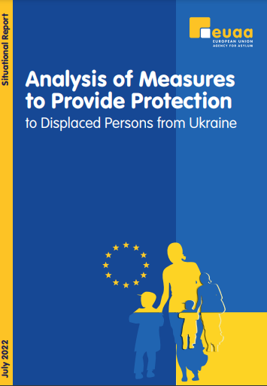
Situational Report: Analysis of Measures to Provide Protection to Displaced Persons from Ukraine
Highlights
Preparedness and contingency planning prove fundamental during the crisis management stage
Provision of information as a necessary condition for an effective operational response
Public–private voluntary partnerships may temporarily ease the heavy burden on countries, but voluntary support offers require coordination, clear information and monitoring through control mechanisms.
One-stop service points as the new norm for temporary protection
Registration procedures differ between EU+ countries
Reception is organised both within the regular international protection framework
as well as outside e.g. private housing, coordination with regional authorities etc.
Various implications for international protection procedure
Notes:
The analysis reflects on Innovative approaches that can enrich the existing toolbox to address future migration crises as envisaged in the Migration Preparedness and Crisis Blueprint and advance effective operational responses.
Disclaimer: While not bound by the EU temporary protection framework, Denmark, Iceland, Norway and Switzerland have introduced similar provisions to the directive. References to these countries should be read in conjunction with the respective national legal framework.
Additional background info:
one-stop service points are points where various authorities operate under one roof. The services which are provided vary between the provision of information, registration, consultation on access to rights, counselling, referrals to accommodation, basic care, documenting biometric data and security screening. In some cases, these points serve as emergency shelters or stays of overnight. One-stop service points ensure immediate support and access to accommodation upon registration and enable comprehensive orientation on rights and relevant procedures.
One-stop service points have been established, for example, in Belgium, Czechia, Estonia, France, Greece, Latvia, Lithuania, Norway, Portugal, Spain and Switzerland.
Registration for temporary protection varies across EU+ countries in terms of the responsible authority, the documentation issued and processing times. In 18 EU+ countries, the authority that performs the registration also issues relevant documentation. In 7 countries, multiple authorities oversee the registration procedure. Furthermore, municipalities and local authorities are responsible for registration in France, Netherlands and Slovenia.
The type of documents and the processing times also differ significantly. 17 EU+ countries issue relevant documentation on the same day of the registration. For the remainder, waiting times reportedly range between 24 hours to 2 weeks. In some countries, a decision is issued by the competent authority upon examination of the request. (Note: This might denote a non compliance in relation to COM guidance on registration)
Various implications for international protection procedures.
suspension of asylum applications, removal of Ukraine as safe country of origin, etc.

Slide 11
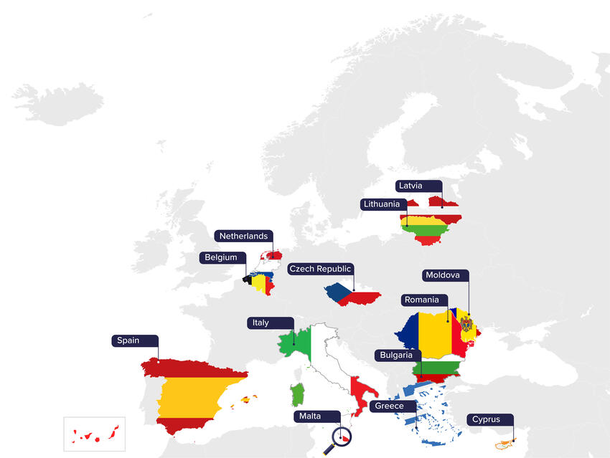
EUAA Operational Support
present in 12 EU Member States and Moldova
  information provision
  training support
  reception units, and assist in site planning;
  technological support with registration
  registration
  Interviews
  assistance on appeal procedures etc.
Notes:
Μ

Slide 13
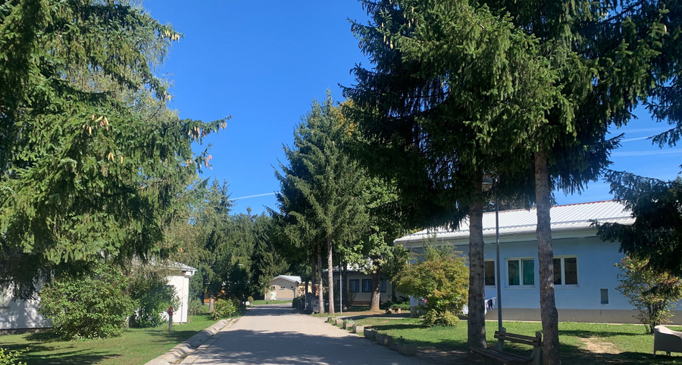
Thomas Jezequel, Head of Reception & Vulnerability Sector, EUAA
Reception of displaced persons from Ukraine in the EU: the EUAA’s role
Thomas Jezequel, Head of the Reception and Vulnerability Sector, EUAA

Slide 14

EUAA reception mandate and specificities of the TPD status
          The EUAA supports EU+ states in the implementation of the Reception Conditions Directive
          Beneficiaries of the RCD do not benefit from reception conditions if they do not ask for asylum (27400 out of 4.7 millions did)
          Reception authorities were often asked to step in but are not necessarily the lead in terms of support to displaced persons from Ukraine.
          Overall recourse to private housing BUT reception capacity has been used too : people without network / support / personal resources to settle in.
          Perspective?
Notes

Slide 15
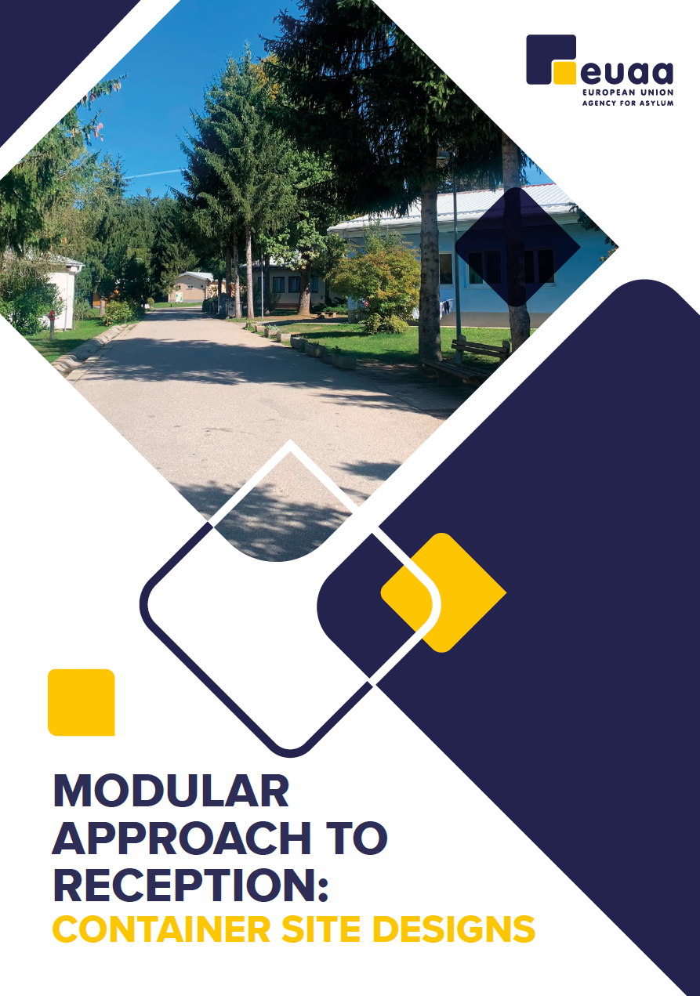
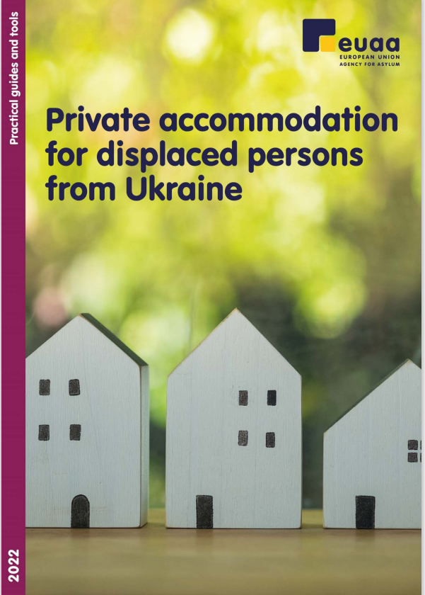
A guide to relevant stakeholders (e.g. national, regional and local authorities, as well as civil society organisations) when designing and building new reception centres based on containers, according to the agency’s standards and guidelines
Practical recommendations on the provision of emergency placement in private accommodation for persons displaced from Ukraine

Slide 16
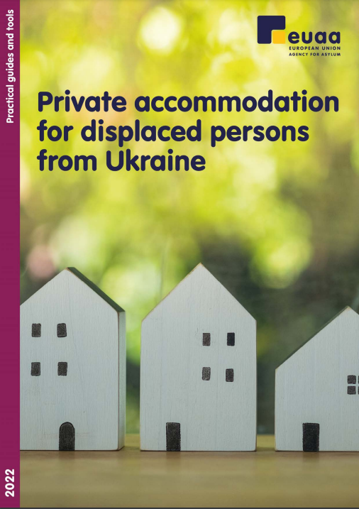
EUAA Guidance on private accommodation
          Guide relevant stakeholders in matching displaced persons with available private accommodations
          Complement the efforts at national, regional local and community level, not replace them.
          Ensure safeguards are in place for persons in need of emergency accommodation and for those hosting them.
          Feed into ongoing initiatives (10-point plan, safe home initiative, etc.)
          Reaffirm and complement the EUAA standards and indicators on reception.
Notes

Slide 17

New: EUAA Guidelines on Modular Approach to Reception: site design
EUAA Guidance on Modular Approach to Reception: site design
Published on 7 October 2022
Supporting national and regional authorities in designing and building reception centres based on modular housing units according to the Agency’s standards and guidelines.
Outlines 9 principles for the design and management of a reception centre that Member States should follow when setting up such facilities.
Applied in the field when EUAA is asked to support with site design / provide additional capacity.
Also applicable to displaced persons from Ukraine / beneficiaries of the TPD.

Slide 18
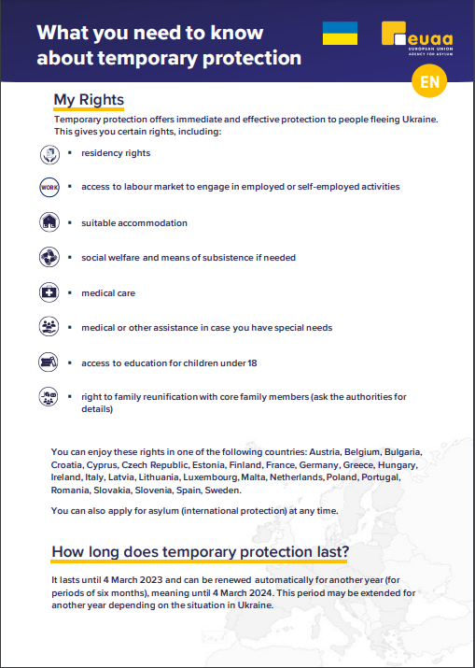
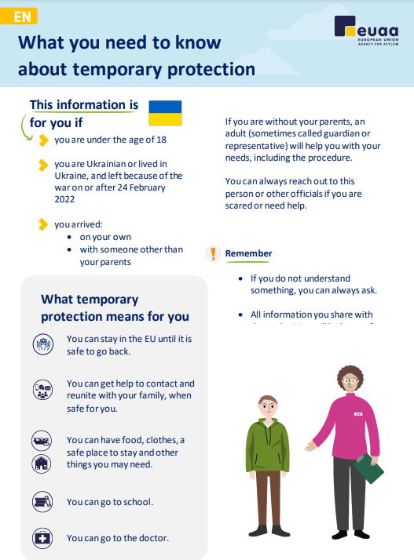
EUAA Information material on TPD
          Leaflets for adults and children: supporting Member States in providing the same information and key messages on what TPD entails.
          Timely and adequate information provision enables those fleeing to enjoy their rights.
          Child friendly and age-appropriate language for older unaccompanied and separated children.
Notes

Slide 19
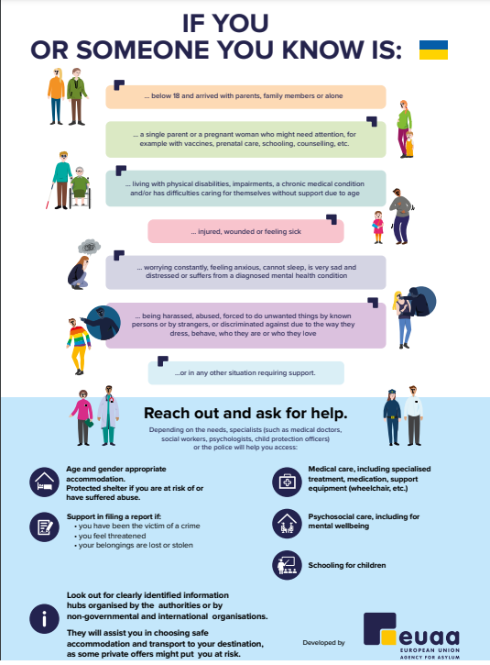
EUAA Information material on TPD
          Poster on self identification of vulnerability needs for people fleeing Ukraine : informing people who fled Ukraine and might have special needs about the possibility to ask for help and how to do so in a safe manner, by reaching out to the authorities and other relevant actors.
          It emphasizes the importance to obtain information from clearly identified information hubs organised by the authorities, international and non-governmental organisations in order to be assisted to access services
Notes

