Slide 1
Policies to support refugees from Ukraine
Information from Eurofound’s EU PolicyWatch database
Maria CANTERO
21 November 2022

Slide 2
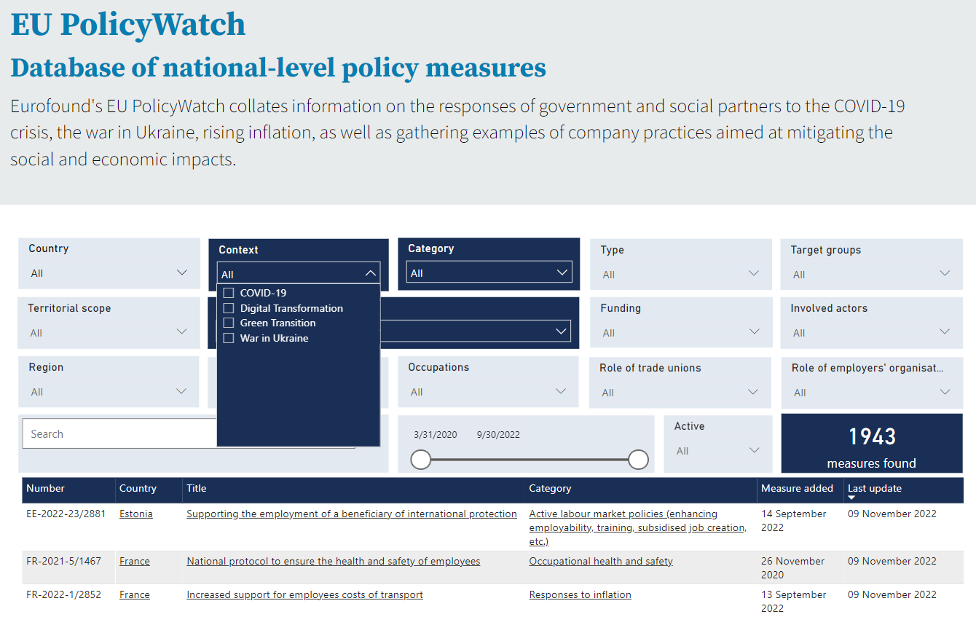
EU PolicyWatch database
Qualitative information with background information, content and use of measures as well as social partner involvement for 1,900+ measures.
3 rounds of updates per year from the Network of Eurofound Correspondents (NEC).
Initial focus on responses to the COVID-19 crisis, from 2022 onwards
Responses to the War in Ukraine
Policies addressing the dual transition to digitalisation and greening
Integration of the European Restructuring Monitor Support instruments database
Main page: Eurofound EU PolicyWatch (europa.eu)
Dashboard: Eurofound EU PolicyWatch (europa.eu)
Results as of November 2022
Notes:
A disadvantage of PolicyWatch is, that we can’t guarantee the same degree of ‘completeness’ (or detail), if we had launched a comparative questionnaire.. / So we need to present the information and data with a pinch of salt.
But its advantage is that we get a quick insight into the policy responses on a certain topic (such as those related to refugees in the Ukraine) across all MS. [That’s how I would introduce it]
A database to capture governments and social partners responses to cushion and mitigate the social and economic effects of the crisis has been developed.
Populated by Eurofound’s network of correspondents and checked by Eurofound staff.
Used for series of articles (instead of quarterly reports on latest developments in working life) and feeding into other projects, including a ‘Mapping report’ on first policy responses and recent articles on support for refugees and responses to inflation
Coverage: EU Member States + EU level + Norway
Context: COVID-19, Digital transformation, ERM support instruments, Green Transition, War in Ukraine
Target group (refugees, self-employed, companies, …)
Actors (Government, Social security providers, …)
Social Partners role and involvement
Date, territorial scope (nationwide / regionally / locally), sector, occupations…
Case-by-case fact sheets and country overviews

Slide 3
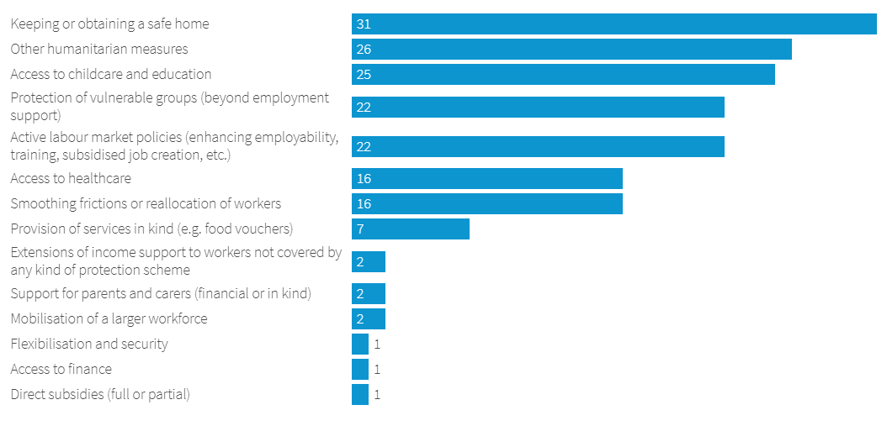
Policies to support refugees from Ukraine
Housing, education, healthcare and social protection, have been top priorities.
Many measures draw directly from the Temporary Protection Directive.
Passed with very limited social partner involvement. Afterwards, they have expressed favourable views and in some instances have expressed ideas on how these programmes can be improved.
185 measures to support refugees from Ukraine in all EU Member States + Norway. Collected in Eurofound’s EU PolicyWatch database and summarised on article Policies to support refugees from Ukraine.
Results as of November 2022
Notes:
Subcategories to focus on:
Keeping or obtaining a safe home
Other humanitarian measures
Protection of vulnerable groups
Access to healthcare
Provision of services in kind
Support for parents and carers

Slide 4
Reception and initial support
Housing
Several Member States saw the need to set up reception facilities or increase the capacity of existing ones.
Others have set up dedicated websites or telephone lines.
There have been several instances of financial support, and provision of services in kind.
Poland: Food assistance for Ukrainian refugees
Netherlands: Refugeehelp.nl: A webpage for refugees and helpers
Policy measure | Member State
Direct provision of housing by governmental or semi-governmental organisations | BE, CZ, LU, NL, NO, PL, SE
Public funds for housing refugees in tourist accommodation | BG, CY, PT, SK
Rental support for refugees | CZ, EE, LT, SI
Subsidies for private hosts providing accommodation free of charge | HR, CZ, DK, LV, LT, PL, RO, SK
Relaxation of regulations on the accommodation standards for refugees | SE, NO
Results as of June 2022
Notes:
Financial support examples: Bulgaria allocated BGN 375 (€192) per family and Czechia allocated CZK 5,000 (€203) per family, while Croatia offered HRK 2,500 (€332) to individual refugees. Slovenia offers monthly income support starting at €120 for an individual, which increases according to the family situation.
Services in kind: food vouchers and free public transportation

Slide 5
Social protection
Access to healthcare
Some Member States have provided access to social assistance under the same conditions as other residents, others have set up dedicated efforts.
Czechia: Subsidy for social services to assist people from Ukraine
Belgium: Additional financial resources for social services
Germany: Access to basic social assistance, students’ assistance and health insurance for Ukrainian refugees
Romania: Access to social services for vulnerable refugees from Ukraine
Some Member States go beyond the provision of emergency care required by Article 13(2) of the Temporary Protection Directive and essential treatment of illness by providing refugees with access to healthcare services akin to those of their own citizens.
Including AT, DK, EE, GR, PL, PT, RO and SK. DK and PT extended these services to refugees who are applying for residence permits.
Results as of June 2022

