Slide 1
Raising people's awareness about their Charter rights
Dennis van der Veur (FRA)
EESC hearing on
Empowering civil society, rights defenders and justice practitioners and strengthening awareness of Charter rights

Slide 2
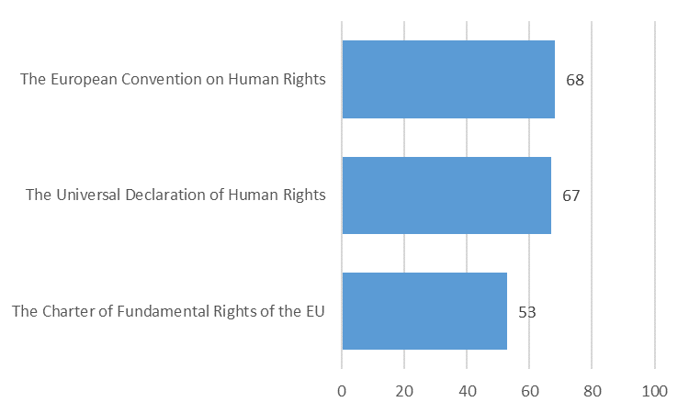
Awareness of general population on Charter

Slide 3
Why to create more awareness on Charter?
Young, modern instrument combining civil and political rights with social and economic rights
Includes EU-specific rights (e.g. right to petition to the EP), right to access EU documents, the right to refer cases of maladministration to the European Ombudsman
Increases visibility of fundamental rights within the EU
The Charter is more than a legal instrument – it is “ a set of shared values and fundamental rights that serve as a compass to guide our actions” (Vera Jourova)

Slide 5
“ What’s in it for me ? ”
Your rights and how to claim them
Tell a human story: show concrete impact of the Charter
Define your audience and design your message accordingly

Slide 6
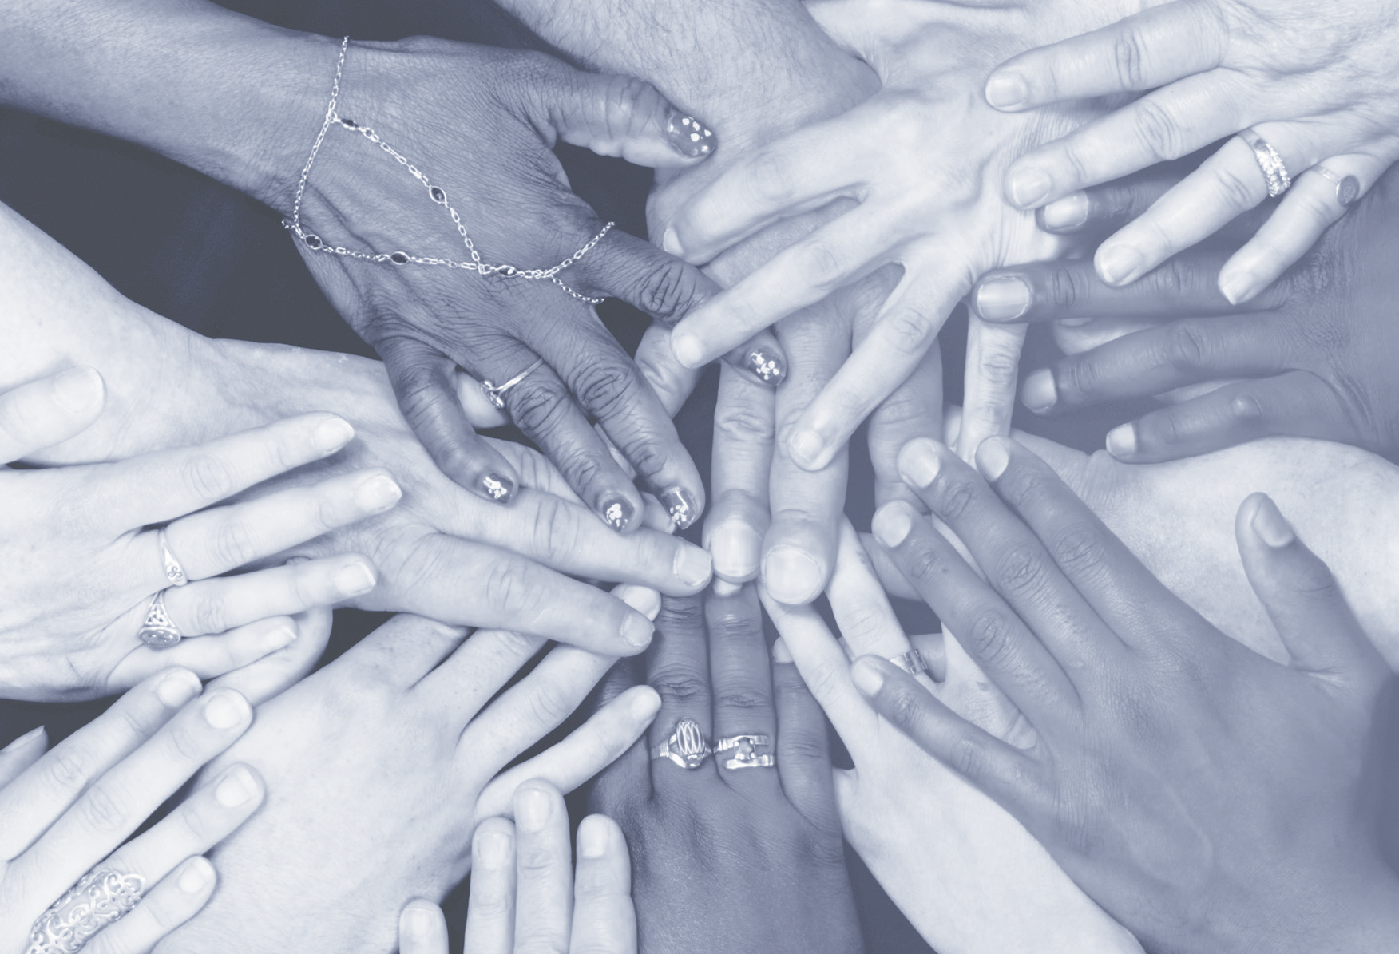

10 keys
to effectively communicating human rights

Slide 7
Charter Strategy invites Member States to…
share best practices on Charter use and awareness
promote a supportive and safe environment for civil society and rights defenders
take initiatives to promote people’s awareness of their Charter rights and of where to turn to, in particular by empowering local actors in their mandate

Slide 8
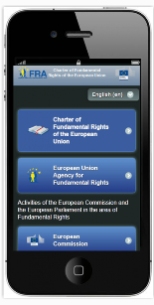
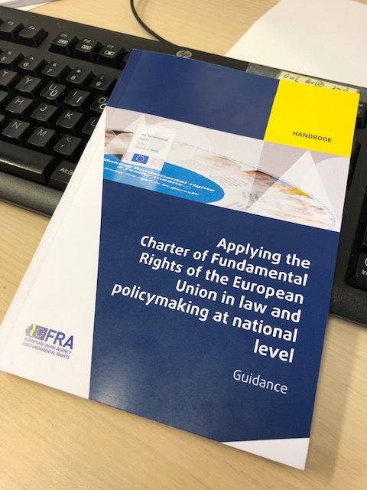
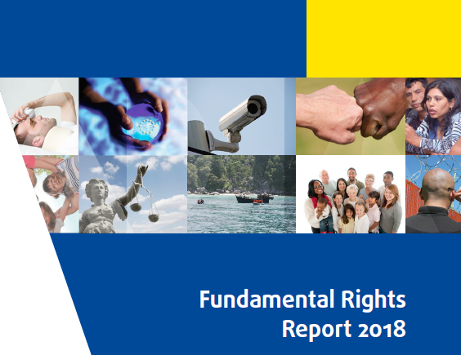
FRA resources
Yearly chapter in FRA’s
Fundamental Rights Report
Training and checklists for applicability of
and compliance with the Charter
National Charter factsheets
Charter clips
Podcasts

Slide 9
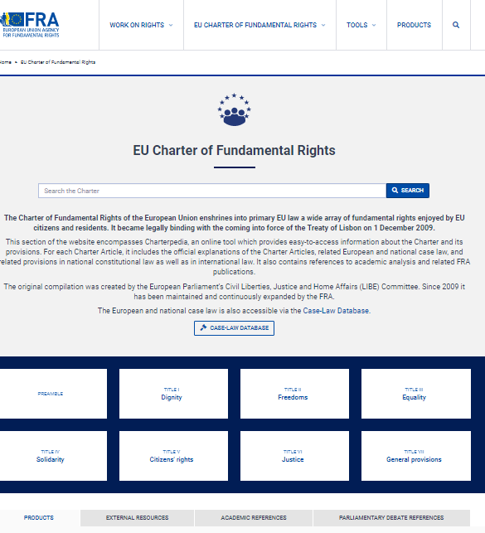
Charterpedia
National and European case law
Relevant national constitutional provisions, EU law, international law
Academic references

