Slide 1
The patient’s role in digital health literacy
Kaisa Immonen, Director of Policy
European Patients’ Forum
30 January 2019, Brussels

Slide 2

The patient’s conundrum
Healthcare and health information are becoming more complex
People increasingly told to “take more responsibility” for their health… but not supported to do so
Information landscape is changing – impact on the ways people interact with the system
Electronic health records
Dr Google, online portals
Social media, influencers
We used to complain about lack of information – now it is too much information, wrong information & misinformation
Navigating the information maze is challenging … even if you are highly educated
Notes:
Patient empowerment is a profound challenge to the current health/care system
We have a discourse where individuals are told to “take more responsibility” for their health – but the system is not supporting them to do so
People are faced with more complex decisions, in an environment where there is simultaneously an “overload” of information and yet a perceived lack of good, relevant, understandable information
Navigating the healt/care maze is challenging even for people who are highly educated and health literate
The Health system can be profoundly disempowering – it encourages passivity and discourages patients’ active participation

Slide 3
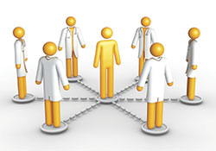
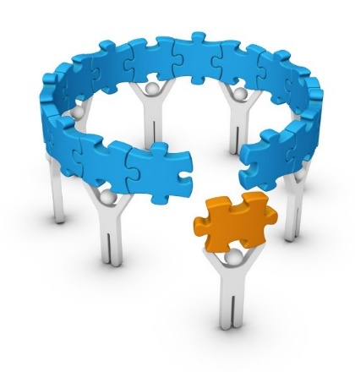
HL – an essential ingredient in future healthcare
Participatory
Collaborative
Partnership
“patient-centred” (passive patient)
Active patient
Notes:
Patient empowerment is a profound challenge to the current health/care system
We have a discourse where individuals are told to “take more responsibility” for their health – but the system is not supporting them to do so
People are faced with more complex decisions, in an environment where there is simultaneously an “overload” of information and yet a perceived lack of good, relevant, understandable information
Navigating the healt/care maze is challenging even for people who are highly educated and health literate
The Health system can be profoundly disempowering – it encourages passivity and discourages patients’ active participation

Slide 4


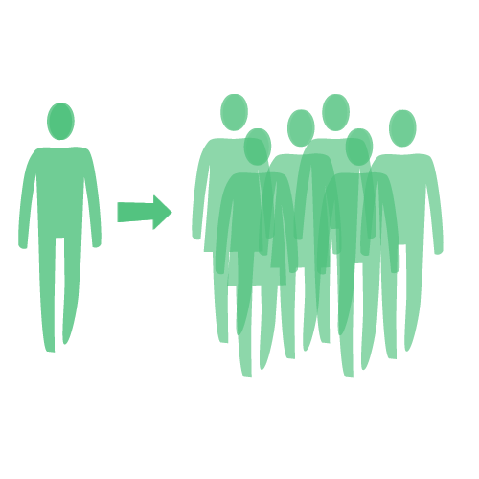
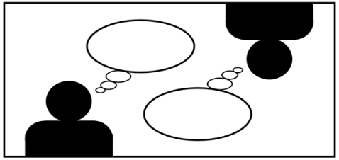
Health literacy and empowerment
Empowerment = “A multi-dimensional process that helps people gain control over their own lives and increases their capacity to act on issues that they themselves define as important.”
Collectively, “a process through which communities are able to express their needs, present their concerns, devise strategies for involvement in decision-making, and take political, social, and cultural action to meet those needs.”
(see EPF PE Toolkit)
3 Facets of empowerment
Health literacy
Information / education
ICT tools
Systems navigation…
Self-management
Skills, behaviours, self-efficacy
psychological-emotional support…
Shared decision-making
Relationship
Decision aids
Communication
HCP skills, attitudes…
A process: non-binary, non-linear
Cannot be imposed top-down
Relational, realised in interactions
Notes:
A process – non-binary (there are degrees of empowerment) and non-linear (it can change according to the people and structures a person comes into contact with).
Cannot be imposed from top-down – needs changes at all levels
Individual but also collective (patient community)
What it is not: shifting responsibility on to patients inappropriately
The tree facets of empowerment are based on a conceptual model developed in EMPATHIE
Empowerment interventions aim to equip patients (and their informal caregivers whenever appropriate) with the capacity to
participate in decisions related to their condition to the extent that they wish to do so;
become “co-managers” of their condition in partnership with health professionals;
develop self-confidence, self-esteem and coping skills to manage the physical, emotional and social impacts of illness in everyday life.

Slide 5

Low HL makes it difficult to…
HL = literacy skills + capacity to assess and relate information to one’s own situation + take action to make appropriate choices
Focus is on interaction between people and healthcare services / systems
Fill out a medical form
Understand & act upon medical advice
Read a medicine information leaflet
Understand a vaccination chart
Maintain a healthy lifestyle
Find the right treatment
Find and assess reliable health information
Know your rights & access care
Notes:
For individual patients (people), poor communication that does not take into account health literacy can result in errors, worse outcomes and risks to patient safety.
At a population level, there are implications for participation in ongoing debates about health, medicine, scientific knowledge and cultural beliefs, for example around the risks and benefits of medicines.
Important to note: distinction between “functional, interactive and critical” health literacy.
Functional health literacy: te ability to apply basic literacy skills in health situations
Interactive health literacy : includes ability to apply more advanced cognitive and literacy skills to make decisions in health
Critical health literacy: the ability to critically analyse health information and situations – and take actions accordingly, for instance at community level to address systemic barriers to participation

Slide 6
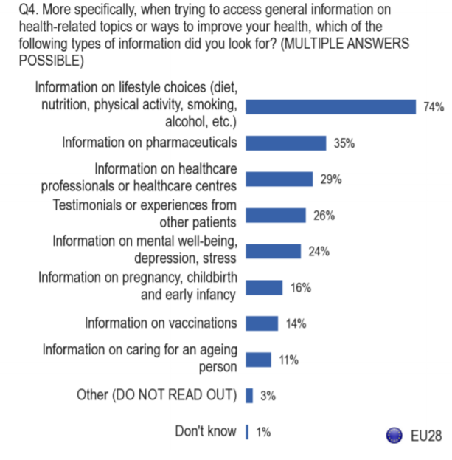
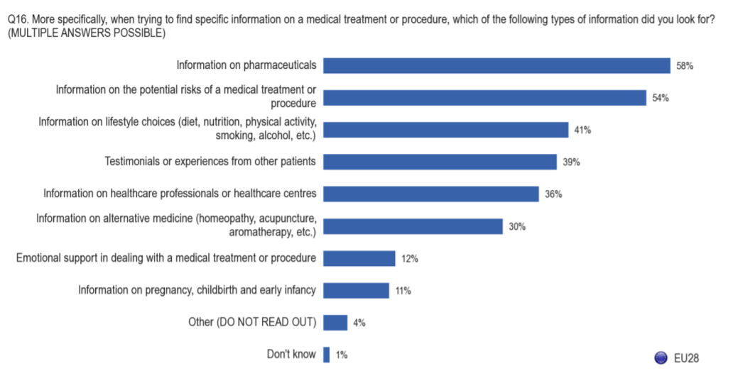
People look for information digitally
6 in 10 Europeans look for health information online
Medicines information is a top search topic
Most people think they can distinguish high from low-quality information online – 17% think they cannot
Eurobarometer, Sept 2014

Slide 7
Example – medicines package leaflets
Understanding the PIL is basic – but not for everyone
Shortcomings known for a long time…
HLS-EU survey: 27.5% found understanding PILs “fairly” or “very” difficult
The most diverse item in survey – from 13.1% in NL to 48.3 in DE
HL relates not only to words, but also design and numbers
PIL should be easy for all levels of HL
Primary source of medicines information for patients

Slide 8
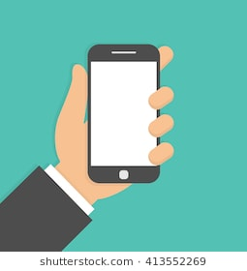

Opportunities of digital PILs
Accessibility
Availability – when and where you want, all EU languages
Designed for readability
Adapting to people with disabilities, e.g. large text, design features
Portability – have it on your mobile phone
Enhanced information & functionalities
Devices: video instructions, visuals
Search functions
Hover -over “glossary”…
Up-to-date info
Changes communicated right away
Interactivity → link to ADR reporting, other portals
Alert: new information on your medicine !

Slide 9
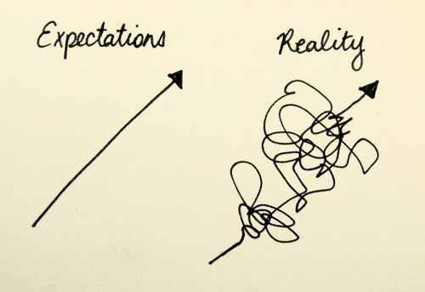
Potential Challenges / Caveats
Limited access to computers & internet
Make it mobile gadget-friendly
Paper must remain available to those who need it
Ideally single portal at EU level as “one stop shop” for information
Should be controlled by public authority – EMA & national regulators
Important to ensure public trust and confidence
The PIL format still needs improving
Merely digitalising PIL won’t make it HL-friendly!
Patient review comes too late / is not incorporated
Should the PIL be a communication tool or a legal document?

Slide 10
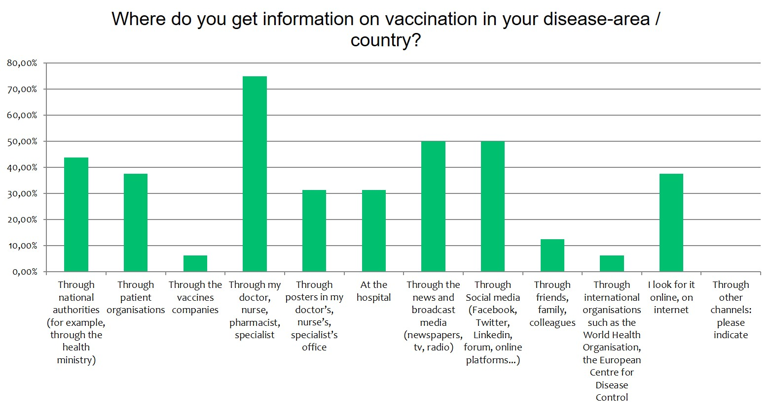
Example: vaccination
EPF initiative 2018: started with a membership survey
Patients identified gaps:
Vaccination info for specific chronic diseases
Reliable information on benefits vs risks – contextualised
Information on risks of not being vaccinated
Difficult to find “good” info online

Slide 11
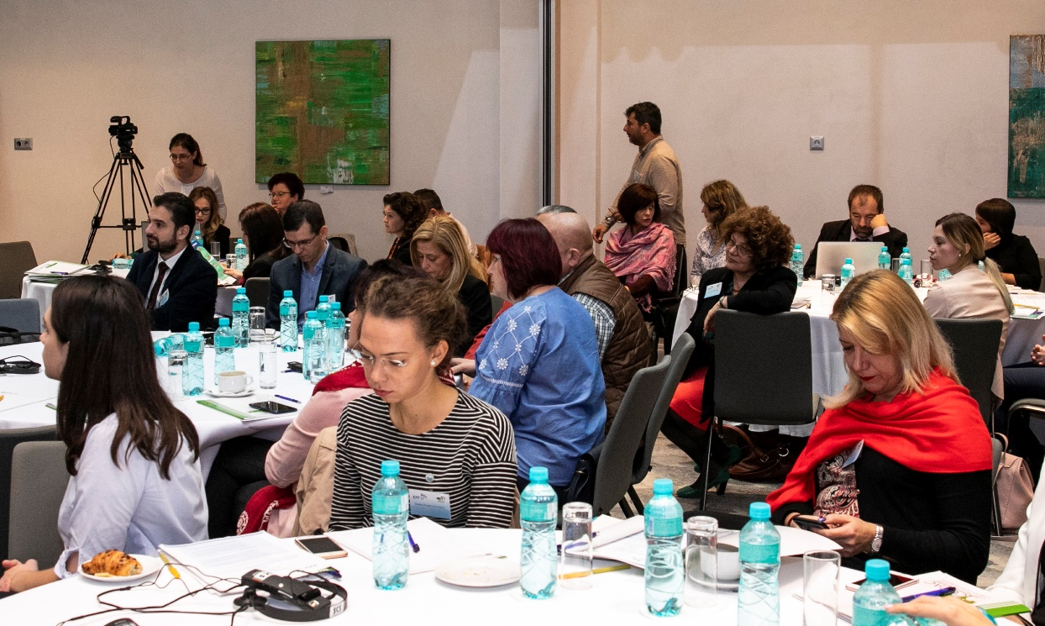
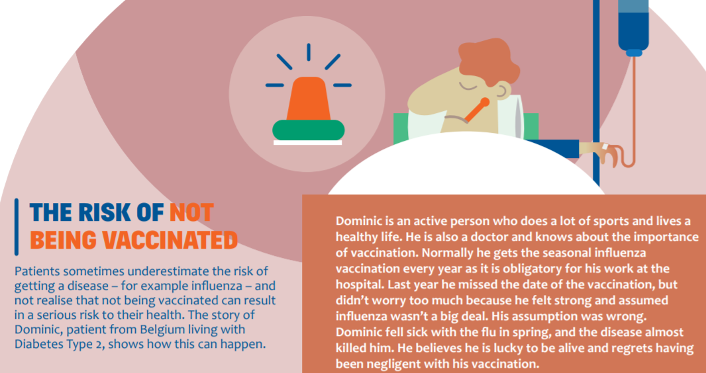
EPF initiative on vaccination for patients
Online information resources for patients & patient organisations (EN, RO, FR, DE)
Background report
Factsheets
Template PPT
Pointers to reliable, lay-friendly tools
“Manifesto” on the importance of vaccination from a patient perspective
Pilot workshop held with patient organisations in Bucharest, 1 November 2018
Follow up in 2019 + extension to further country
In collaboration with national umbrella patient organisations

Slide 12
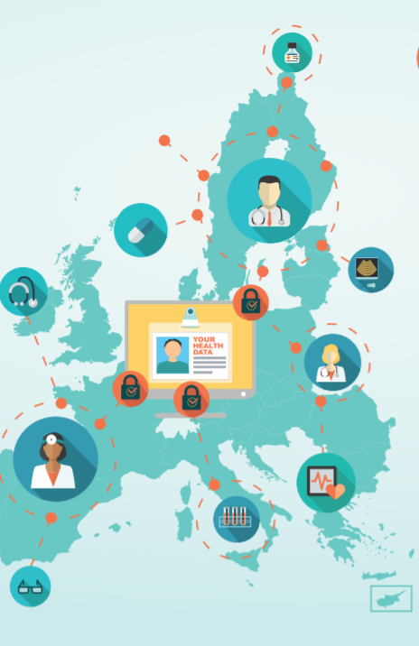
Conclusion: recommendations for action
Include digital HL actions under COM pillar "patient & citizen empowerment"
HL as a specific focus in EU collaborations, e.g. AMR, vaccination
EMA & national regulators → recognise HL and improve communication and public engagement approaches
Regulators largely trusted sources of info – but operate in challenging environment & not traditionally good at communicating
Evidence-based information, attractively presented, should be the first thing people find when googling!
EMA needs to be resourced to really improve PIL (not only make it digital)
Patient organisations, natural allies → “translating” scientific information into lay-friendly formats & disseminating
Resourcing is often a barrier

Slide 13
www.europeforpatients.eu
#europeforpatients

