Slide 1

EESC Session, 1st October, 2026
"Civil society, health and peace – together for global solidarity"
By Mariano Votta
Responsible for EU Affairs at Cittadinanzattiva APS

Slide 2

Cittadinanzattiva & Active Citizenship Network
Active Citizenship Network
The European branch of Cittadinanzattiva, established in 2001
One of the most widespread networks, with more than 100 civic, patients and user organisations
Promotes the European citizens’ point of view in all public policies areas, focusing on healthcare, consumers and corporate social responsibility issues.
Cittadinanzattiva
Italian NGO founded in 1978
More than 35,000 volunteers, 270 local assemblies and 84 local centres
Mission: Promoting citizens' activism for the protection of rights, support for vulnerable populations, and the care and protection of common goods:
In 2007 we were awarded a gold medal for our commitment to improving the public health system in Italy
Art. 4.1 – Health & Safety: Protection of health as a fundamental right, alongside individual and collective safety.
Art. 4.2 – Peace & Non-violence: Promotion of a culture of legality, peace among peoples, non-violence, and non-armed defense.

Slide 3
Health & Peace as Exhaustible Common Goods
Key Definitions of "Common Goods"*
"Common goods are those goods that, if enriched, enrich everyone; if impoverished or destroyed, impoverish each one of us” (2015: Prof. Gregorio Arena -Labsus / Former President of Cittadinanzattiva)
"Goods of non-rivalrous but exhaustible consumption [...] which express functional utility for the exercise of fundamental rights and the free development of persons, requiring collective enjoyment guaranteed by law for future generations“(Rodotà Commission - Italian Ministry of Justice, 2007)
Key Policy Takeaways
Non-Rivalrous yet Exhaustible: Health and peace belong to everyone, but if neglected or sacrificed to geopolitical and military interests, they erode rapidly, tearing the social fabric.
Shared Governance & Co-Care: Protecting these exhaustible common goods requires structured collaboration between active citizens and public administrations.
Prerequisite for Public Diplomacy: Meaningful public diplomacy requires recognizing civil society as an equal partner and providing real, protected spaces for civil dialogue and co-decision.
Civic Public Diplomacy: Bridging the gap between citizens, patient organizations, and European/International institutions through bottom-up advocacy, participatory democracy, and community engagement.
Why preserving health and peace is essential for democratic and social cohesion
*Source: click here

Slide 4
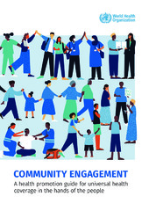


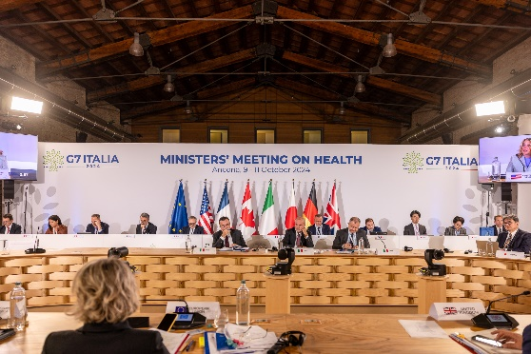
Community and civil society engagement in health
The WHO has defined community engagement as “a process of developing relationships that enable stakeholders to work together to address health related issues and promote well being to achieve positive health impact and outcomes” and it underlines the “Community and civil society engagement” as a pillar of its “Global Action Plan for Healthy Lives and Well-being for All”.
5 December 2023, the European Commission adopted the EU4Health 2024 work program to implement key health policy priorities within the European Health Union. As Stella Kyriakides, European Commissioner for Health and Food Safety, said, "Civil society has a crucial role to play in reaching out to our citizens".
G7 Ministers’ Meeting on Health 9/11 Oct. 2024 Ancona (Italy):
We will support the involvement of all relevant stakeholders in the decision-making processes at all levels, according to the One Health Approach, and ensuring that health equity considerations are incorporated in developing policies
Health-in-All-Policies and participatory governance are cornerstones for health promotion and prevention to achieve a long and healthy life, in alignment with the resolution on “Social participation for universal health coverage, health and well-being” adopted during the 77th WHA.
We reiterate the importance of developing target-group specific activities taking into account persons in vulnerable and marginalised situations and socioeconomic and cultural barriers that can hinder their equal participation, as part of an overall physical activity promotion policy.
“….vaccination is an essential preventive measure and reiterate the crucial role of routine immunisation and campaigns”…. “the importance of raising awareness and involving the general population by providing evidence-based information through campaigns aimed at citizens’ empowerment and increasing health literacy regarding prevention, research and care”

Slide 5

Health at the Conference on the Future of Europe
The Conference on the Future of Europe was a citizen-led series of debates and discussions that let people across Europe share their ideas and shape Europe’s common future. It engaged citizens through a digital platform, citizens’ panels, and EU-wide events, resulting in 49 proposals covering nine topic areas submitted to the EU institutions on 9 May 2022.
the biggest surprise is that even during the health crisis, the topic that received the least interest on the web platform (about 1,413 contributions) was health and healthcare, reflecting a perceived lack of EU competence in this field
•Although health is one of the least discussed topics in this debate on the future of the EU, the COVID-19 pandemic is prompting citizens to recommend that “health and healthcare be included among the competencies shared between member states and the EU”, with an amendment to Article 4 of the Treaty on the Functioning of the European Union since “the EU does not have enough competence to legislate on healthcare and the pandemic has shown that we need more Europe in health”, reads the recommendation approved with 74 per cent of the votes.
• More Europe in healthcare means ‘ensuring that care and treatment within the EU is of the same quality and at a fair cost’ and also increasing ‘the budget dedicated to research and innovation in the healthcare sector, without budget cuts’.
Source: EU Commission

Slide 6
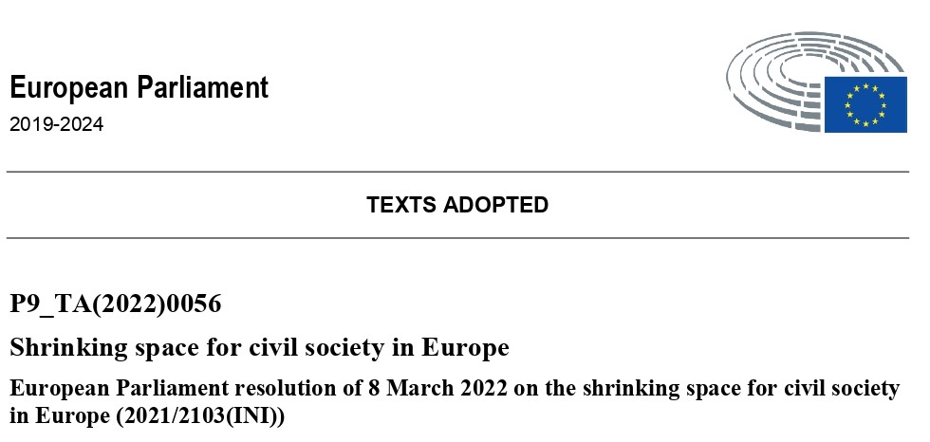
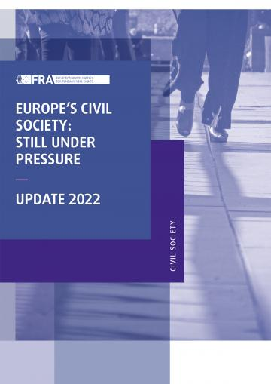
Shrinking space for civil society in Europe: complaints
Source: EU Parliament - Committee on Civil Liberties, Justice and Home Affairs
Rapporteur: Anna Júlia Donáth
freedom of expression and access to information has been restricted in some Member States, often under the pretext of fighting disinformation related to COVID-19.
freedom of association is being eroded in some Member States by reforms that put CSOs at risk
in some Member States, restrictions have been imposed with the deliberate aim of limiting civic space and are accompanied by legal, administrative and fiscal harassment
some national CSOs that act as watchdogs are particularly targeted by restrictions and surveillance.
certain Member States have placed restrictions on CSOs’ ability to engage in political activities.
in some Member States, emergency legislation in response to the health crisis has been used as a pretext to arbitrarily restrict fundamental rights and freedoms and to crack down on civil society and other dissenting voices.
Source: European Union Agency for Fundamental Right
the emergence of government-organised non-governmental organisations (GONGOs) designed to always support the political legitimacy of those in power and to support the government in public debates and in its political goals while presenting themselves as independent voices constitutes one of the gravest forms of attack against CSOs, jeopardising their existence by undermining active citizenship

Slide 7

Shrinking space for civil society in Europe: recommendations
“considering the spread of the COVID-19 pandemic has seen an unprecedented engagement of CSOs in providing solutions to the pandemic and providing support to people in vulnerable situations”
European Parliament resolution - 8 March 2022
Stresses the importance of civil dialogue in informed policy-making and emphasizes that CSOs play a key role as intermediaries between citizens and authorities at all levels by ensuring structured dialogue; highlights the important role of CSOs in consistent contact with citizens, including marginalised or vulnerable groups, and acknowledges their expertise, confers on them a key role in civil dialogue and accentuates their role in empowering those furthest away to participate and voice their concerns, while exercising democratic control over and ensuring accountability for public action.
Regrets that civil dialogue often remains an ad hoc process; calls on the Member States to develop coherent policy frameworks that ensure structured, predictable and long-term processes, inclusive participation and systematic review, and to allocate appropriate resources, including for the training of officials; calls on the Commission to provide recommendations prepared in close cooperation with civil society, based on analysis of existing practices.
Calls for the Member States, the EU institutions in general and the Commission in particular to ensure close consultation with civil society during the preparation or review of legislation potentially affecting civic space and freedoms.
Takes note of the attribution to a Commission Vice-President of the responsibility to maintain an open, transparent and regular dialogue with civil society.

Slide 8
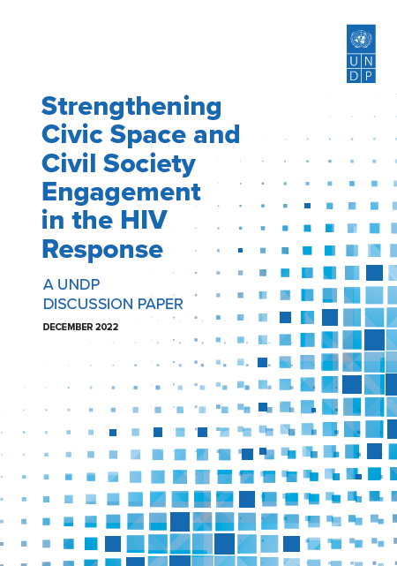
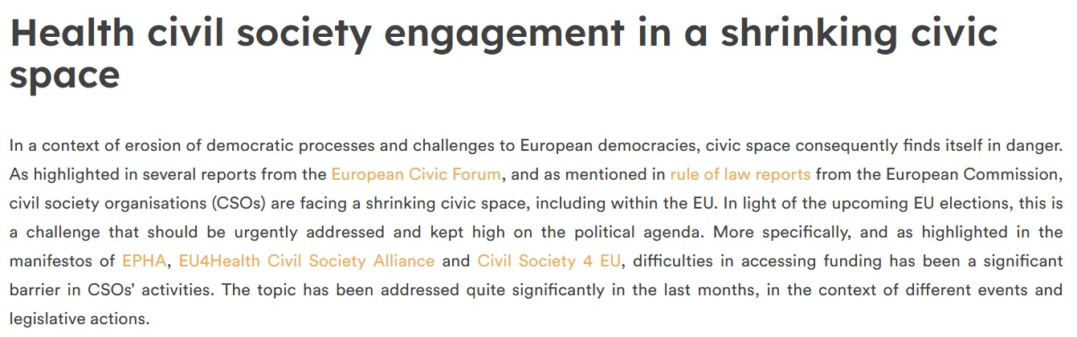
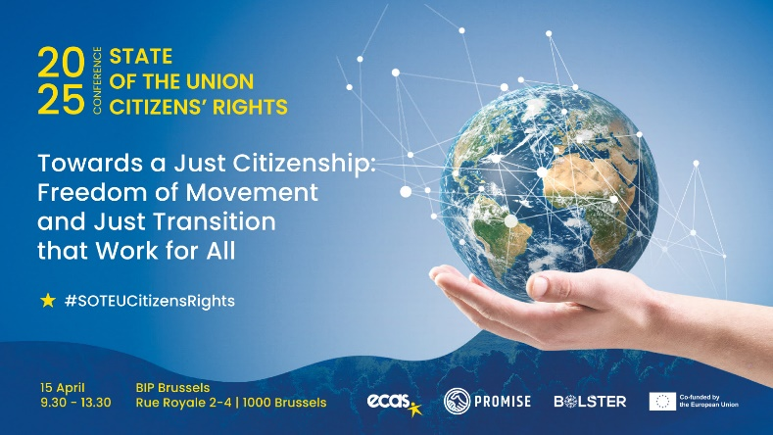
Health civil society engagement in a shrinking civic space
Shrinking civic space at the national, regional and international level blocks opportunities for civil society to advocate for health and human rights, monitor access to services, claim redress for rights violations or reach those left behind with health and legal support services.
UNDP – 8 December 2022
The European Public Health Alliance – 27 March 2024

Slide 9
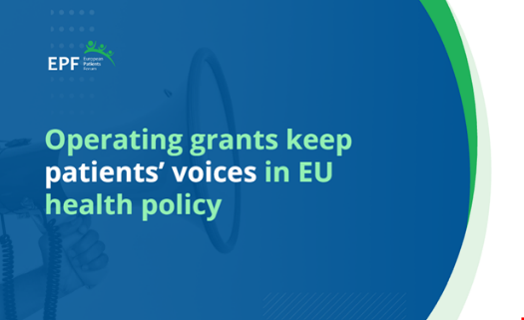
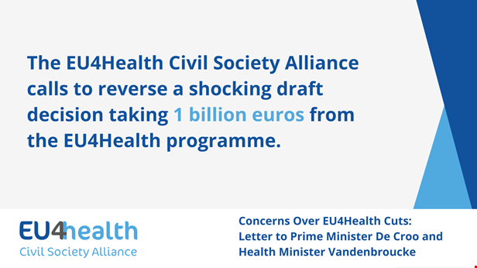
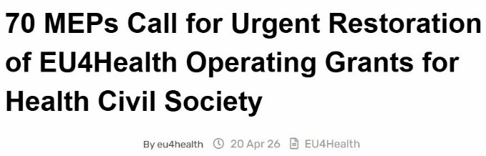
EU4Health budget cuts
A one-billion-euro cut to the EU4Health programme during the 2021–2027 Multiannual Financial Framework (MFF) mid-term revision resulted in a roughly 20% reduction to the EU's dedicated public health budget.
"A one-billion cut to EU4Health would not only translate to a 20% cut of the overall EU health budget under the current MFF, but it would subvert the priorities and strategic programming of health financing left for the remaining years of the Framework."
The EU4Health budget envelope was reduced to around €4.4–€4.6 billion following the redeployment of funds toward defense, migration, and Ukraine's recovery.
Patient Advocacy Groups (PAGs) emphasize that operating grants provide organizations with the essential capacity to participate in EU policy-making, share expertise, consult their communities, gather evidence, and draft recommendations (read more).
At a time when democratic values and civic space are under growing pressure, supporting an independent health civil society is defined as "an investment in better policies, a stronger democracy, and improved public health".
However, as reported by the European Court of Auditors, "most NGO funding ends up with a few government-linked entities": out of over 4,400 registered organizations, just 30 received more than 40% of the total funding between 2014 and 2023 (amounting to €3.3 billion).
This is why, rather than simply asking for more funds, we must revise the allocation criteria.
Participation requires sustainable support

Slide 10
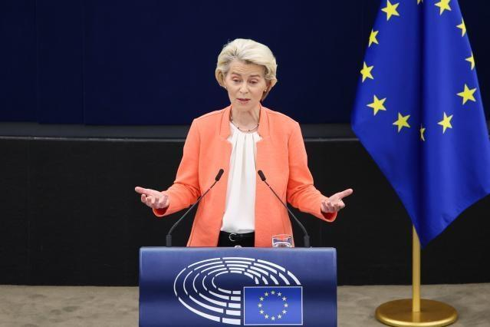
Welcome to (which?) Europe
Every September, the President of the European Commission delivers the State of the Union address to the European Parliament.
The speech takes stock of the achievements of the past year and sets out the priorities for the year ahead.
2020:
“we need to build a stronger European Health Union”
(State of the Union Address by President von der Leyen at the European
Parliament Plenary in
Brussels, 16 September 2020)
2024:
European Union defence. The Commission’s priorities for 2024-2029, from defence and security to sustainable prosperity, democracy and social fairness.
(based on the Political Guidelines presented to the European Parliament in July 2024)
2026: “A battle of narratives is seeking to weaken confidence in Europe;
to paralyse our democracies” - “It was the best of times, it was the worst of times”
2026 SOTEU Word Occurrences: War: 21; defence: 14; peace: 5; health: only 3

Slide 11

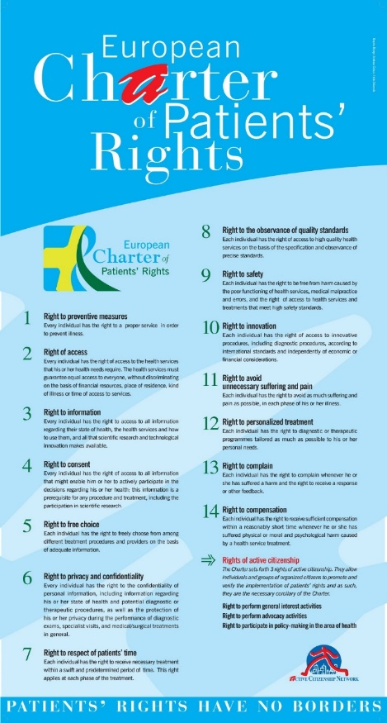

Charter of rights: main features
A Charter of Rights is a document containing a set of rights which express ways to protect the more general right to Health, recognised by the (national and international) laws, but often unknown or violated.
What makes a Charter of rights different?
It is based on civic participation and advocacy
It is not legal or technical, but it comes from citizens’ reports and complaints about violations or inefficiencies
It is a grassroots initiative
It enables the concrete applications of rights with specific actions and interventions.
It should be proclaimed and promoted by all the relevant institutions and stakeholders, professionals, associations, citizens.

Slide 12







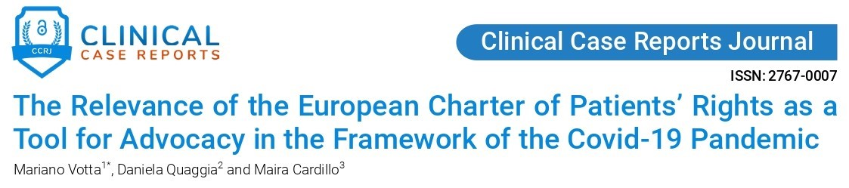
European Charter of Patients’ Rights
In 2002, Cittadinanzattiva-Active Citizenship Network, together with organizations from 15 EU countries, drafted the European Charter of Patients’ Rights. It lists 14 fundamental patients’ rights, which each EU country must protect and guarantee. Drafted in 21 languages, it has become a reference for EU citizens’ rights in healthcare and a milestone for other EU Charters.
Why?
To bring together the inalienable patients’ rights which each
EU Member State should protect and guarantee
To help build a European identity
To facilitate dialogue among different stakeholders and for
setting standards.

Slide 13



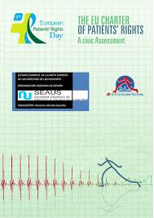
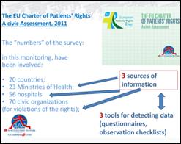
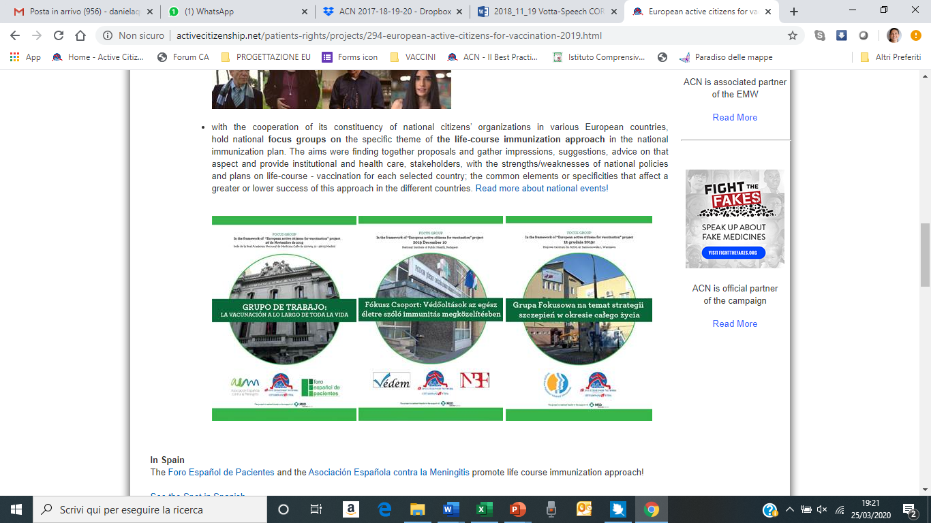
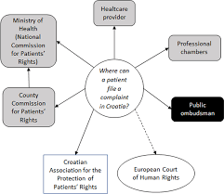
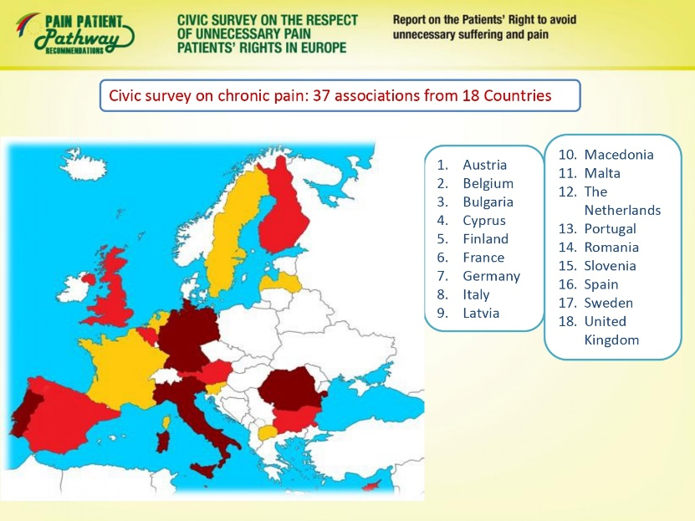


The EU Charter as an evaluation tool
Monitoring Patients' Rights in Europe
2005/2007
&
2010/11
EU Ranks Estonia for Patient Rights Protection
Reporting violations of European Charter of Patients' Rights: analysis of patient complaints in Croatia
National Vaccination Plan in:
Spain Hungary Poland
Pain: Report on respect of Patients' Right in Europe

Slide 14
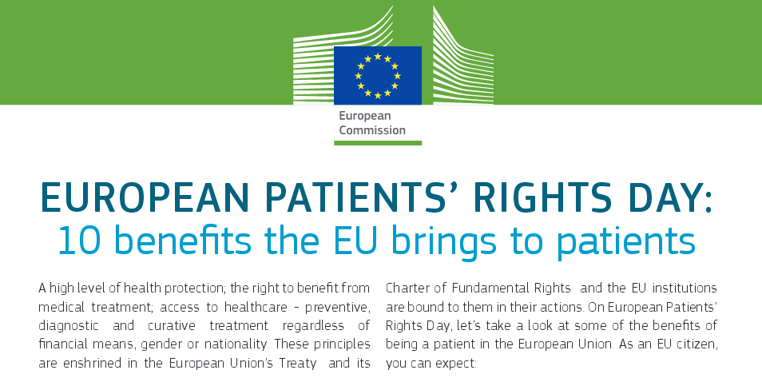
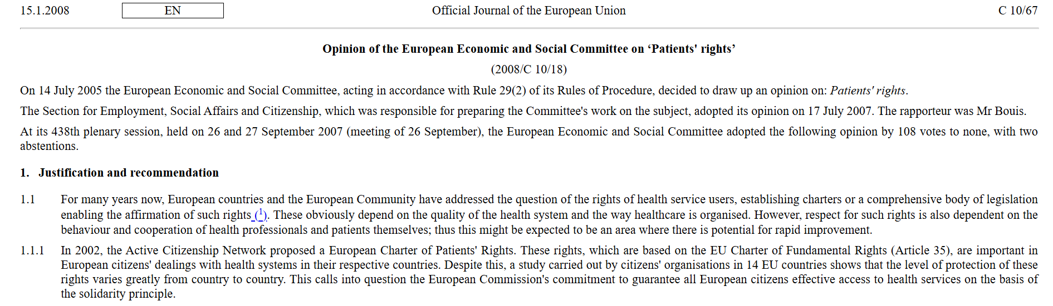
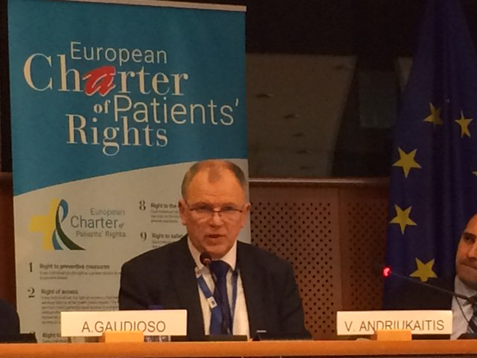
Endorsement by EU Institutions
The majority of the 14 rights are embodied within the "Council Conclusions on Common values and principles in European Union Health Systems" adopted in June 2006.
The EU Directive 2011/24/EU on the application of patients’ rights in cross-border healthcare officially recognizes the “right to free choice” and the “right to information” included in the European Charter of Patients' Rights.

Slide 15
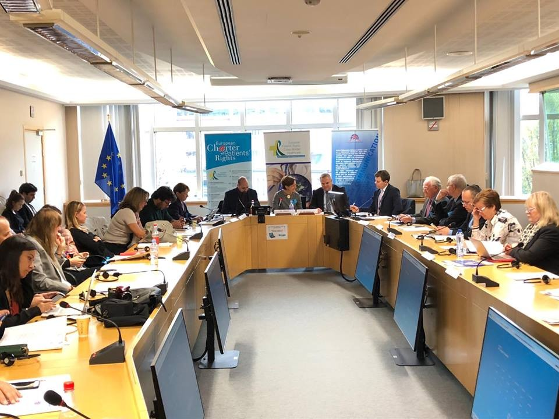
Endorsement by the EU Parliament
“The European Parliament recognizes the value of citizens’ initiatives, such as the European Charter of Patients’ Rights based on the Charter of Fundamental Rights of the European Union, and the European Patients’ Rights Day, which has been organised every year on 18 April since 2007; invites the Commission and the Member States to support the European Patients’ Rights Day at local, national and EU level”.
Report on safer healthcare in Europe: improving patient safety and fighting antimicrobial resistance
(2014/2207(INI)), approved by the European Parliament on 19 May 2015
“The European Parliament recognises the value of citizens’ initiatives such as the European Charter of Patients’ Rights, based on the Charter of Fundamental Rights of the European Union, and the European Patients’ Rights Day celebrated each year on 18 April at local and national level in the Member States; invites the Commission to institutionalise the European Patients’ Rights Day at EU level”
Options for improving access to medicines
European Parliament resolution of 2 March 2017 on EU options for improving access to medicines (2016/2057(INI))

Slide 16



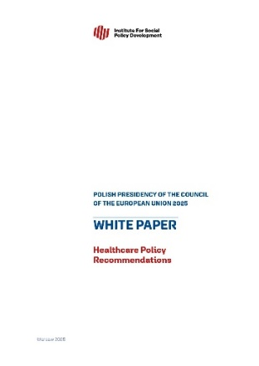
2025: The commitment of the Polish Presidency of the Council of the EU
2025
Since 2007
2002
Since 2015
The aim of the Polish Presidency of the Council of the EU (Jan-June 2025) is to institutionalise at EU level the principles of patients’ rights, contained in the EU Charter of Patients’ Rights, and integrate them into the acquis communautaire,
as highlighted in the White Paper “Healthcare Policy Recommendations” & discussed at “10th Health Challenges Congress” on 13 March 2025 with PAGs from Member States.

Slide 17



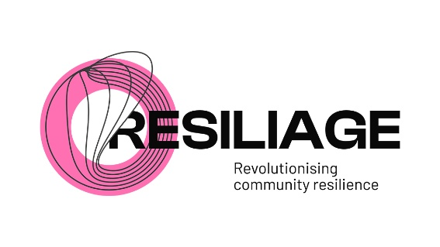
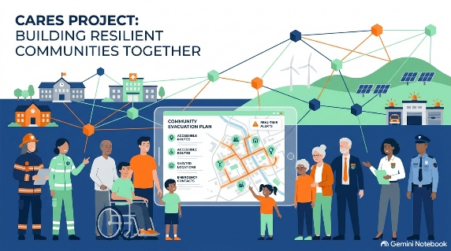
Resilience / large emergencies / First Responders
2026–2029 | CARES – Citizen Awareness and Resilience for Emergency Systems
2025/2027 | Empowering Citizens by Considering their Feedback in Preparedness Plans
2023-2026 | RESILIAGE (Advancing holistic understanding of community RESILIence and heritAGE drivers through community-based methodologies)
2021/2024 | NIGHTINGALE - Novel integrated toolkit for enhanced pre-hospital life support and triage in Challenging and large emergencies
2020/2023 | Engage Society for Risk Awareness and Resilience

Slide 18

HERA Advisory Forum
More info here
The Health Emergency Preparedness and Response Authority’s (HERA) mission is to prevent, detect, and rapidly respond to health emergencies. HERA was launched as a new European Commission Directorate-General on 16 September 2021, and carries out the Commission’s policies related to health preparedness and crisis response and ensuring the resilience of healthcare systems across Europe.
The HERA Advisory Forum is a group of experts from the Member States that assists the HERA Board. They represent technically competent bodies in the field of health security and are designated by the Member States.
The mission of the HERA Advisory Forum is to:
Provide scientific and technical advice on issues raised by the HERA Board and support implementation of HERA work plan;
Facilitate the exchange of views between experts from technically competent bodies in the Member States;
Pool knowledge of preparedness and response in the area of medical countermeasures (MCMs).
The Forum discusses a broad range of subjects with regard to assessing health threat priorities and identifying relevant MCMs, from ongoing preparedness initiatives by Member States to epidemiological intelligence and challenges in supply chains.
The Forum is supported by two sub-groups, the Joint Industrial Cooperation Forum (JICF) and the Civil Society Forum (CSF).
The Joint Industrial Cooperation Forum supports collaboration with health-related industrial ecosystems in the area of preparedness and response to health crises. It brings together Member State and industry representatives.

Slide 19

HERA Civil Society Forum
More info here
The Civil Society Forum (CSF) helps ensure that the HERA Advisory Forum receives regular input from and hears the views and opinions of civil society, acting as a contact point between HERA and stakeholders representing patients, consumers, and healthcare professionals.
The CSF monitors and gives its views on research, as well as on industrial and policy developments in the areas of health preparedness and response, with a focus on medical countermeasures (MCM). Along with the JICF, it provides the Advisory Forum with observations and assessments to support its work and contributes to informed decision-making.
The Forum acts through specialised working groups.

Slide 20


Mariano Votta
Responsible for EU Affairs at Cittadinanzattiva
Director of Active Citizenship Network
m.votta@cittadinanzattiva.it
@marianovotta

