Slide 1
Towards a European system for natural catastrophe risk management
27/10/2026
Marie Scholer

Slide 2
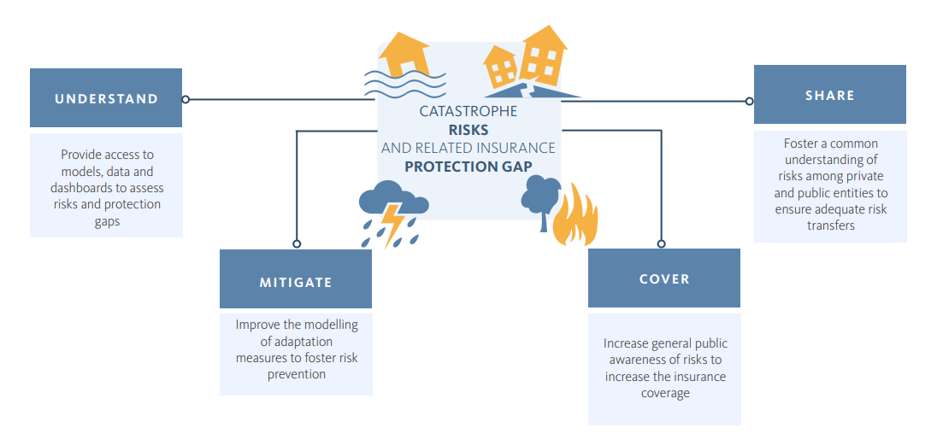
Address insurance protection gaps

Slide 3
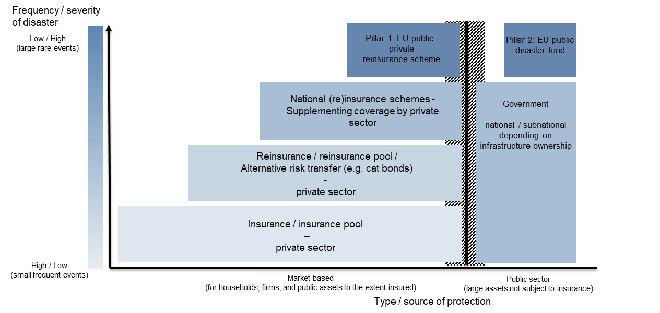
POSSIBLE EU-LEVEL APPROACH
Clarify private and public responsibilities and ensures complementarity of actions taken.
Encourage ex ante risk mitigation
Ensure efficient use of private and public sector funds for natural disaster payouts
Reduce moral hazard
Improve insurance coverage
Limit public costs
  EIOPA and ECB propose European approach to reduce economic impact of natural catastrophes - EIOPA

Slide 4

EIOPA/ESM Discussion Paper - Sharing the risk: A European approach to natural catastrophe risk management
🔍 What the Work Is About
Quantitative analysis of a potential European reinsurance/backstop scheme
Complements prior qualitative ECB/EIOPA papers
Focus areas:
-Model the total economic losses and the total insured losses
- Build case studies for different sizes of a European reinsurance scheme and the size of a backstop.
EIOPA and ESM staff propose mechanism to better manage fallout from outsized natural catastrophes - European Insurance and Occupational Pensions Authority

Slide 5
Key messages
There is a significant catastrophe insurance protection gap in Europe.
All parts of the ecosystem (Consumers, cities and builders / (Re)insurance and Financial Markets / National governments / EU) need to act to help addressing the Nat Cat insurance protection gap.
More pro-active risk management & systematic inclusion of prevention measures in any (national/EU) solution is required.
A proper quantification of the risk to take adequate prevention decisions is key.

Slide 6
For more information visit:
https://www.eiopa.europa.eu

