Slide 1
"Tax rules as code (TRACK) for EU tax directives: Enhancing legal clarity, cross-border comparability, and democratic governance through artificial intelligence."
Professor Christiana HJI Panayi
c.hji-panayi@qmul.ac.uk

Slide 2
Introduction
Good tax administration & robust legal framework
The importance of competitiveness
Complexity of new tax legislation
  Tax evasion/avoidance, high compliance costs for businesses
Simplification initiative: ‘Declutter’
  Directive on Administrative Cooperation (and all its amendments)
  Anti-Tax Avoidance Directive

Slide 3
Directive on Administrative Cooperation
DAC 6 especially problematic
  Different interpretation/application of hallmarks, penalty regimes, legal professional privilege etc
  Shifting of reporting obligation to taxpayers
  Uncertainty as to how information is processed by local tax authorities
  Disproportionate administrative cost

Slide 4
Anti-Tax Avoidance Directive
Level playing field among Member States (?)
Fragmented implementation
Overlap with other legislation
One-size fits all approach re interest limitation rule
More legislation to come

Slide 5
How Can the Use of AI in Tax Policy Boost Economic Growth and Competitiveness?
Prior question of how tax policy can boost economic growth and competitiveness in the EU
  Reducing compliance burden (tax administration and cross-border compliance issues)
  Removing tax obstacles to cross-border movement (non-discrimination)
  Incentivizing private investment (cf state aid limitations, Pillar 2 limitations)

Slide 6
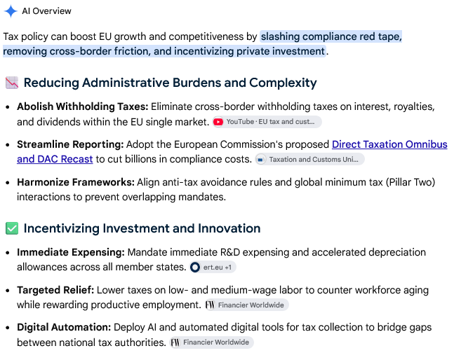
How Can Tax Policy Boost Economic Growth and Competitiveness?

Slide 7
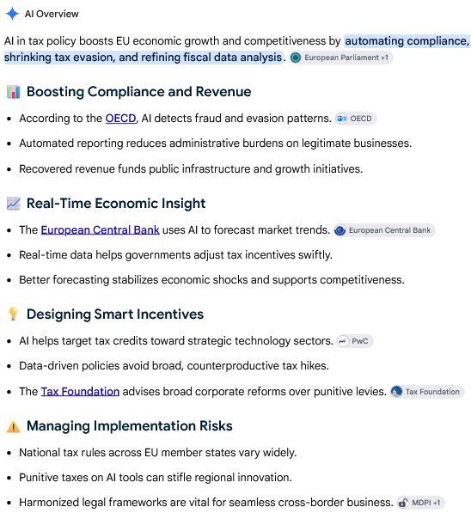
How Can the Use of AI in Tax Policy Boost Economic Growth and Competitiveness in the EU?

Slide 8
AI in tax administration and tax enforcement
Detection of non-compliance: Using predictive risk scoring models, selection of taxpayers for audit
Used in assessment and assists in imposing administrative penalties
Used to monitor enforcement
Issues with Charter of Fundamental Rights (and ECHR)
  Criminal penalties? Engel test (ECtHR, App. No. 5100/71, 8 June 1976)
    Art 6 ECHR & Art 37 CFR
Application of AI systems in tax enforcement does not fall within high risk category of activities under EU AI Act (Regulation (EU) 2024/1689) – no extra oversight safeguards
  Should this change?

Slide 9
AI in legislation?
Drafting
Implementation
“The EESC highlights that Rules as Code (RaC) opens up greater opportunities to achieve uniform implementation and applicability of rules across national tax legislations and across countries, thereby improving legal certainty and minimising fragmentation and in turn supporting the consolidation of the single market.” 1.12
How?
Language variations?

Slide 10
AI in legislation?
“The EESC highlights that Rules as Code (RaC) opens up greater opportunities to achieve uniform implementation and applicability of rules across national tax legislations and across countries, thereby improving legal certainty and minimising fragmentation and in turn supporting the consolidation of the single market”. 1.12
“Rules as Code (RaC) refers to the process of translating legal rules into machine-consumable formats while preserving their legal meaning, enabling automated application, improved compliance, and integration into digital systems. RaC allows legislation to be both human-readable and executable by software/machine, opening up new possibilities for the authorities involved in implementation, as well as for enterprises/individuals required to abide by specific rules”. 2.2

Slide 11
AI in legislation?
How would the Rules as Code work?
Suggestions
  Drafting/codifying national rules (natural language processing?)
  Implementation/monitoring (real-time tracking of changes)
  Simplifying processes and facilitating tax compliance
  Impact assessment methodologies and legislative drafting guidelines
  Complementing rather than replacing legal interpretation and human judgment

Slide 12
AI in legislation?
Potential problems?
  Language variations
  Algorithmic bias
  Accountability/challenges
  Data protection/Cybersecurity
  Taxpayers’ fundamental rights
  Impact of CJEU case law

Slide 13
AI in legislation?
Reference to OECD project: Rules as Code – Tax Administration 3.0.
  This focuses heavily on tax administration….
Should we be more specific as to the role of AI in legislation? Less ambitious and/or more realistic?
  Concrete examples of how it works would help!
Can we use AI to predict CJEU judgements?

