Slide 1
The Path to the Digital Euro - EESC
6 July 2026 – Atze Faas

Slide 2

Retail & Wholesale is a huge economic and social contributor in the EU

Slide 3




Merchant Payments Coalition Europe

Slide 4
Payments from merchant perspective
Not our core business
Payments are “for free”
Resilience
>15 pieces of EU payments legislation
Increasing involvement
Cost differences
Surcharging bans not helping
Business continuity
Diversification
Power imbalance
Offering Choice
Unilaterally imposed fees
Deepest impact on SMEs
Right tool for the job

Slide 5
Just to give you an idea: card fee ranges today
 | Measure | Domestic* | Debit# | Credit
Consumer | Per txn | 3-6ct | 3-6ct | -
 | % | 0.12%-0.2% | 0.4%-0.6% | 0.5%-0.9%
Commercial | Per txn | 3-6ct | - | -
 | % | 0.12%-0.2% | 1%-1.5% | 1.5-2.25%
Notes:
costs include Interchange, all scheme/assessment fees and acquirer fees.
Does not include PSP gateway or wallet costs.
Does not show payment methods such as account-to-account, PayPal (1,5-3%) and Buy Now Pay Later (3,5%+).
Some schemes have %-only or fixed fee only and some have a mix.
* e.g. Bancontact, Girocard, Multibanco, Cartes Bancaires
# in some countries (e.g. Netherlands) domestic debit on Maestro/V Pay historically has the same fees as (previous) domestic schemes, however that may change to IC++% due to the move to Debit Mastercard and Visa Debit.

Slide 6
Merchants see the potential of the digital euro to:
Lower the average cost of payments
Enhance competition & innovation
Increase resilience
See also:
Digital Euro: make it work for merchants – EuroCommerce
Make digital euro fee fair for merchants and citizens - EuroCommerce

Slide 7
6 issues stand in the way of realising that potential:
Offline
Phasing
Reuse infrastructure
01
03
05
02
04
06
Compensation Fee model
Basic services
B2B payments
Merchant holdings
Complexity => costs => fees => prices => cost of living

Slide 8
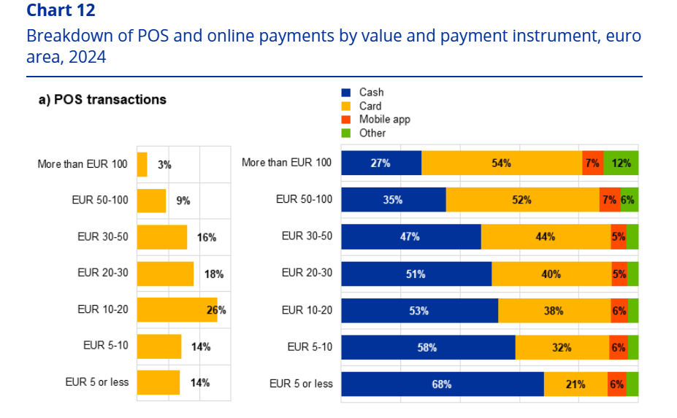
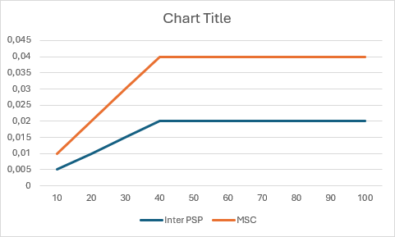
Fee simplification: 0,1% up to 40 euro, 4 cent for 40 euro and up
Source: ECB Study on the payment attitudes of consumers in the euro area 2024.

Slide 9
Illustrative understanding of EP digital euro fee model –
Base case: cost of PSPs smaller than benefit, cap < average
Adjustment factor
Comparable digital means of payment: consumer debit domestic and international cards
€€€
+/+ cost of PSPs
SMEs
Higher risk
Merchant fee cap
Euro area weighted average
Lower risk
= remainder to be shared equally between PSP and merchant
Large
-/- Benefit from absence of ECB scheme/ processing fees
No worse off:
If a merchant pays less for any comparable digital means of payment, that will be that merchant’s fee cap
€

Slide 10
6 issues stand in the way of realising that potential:
Offline
Phasing
Reuse infrastructure
01
03
05
02
04
06
Compensation Fee model
Basic services
B2B payments
Merchant holdings
Complexity => costs => fees => prices => cost of living

Slide 11
Our other key points
02
Offline digital euro ≠ offline connectivity
Enable remote payments with offline digital euro
Clear definition of basic services to merchants covered by fee
No loopholes
‘Big bang’ is impossible => phased implementation required
Merchant payments first, P2P can wait
B2B payments to be included as alternative to commercial cards
Optional batching of transaction settlement, e.g. daily
Open standards, common acceptance layer, use synergies with instant payments
03
04
05
06

Slide 12

The digital euro as catalyst
European Commission: ‘Make doing business easier’ and ‘One Europe, One market’
Fragmentation costs money
  Reduces competitiveness
  Interoperability is not enough
Getting EU payments right:
  Provide clear direction/vision
  Common acceptance layer
  Centralise competence, resources,
  enforcement, expertise
Complete the single market for
payments: public and private
stakeholders to join forces
Instead of trying to catch-up: unlock Europe’s potential to jump ahead using the digital euro as a catalyst

Slide 13
For more information:
www.eurocommerce.eu/payments
faas@eurocommerce.eu

