Slide 1

Our campaign to end forced sterilisation in Europe
Funded by the European Union. Views and opinions expressed are however those of the author(s) only and do not necessarily reflect those of the European Union or the European Commission. Neither the European Union nor the granting authority can be held responsible for them.

Slide 2

What you'll find in this presentation
1. Introduction to the European Disability Forum
2. Our work to end forced sterilisation in the EU
3. Key demands for the EU

Slide 3
1. The European Disability Forum (EDF)
EDF is an umbrella organisation of persons with disabilities that defends the interests of over 100 million persons with disabilities in Europe.
We are an independent non-governmental organisation (NGO) that brings together representative organisations of persons with disabilities from across Europe.
We are run by persons with disabilities and their families.
We are a strong united voice of persons with disabilities in Europe. We have 119 members organisations.

Slide 4
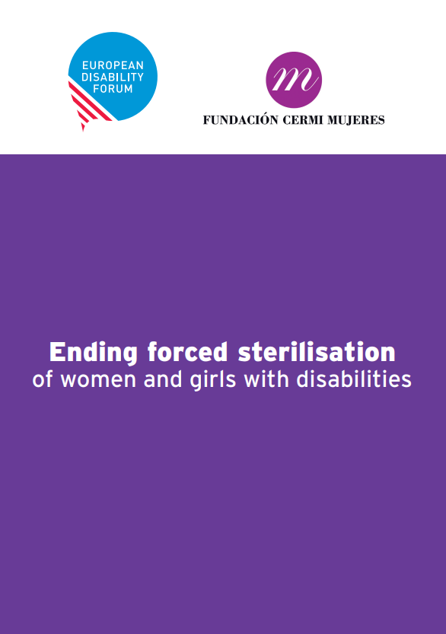
2. Our work to end forced sterilisation
EDF engagement to ban forced sterilisation across the EU started almost 10 years ago.
2017/2018: Report on ending forced sterilisation of women with disabilities – in collaboration with CERMI Mujeres (Spanish member).
This research helped the Spanish reform (Organic Law 2/2020 criminalised forced sterilisation).

Slide 5
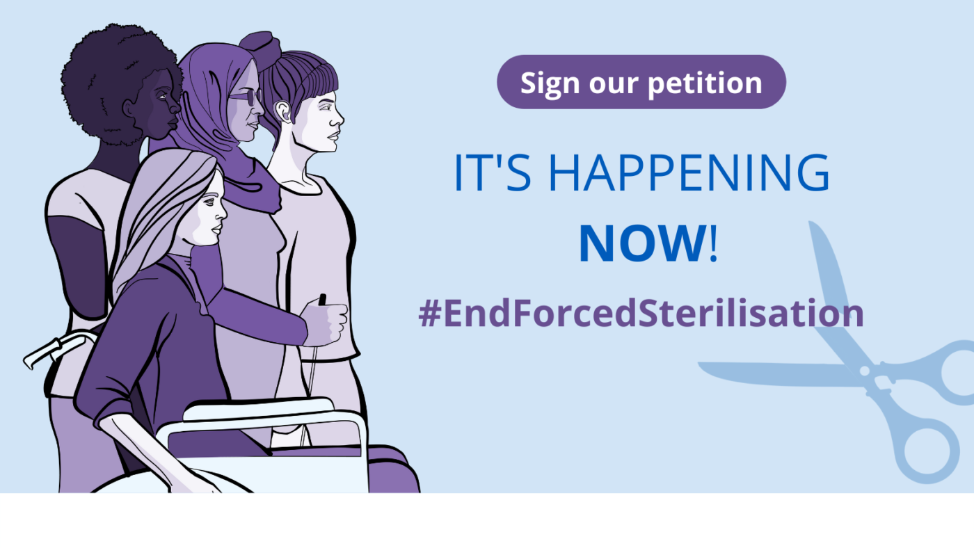
2. Our work to end forced sterilisation
2022: We launched the campaign to #EndForcedSterilisation of persons with disabilities in Europe, asking the European Parliament, the Council and the European Commission to prohibit forced sterilisation in all EU Member States.

Slide 6
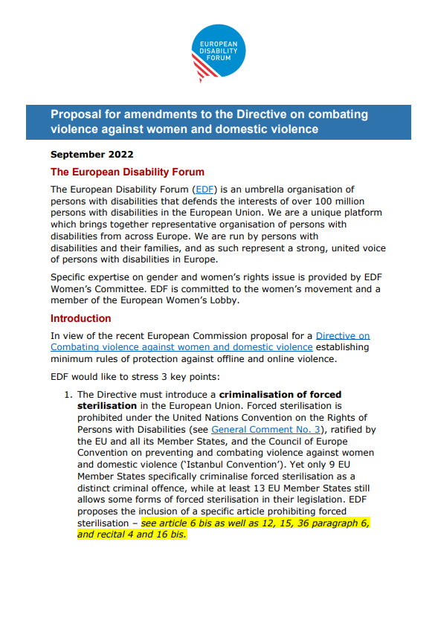
2. Our work to end forced sterilisation
2022: Advocacy on the Directive on combating violence against women and domestic violence to:
Introduce a criminalisation of forced sterilisation in the Directive.
Accessibility, adequate support and training of professionals.
Data and research to identify the root causes of violence.

Slide 7
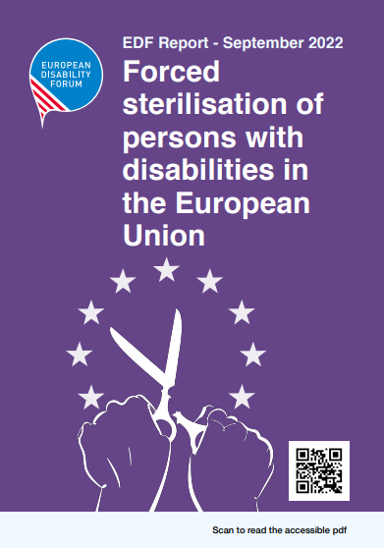
2. Our work to end forced sterilisation
2022: Report mapping the situation of forced sterilisation of persons with disabilities in the European Union.
Key findings:
12 EU countries allow the forced sterilisation of persons with disabilities in their law.
3 EU countries also allow forced sterilisation of children.

Slide 8

2. Update on forced sterilisation report
Now, we are updating of our report to:
Reformulate some information inaccurate in the report of 2022 (e.g. Austria) and change of law (Malta)
Include new research and media investigation happened since, including testimonies
Highlight the strong campaign happening to change the law (Portugal)
Provide support for national advocacy

Slide 9
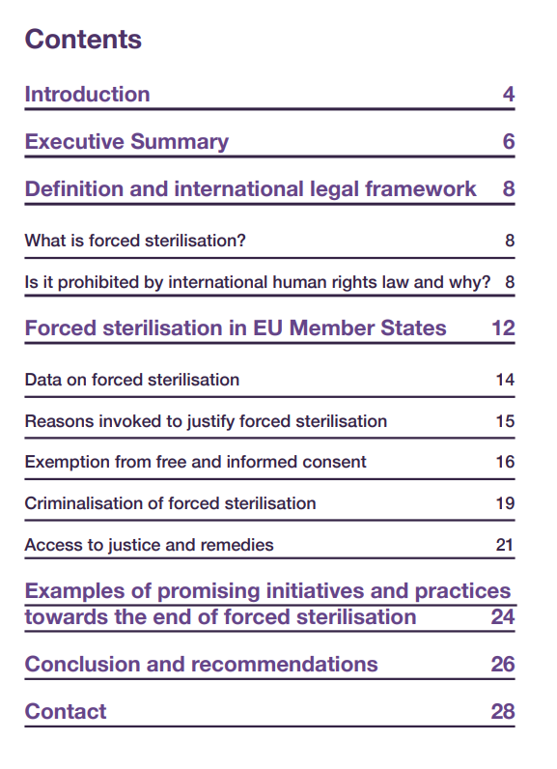
2. Update on forced sterilisation report
What we plan to include in the updated report:
New analysis and updated maps
New cases / testimonies section (in the section on data)
Strengthening section on access to justice and remedies (including examples)
New section on successful and ongoing campaigns to end forced sterilisation

Slide 10
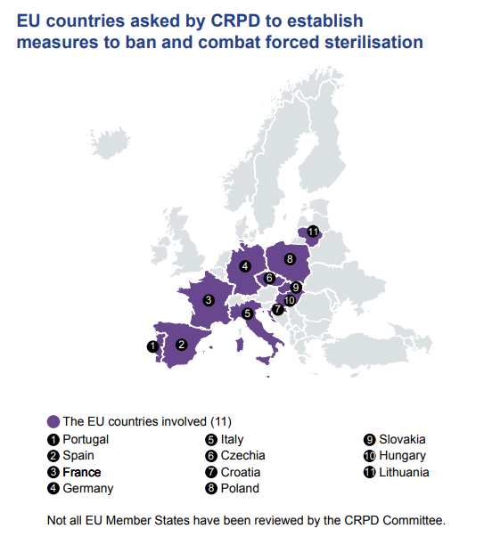
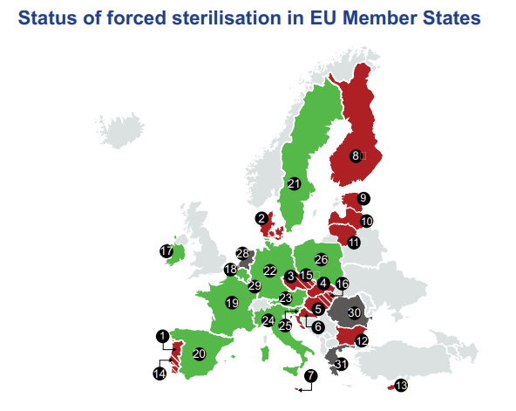
2. Update on forced sterilisation report

Slide 11

2. Our work on forced sterilisation
2023: Briefing “A silenced truth: Stories of forced sterilization in the EU”, containing stories in the media about the impact of forced sterilisation on women with disabilities.

Slide 12
2. Our work on forced sterilisation
Other key activities:
Work with journalists (more investigations and testimonies needed). Some examples:
  EUObserver : EU’s first gender-based violence law a ‘big disappointment’
  EUObserver: The voices of EU’s forcibly-sterilised disabled women
  Malta Independent : Parliament begins discussing ban on forced sterilisation
  DW documentary – Forced sterilisation in Europe

Slide 13
2. Our work on forced sterilisation
Other key activities:
Support of the work of the European Economic and Social Committee: Mission to Spain in September, Own initiative opinion.
GREVIO review of the EU and European countries.
Continue work on access to Sexual and Reproductive Health and Rights

Slide 14
3. Key demands for the EU:
The EU has been silent towards the ban of forced sterilisation:
There is no reference to forced sterilisation in the Strategy for the Rights of Persons with Disabilities, nor in the Gender Equality Strategy.
The Commission Recommendation on the prevention of harmful practices against women were not adopted.

Slide 15
Key demands for the EU:
Extend the scope of the EU Directive on Combating Violence against Women and Domestic Violence to include a harmonised criminal definition of forced sterilisation, with no exception based on disability, legal capacity, guardianship or age.
Develop an action plan to end forced sterilisation, including public apology, rehabilitation, reparation (including economic reparation), and a guarantee of non-repetition.

Slide 16
Key demands for Member States:
Criminalise forced sterilisation, with no exception based on disability or legal capacity, guardianship or age.
Ratify the Istanbul Convention. The Instanbul Convention explicitly requires Member States to criminalise forced sterilisation.
Adopt measures to ensure access to justice, including adequate criminal sanctions, public apology, rehabilitation, guarantee of non-repetition, and compensation for victims.

Slide 17
Conclusions
Finally, it is crucial to work together with families of persons with disabilities, more at risk of having their daughter or son sterilised.
Women with disabilities and their families need to be given guidance and support services in sexual and reproductive health, such as information on contraceptives, sexual health, fertility management, pregnancy, the menopause, and breast and cervical cancer screening programmes for women with disabilities.

Slide 18
Thank you!
Notes:
Thank you!

