Slide 1



Ending forced sterilization
A global perspective based on a multi-year, international research project
Alana Carvalho
Senior Program Officer, Women Enabled International
EESC Public Hearing on
Ending Forced Sterilisation
8 July 2026

Slide 2
What will we discuss today?
1 | The lack of data on forced sterilization at the international level
2 | Findings of the global research My Body, (but not) My Choice
3 | Recommendations: Ending forced sterilization and empowering reproductive autonomy

Slide 3
Forced sterilization from an international angle
Under international law, when forced or coerced, sterilization is a form of:
  Cruel, inhuman, and degrading treatment
  Reproductive control
  Gender-based violence
  However, it is still underresearched, particularly at the intersection of gender and disability.
  The lack of data leads to an ineffective response to this severe human rights violation.

Slide 4
My Body, (but not) My Choice: Methodology
  WEI and 8 partners
  Global desk research on legal capacity violations and their consequences, including forced or coerced sterilization
  Case studies in five countries: Fiji, Kenya, Spain, Uganda, and the United States
  Participation of over 100 women with intellectual or psychosocial disabilities in the focus groups
  Published in 2025

Slide 5
My Body, (but not) My Choice: Results on
forced sterilization
Where or when forced sterilizations occur:
  Institutional settings
  Healthcare settings
  After engaging in a romantic relationship
  After (or due to the fear of) a rape
Common justifications for forced sterilization:
  Harmful stereotypes against parents with disabilities
  Eugenic thinking
  Alleged best interests of women and gender-diverse people with disabilities
Common legal mechanism that allows forced sterilization:
  Denial of the right to legal capacity on the basis of disability
  Absence of free and informed consent to the procedure
Notes:
Expand on best interest

Slide 6
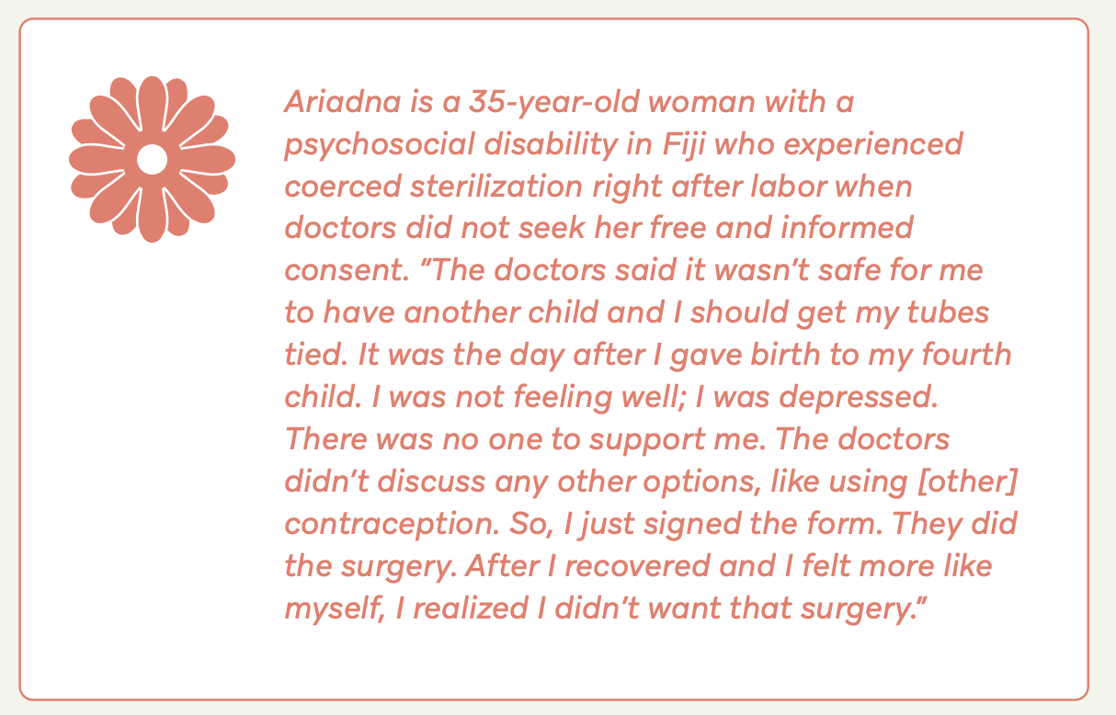
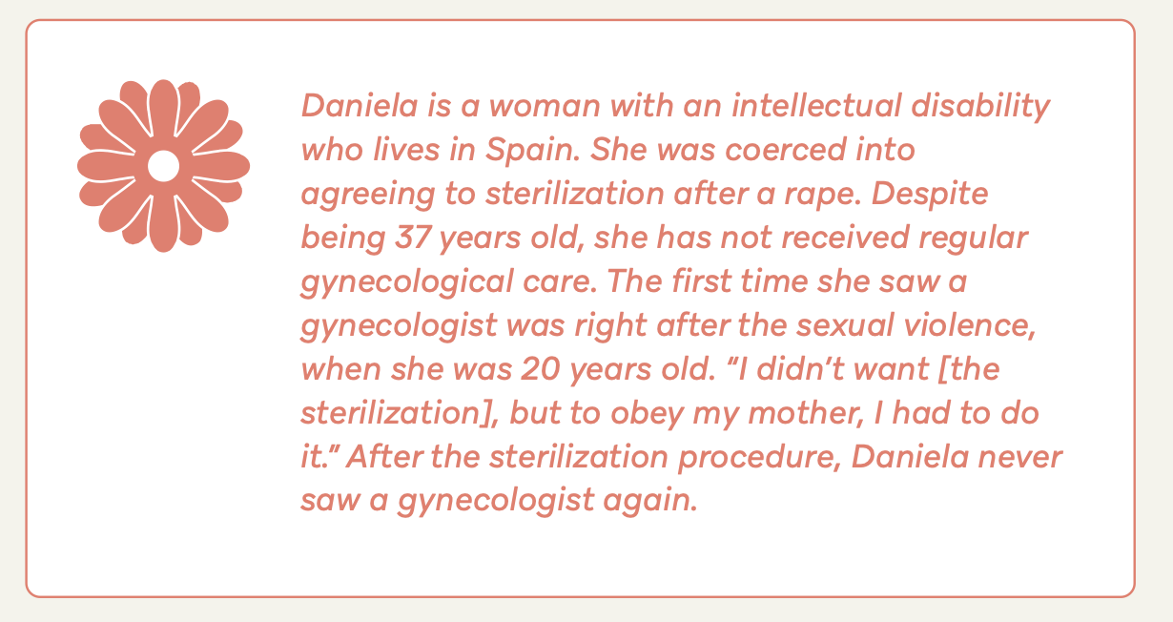
My Body, (but not) My Choice: Results
Forced or coerced sterilization

Slide 7

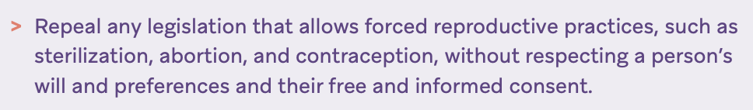
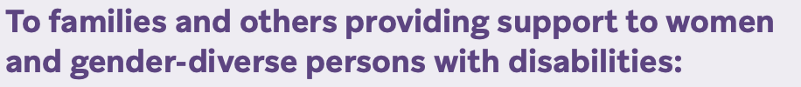
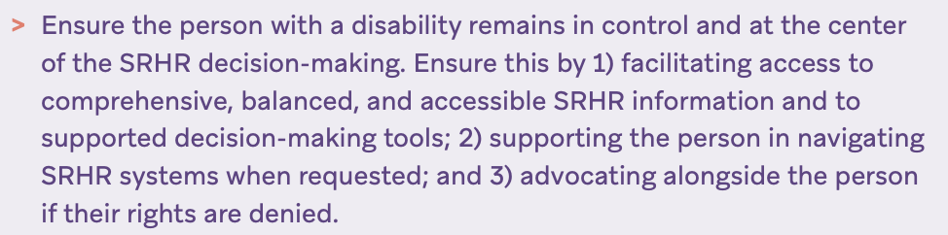
Recommendations: Ending forced sterilization
Notes:
Change this layout

Slide 8
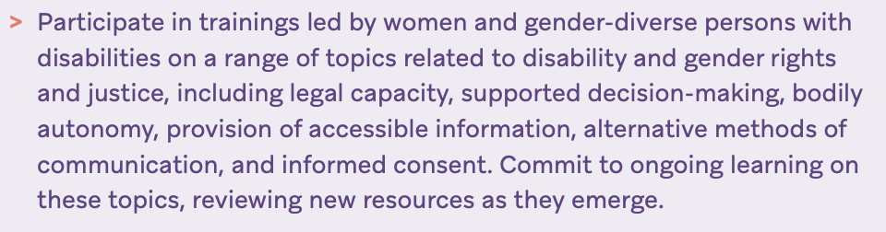
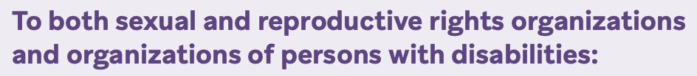
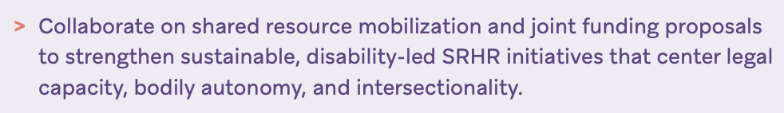
Recommendations: Ending forced sterilization
Notes:
Change this layout

Slide 9
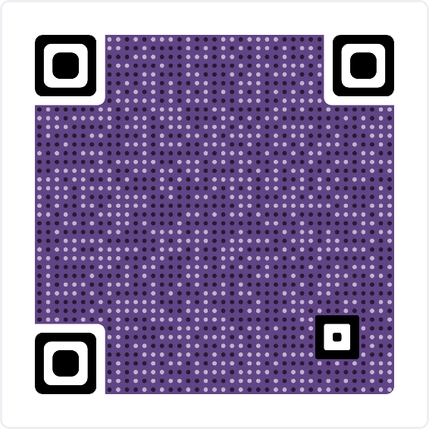



Thank you!
To stay in touch with WEI
www.womenenabled.org
LinkedIn - Instagram – Facebook - YouTube
@womenenabled
a.carvalho@womenenabled.org

