Slide 1
Safe and healthy work in a digital world
– the role of AI and the impact of psychosocial risks
Exchange with EESC section for Employment, Social Affairs and Citizenship
14 April 2026
William Cockburn
EU-OSHA Executive Director

Slide 2
Changing world of work
ESENER 2024 | 2019 | 2024
Employees working from home on a regular basis | 13% | 23%
Employees consulted on working from home practices (*) |  | 77%
Risk assessments cover home workplaces (**) | 31% | 48%
Use of digital technologies covered in risk assessments (***) |  | 56%
Training on routine use of digital technologies (****) |  | 44%
Having employees that have difficulties understanding the language spoken at the premises | 8% | 10%
Training provided in other languages (*****) | 21% | 27%
Base: asked to all establishments in the EU-27 except:
(*) having employees working from home
(**) carrying out risk assesments and having employees working from home
(***) carrying out risk assessments
(****) reporting use of digital technologies
(*****) having employees with difficulties understanding language spoken at premises
ESENER, % of all establishments EU-27

Slide 3
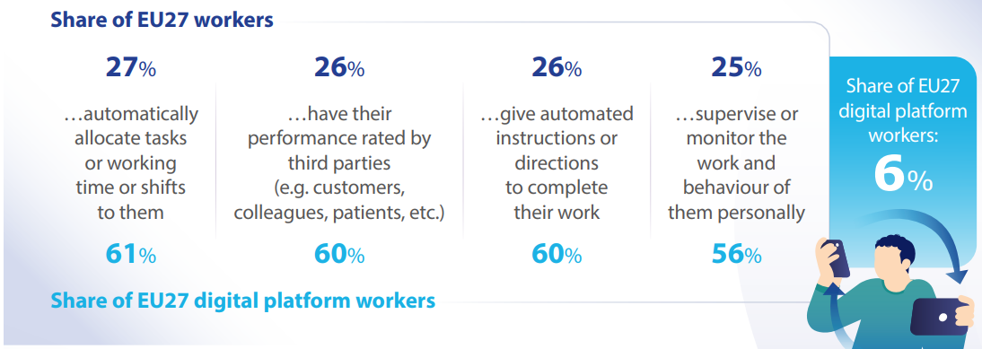
What is digital technology being used for?
OSH Pulse 2025

Slide 4
Facts and figures: digital technologies & psychosocial risks
EU-OSHA, ESENER 2019
Workplaces reporting psychosocial risks by presence of digital technology, EU27
Where technology is present, it is more probable that psychosocial risks are mentioned
Personal computers at fixed workplaces | Not present
 | Present
Laptops, tablets, smartphones, or other mobile computer devices | Not present
 | Present
Robots interacting with workers | Not present
 | Present
Machines, systems, or computers determining the content or pace of work | Not present
 | Present
Machines, systems, or computers monitoring workers’ performance | Not present
 | Present
Wearable devices | Not present
 | Present

Slide 5
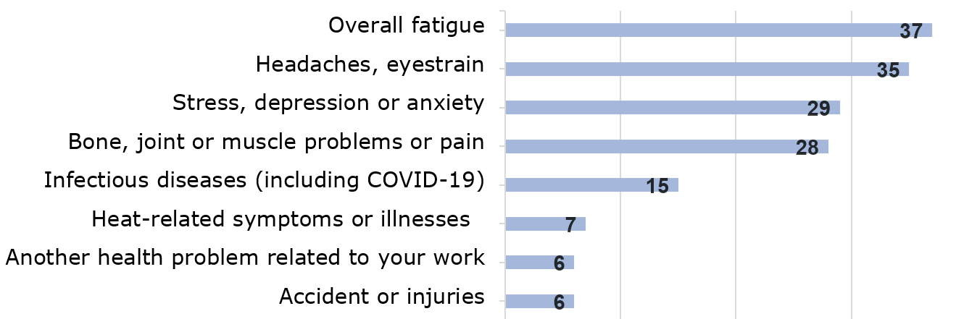
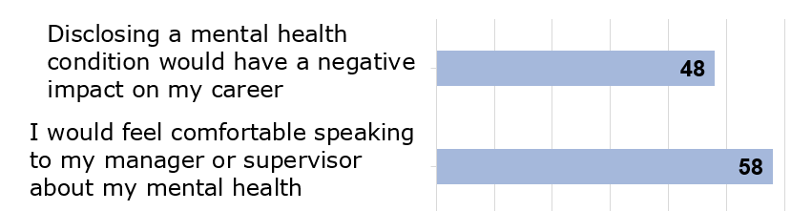
Work-related health problems and the stigma of mental health
Health problems caused or made worse by your work
Mental health stigma
OSH Pulse 2025

Slide 6

AI-based worker management (AIWM) – OSH risks
Constant monitoring and direction
Reduced autonomy and job control
Increased pressure or work intensity
Isolation and feeling of loneliness
Reduced interaction with managers and peers
Reduced role in decision-making
  Lack of transparency and information imbalance
  Few opportunities for feedback or negotiation
Privacy and data protection issues
Psychosocial risks need specific attention

Slide 7

Potential benefits of AIWM for OSH
Better allocation of tasks and workload
Risk monitoring and alert for various psychosocial risks
Personalised digital counselling
Data to support risk assessment
Input to OSH training programmes
  OSH improvements through AIWM remain limited in practice

Slide 8
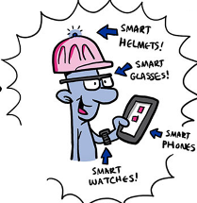


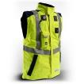
Smart digital systems for OSH
Definition:
Digital systems that collect and analyse data, often real-time, to identify, alert and/or assess OSH risks, thereby preventing or minimising harm and promoting OSH
  Smart glasses, or drones in construction and mining, to reach and monitor dangerous areas
  Wearable devices to identify levels of gases, noise and high-risk temperatures
  Smart sensors, e.g. signaling when a specific limit is exceeded for dangerous substances
  Smart wearables to monitor workers’ vital signs, e.g. detecting sleepiness
  E-textiles, smart helmets or smart glasses interact with workers, e.g. construction, firemen
  Phone apps for reporting or task assistance in the event of accidents, or to assist workers

Slide 9
Smart digital systems for OSH
Opportunities:
Monitor (real-time) risks, support risk assessment
Digital counselling for workers
Informed decision-making
Input to design OSH trainings
Support targeted OSH inspections
Risks and challenges:
Data inaccuracy or misinterpretation
Overreliance on technology
Privacy and data protection
Information overload for OSH management
Examples:
COVID-19 monitoring workers’ proximity, helping to maintain safe distance
Worker and fork-lift position can be monitored to avoid collision in warehouses

Slide 10
Key pointers for OSH prevention
A human-centred approach with humans in command
Regulation and enforcement
Prevention-through-design
Correct selection of tasks and processes to be digitalised
Preserve workers’ control and autonomy
Sound OSH policy and OSH management system
Regular Workplace Risk Assessment (EU-OSHA OiRA tools on Telework & Automation)
Training and upskilling
Equal access to information, and worker participation
Raise awareness about psychosocial risks and mental health
Exchange of expertise (EU-OSHA Case studies & Good practices)

Slide 11

TOGETHER FOR MENTAL HEALTH AT WORK
Healthy Workplaces Campaign 2026-2028
Priority areas
1. Psychosocial risk assessment and management - February – May 2027
- better awareness and understanding, leadership, worker involvement, positive aspects
2. Harassment, sexual harassment, and violence - June – September 2027
- better awareness and understanding, consequences, good prevention practices, cyberbullying
3. Physical risks and mental health - October 2027 – January 2028
- interaction between different risks, effects of physical risks on mental health, inc. agriculture and construction
4. Psychosocial risks in the health and social care sector - February – May 2028
- high prevalence of PSR risks, overlooked groups within the sector
5. Working with mental health problems - June – September 2028
- inclusive workplaces, early intervention, return to work
https://healthy-workplaces.osha.europa.eu/

Slide 12
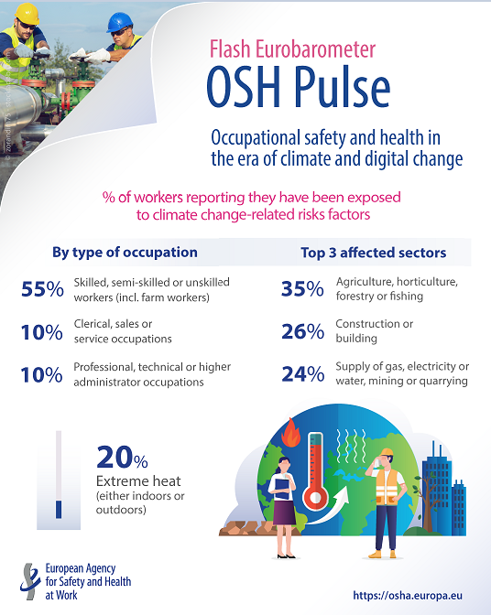
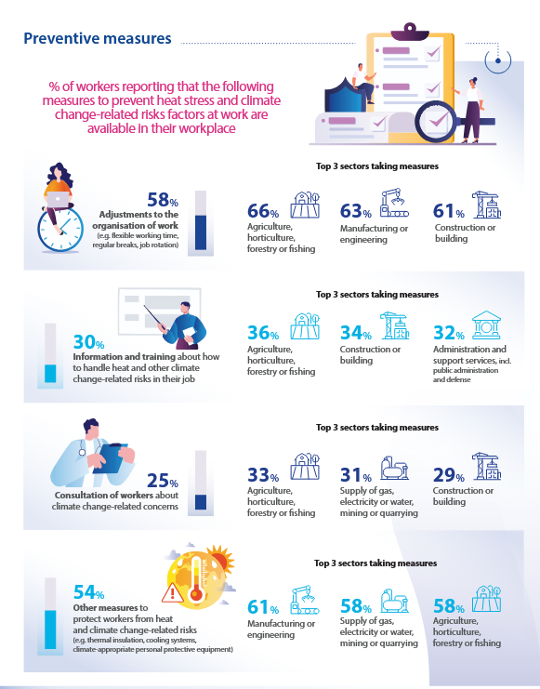
Data - Climate change in the OSH Pulse survey 2025
Notes:
OSH Pulse:
A survey gathering opinions and experience in the area of OSH (main issues they are facing, what they think of OSH measures in their workplace, etc)
Flash: shorter duration of fieldwork (about three weeks)
Representative sample of (employed) workers in all EU27 countries + Norway and Iceland (Switzerland carrying out their own survey using our questionnaire)
Probabilistic sample based on Random Digital Dialling (RDD) - mobile phones
Shorter questionnaire = 18.5 questions (although multi item, so number of variables is higher) + demographic questions (job and worker characteristics)
Data comparable across countries (although not for too granular analysis at country level)
About 25000 participants (500 in smaller countries, 1000 in rest of countries

Slide 13





Find out more:
Thank you
Multilingual website: https://osha.europa.eu
Monthly e-newsletter OSHmail: https://osha.europa.eu/en/news/oshmail
Publications: https://osha.europa.eu/en/publications
Social media:

