Slide 1
Cohesion policy 2028-2034: A new fund, a new framework, a new role for civil society?
The territorial dimension
Dr Martin Ferry
25 February 2026

Slide 2
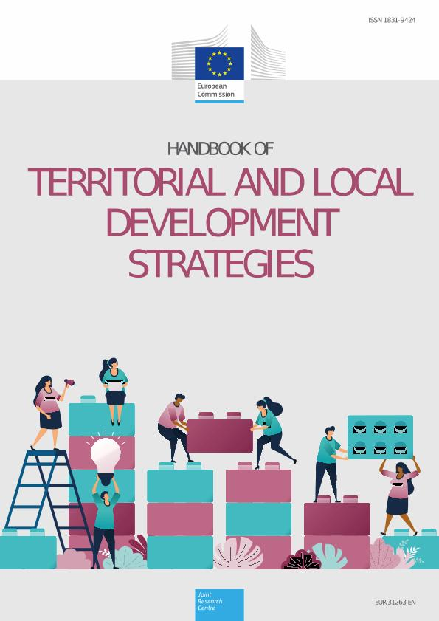
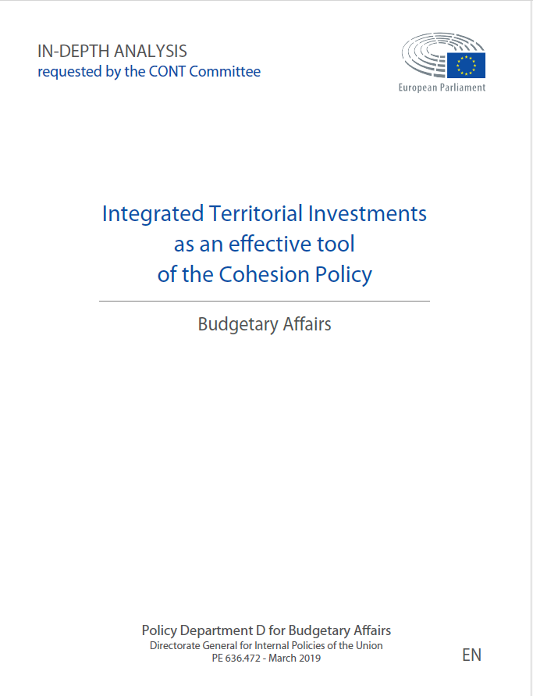
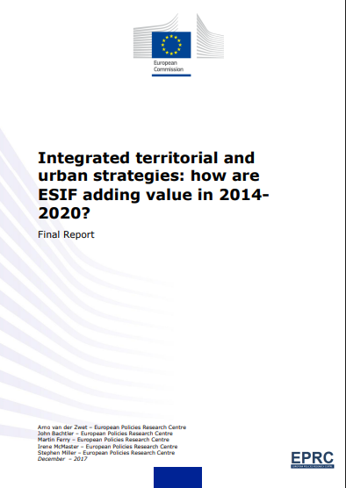
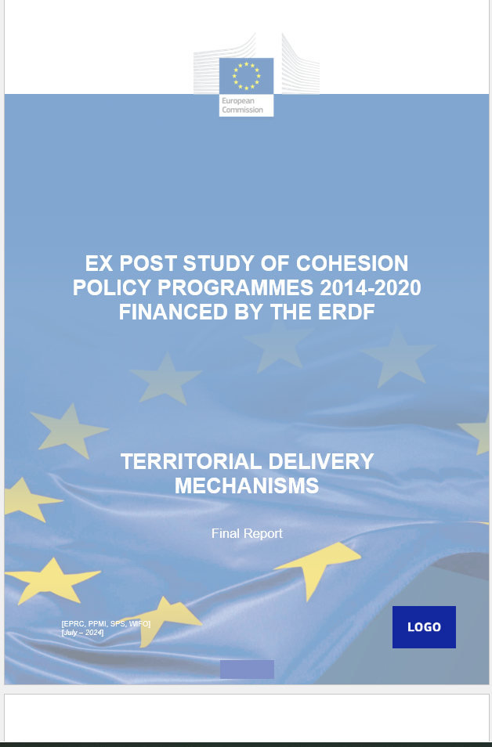
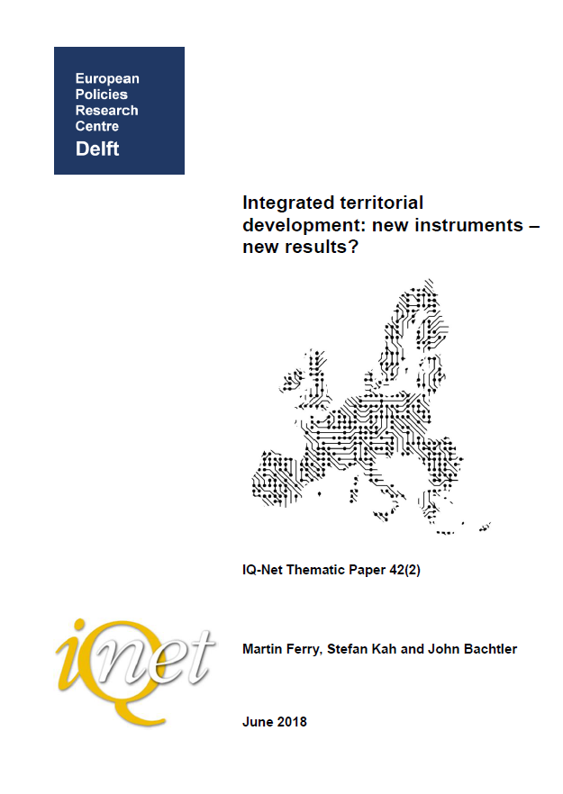
EPRC & CP TERRITORIAL INSTRUMENTS
Long standing work on territorial delivery mechanisms
COM initial assessment of use (2017)
COM Ex-post 2014-20
European Parliament studies
JRC Handbooks for practitioners
IQ-Net reports (2018, 2022)

Slide 3

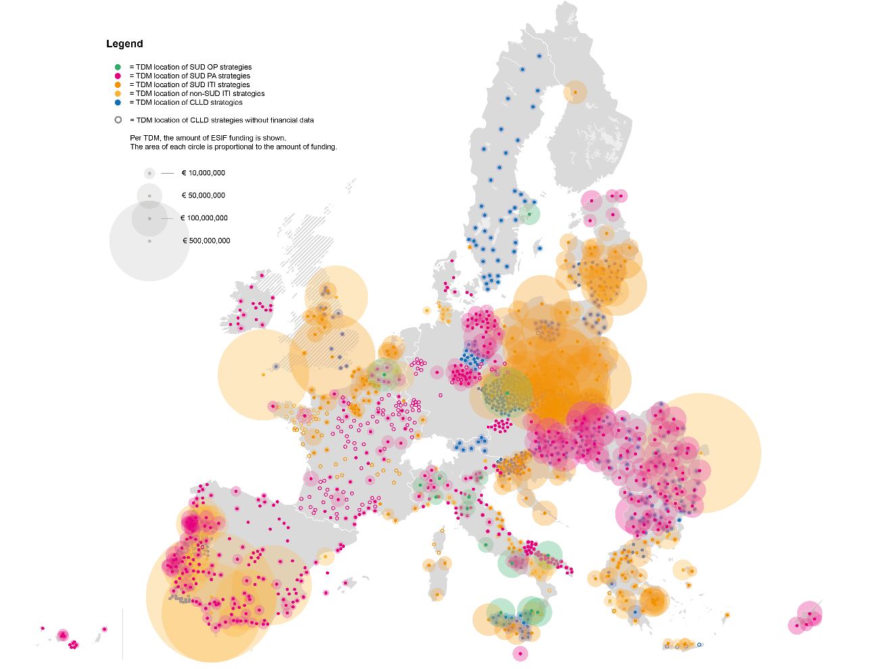
Location of TDM strategies and associated funding – 2014-20
Source: map prepared by Niek Lurling, TU Delft, based on STRAT-Board and Cohesion Open Data.
Note: map does not include TDMs in the outermost territories of La Reunion, Mayotte, French Guiana, Guadeloupe and Martinique. The map reflects some minor discrepancies stemming from STRAT-Board data that should be revised.

Slide 4
Key principles of TDMs
Place-based concept operationalised through “territorial development mechanisms”
Integrated Territorial Investment (ITI) (could be used for ‘earmarked % of ERDF for urban development)
Community-led Local Development (CLLD)
Cross-sectoral actions for CP territorial impact
Can integrate OPs, priorities, funds
Designated territory (urban, urban-rural, sub-regional, inter-regional..)
Territorial strategy, package of measures
Delegation of tasks to territorial actors

Slide 5
Overview: ADDED VALUE & LIMITATIONS
Type | Examples | Limitations
Strategic planning | Filling ‘strategic gap’ (e.g. metro strategies) | Limited quality of some new strategies (e.g. weak intervention logic)
Functionally integrated CP investment | Investments under different fields target specific territory (e.g. skills and business support in deprived districts) Investments in specific field linked across territory (e.g. sustainable urban mobility) | Less evident where instruments covered administrative borders not functional space Regulatory challenges (e.g. integrating ERDF, ESF)
Local governance of CP | Through delegation, local authorities and their partners (incl. CSOs) acquire capacity to manage EU funds – not just beneficiaries | Delegation fullest where capacities already established
Spillovers to domestic policy system | Administrative policy learning, institution building at local level (e.g. new local departments or agencies, inter-municipal structures) | Strongest where CP funding on territorial instruments high and where parallel processes of domestic policy review or reform were underway
EU visibility ‘on the ground’ | Drafting and launch of strategies raises local awareness, more opportunity for publicity. | Varies according to investment type (‘softer’ interventions less visible)

Slide 6



Civil society PARTICIPATION IN TDMS
TDMs offer CSOs a variety of responsibilities:
CSOs have supported participatory approach to drafting territorial strategies (e.g. CSO Dialogue Centre in Banská Bystrica helped in participatory process (“Ideathon”) to collect citizens’ ideas for ITI strategy projects.
CSO role in governance and implementation. (e.g. active in Local Action Groups implementing CLLD, sitting at table with local authorities, communities to design project solutions for territories (e.g. Sachsen-Anhalt CLLD LAG involves 10 local associations).
CSOs and monitoring. Role in generating accurate data for TDMs ‘on the ground’ and drafting accurate and actionable civic monitoring reports. contributed to an evidence-based discussion of project implementation and results.

Slide 7
Looking ahead: the territorial dimension post-2027

Slide 8
Territorial dimension UNDERLINED in reports…
Report | Opinion
Letta Report on the future of the single market (2024) | “To build a successful strategy, there is a need to rely on regional and local governments which have a deep knowledge of the specific strengths and weaknesses of their territory. Sub-national authorities are also well-placed to avoid coordination failures between different levels of government and engage with local private actors”
High-Level Group Report on the Future of Cohesion Policy (2024) | ITI, CLLD as ‘pioneering place-based tools’ potential to build on this experience, using more sophisticated regional and territorial diagnosis to better target investments and to closely align interventions and investments with local conditions and European challenges
Warsaw declaration from European ministers in charge of Cohesion policy, territorial development and urban policy (2025) | Emphasises the need for the Commission and national governments to ensure that all EU and national policies consider the territorial dimension.

Slide 9
Some positive signs IN PROPOSALS….
Article in proposals | Description
Partnership principle included (Art. 21) | Refers to partnership principle – inclusion of regional, local stakeholders in CP governance. But very vague - when and how?
Inclusion of ITI, SUD and CLLD strategies (Art. 74) | ITI, CLLD strategies included as types of territorial and local cooperation initiatives that Member States, again no requirement - ‘may establish’.
TDM principles noted (Art.75, Art. 76) | MAs can select integrated territorial and urban development strategies that: set out the geographical area and population implemented under the responsibility of the relevant territorial or urban authorities or bodies, which shall select, or be involved in selecting, the operations.

Slide 10
…but risks, uncertainties
Proposal | Implication for territorial instruments
How do territorial stakeholders fit into single regulatory framework (NRP Plan Regulation)? | Integration could be positive… bringing together cohesion, rural dev’t etc, can in theory support territorial cohesion. But…risks of sectoral orientation, sectors as separate chapters rather than integrated into national or regional frameworks? Include regional and territorial chapters ‘where relevant’ but unclear – optional? include dedicated ‘territorial sections’? Implications for sub-national governance: move to national plans strengthening central admin. role, weakening voices of regional, territorial stakeholders? Simplification at what level? Single plans risk becoming lengthy and complex – challenging for local authorities, territorial actors to navigate ‘on the ground’
Performance-based funding model and territorial cohesion? | Sub-national administrations may lack competence to deliver against investment and reform milestones. TDMs often focus on process and capacity-building (tangible results in long-term), but performance-based model requires clear, quantifiable targets.
Implications for TDMs if mandatory earmarking of ERDF’s 8% for SUD is removed? | Trade off - more flexibility, but no guaranteed funding, TDM continuation only where embedded? Without safeguards, territorial actors risk exclusion from decision-making and funding.

Slide 11
CONCLUSIONS
CSOs have helped TDMs tailor policy to local needs and strengthen territorial implementation, functional area planning, territorial coherence of CP investment.
This contribution relies on strong multi-level governance systems that recognise role of territorial partners.
Supported by growing trust and capacity to meet transaction costs, address complexity and bottlenecks, overcome delays.
Proposals offer opportunities: integration, flexibility, building on experience, capacity.
But more centralised systems have implications for territorial stakeholders: national authorities act as gatekeepers, priorities set at higher governance levels, territorial versus sectoral orientation, challenge of finding appropriate arenas, structures, systems for meaningful participation?

Slide 12
Thanks for your attention!
martin.ferry@strath.ac.uk

