Slide 1
Making VET qualifications transparent and recognised across Europe

Slide 2
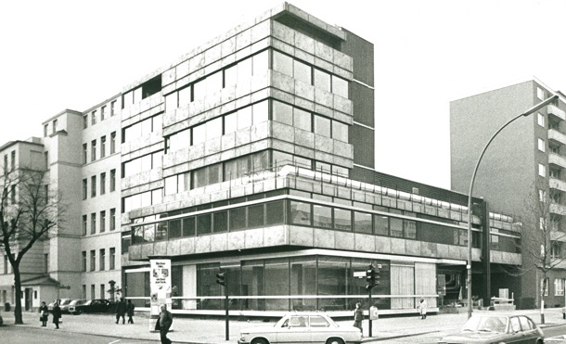
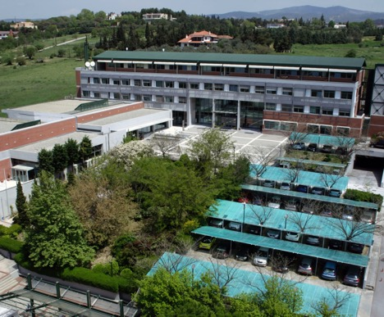


Who we are what we do
one of the first ‘decentralised’ EU agencies
specialising in vocational education and training (VET), skills and qualifications policy
set up in 1975 in Berlin, founded upon the initiative of the EESC
moved to Thessaloniki
in 1995

Slide 3



Why recognition matters
Europe faces
labour and skills shortages
Builds trust
between countries
Helps people use
their qualifications across borders
Supports labour mobility and the
single market
Recognition helps
access jobs and
further learning

Slide 4


Why focus on VET
Many shortage jobs require vocational skills
Skills exist
but are not always recognised
Demand for recognition
is increasing
Recognition in VET is less developed than in higher education

Slide 5




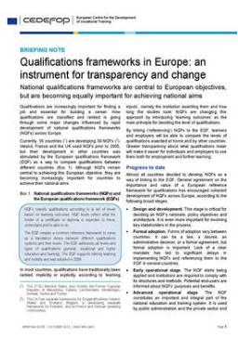


Cedefop’s work
2009 The shift to learning outcomes
2018 Analysis and overview of NQF level descriptors in European countries
2022 Comparing vocational education and training qualifications
2024 Transparency and transferability of learning outcomes: a 20-year journey
2012 Qualifications frameworks in Europe: an instrument for transparency and change
2020 Overview of national qualifications framework developments in Europe 2020
2023 European guidelines for validating non-formal and informal learning

Slide 6

Tools
Professional Qualifications Directive European Qualifications Framework (EQF) National Qualifications Framework (NQFs) ESCO (European Skills, Competences, Qualifications and Occupations) classification Europass Lisbon Recognition Convention (LRC) Recommendation on Automatic Recognition European Learning model
And challenges
Many EU tools developed to support transparency
Landscape remains complex for individuals and employers
Terms and procedures differ across countries
Not all tools are well known

Slide 7



Recognition practices for VET qualifications
Fragmented practices within and across countries
Automatic recognition is rare
Case‑by‑case assessment is common
Information and documentation can be limited
Demand is increasing but coordination is limited

Slide 8


Addressing mutual trust
Trust between systems is essential
Countries focus on differences rather than similarities
Limited transparency on recognition decisions
Limited cooperation between countries
Need more information sharing and openness

Slide 9


Priority solutions
Approaches focusing on individuals and employers
Simpler recognition systems and better coordination between actors
Stronger European cooperation
Better use of digital tools and AI
Clearer descriptions of qualifications

Slide 10


Taking work further
Forthcoming study: From comparison to recognition - Developing a methodology for the recognition of VET qualifications across Europe
map and analyse national policies and practices related to the comparison and recognition of VET qualifications and skills, with a particular focus on access to employment and pathways to further learning.
develop a user-oriented methodology to support the recognition of foreign VET qualifications across the EU.

Slide 11
Images licence: stock.adobe.com, slide 2 stock.adobe.com and Cedefop

