Slide 1
Current and future VET and labour market trends
Inspiration for the EU VET strategy
Jasper van Loo, Coordinator Department for VET and Skills
Notes:
Welcome, thank you

Slide 2
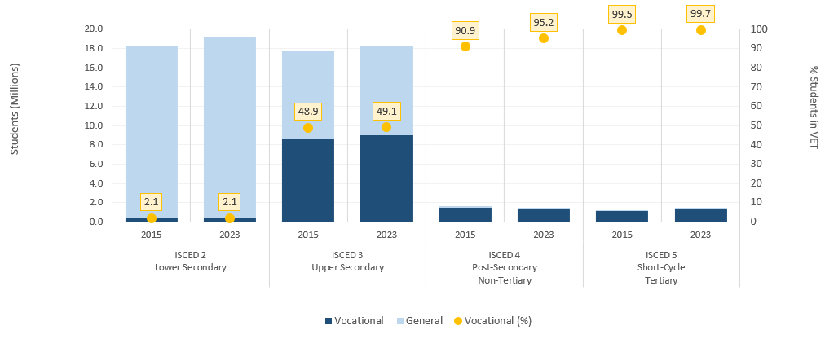

VET remains strong: students in 2015 and 2023 by ISCED level
Source: Cedefop's calculations based on Eurostat, UOE data on formal education

Slide 3
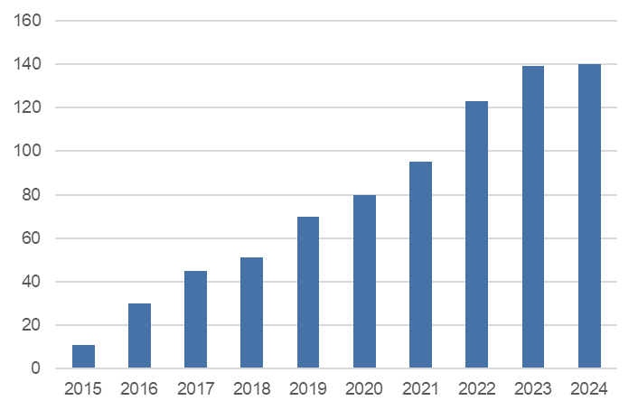
How VET attractiveness became a priority and why it needs to remain key
Number of policy actions/measures promoting VET attractiveness in EU Member States and Norway and Iceland, 2015-24
Persistent issues
Gender imbalances
women underrepresented in science (45% of VET enrolment), IT technology (14%), engineering (15%)
Overrepresented in education (89% of VET enrolment), health and welfare (82%), and social sciences (60%)
Teacher shortages
discourage people from entering the teaching profession
cause some teachers to leave the field
Create a vicious cycle of low-quality education that reinforces inequalities.
Source: Cedefop policy reporting based on ReferNet VET monitoring

Slide 4
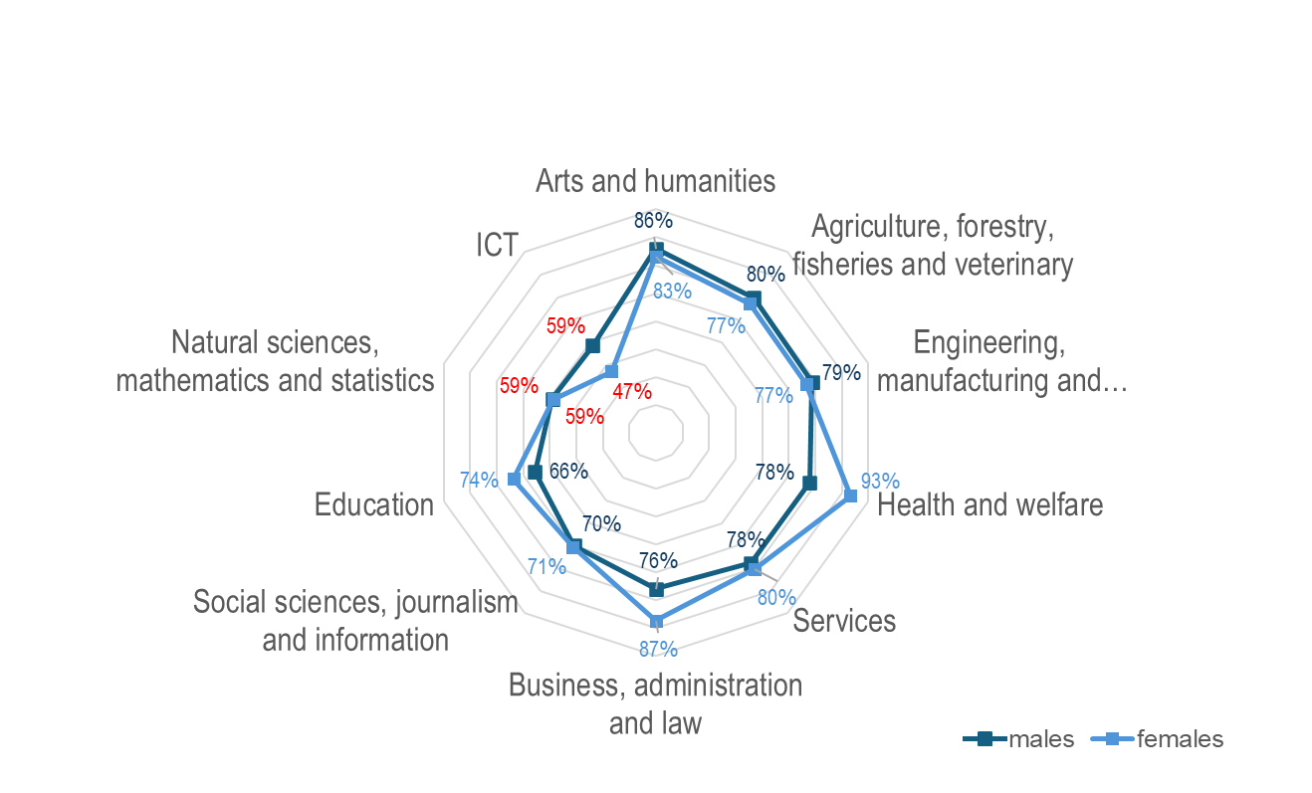
Mean completion rate in upper secondary are low in shortage fields
Mean completion rates in upper secondary VET by field of study and gender, EU27. Source: Cedefop policy brief on VET attractiveness (in publication)

Slide 5
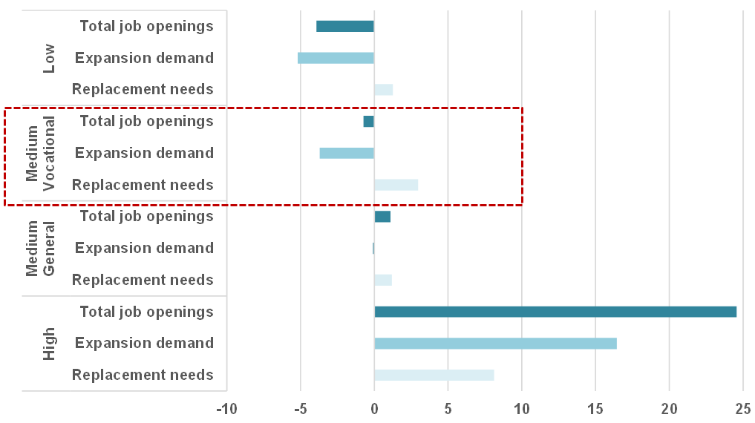
Europe relies on high quality VET - job opportunities by qualification until 2035
Stable demand for medium-VET
General and Vocational
Source: Cedefop Skills Forecast, 2026

Slide 6
Notes:
Thank you

