Slide 1
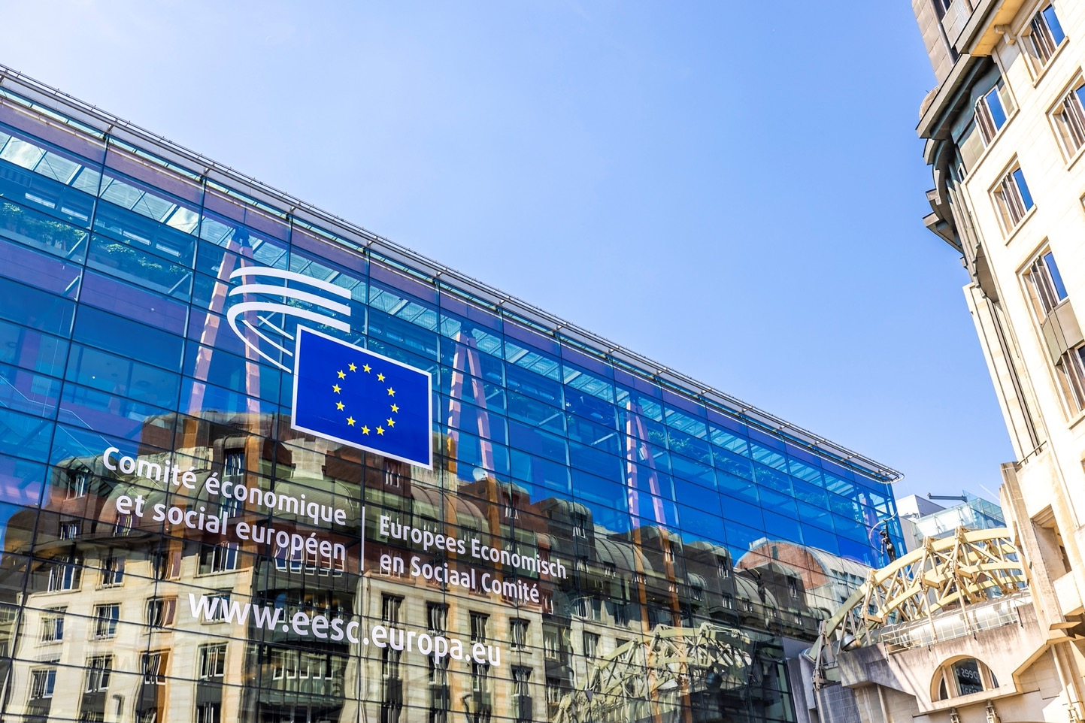
WELCOME

Slide 2
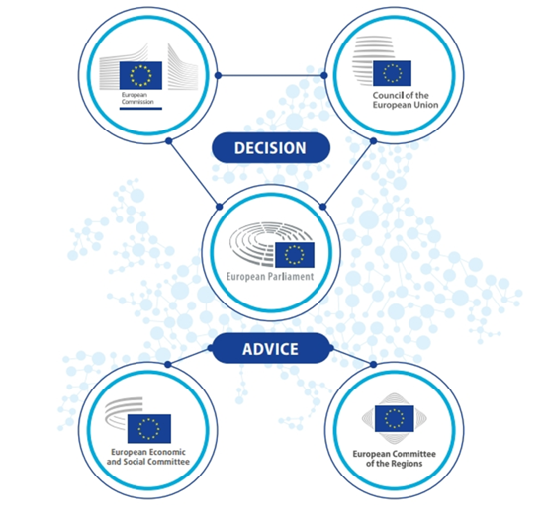
The European Economic and Social Committee is a consultative body that represents organised civil society.
“The European Parliament, the Council
and the Commission shall be assisted by
an Economic and Social Committee
and a Committee of the Regions acting
in an advisory capacity.”
Treaty on European Union, Article 13

Slide 3
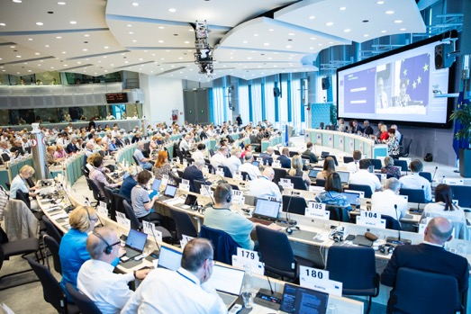
AN ASSEMBLY OF 329 MEMBERS FROM
ALL MEMBER STATES OF THE EUROPEAN UNION
Appointed for a renewable five-year term by the Council on a proposal from each Member State.
Independent (= not politically affiliated) and acting in the interests of all EU citizens.
Not based full-time in Brussels: most continue working for their home organisations in their country of origin. Their travel and accommodation costs are covered by the EESC.

Slide 4
WHAT DOES ORGANISED CIVIL SOCIETY MEAN?
  It comprises all the groups and organisations in which people work collaboratively:
Employers (107)
Workers (110)
Civil Society Organisations (110)
Employers’ federations,
Chambers of Commerce,
SMEs’ organisations
Representing Farmers, Consumers, Young people, the Professions, Disabled people, Academics, Cooperatives, NGOs, …
Trade Unions
  They are committed to defending their groups’ (or their communities’) interests and causes, and often act as intermediaries between decision-makers and the general public.
* Two members are not affiliated to any of the three groups

Slide 5
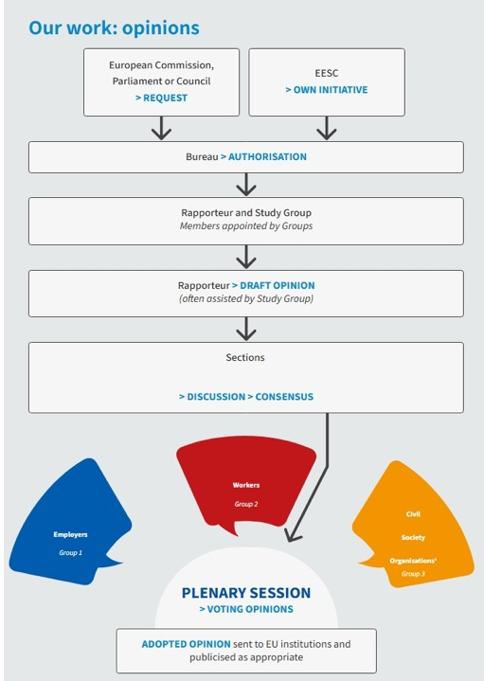
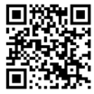

WHAT DOES THE EESC DO?
The European Parliament, the Council of the EU and the European Commission are legally obliged to consult the EESC when passing new laws. Consultation can cover a wide range of topics.
EESC members, representing all three Groups, debate, consult and reach a consensus, set out in a single document called an “opinion”, on the proposed legislation.
After an opinion is adopted, it is sent to the EU institutions to be discussed and published in the EU’s Official Journal (24 languages).
The rapporteur presents the EESC opinion’s key findings and promotes it at EU, Member State and local level.
In total, the EESC issues around 200 opinions every year.
Scan the QR code to find out more!

Slide 6
WHY IS THE EESC IMPORTANT FOR THE EU?
The Committee is the only institutional meeting place and forum for dialogue at European level that enables consensus to be reached between diverse interests. It is the only way for Europe’s interest groups to have a formal say in draft EU legislation within an interinstitutional framework.
This participation by civil society organisations is a fundamental element of European democracy:
participatory democracy.
Many topics affecting people’s daily lives are covered: employment, health, consumer rights, farming, the fight against organised crime, etc.

Slide 7



WORKING BODIES: 6 SECTIONS & 1 COMMISSION
External Relations
Transport, Energy, Infrastructure and the Information Society
Agriculture, Rural Development and the Environment
Civil Society dialogue with third countries
Enlargement
Trade
Neighbourhood relations
International cooperation
Affordable and clean energy
Sustainable and smart transport
Decent, accessible and affordable housing
Spatial planning for the general public and civil society
Sustainable food system
Climate action
Environment and biodiversity
Agriculture
Sustainable development - general
Sustainable rural and urban development

Slide 8




WORKING BODIES: 6 SECTIONS & 1 COMMISSION
Economic and Monetary Union and Economic and Social Cohesion
Employment, Social Affairs and Citizenship
Single Market, Production and Consumption
Consultative Commission on Industrial Change
Economic and Monetary Union
Financial and capital markets
Taxation
EU budget and own resources
Cohesion and urban policy
Statistics
Employment
Social inclusion
Citizenship
Social protection
Equal opportunities
Consumer protection
Single Market
Enterprises
Industrial policy
Financial services
Research and innovation
Sectoral industrial policies, e.g. defence, water, health, energy-intensive industries, robotics
Industrial & technological foresight
Critical raw materials
EU Blue deal coordination

Slide 9


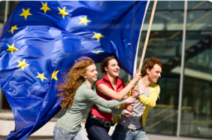
OTHER WORKING BODIES
Observatories
Sustainable Development Observatory (SDO)
Single Market Enforcement Observatory (SMEO)
Labour Market Observatory (LMO)
Ad-hoc Groups
Group on the European Citizen’s Initiative
EESC Youth Group
Group on Equality
10 Permanent Groups
connected to the sections’ activities

Slide 10
RECENT SUCCESS STORIES
This series of recent success stories aims to show the EESC’s impact on EU legislation, where we have brought essential civil society issues to the EU and where we have established ourselves as key players
Calling for secure access to social and affordable housing for all
Leading the call for an EU Water Strategy
Ensuring that trade agreements benefit all sections of society
The EESC’s demands shaped the Liège Declaration of March 2024, adopted at the European Conference of Housing Ministers under the Belgian Presidency of the Council.
In 2023, the EESC launched the EU Blue Deal – the first major call for a unified EU water policy. This initiative not only identifies Europe’s water issues, but also delivers a clear and concrete roadmap for tackling them.
The EESC was appointed by the European Commission as the secretariat for all the EU’s Domestic Advisory Groups (DAGs), led by chief coordinator Tanja Buzek, EESC member.
Upholding the right to affordable energy for everyone
Placing the right to repair at the core of the EU’s consumer protection policy
Calling for an EU action plan
on rare diseases
The EESC’s recommendation for a European Poverty Observatory led the European Commission to create the Energy Poverty Advisory Hub (EPAH).
In 2023, the Commission submitted the legislative proposal on the ‘Right to repair’ as part of the New Consumer Agenda. It addresses obstacles that deter consumers from repairing products.
Through a series of recommendations and conferences, the EESC has pushed to ensure that an EU action plan on rare diseases is included in the next Commission’s work programme.

Slide 11
RECENT SUCCESS STORIES
Incorporating young people’s views
in EU decision-making
Making it mandatory to consult civil society on necessary economic reforms
Bringing food policy to the EU table
In 2022, the EESC became the first EU institution to commit to the EU Youth Test, a pioneering tool to mainstream youth participation in policy-making.
In 2023, the European Commission submitted a proposal to reform the EU’s economic governance framework in order to address today’s economic challenges. The EESC had issued pivotal recommendations which significantly shaped the final legislative package.
In 2024, the EESC adopted recommendations for the post-2027 common agricultural policy, pushing for more sustainable food options that are both accessible to EU consumers and affordable for socially vulnerable groups.
Driving the future of sustainability with the European Circular Economy Stakeholder Platform
Leading the way in just transition
... and many more!
In 2023, the EESC’s ad hoc group on the UN Framework Convention on Climate Change (UNFCCC) contributed to the Just Transition Work Programme (JTWP) by directly influencing the positions of EU Member States and the Commission.
Check out other recent achievements at eesc.europa.eu
In 2017, in partnership with the European Commission, the EESC launched the European Circular Economy Stakeholder Platform (ECESP).

Slide 12

MULTILINGUALISM AT THE COMMITTEE
The EU’s motto - United in Diversity - truly comes to life in multilingualism at the EESC.
We deeply value and actively promote the use of all 24 official EU languages.
To support this, our members have the right to work in their own language, both in speech and in writing.
All EESC opinions, official documents and most digital content are made available in every language, thanks to the work and dedication of our Directorate for Translation.

Slide 13



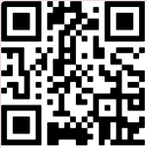
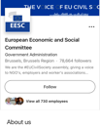



DO YOU HAVE ANY QUESTIONS?
Scan the QR for the evaluation form
Want to reach out? Email us at visitEESC@eesc.europa.eu
Follow us for more:
European Economic and Social Committee
@eu_civilsociety
@eesc.bsky.social
Keep in touch!
EESC - European Economic and Social Committee
@EU_EESC
@EurEcoSocCommittee

Slide 14
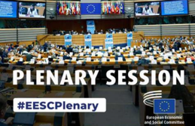

Members Page
Follow-up on Opinions
Full list of current EESC Members and CCMI delegates
Action taken on EESC opinions
EESC Opinions
ANNEX:
ADDITIONAL INFORMATION
Plenary sessions
Opinions currently in the spotlight
How to follow an EESC Plenary Session
Work with us!
Twice a year, the EESC offers 5-month paid traineeships in various fields
The lifecycle of an opinion
What Europe does for me
CESlink
How EESC opinions are drafted (video)
Impact of the EU’s actions on the everyday life of Europeans
Online community of national Economic and Social Councils

Slide 15
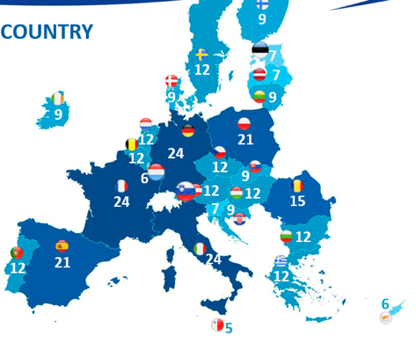
MEMBERS BY COUNTRY
As with other European institutions, the EESC’s geographical representation is proportional, meaning that more populous countries are allocated a greater number of members to represent them.
So France, Germany and Italy have the most members (24), while Malta has the fewest (5).
GENDER BALANCE
The EESC's 2025-2030 term of office will have the highest number of female members since statistics on membership began in 2010.
There is a higher percentage of women at the Committee than ever before: 39%, compared to 33% in 2020 and 28% in 2015 – an upward trend!

Slide 16

WHAT DOES THE EU DO FOR YOUNG PEOPLE?
Speak
You can take part in youth events like the EU Youth Dialogue, the European Parliament's European Youth Event (EYE), and Your Europe, Your Say! here at the European Economic and Social Committee.
You can make your voice heard!
Work
You can apply for jobs anywhere in the European Union as of the age of 18. The EURES scheme connects you with employers across the EU, Norway and Iceland.
Explore
Thinking about a job in the EU institutions or another EU country?
Each year, the EU offers paid traineeships to young university graduates.
Study
You are entitled to study at any EU university under the same conditions as nationals of that country.
The ERASMUS programme allows you to do part of your university studies abroad.
Travel
The border-free Schengen Area gives 400 million EU citizens free movement between countries. For instance, the INTERRAIL train pass allows you to reach over 40 000 destinations in 30 countries.

Slide 17





EESC YOUTH INITIATIVES
EESC Youth Group
Your Europe, Your Say!
Study on youth participation at various levels
Created in 2023 to boost youth participation in EU policy-making, it brings together EESC members and youth organisations in order to take on board young people’s views, apply the EU Youth Test (→), and coordinate youth-related initiatives.
YEYS is the EESC’s annual youth event that brings together students from all EU Member States and candidate countries to engage with the European Union. Since 2010, young participants have come to Brussels to debate, exchange ideas, and draft resolutions reflecting their vision for Europe’s future, which are then shared with EU institutions.
EU Youth Test at the EESC
The EU Youth Test is a tool aimed at ensuring that young people participate more in policy-making. At the EESC, this means for example involving youth representatives in opinions. If an organisation expresses interest in an opinion, other involvement could be foreseen as well, such as providing input on the topic via email, a meeting with EESC members, etc.
​
Youth Climate and
Sustainability Round Tables
Youth Delegate to COP
An EESC initiative that involves a young representative joining the EU delegation to UN climate and biodiversity conferences. The youth delegate, selected through an open process every two years with the European Youth Forum and Generation Climate Europe, contributes to EESC work on climate policy before, during and after COP meetings, ensuring that young people’s views are heard in international climate and sustainability discussions.
An EESC initiative held twice a year to foster dialogue between young people and EU decision-makers on climate and sustainability. Organised with the European Commission and youth networks, these meetings ensure that young people’s proposals are heard and are given concrete follow-up.
Notes:
For some years now, the EESC has been working on how to better integrate the voice of young Europeans in its work and in the EU decision-making process in a structured and meaningful way

Slide 18
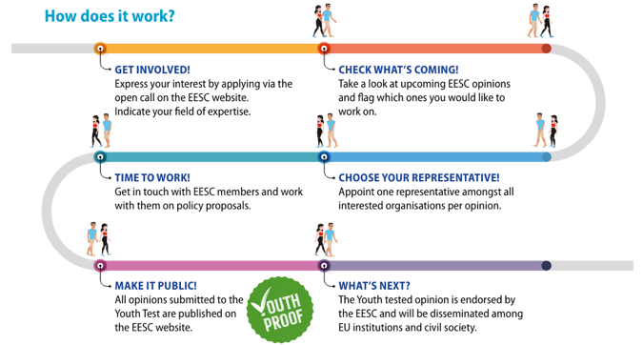


THE EU YOUTH TEST AT THE EESC
The Youth Test is a tool designed to strengthen youth participation and youth mainstreaming in policy-making. This means that, at the EESC, young people’s representatives can be involved in preparing the EESC’s policy recommendations:
Participating in meetings and hearings
Providing written contributions
Monitoring the follow-up to the opinion

Slide 19
AT THE HEART OF EU DECISION-MAKING
The European Parliament, the Council of the EU and the European Commission are legally obliged to consult the EESC when passing new laws on a wide range of topics in the following domains:
Agriculture and fisheries Common rules of competition, taxation and approximation of laws Consumer protection Economic, social and territorial cohesion Education, vocational training, youth and sport | Employment Energy Environment European Social Fund Free movement of persons, services and capital Health and Safety Industry Investment | Non-discrimination and citizenship of the Union Nuclear common market Public health Research and technological development and space Social Policy Trans-European Networks Transport

Slide 20
Groups
Group on Fundamental Rights and the Rule of Law
Group on the European Semester
Group on the Conference of the Parties to the United Nations Framework Convention on Climate Change
Group on Services of General Interest
Group on Energy
Group on Transport
Group on Immigration and Integration
Group on Inclusion of the Roma
Group on Disability Rights
Group on Sustainable Food Systems

