Slide 1
The impacts of non-EU distance selling on businesses and society
European Consumer Day 2025

Slide 2
The volume of small goods flowing from China has increased explosively over a couple of years
Customs estimate that the volume of e-commerce shipments flowing from China is no longer manageable: appropriate inspections to ensure the safety of products have become impossible.
"We can no longer ensure that the products are safe. No separate intensive monitoring would pay itself back," says Sami Rakshit, Director General of Customs.
The concern of Customs is understandable, as a total of more than 28 million e-commerce shipments arrived in Finland last year. 98 per cent of these shipments came from China, and this year, the volume is expected to exceed 50 million parcels.
Shipments to Finland
million pcs
The statistics apply to shipments worth less than EUR 150.
Source: Customs
Source: Tullin pääjohtaja esittää villin idean – Kielto iskisi Temuun | Kauppalehti

Slide 3

Third country ecommerce avoids regulations and cost that apply to shops operating in the EU

Slide 4
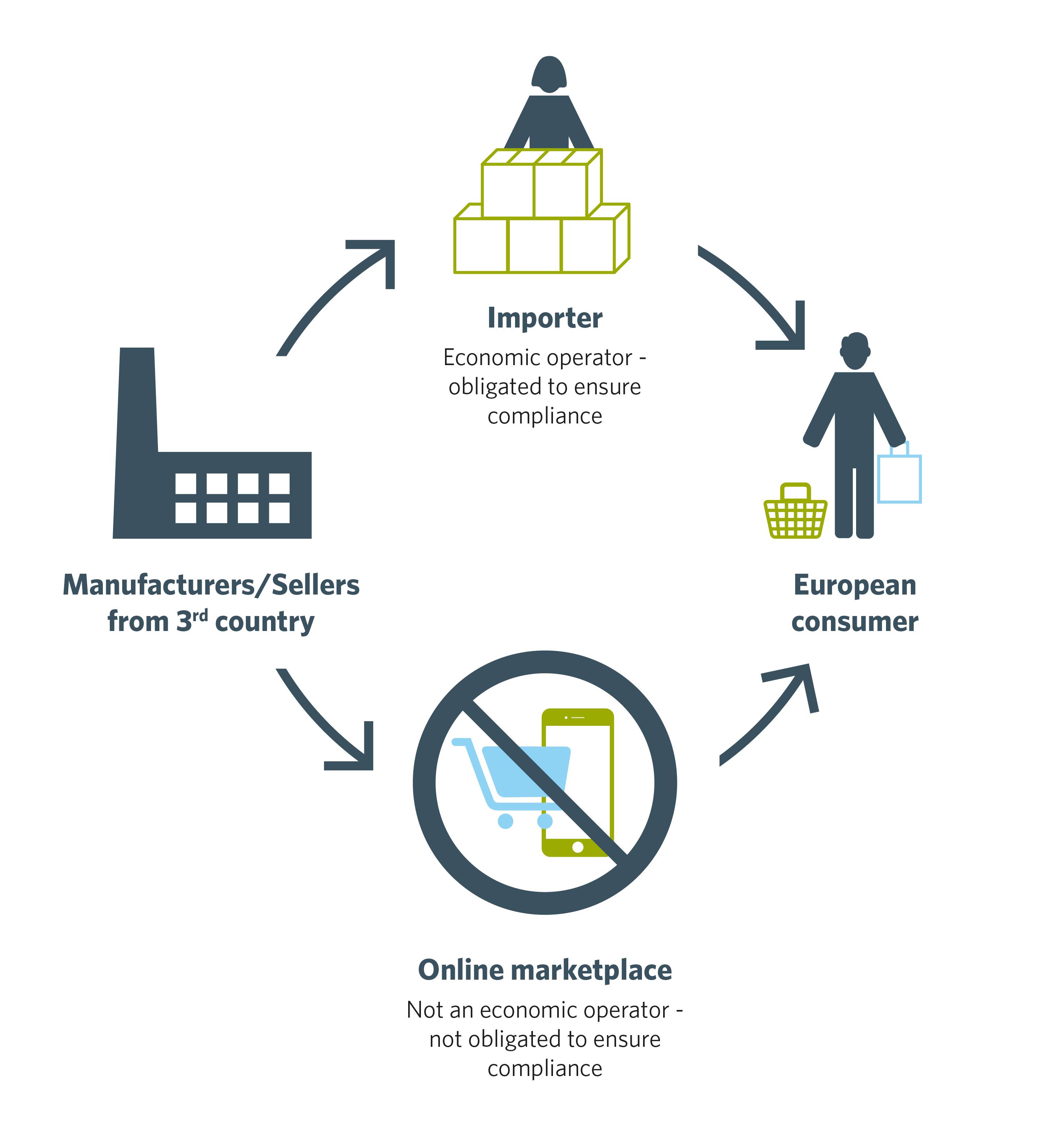
Different sales channels
In case of third country ecommerce, consumer is the importer

Slide 5




Third country ecommerce avoids the costs that apply to stores operating in the EU
Distortion of competition is caused by, among other things:
Product safety related costs
Relief from customs duty for distance selling up to EUR 150
Compliance with intellectual property rights
Compliance with consumer protection
Recycling costs
Compliance with data protection
Possible government support for platforms

Slide 6
Complying with product safety causes significant costs for stores
Average purchase price of a similar product from an Asian manufacturer compared to the purchase price paid by a Finnish company
Purchase price of a product that meets EU standards for Finnish retail trade, when the costs include the company’s self-monitoring and externally purchased audits
Purchase price from an Asian manufacturer without requirements for EU standards and self-monitoring or purchased audits.
65
70
61
66

Slide 7

Third country ecommerce causes problems to Finnish society

Slide 8






Third country ecommerce causes problems in Finnish society
Fewer jobs
Lower tax revenue
Compromised circular economy
Inadequate product safety
Loss of headquarters and the impacts on subcontracting chains

Slide 9
Background to the calculations
Basis for calculating the potential loss of VAT revenue:
Customs' statistics on the distance selling of low-value products worth less than EUR 150 to Finns in 2024.
In the assessment, the 100 most purchased commodity codes were used and the price of a product representing a class of goods was searched from Statista’s service and the online stores operating in Finland: Prisma, Tokmanni, Kärkkäinen, Motonet, Glitter, Keskisen Kello, LevykauppaÄx, Verkkokauppa.com and Suomalainen Kirjakauppa.
The average general VAT rate in 2024: 24.5 per cent (the rate was increased from 24 to 25.5 per cent on 1 September 2024)
Basis for calculating the potential loss of income tax revenue:
Share of labour by sector: Statistics Finland’s input-output statistics.
Income tax bases and tax-like payments in 2025.
Corporation tax rate 20 per cent.

Slide 10


Chinese junk decreases the tax revenue of Finland Note! The calculations do not take into account any taxes paid on the shipping fees for consumer parcels to Finland. The calculation would have been difficult to implement because the shipping fee is often EUR 0 for orders placed through Temu, for example.
Last year, the tax revenue received by Finland from online purchases worth less than EUR 150 made from outside the EU was EUR 29.4 million. **
If only 30 per cent of the online purchases had been replaced by purchases made in Finland, the tax revenue* remaining in Finland would have been EUR 97.2 million, which is more than three times higher than the tax revenue received by Finland.
If 100 per cent of the online purchases worth less than EUR 150 made from third countries had been replaced by purchases made in Finland, the tax revenue* remaining in Finland would have been EUR 324.2 million, which is more than 11 times higher than the tax revenue received by Finland.
*labour taxes, corporation tax, VAT
**Import VAT reported in the IOSS system.

Slide 11


Example: Women’s shirt
Price in a Chinese online store:
EUR 11.24 *
Taxes to Finland:
EUR 2.29 **
Price in a domestic specialty goods store:
EUR 32.00
Taxes to Finland:
EUR 13.10 **
* The shipping fee for the consumer is typically EUR 0.
** Labour taxes and corporation tax EUR 0, VAT EUR 2.29.
** Labour taxes EUR 6.1, corporate tax EUR 0.5, VAT EUR 6.5.
In addition, a possible online store delivery fee of EUR 4.5-6.9.

Slide 12
Background to the example calculations
Basis for the cost breakdown for a women’s shirt made in Asia:
The impact of costs related to compliance with EU standards on the purchase price: Finnish Commerce Federation member survey 2024.
Posti’s price list for the transport costs of e-commerce.
The distribution of costs in specialty goods trade: Finnish Commerce Federation, 10 February 2025.
The tax handprint of a women’s shirt purchased through different channels in Finland.
Share of labour by sector: Statistics Finland’s input-output statistics.
Income tax bases and tax-like payments in 2025.
VAT rate 25.5 per cent.
Corporation tax rate 20 per cent.

Slide 13

The problems must be addressed both on EU level and nationally.

Slide 14

There are solutions to the problems of distance selling outside the EU
At the EU level
Increasing the responsibility of platforms
In Finland
Clear responsible party in the central government
Accelerating the customs reform
Targeting and enhancing supervision
Solving the producer responsibility problem
Increasing the Commission’s supervisory powers
Supporting the innovations and competitiveness of commerce
Educating consumers
Strengthening purchasing power
Improving implementation and coordination

Slide 15

Holding platforms responsible and enforcing rules on EU level
Online marketplaces must be assigned more responsibility for the products and services sold via them.
Key tools are Digital Services Act (DSA) and New Legislative Framework (NLF)
Nordic White paper on E-commerce from 3rd countries - The role of online market places
Bringing platforms more closely under producer responsibility
through Extended Producer Responsibility (EPR)
The removal of the EUR 150 duty-free limit for goods purchased from outside the EU must be urgent and other reforms under customs reform
Threshold implementation should be effective during 2026
However, proper implementation may take years.
The scope and responsibilities of the “deemed importer” concept remain unclear also the amount of handling fee
The Commission’s enforcement powers should be extended to the market surveillance of e-commerce outside the EU.
The national authorities do not have sufficient prerequisites to intervene in their operations or address any issues that have emerged.
Key tools are Consumer protection cooperation regulation (CPC) and Market Surveillance Regulation (MSR)

Slide 16




More information from the experts of the Finnish Commerce Federation
EU Affairs and corporate legislation:
Tiina Vyyryläinen, Chief Policy Adviser
tel. +358 50 606 74, tiina.vyyrylainen@kauppa.fi
Circular economy and environmental legislation:
Marja Ola, Chief Policy Adviser tel. +358 50 383 7711, marja.ola@kauppa.fi
Customs and tax legislation:
Toni Jääskeläinen, Chief Policy Adviser
tel. +358 50 533 0619, toni.jaaskelainen@kauppa.fi
Calculations and their analysis:
Jaana Kurjenoja, Chief Economist,
tel. +358 40 820 5378, jaana.kurjenoja@kauppa.fi

