Slide 1

The 2026 European Semester Autumn Package
38th European Semester Group meeting
09/12/2025
Naïm Cordemans, European Central Bank, Representative Office in Brussels
Disclaimer: Views expressed in this presentation do not necessarily reflect those of the ECB.

Slide 2
Monetary Policy Statement of 30 October 2025
Fiscal and structural policies should boost productivity, competitiveness and resilience.
It is essential to implement the European Commission’s competitiveness roadmap swiftly.
Governments should prioritise growth-enhancing structural reforms and strategic investment, while ensuring sustainable public finances.

Slide 3
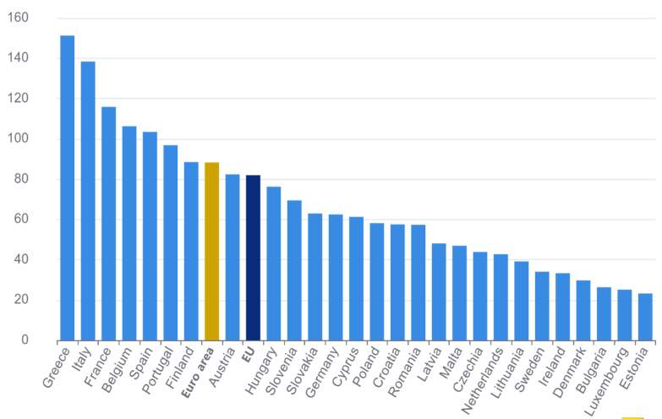
Policy challenges: doing more with less
General government debt (% of GDP)
The EU is facing unprecedented challenges (green and digital transitions, ageing, economic security, competitiveness and defence)
Limited fiscal space in countries with debt challenges
Euro area fiscal position has recently improved, but remains under pressure
Source: European Commission

Slide 4
Europe must build on its strengths …
A resilient economy, with a strong labour market and inflation under control
A highly educated workforce and world-class research institutions
A diversified production structure
Strong institutions and a predictable legal environment
High savings and a robust financial sector

Slide 5
... to do better (1)
Tap remaining reserves of growth and higher productivity: build a genuine S&I Union to mobilise private capital and remove remaining barriers in the Single Market
Adopt a more sustainable and growth‑friendly fiscal policy:
  Shift towards taxes less harmful to growth and that fairly support the green transition
  Use flexibility offered by the new EU fiscal rules to prioritise productive public investment (R&D, education) and structural reforms that boost productivity and long‑term growth
  Fiscal consolidation must not jeopardise future prosperity: Europe needs investment to generate the productivity gains that can sustain its social model and ageing population

Slide 6
... and do better (2)
III. Deploy collective resources more efficiently:
  Europe faces unprecedented investment needs to finance the green, digital and defence transitions. Together, these are estimated to require an additional €1.2 trillion of spending per year between now and 2031
  We should explore the way to pool national resources in high‑multiplier, cross‑border areas (notably R&D, energy and defence) where Europe needs to build strategic capabilities and can reap clear economies of scale
  EU budget instruments should be used to mobilise private capital

Slide 7
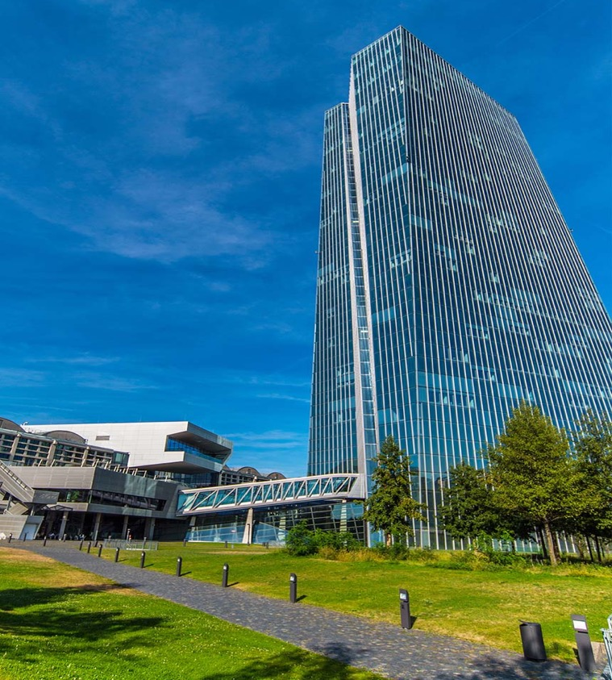
Thank you for your attention!

