Slide 1
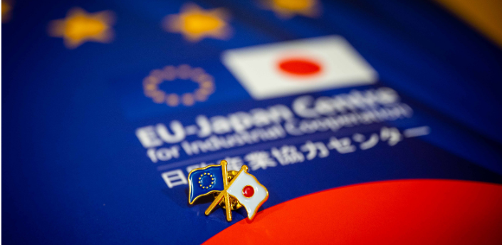
EU-Japan Economic Partnership Agreement (EPA)
6th Joint Dialogue with Civil Society
Trade and Sustainable Development
📍 Brussels, 23 June 2025
🕘 9:00–13:00 (16:00–20:00 Tokyo)

Slide 2
Main topic and background
Trade and Labour:
✅ Upholding high labour standards
✅ Effective implementation of ILO Conventions
EPA in force since February 2019
Japan has reported progress on ILO Convention ratification
Focus: not just ratification but real implementation
EPA Article 16.3
“Each Party shall make continued and sustained efforts on its own initiative to pursue ratification of the fundamental ILO Conventions and other ILO Conventions which each Party considers appropriate to ratify”

Slide 3
Fundamental ILO Conventions: the ILO CAS cases C87 and C98
Labour rights of Japan's public service employees
Restrictions from 1948 still in place
Violations of ILO Conventions 87 and 98
No meaningful reform after 77 years
In Japan, the legislation still maintains restrictions on the basic trade union rights of public employees that are incompatible with principles of freedom of association and collective bargaining, including firefighters, prison staff, and civil servants
Reports by:
📌 Committee of Experts on the Application of Conventions and Recommendations
📌 Committee on Freedom of Association

Slide 4
Conclusion
📣 Under EPA Articles 16.15 & 16.16
📝 EU DAG calls for:
sound and steady implementation of ratified conventions
fully respect ILO monitoring body reports and recommendations
🔍 Full implementation of core labour rights is a cornerstone of the EPA’s credibility
🤝 Ongoing dialogue and international supervision remain essential tools

