Slide 1
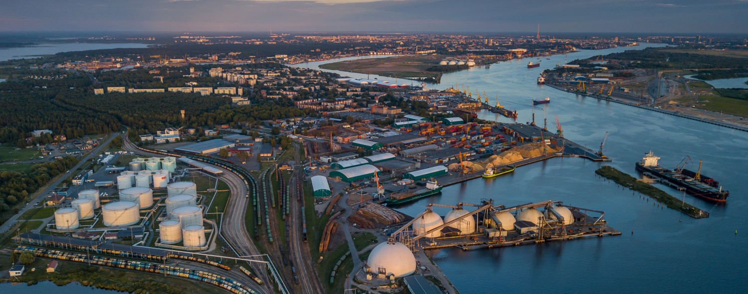
'Economic Impact of the Implementation of the EU Emissions Trading System (ETS)’ 10/06/2025
Tim Verhoeven - European Sea Ports Organisation
Port of Rotterdam © Freek van Arkel

Slide 2
European Sea Ports Organisation
ESPO represents the port authorities, port associations and port administrations of the seaports of 22 Member States of the European Union including Norway at EU political level.
ESPO also has observer members in Albania, Iceland, Israel, Montenegro, Ukraine and United Kingdom.
ESPO
The first port of call
for European transport policy makers in Brussels
A knowledge network
that drives ports to perform better

Slide 3
Past Role of Ports: Traditional Functions
      Basic Infrastructure: Cargo handling, storage, and logistics.
      Regulatory Role: Customs, border control, and maritime safety.
      Local Economic Hubs: Supporting regional trade and employment.

Slide 4
Present & Future Role: Strategic Enablers
      Energy Transition Hubs:
          Import/export of renewable energy (e.g., hydrogen, wind components).
          Basis infrastructure (pipelines, …)
          Support for offshore wind and ocean economy.
      Decarbonisation partners & facilitators
          Electrification of port operations.
          Green corridors for shipping.
          CCS
      Climate Resilience Frontlines:
          Infrastructure upgrades to withstand extreme weather and sea-level rise.
      Critical Defence Infrastructure:
          Strategic logistics for European defence and security.
          Dual-use capabilities for civil and military operations.

Slide 5
Key Challenges Ahead
      Climate Resilience: Adapting infrastructure to climate change.
      Energy Transition: Scaling up green energy logistics. Grid, Basic Infrastructure (80 billion investment needs)
      Decarbonisation: Reducing emissions in port and maritime sectors.
      Safety & Security: Cybersecurity, physical protection, and geopolitical risks.
      Competitiveness: ships can move, ports cannot move
      Conundrum: ports considered as “undertakings” but must absorb (all) costs of public interest roles
  → Major and costly challenges

Slide 6
Impact of ETS
Financial impact for shipping is real: Cost differences are significant when rerouting. And shipping is a competitive business. --> Competitive disadvantage for ports,
Operational impact: extra stops from far-east takes extra time
Strategic control over transshipment in danger: Transhipment ports often in strategic geopolitical locations (difficult to keep these state of the art if no economic base)
Loss of cargo outside EU will affect competitiveness of EU ports & jeopardise investments that come with crucial challenges.
Counterproductive effect on emissions: modal shift to road, longer sailing routes and extra stops can lead to more emissions. Needs to be monitored!

Slide 7
ETS and Fuel EU
    We fully support the decarbonisation strategy of Europe
    BUT: EU local shipping measures → concern about carbon & business leakage
    → Support the global approach for decarbonising shipping under IMO
              Need for maximal alignment
              Avoid overlap and double counting

Slide 8
ESPO’s 9 Priorities for Europe’s Seaports (2024–2029)
Ports as Enablers of a Net-Zero, Smart, and Resilient Europe
      Effective Implementation
      Ensure coherent, supportive application of EU regulations.
      Energy Transition Leadership
      Empower ports to facilitate renewable energy and circular economy.
      Emission Reduction
      Support global GHG pricing and prioritize green investments.
      Level Playing Field
      Safeguard competitiveness and fair access to funding.
      Resilience & Security
      Strengthen ports’ role in supply chain sovereignty and foreign influence control.
      Digital & Cybersecurity
      Advance smart port operations and cyber resilience.
      Investment Support
      Secure €80 billion over 10 years with dedicated EU funding.
      Workforce & Skills
      Attract talent, promote diversity, and upskill for the green and digital transition.
      Port-City Relations
      Foster sustainable integration with surrounding communities.

