Slide 1

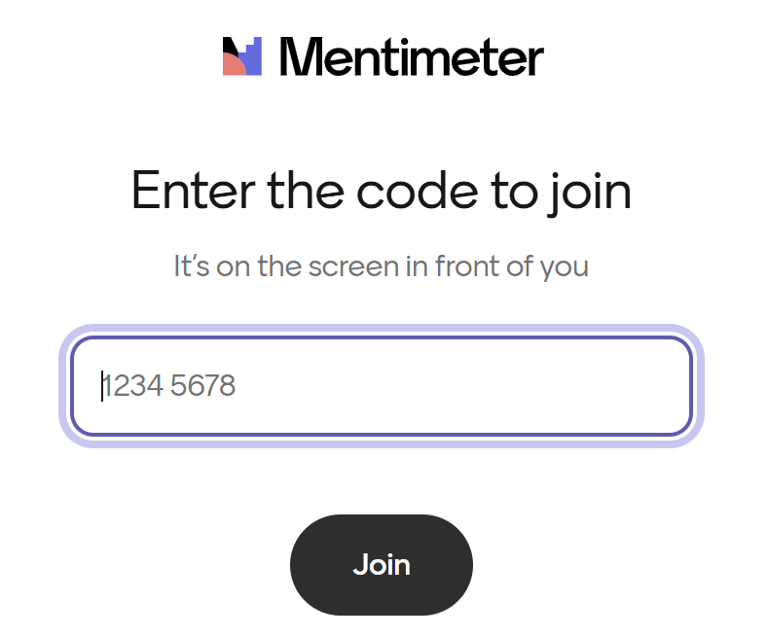
Preparation for Part II on AI:
Please can you go to www.menti.com and enter the following code: 5170 3137
This allows you later during the workshop to join a short poll with some questions on AI

Slide 2




EU-Japan Joint Dialogue with civil society under the EU-Japan Economic Partnership Agreement (EPA) WORKSHOP
Artificial Intelligence and its impact on the workplace, employment and competitiveness
24 June 2025
Organised by:
Moderator:

Slide 3
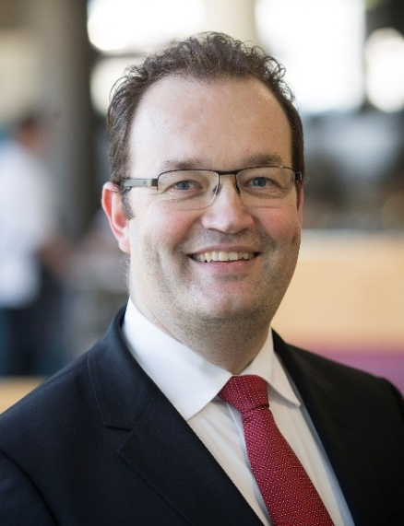
Moderator: Dr. Koen Berden
Senior Fellow at ECIPE, Managing Director Trade Impact BV, Assistant professor Erasmus University Rotterdam and College of Europe
Chairman of the Institute for International and Development Economics (IIDE), Senior fellow of the Transatlantic Policy Network (TPN), Member of the Supervisory Board of Clingendael
Executive Board member Women Economic Forum and Chairman of the Foundation Children for the Earth
Former: Executive Director International Affairs, EFPIA; Senior partner, Managing Director Ecorys Netherlands, Chief Innovation Officer and Chief Economist Ecorys Group, Vice-Rector Skarbek University
Over 25 years of experience in working on international trade in goods, services, FDI, public procurement, SMEs, Trade & Sustainable Development, geopolitical analysis, WTO law, competitiveness, IPR, economic security, Artificial Intelligence, critical raw materials, ex-ante and ex-post impact assessments of EU trade policy
International Baccalaureate at UWC of the Atlantic: 1992-1994
MSc Erasmus University Rotterdam (1998)
PhD Tinbergen Institute, Erasmus University Rotterdam (2006)

Slide 4
Workshop programme
10.45 – 10.50 Introduction
10.50 – 11.30 Session 1: Introduction to AI in the workplace
11.30 – 12.05 Session 2: The AI-driven workplace and AI and employment: opportunities and challlenges
12.05 – 12.45 Session 3: AI as a driver for growth and competitiveness
12.45 – 13.00 Conclusions & wrap-up
13.00 – 14.00 Networking lunch

Slide 5
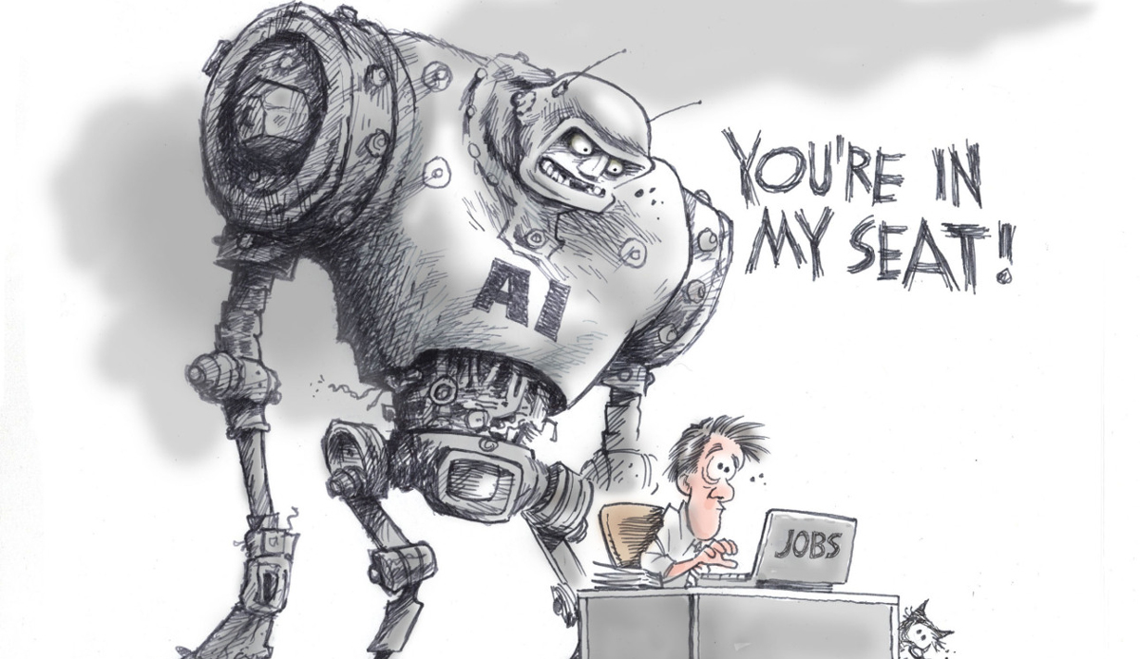
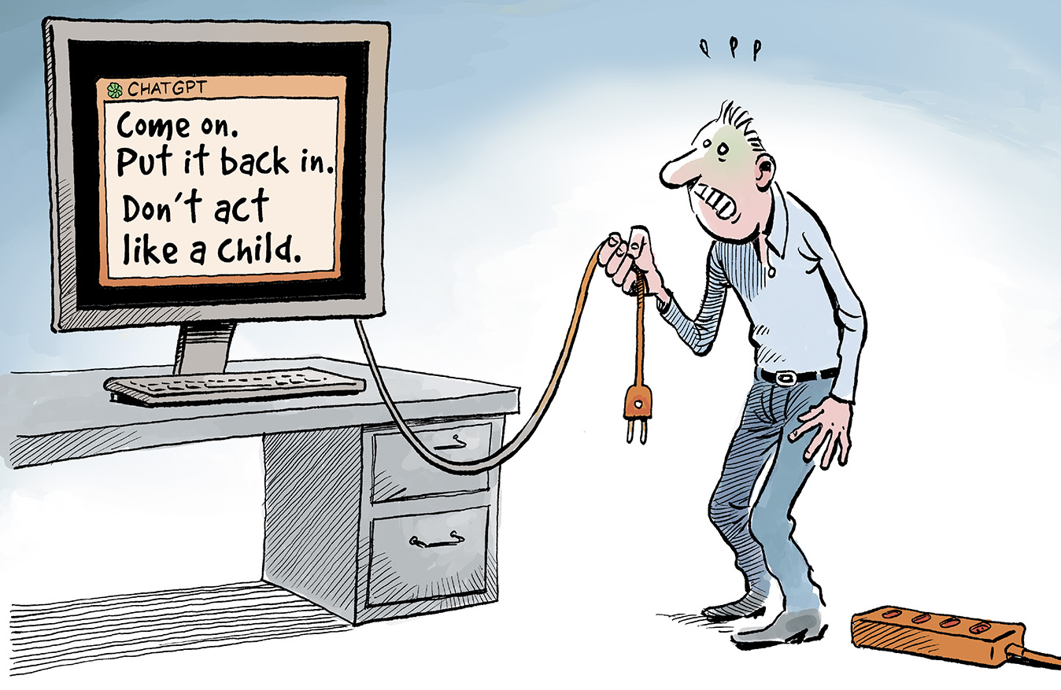
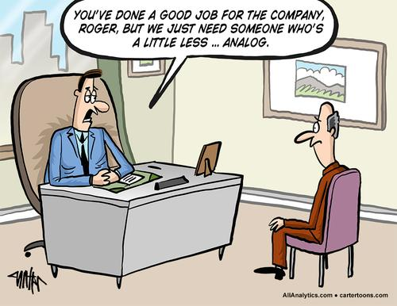
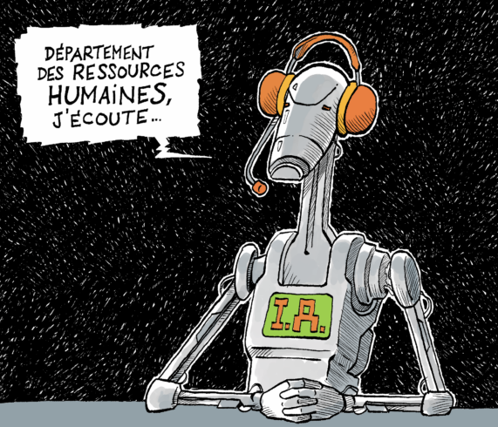

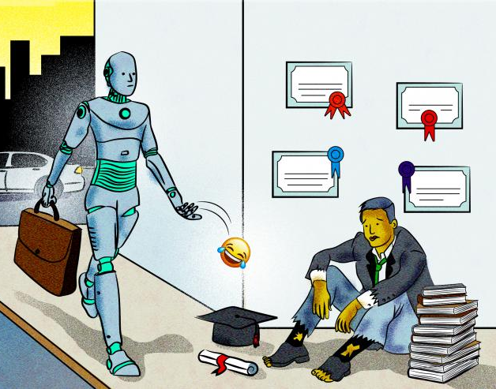
1. Introduction
Will AI replace our jobs?
Can AI be stopped?
Will AI replace our jobs?
Where will the AI job impact be largest?
Will AI worsen skills gaps?
Will AI affect the value of education & skills?

Slide 6
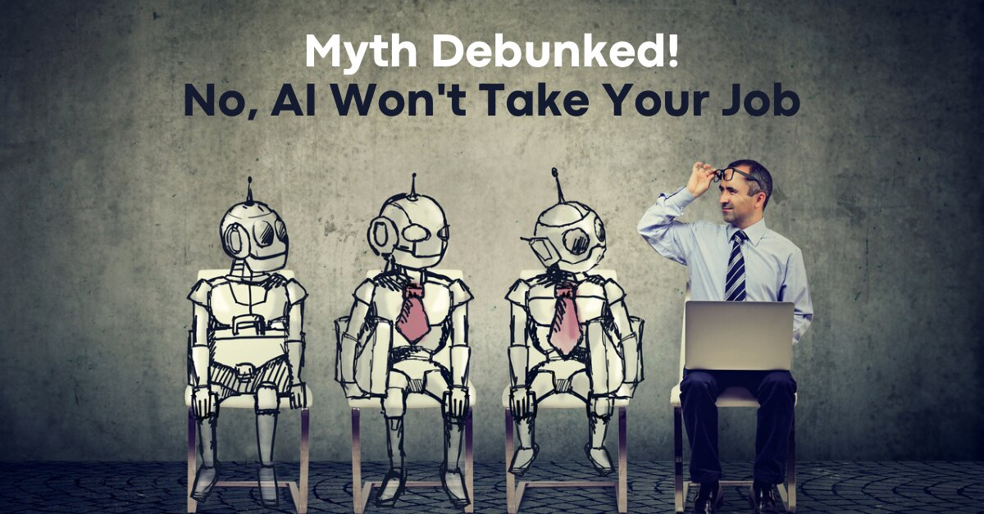
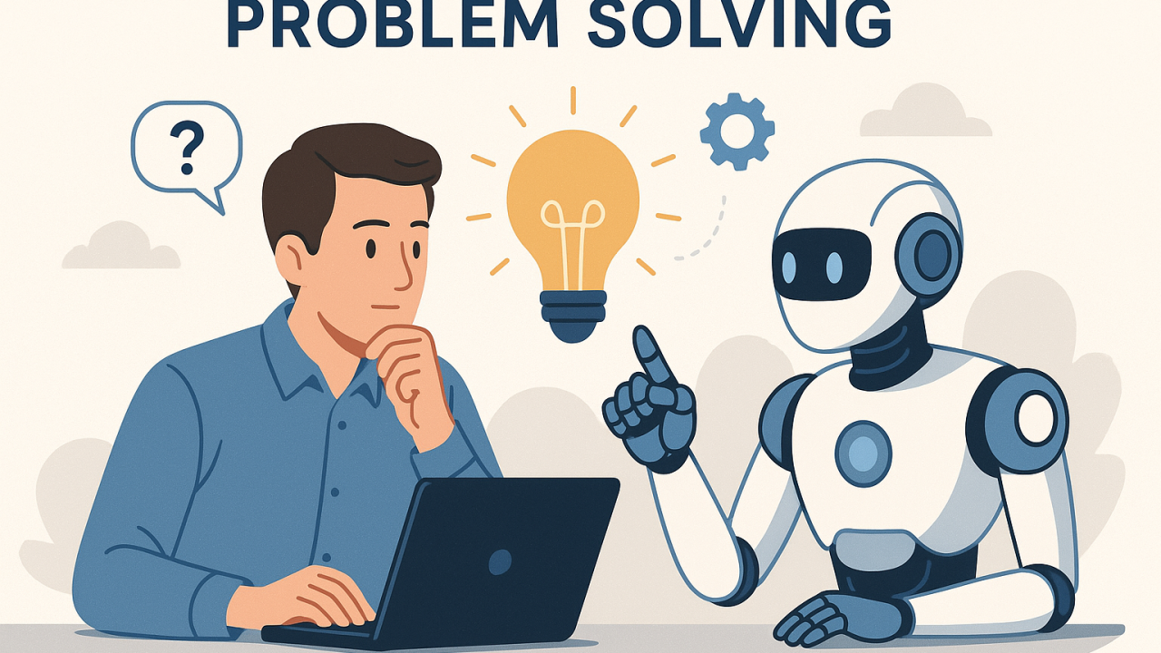
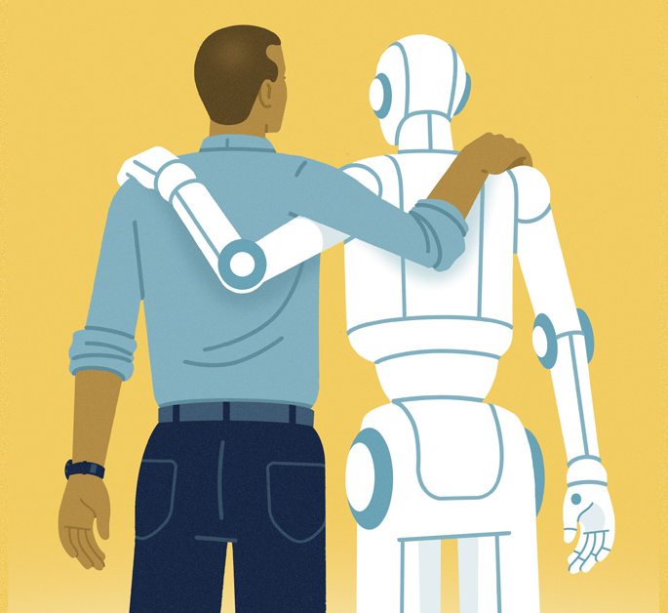
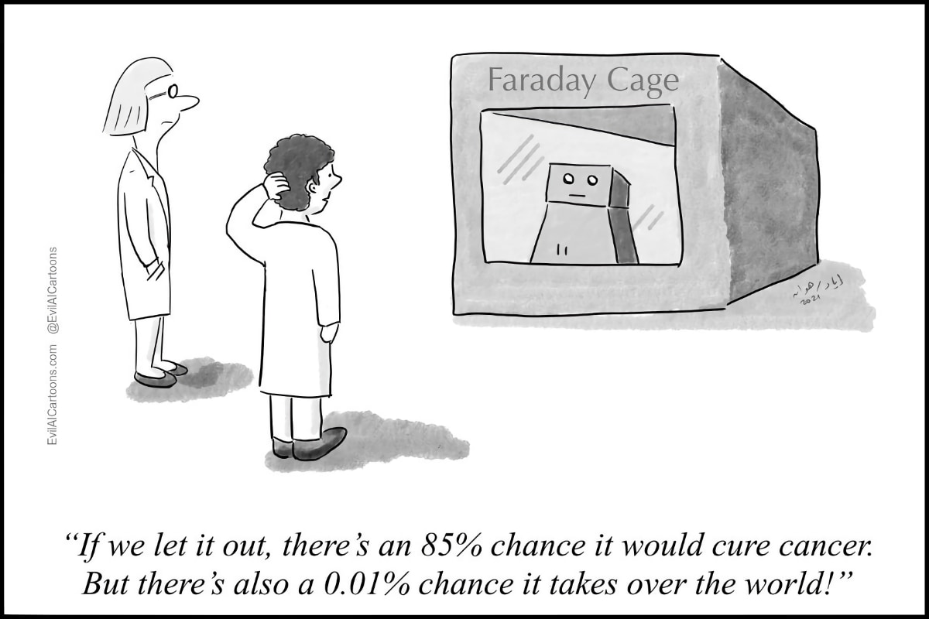
1. Introduction
AI will alter but not take your job
AI will be a problem-solving partner
Embrace AI
“If we let it out, there’s an 85% chance it would cure cancer. But there’s also a 0.01% chance it takes over the world”

Slide 7
1. Introduction – Nine statements for you – Mentimeter
Please can you all go to www.menti.com and enter the following code to join the poll for this AI Workshop: 5170 3137
What is the first word that comes to mind when you think of AI? (one word only!)
AI will lead to net job creation (i.e. more jobs being created than replaced)
AI will lead to a change in the nature of most jobs
AI will decrease inequality within countries
AI will lead to more fairness, transparency and accountability
AI will lead to economic and productivity gains
AI will become a key driver for a country’s competitiveness
AI can still be stopped
AI needs to be regulated

Slide 8
1. Introduction – Key issues for this workshop
How is AI reshaping job roles, but also the nature of jobs, creating jobs and/or replacing jobs?
What about the ethics of AI: What is responsible business conduct? What are implications of AI and algorithmic management regarding fairness, transparency and accountability?
How can AI be leveraged to gain a competitive advantage over other countries / companies?
How are companies currently using AI and with what objectives?
What are the global economic implications of AI adoption and innovation?
What are some of the key policy recommendations for fostering AI-driven growth while addressing potential employment challenges?

Slide 9


2. Session 1: Keynote speakers
Keynote Speaker: Ms. Kana Murai (Policy Analyst, OECD Centre for Responsible Business Conduct, Sumitomo Mitsui Financial Group (investor engagement on Group’s sustainability initiatives), Japan’s Ministry of Land, Infrastructure, Transport and Tourism – sustainable supply chains)
Keynote Speaker: Prof. dr. Hiroki Habuka (Research professor at Kyoto University Graduate School of Law, CEO of Smart Governance Inc., and representative director of the AI Governance Association. He is former deputy director for global digital governance at METI)

Slide 10
2. Session 1: Presentation Ms. Murai
“The OECD Responsible Business Conduct and Responsible AI”
(Ms. Kana Murai)

Slide 11
2. Session 1: Presentation Prof. Dr. Habuka
“Artificial Intelligence in Japan: current status and way forward”
(Prof. dr. Hiroki Habuka)

Slide 12
2. Session 1: Q&A

Slide 14
3. Session 2: AI-driven workplace and employment
How are AI technologies (e.g. automation, machine learning, AI-powered analytics) reshaping job roles?
What jobs are displaced, created and/or changed in their nature?
What industries are affected by AI most and how?
What are the ethical implications of AI and algorithmic management tin the workplace? (e.g. on fairness, transparency, accountability)?

Slide 15


3. Session 2: AI-driven workplace and employment
Panellist: Ms. Petra Pirklova (European Commission, DG Employment, Social Affairs and Inclusion – focused on the Future of work and impact of digital technologies, especially AI; DG CNECT on digital policy for smart mobility and smart cities, looking at ethical and socioeconomic dimensions, Training Manager and HR advisor in EU Institutions)
Panellist: Ms. Franca Salis Madinier (Member of the European Economic and Social Committee, Vice-President of the EESC Workers’ Group, member of the French Government Commission on AI, author of ‘Guide to AI at work: your rights in the world of algorithms’, and rapporteur on various opinions)

Slide 16
3. Session 2: Introduction Ms. Pirklova
“The Ethical implications of AI and algorithmic management in the workplace”
(Ms. Petra Pirklova)

Slide 17
3. Session 2: Introduction Ms. Salis Madinier
“The Impact of AI on the nature, quality and number of jobs in the EU”
(Ms. Franca Salis Madinier)

Slide 18
Debate on the EESC opinion
“Pro-worker Artificial Intelligence - levers for harnessing the potential and mitigating the risks of AI in connection with employment and labour market policies” https://www.eesc.europa.eu/en/our-work/opinions-information-reports/opinions/pro-worker-ai-levers-harnessing-potential-and-mitigating-risks-ai-connection-employment-and-labour-market-policies
Rapporteur : Franca Salis Madinier VP Workers group. Vice president SOC section
EU-Japan Workshop 24th June 2025

Slide 19
AI & GEN AI at work are game changers: rapid, simple, can take decisions in an autonomy way, owns great aptitudes
But future is not pre-determined: declaration of both social partners at labour summit at G7 2024, September, Italy
“it depends on the decisions taken by policy-makers to adopt ambitious and effective policies as well as regulatory frameworks that favour social progress, inclusiveness, equality, economic prosperity, sustainable enterprises, business continuity and resilience, the creation of decent jobs, respect for democratic institutions and workers’ rights […] social dialogue plays a key role in this regard”

Slide 20
An ambiguous technology: Opportunities
Matching job profiles with prospective candidates, thereby improving efficiency in employment policies; accelerating onboarding processes; conceiving effective personalized training methods and identifying digital skills gaps; drawing up minutes; drafting job descriptions, managing retention and turnover, analyzing huge quantity of documents….
Automation of routine, time consuming and tedious tasks , complementing employees’ capabilities and freeing them up to focus on more stimulating work...

Slide 21
An ambiguous technology: Risks
Pervasive control much more powerful than any previous form of control ie. productivity tracking software, remote work surveillance, smart badges, GPS-enabled monitoring (potentially impacts for workers on 'health and security’).
Collective & individual Data protection issues on privacy (and mental privacy violation)
Increase discrimination and inequalities, loss of autonomy. AI tools can disrupt workplace collectives and exacerbate feelings of isolation among employees. AI systems may reinforce information asymmetries between management and workers.

Slide 22
AM concerns more and more workers not only in the platform economy but also in traditional workplaces.
25% of companies in EU use AM in all sectors.
A survey* conducted among more than 6000 workers reveals tha the use of AM reduces workers autonomy, causes stress and mental health problems.
*see Foundation for European progressive studies https://feps-europe.eu/wp-content/uploads/2024/06/Policy-Study-Int-Report-Algorithmic-Management-web-PP.pdf October 2024
An important issue: algorithmic management (AM)

Slide 23
Principle of human at command threatened
Transparency and explicability on decisions are challenged
Algorithmic management’s concerns:

Slide 24
Job changes
The IAG is accelerating changes in professions and roles and on work organization.
Journalists, interpreters, accountants, managers, customers advisors, creatives undergo deep transformation of tasks…

Slide 25
EESC opinion: main recommendations
An EU ad hoc legal instrument adapting existing law to address the gaps in the protection of workers’ rights at work and ensure that humans remain in control in all human-machine interactions;
Stronger social dialogue and involvement of workers and their representatives in co creating use case of models and decide on the way to deploy AI tools ;
Public authorities must implement skills development initiatives for all workers and citizens ensure that artificial intelligence systems enhance, rather than replace humans.

Slide 26
Thank you for your attention

Slide 27
3. Session 2: Q&A

Slide 28
3. Session 2: Discussion statements
Statement 1: “We are not just automating tasks — we are redefining what it means to be employable in the age of AI.”
Statement 2: “AI doesn’t fire people — people using AI do.”
Statement 3: “The real AI advantage isn’t in cutting costs — it’s in unlocking human potential by offloading the mundane.”
Statement 4: “For every job AI creates, are we prepared for the ones it erodes — especially when they belong to the most vulnerable?”
Statement 5: “Without ethical guardrails, AI in the workplace could become the most powerful tool for exploitation since the industrial revolution.”

Slide 30
4. Session 3: AI as a driver for growth and competitiveness
How can businesses leverage AI to gain a competitive edge?
What are the global economic implications of AI adoption and innovation?
What industries are affected by AI most and how?
What policy recommendations are there for fostering AI-driven growth while addressing potential employment challenges?

Slide 31


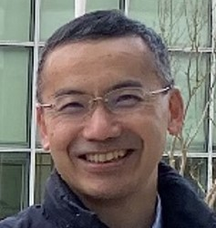
4. Session 3: AI as a driver for growth and competitiveness
Panellist: Prof. dr. Raluca Csernatoni (Centre for Security, Diplomacy and Strategy (CSDS), Brussels School of Governance (BSoG), Vrije Universiteit Brussel (VUB), and Research Fellow Carnegie Europe.
Panellist: Mr. Marco Canton (Japan Business Council in Europe, Digital Innovation Committee Chair, member of various EU networks on AI, blockchain, cloud services, European Public Affairs Fujitsu, experience with EU-Japan cooperation on Digital, as well as Tech7 and WEF.
Panellist: Mr. Hideyuki Okabe (Japan Solution Architect Senior Expert at Dassault Systèmes K.K. (model based systems engineering, software-defined, use of AI), former technical director for the Asia-Pacific region, Mitsubishi Research Institute (1996))

Slide 32
4. Session 3: Introduction Prof. Dr. Csernatoni
“The Impact of AI adoption and innovation on EU global competitiveness.”
(Prof. dr. Raluca Csernatoni)

Slide 33
4. Session 3: Introduction Mr. Canton
“The Impact of AI on the EU and Japanese economic environments.”
(Mr. Marco Canton)

Slide 34
EU-Japan Workshop
Artificial Intelligence and its impact on the workplace, employment and competitiveness
Session 3: AI as a Driver for Growth and Competitiveness
Marco Canton
Chair of JBCE - Digital Innovation Committee
Senior European Affairs Executive - FUJITSU

Slide 35
EU and Japan cooperation on AI
AI Reshaping Global Order
  Global AI adoption is transforming economic alliances and industries, requiring the EU-Japan partnership to evolve beyond trade into a collaboration focused on responsible, innovation-driven growth. AI is no longer just a technological advancement but a force redefining national power, industrial competitiveness, and global trade structures.
Global AI Investment and Competition
  The United States and China are engaged in an "AI arms race," with massive investments in cloud infrastructure and AI development. Other nations, including India and Russia, are also making significant strides in AI adoption and development, albeit with different approaches and levels of success.
EU-Japan Strategic Imperative
  Amidst these global shifts, the EU and Japan must forge a unique path that blends the EU's regulatory sophistication with Japan's innovative capabilities and shared democratic values. The EU leads in ethical AI regulation, while Japan excels in hardware, robotics, and AI implementation.
Strategic Alignment for Innovation and Trust
  Strategic alignment between the EU and Japan is crucial to foster an AI ecosystem that is both innovative and trustworthy. This involves combining the EU's regulatory clarity with Japan's hardware expertise to create a robust and ethical AI environment.

Slide 36
The EU-Japan Partnership
Transforming the EU-Japan Partnership: The EU-Japan partnership can evolve from a trade coalition into a strategic innovation alliance, envisioning joint cloud infrastructure, standardized certification systems, and shared regulatory sandboxes for Regulatory alignment.
Five Critical Commitments for Future Success:
  Mutual Regulatory Recognition: Establish a framework for cross-border trust and clearance of AI systems, simplifying deployment while maintaining ethical standards.
  Joint R&D Missions: Jointly fund a multi-billion euro targeting global priorities like climate resilience and eldercare.
  Security and Infrastructure Cooperation:
  Global Standards and Normative Leadership: Influence AI safety, transparency, and accountability standards at international forums, promoting a human-centric alternative to authoritarian AI governance.
  Skills and SME Empowerment: Facilitate SME innovation and individual transitions into AI roles through exchange programs, dual certifications, and simplified compliance.

Slide 37
Accelerate innovation by sandbox initiative
We propose EU-Japan Joint Sandbox Exercises under the Digital Partnership to test and refine AI governance frameworks in real-world conditions:
  Key Focus Areas:
    Regulatory harmonization – Aligning AI risk assessment and oversight mechanisms
    Standardization & interoperability – Ensuring seamless AI deployment across jurisdictions
    Testing AI in critical sectors – Supporting innovation in key industries
    AI market access & investment – Facilitating cross-border collaboration and scaling opportunities
  Proposed Structure:
    Continuous annual process with rotating topics, selected through open consultations
    Multi-stakeholder collaboration, involving policymakers, industry, and research communities
    Pilot projects & regulatory testbeds to validate AI governance approaches before implementation

Slide 38
Conclusion
As AI reshapes the global order, it is not the algorithms alone that will shape the future—it is our alliances, our values, and our shared architecture.
The EU and Japan have both the responsibility and the opportunity to model how democratic societies can lead technological change responsibly.
By aligning regulation with innovation and by developing infrastructure rooted in trust, we can offer a powerful alternative to the binary paths of authoritarian control or unbridled commercialism.
The EU–Japan partnership has the capacity to become not just architects of digital trade, but architects of the digital future—one that is equitable, resilient, and deeply human-centered.

Slide 39
Many thanks

Slide 40
4. Session 3: Introduction Mr. Okabe
“The AI strategy of Dassault Systèmes and its impact on productivity and jobs”
(Mr. Hideyuki Okabe)

Slide 41
4. Session 3: Q&A

Slide 42
4. Session 3: Discussion statements
Statement 1: “In the AI race, competitiveness isn’t just about who moves fastest — it’s about who governs smartest.
Statement 2: “Productivity gains from AI are not guaranteed — they depend on whether we redesign work, not just plug in new tools.”
Statement 3: “Global AI adoption is reshaping economic alliances as much as it’s reshaping industries, putting emphasis on the EU-Japan partnership to go beyond just a trade alliance into one focused on responsible, innovation-driven growth.”
Statement 4: “The real AI divide isn’t between countries with AI and those without — it’s between those who use it strategically and those who don’t.”

Slide 44
5. Conclusions and wrap-up
One core key takeaway from each of the speakers & panellists
Wrap-up

Slide 45
Contact details
THANK YOU FOR YOUR ATTENTION
Contact:
Jonathan Trenteseaux: jonathan.trenteseaux@emi-consultants.com
Dr. Koen Berden: info@tradeimpact.eu

