Slide 1




EU-Japan Joint Dialogue with civil society under the EU-Japan Economic Partnership Agreement (EPA)
Workshop on the ex-post evaluation of the impact of EU FTAs on key environmental aspects, including climate
24 June 2025
Organised by:
Moderator:

Slide 2

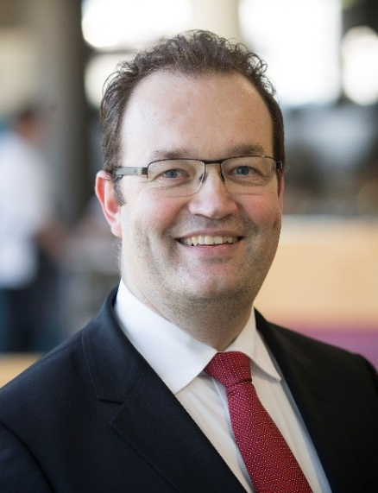
Moderator: Dr. Koen Berden
Senior Fellow at ECIPE, Managing Director Trade Impact BV, Assistant professor Erasmus University Rotterdam and Visiting professor at the College of Europe
Chairman of the Institute for International and Development Economics (IIDE), Senior fellow of the Transatlantic Policy Network (TPN), Member of the Supervisory Board of Clingendael
Executive Board member Women Economic Forum and Chairman of the Foundation Children for the Earth
Former: Executive Director International Affairs, EFPIA; Senior partner, Managing Director Ecorys Netherlands, Chief Innovation Officer and Chief Economist Ecorys Group, Vice-Rector Skarbek University
Over 25 years of experience in working on international trade in goods, services, FDI, public procurement, SMEs, Trade & Sustainable Development, geopolitical analysis, WTO law, competitiveness, IPR, economic security, Artificial Intelligence, critical raw materials, ex-ante and ex-post impact assessments of EU trade policy
International Baccalaureate at UWC of the Atlantic: 1992-1994
MSc Erasmus University Rotterdam (1998)
PhD Tinbergen Institute, Erasmus University Rotterdam (2006)

Slide 3
Workshop programme
09.30 – 09.45 Welcome and Introduction
09.45 – 10.10 Report findings presentation
10.10 – 10.30 Question & Answer session

Slide 4
1. Introduction
“Ex-post evaluation of the impact of EU FTAs on key environmental aspects, including climate” (February, 2025) – link: Circabc – Ex-post evaluation impact EU FTAs on environmental aspects
Objective: a comprehensive mapping of climate and environmental provisions across trade agreements with eight countries – Canada, Costa Rica, Georgia, Honduras, Japan, Peru, Singapore and Vietnam.
As part of the 20 Case Studies conducted for this evaluation:
Case study 4: EGS trade between the EU, Canada, and Japan
Case study 15: Offshore wind development in Japan

Slide 5
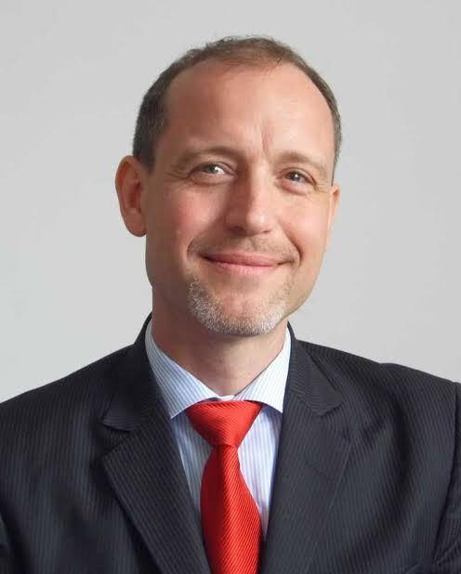
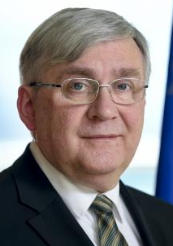
1. Opening remarks
Mr. Jörg Wojahn (European Commission, DG Trade, Head of Unit Bilateral relations in Trade and Sustainable Development, and GSP, EU co-chair of the EU-Japan Trade & Sustainable Development Committee
Mr. Krzysztof Pater (President of the EU-Japan DAG and Vice-President of the EESC, President of the Polish Scouting Association – ZHP)

Slide 6
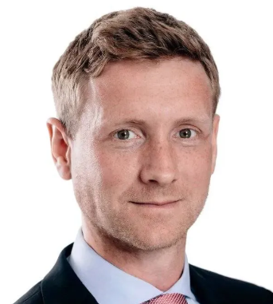
2. Report findings presentation – Dr. Bauer
Dr. Matthias Bauer – Director of Tutwa Europe and Director and Senior Economist at ECIPE. Focusing on policy-related economic research and public advocacy work. Formerly at Konrad Adenauer Foundation, MatBauerEcon (2010), DekaBank, UBS, Mercedes-Benz China.

Slide 7
3. Q&A

Slide 8
Contact details
THANK YOU FOR YOUR ATTENTION
Contact:
Jonathan Trenteseaux: jonathan.trenteseaux@emi-consultants.com
Dr. Koen Berden: info@tradeimpact.eu

