Slide 1

Extension of the EU Emission Trading System to maritime transport
Public hearing on 'Economic Impact of the Implementation of the EU Emissions Trading System (ETS)’
– 10 June 2025, Malta
Timothée Noël, Maritime Team Leader, Clima.B4, European Commission

Slide 2
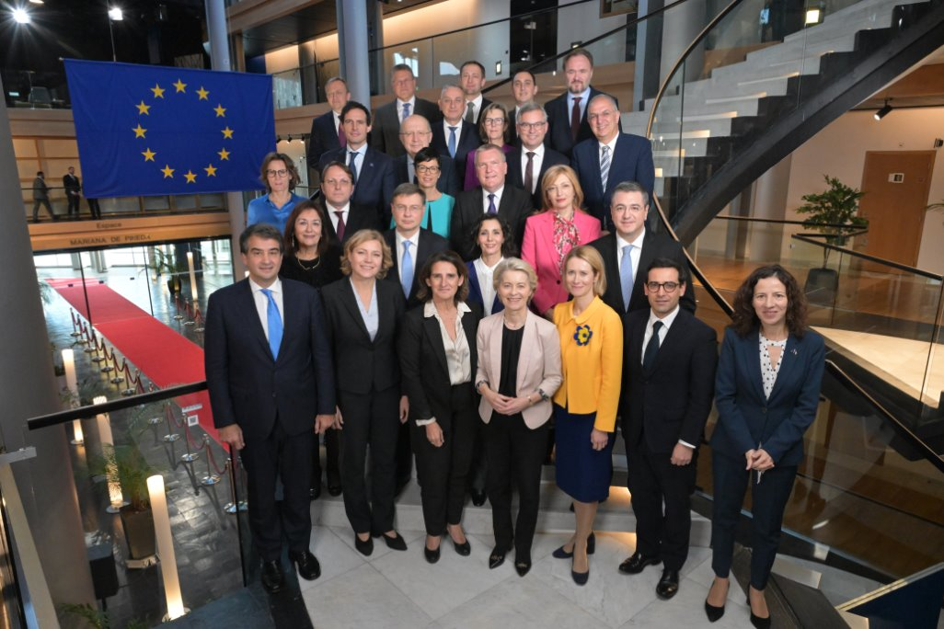
Sustainable prosperity and competitiveness
Climate policy is aligned with shifting geostrategic priorities and realities
An agenda that serves to:
Modernise our economy
Secure competitiveness in the global market place
Build energy independence and strategic autonomy
Prepare society and the economy for uncertainties and threats
Improve socio-economic resilience
Enhance stability and predictability
The College of Commissioners

Slide 3



Overview of the EU ETS – ‘Cap-and-trade’ system
Cap
Cap

Slide 4
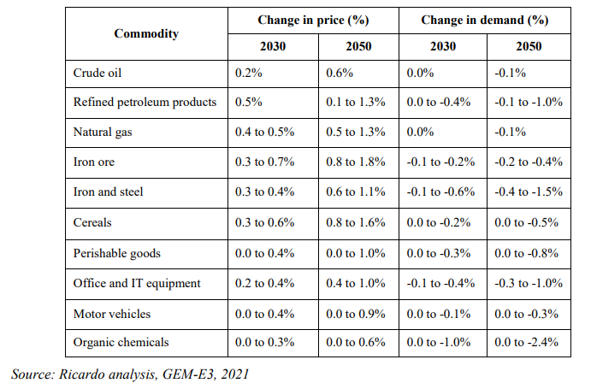
ETS extension to maritime transport
Proposed in 2021 as part of the Fit for 55 Package and adopted in 2023 by co-legislators
One element of a basket of measures:
FuelEU maritime Regulation
Alternative Fuels Infrastructure Regulation
Updated Renewable Energy Directive
Revision of the Energy Taxation Directive
IMO developments
Thorough impact assessment on environmental, economic and social impacts, e.g. on shipping activities, GDP, exports, imports, welfare, employment, trade:

Slide 5
ETS extension to maritime transport – state-of-play
​ | 2023​ | 2024​ | 2025​ | 2026​
Inclusion of maritime transport in EU ETS​ >12 000 ships​ over 5 000 gross tonnage >5 000 shipping companies​ | ​ | Phase-in: 40%​ ​ First monitoring​ | Phase-in: 70%​ ​ First reporting and surrendering​ | Phase-in: 100%​ Second reporting and surrendering​

Slide 6
State-of-play of the different elements relevant to the risk of evasion​/circumvention
​ | 2023​ | 2024​ | 2025​ | 2026​
Anti-evasion measure​ "Port of call" exemption for the neighbouring non-EU transhipment ports where the risk is greatest. ​ | First list of non-EEA neighbouring transhipment ports​ | ​ | Q4: updated list of non-EEA neighbouring transhipment ports ​ ​ | ​
Continuous Monitoring ​ with notably the objective to detect and prevent evasive behaviors at an early stage​ | ​ | ​ | Q1: First monitoring report​ | Q4: Second monitoring report (ETS and FuelEU)​
ETS review clause - In case of the adoption of a global market-based measure at IMO level. - if appropriate, proposals to prevent evasive behaviours at an early stage. - assessing the potential inclusion of smaller ships in the EU ETS. |  |  |  | Mid-2026

Slide 7
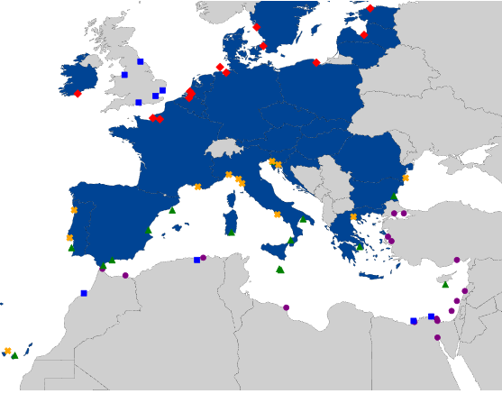
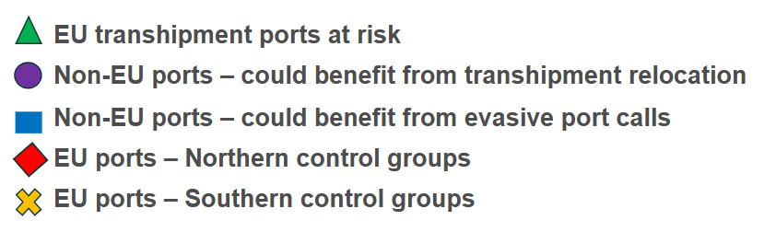
Monitoring the implementation of the ETS extension to maritime
Commission report and supporting study published on 18 March
6 types of evasion risks considered
70 key EU and non-EU ports analysed
Comparison over time (Q1-Q3 2024 against 2022 and/or 2023), between groupings of ports, and through case studies

Slide 8

Monitoring of possible evasive behaviours and future risks
Backward looking indicators
Forward looking indicators
When looking at market trends over the first three quarters of 2024, the available data shows no clear evidence of evasive behaviour due to EU ETS extension to maritime transport so far.
While some significant changes in traffic may be observed, those seem mainly related to impacts of the Red Sea crisis.
When looking at route announcements for 2025 and planned investments in ports, the analysis reveals no discernible trends that could indicate a change in market behaviour resulting from the ETS extension to maritime transport, although few examples suggest that companies may consider circumvention behaviours when designing future routes.
HOWEVER, conclusions should be viewed with caution​

Slide 9
Monitoring of other impacts
ETS costs are estimated to represent on average an increase of 3,7% in overall shipping costs in 2024.
ETS costs are generally passed on to shippers by shipping companies
There is currently no evidence to suggest that a reduction in shipping services to EU islands has occurred, based on the trend in port calls analysed.
This initial report is a first step. The Commission will continue its monitoring activities.
This includes consideration of FuelEU
The Commission will seek active support and collaboration of all interested parties to ensure the rapid identification of new trends, patterns and emerging issues.

Slide 10
Thank you
Fill in copyright information.
© European Union 2025
Unless otherwise noted the reuse of this presentation is authorised under the CC BY 4.0 license. For any use or reproduction of elements that are not owned by the EU, permission may need to be sought directly from the respective right holders.
Slide xx: element concerned, source: e.g. Fotolia.com; Slide xx: element concerned, source: e.g. iStock.com

