Slide 1

EU ETS vs shipping and ports: some thoughts
Harilaos N. Psaraftis
Professor Emeritus
Technical University of Denmark

Slide 2
Purpose
Identify potential EU ETS evasion/carbon leakage scenarios
Discuss potential mitigation measures
Disclaimer: treatment is not encyclopedic!

Slide 3
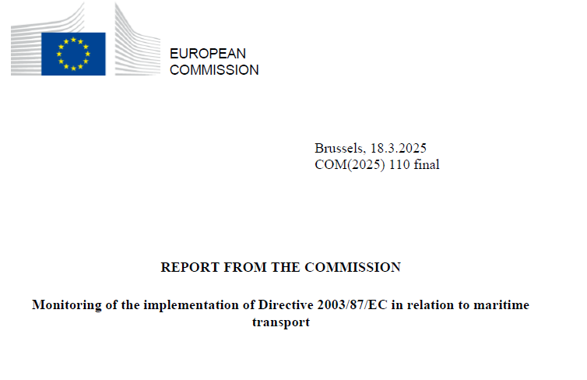
The general picture
2024
Caveats
No discernible evasion pattern
2024 was a transition year (40% of ETS price charged)
Report covers until Q2 (& Q3?)
Red Sea disruption may have “masked” possible evasion

Slide 4
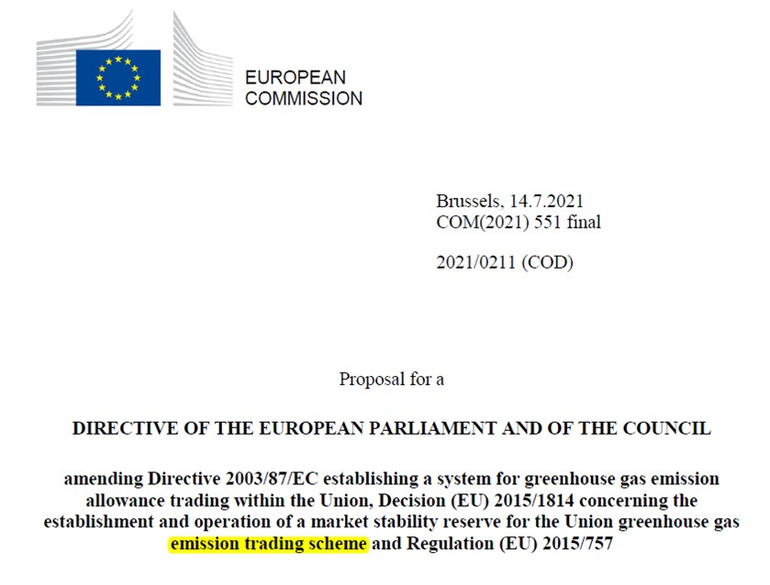
Evolution of the Directive
PROPOSAL (7/2021):
Commission (581 pages)
Did not consider possible relocation of transhipment hubs
No provisions to mitigate associated risk

Slide 5
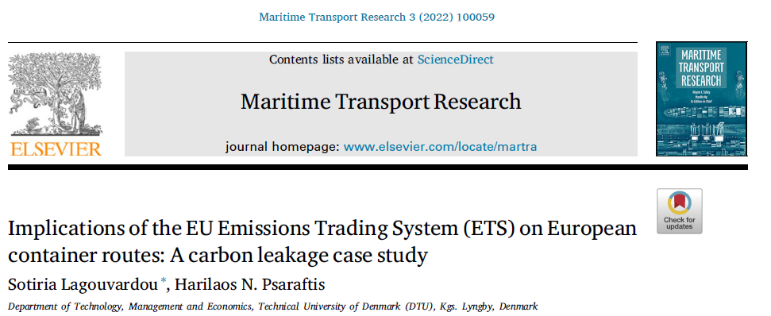
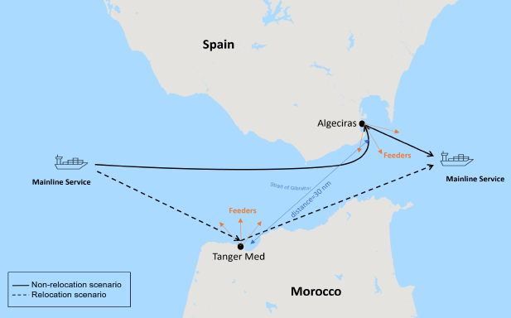
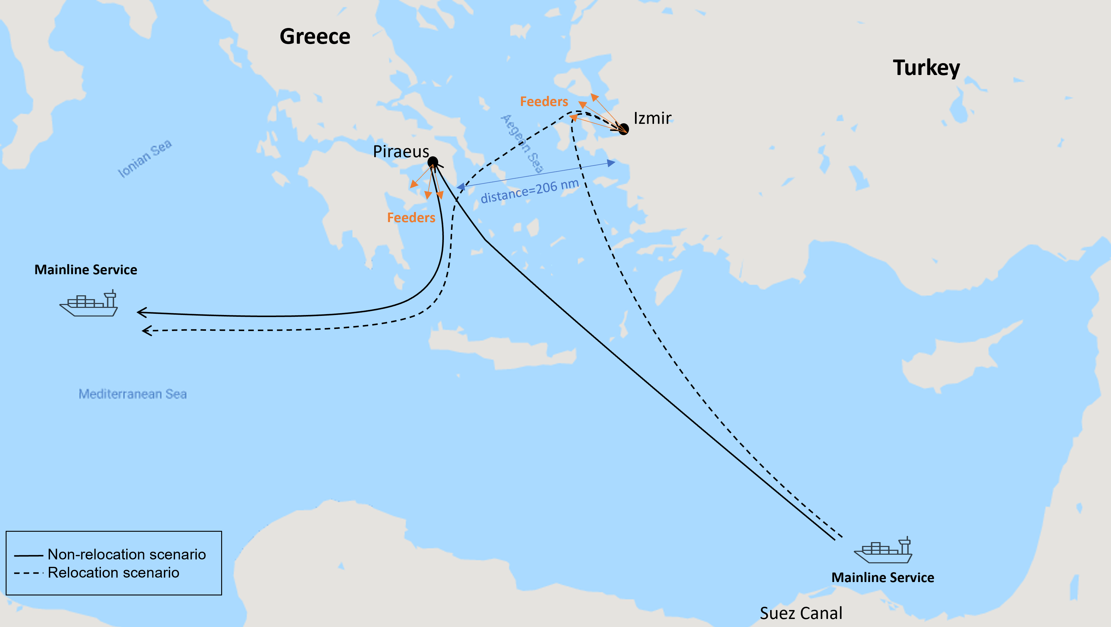
3/2022: paper
Switch to non-EU (EEA) transhipment hubs close to the EU just to avoid paying into the EU ETS
Switch is attractive for carbon prices well below 25 €/tonne of CO2.
Risk of carbon leakage
Risk of lost ETS revenue
Risk of lost EU port income

Slide 6
Evolution of the Directive ii
PROPOSAL (7/2021):
Commission
FINAL version (5/2023): Parliament+Council
Did not consider possible relocation of transhipment hubs
No provisions to mitigate associated risk
Explicitly acknowledged the risk
Substantial language to mitigate it
300 nm exclusion zone
List of relevant non-EU ports
Several versions in 2022 & 2023

Slide 7
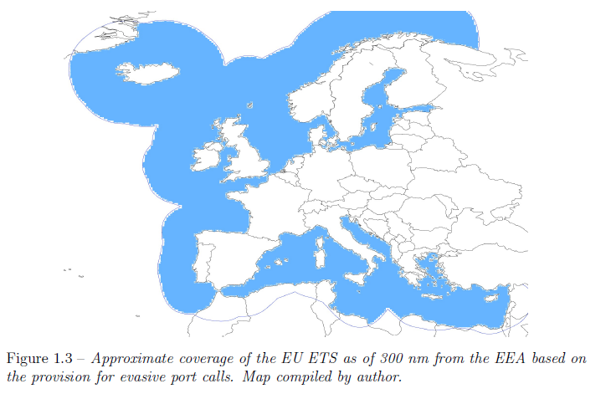
Plugging the transhipment loophole: the 300 nm exclusion zone
Source: Lagouvardou, S. (2023), “Market Based Measures for Sustainable Shipping”, PhD thesis, DTU.
Non-EU container ports with at least 65% transhipment traffic
A non-EU transhipment hub located in this zone would not constitute a legitimate “port call”

Slide 8
Plugging the transhipment loophole: the 300 nm exclusion zone ii
If the ship comes from Singapore, tranships at Tanger Med, and then goes to Rotterdam, the entire trip from Singapore to Rotterdam will count for EU ETS purposes
Q: Does this plug the loophole?

Slide 9
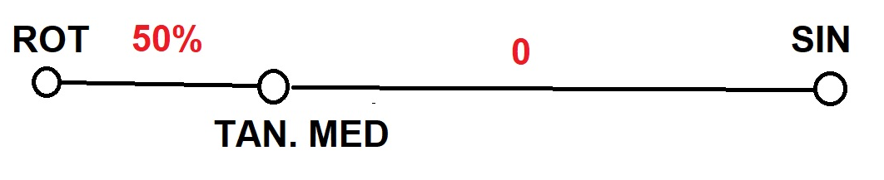
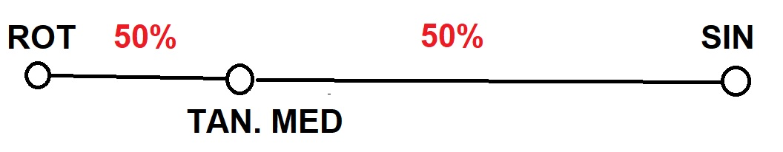
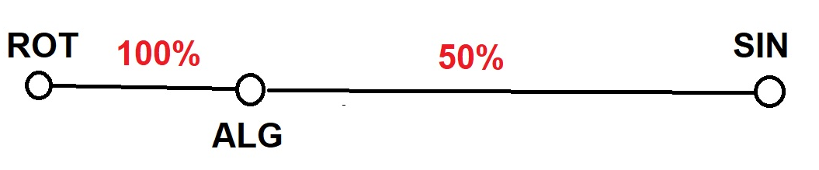
A crude example: Singapore to Tanger Med to Rotterdam
% of CO2 emissions charged
Original Directive
Final Directive
Still cheaper than Algeciras!
LOOPHOLE
PLUG

Slide 10
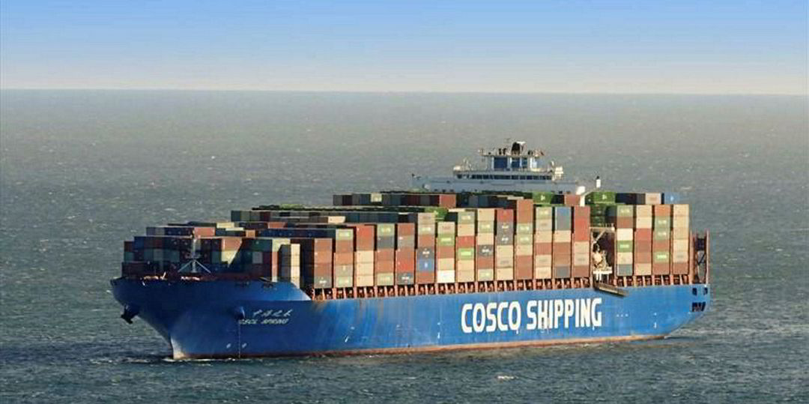
A crude example ii
10,000 TEU vessel
FC = 145 tonnes/day at 22 knots
# of transhipment moves= 3,000
Algeciras (or Tanger Med) to Rotterdam: ~1,365 nm
Transit time: 2 days 14 hrs
Total FC = 374 tonnes
Total CO2 = 1,126 tonnes
ETS price = 70 €/tonne
EU ETS revenue lost ~ 40,000 € per trip
EU port revenue lost: Much more! (~ 200,000 € per trip)

Slide 11
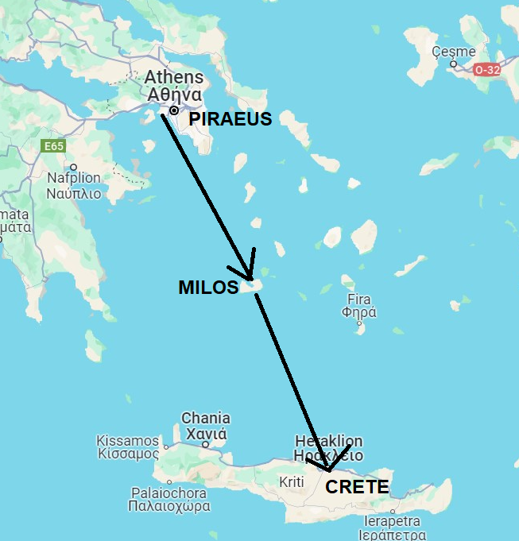
More evasion?
The Piraeus-Crete route is ordinarily charged full ETS price
But if Milos is added as an intermediate stop, route is fully exempted!
Company advertises night service for more time to sleep!
More sleep -> more CO2 evaded!

Slide 12
Potential mitigation measures
Continue monitoring the situation
Charge 100%, not 50% of GHG emissions (EU vs non-EU)
Drop the ≥65% requirement, expand list of non-EU ports
Extend Directive to non-container trades
Reduce exemptions and derogations
Push IMO to adopt a stronger global GHG reduction measure
  Levy (originally supported by EU-27) was rejected at MEPC 83

Slide 13
THANK YOU
hnpsar@dtu.dk
© HNP

