Slide 1

Economic Impact of the Implementation of the EU Emission Trading System (ETS)
Godwin Xerri
Chairman
Malta Maritime Forum
10th June, 2025

Slide 2
Scope of ETS
A noble scope which aims at reducing carbon emission by ships for the benefit of the human kind.
Scope reflected in various EU initiatives such as:
  The Green Deal
  Fit for 55 Package
  The ETS
  Fuel EU Maritime

Slide 3

Scope of ETS
Such initiatives received full support of the international and particularly of the European Maritime industry :
  Shipping is a main victim of climate change:
    Rising sea temperatures.
    Heavy storms.
Shipping industry investing heavily in new technology for ship building, ship engines, propulsion systems:
  The use of cleaner energy
    LNG/Amonia/Bio fuel/shore to ship supply.

Slide 4
Critique of the ETS
Unfair Competition
  As long as ETS applies to EU ports only – such ports are disadvantaged vis-à-vis non-EU ports.
The cost for ETS estimated at around USD 30 million per service per year if calling at an EU port – huge saving to be made when bypassing EU ports.
Carbon Leakage
  When avoiding EU ports, ships are still causing emission in EU waters.
  e.g. Port Said to Morocco – sailing through the Mediterranean.

Slide 5
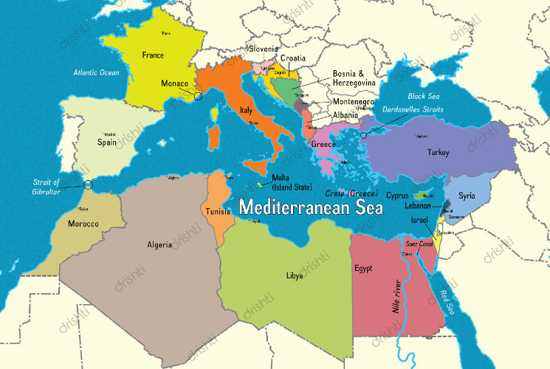
The Mediterranean

Slide 6
Critique of the ETS
Polluter Pays
  One of the objectives of ETS failed because shipping lines introduced ETS Surcharge or ESS Surcharge :
    Eur 500 per container
    Onus of ETS shifted to the consumer.
Reduction in Emission Failed
  When mainline vessels call at non EU ports, cargo still needs to be carried by feeder to end destination;
  Hence apart from the emission by mainline vessel, (which still sails by EU ports)addition of emissions by feeder vessel.

Slide 7
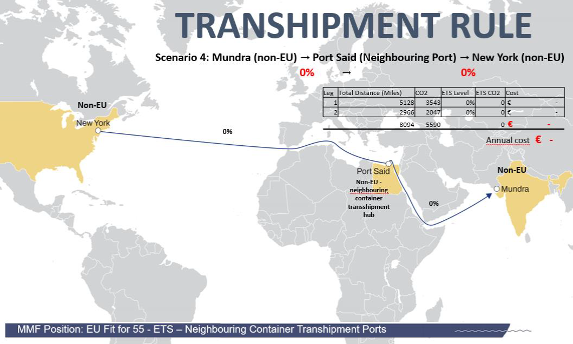
EU Fit for 55

Slide 8
Critique of the ETS
Economic Disadvantage to EU countries because of Lack of Connectivity.
  When mainline services do not call at EU ports, these ports lose direct connectivity to ports of origin(use of transhipment hubs).
  Industry that requires direct services for import of raw material/export of finished product – relocate to countries served by direct services.
Higher Freight Costs
  If a port is not served by direct services – need to add on transhipment and feeder cost.
  Hence higher freight for imports and exports

Slide 9
Critique of the ETS
Longer Transit Time
  If services are provided via transhipment port – increase in transit time due to :
    Time for cargo to connect between main/feeder vessel.
    Longer steaming due to deviation.

Slide 10
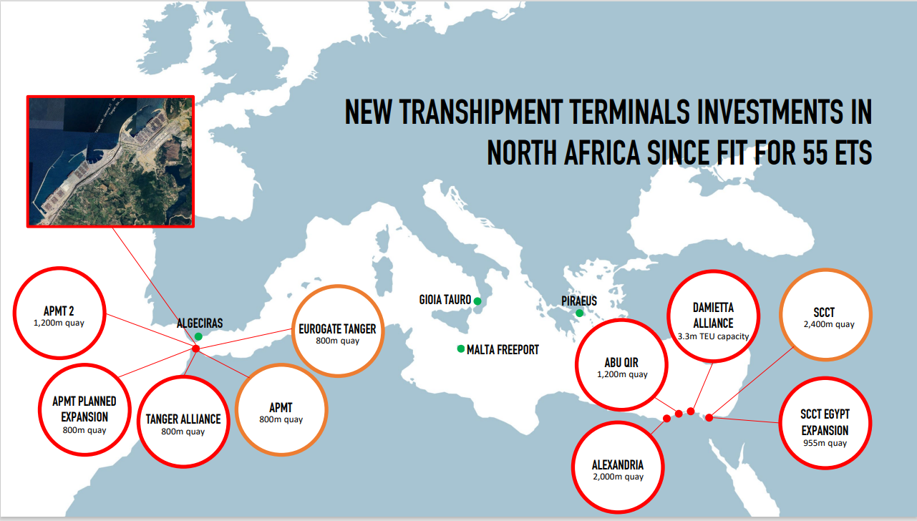
New Transhipment Terminals

Slide 11
Silver Lining
New IMO Regulation – April
NET ZERO Regulations for Global Shipping
Approved during 83rd session of the Marine Environment Protection Committee.
Set to be formally adopted in October 2025.
Entry into force 2027.
Under these regulations – level playing field

Slide 12


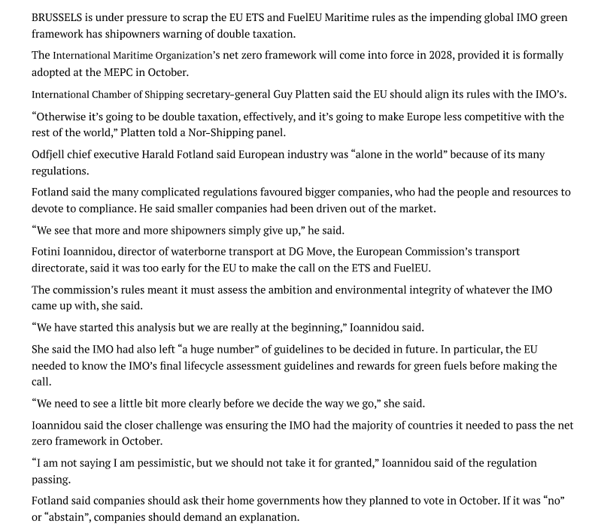

Slide 13


