Slide 1
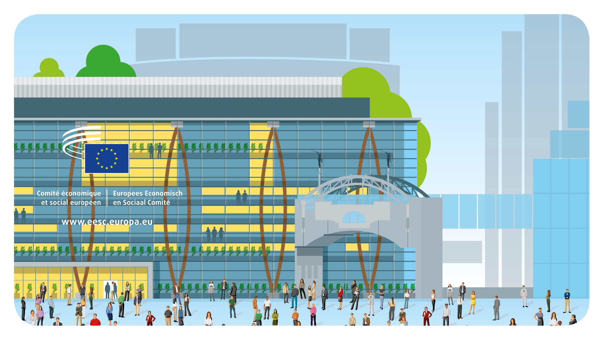
© Architecture: Art & Build + Atelier d’architecture Paul Noël
Welcome

Slide 2
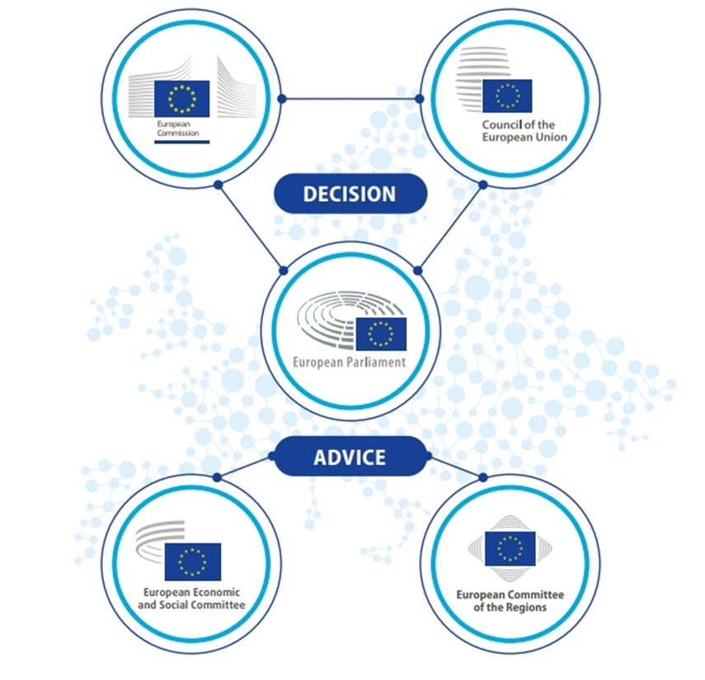
The European Economic and Social Committee is a consultative body that represents organised civil society.
“ The European Parliament, the Council
and the Commission shall be assisted by
an Economic and Social Committee
and a Committee of the Regions acting
in an advisory capacity.”
Treaty on European Union, Article 13

Slide 3
AN ASSEMBLY OF 329 MEMBERS FROM
ALL MEMBER STATES OF THE EU
Appointed for a renewable five-year term by the Council on a proposal from each Member State.
Independent (= not politically-affiliated) and performing their duties in the interest of all EU citizens.
Not based full time in Brussels: most continue working for their home organisations in their country of origin. Their travel and accommodation costs are covered by the EESC.

Slide 4
WHAT DOES ORGANISED CIVIL SOCIETY MEAN?
It comprises all the groups and organisations in which people work cooperatively:
Employers (107)
Workers (112)
Civil Society Organisations (106)
Employers federations,
Chambers of Commerce,
SME organisations s
Trade Unions
Farmers, Consumers, NGOs, Youth, Professions, Disabilities, Academics, Cooperatives…
They are committed to defending their groups' (or their communities') interests and causes, and they often act as intermediaries between decision-makers and citizens.

Slide 5
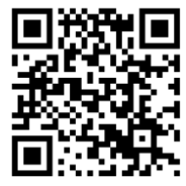
WHAT IS THE EESC’S FUNCTION?
The European Parliament, the Council of the EU and the European Commission are legally obliged to consult the EESC when passing new laws. Consultation can cover a wide range of topics.
The EESC members, representing all 3 Groups, debate, consult and reach consensus to draw up a single document, called an “opinion”, on the proposed legislation.
After an opinion is adopted, it’s sent to the EU institutions to be discussed and published in the EU’s Official Journal (24 languages).
The rapporteur presents key findings and promotes the opinion at EU, Member State and local level.
In total, the EESC produces around 200 opinions every year.
Scan the QR code to find out more!

Slide 6
WHY IS THE EESC IMPORTANT FOR THE EU?
The Committee is the only institutional meeting place and forum for dialogue at European level that enables consensus to be reached between diverse interests. It is the only way for Europe’s interest groups to have a formal say on draft EU legislation in an interinstitutional framework.
Participation of organised civil society is a fundamental element of European democracy: participatory democracy.
Many topics affecting people’s daily lives are covered (employment, health, consumer rights, farming, the fight against organised crime, etc.).

Slide 7
ECO
WORKING BODIES: 6 SECTIONS
Single Market, Production and Consumption
Transport, Energy, Infrastructure and the Information Society
INT
TEN
SOC
Economic and Monetary Union and Economic and Social Cohesion
Employment, Social Affairs and Citizenship
Agriculture, Rural Development and the Environment
External Relations

Slide 8
OTHER WORKING BODIES
Digital Transition and Single Market Observatory
Ad-hoc group Fundamental Rights and the Rule of Law
Labour Market Observatory
Ad-hoc group European Semester
Sustainable Development Observatory
ESG
DSMO
FRRL
LMO
Ad-hoc Group on Equality
Ad-hoc group on COP
CCMI Consultative Commission on Industrial Change
Ad-hoc Youth Group
SDO
EESC Youth Group

Slide 9
RECENT SUCCESS STORIES
Secure access to social and affordable housing for all
Leading the call for an EU Water Strategy
Ensuring that trade agreements benefit all sections of society
The EESC’s demands shaped the Liège Declaration of March 2024, adopted at the European Conference of Housing Ministers under the Belgian Presidency of the Council.
In 2023, the EESC launched the EU Blue Deal – the first major call for a unified EU water policy. This initiative not only identifies Europe’s water issues but also delivers a clear and concrete roadmap for tackling them.
The EESC was appointed by the European Commission as the secretariat for all of the EU Domestic Advisory Groups (DAGs), under the leadership of chief coordinator Tanja Buzek.
Upholding the right to affordable energy for everyone
Placing the right to
Repair at the core of the EU’s consumer protection policy
Calling for an EU action plan on rare diseases
Through a series of recommendations and conferences, the EESC have pushed to ensure that an EU action plan on rare diseases is included in the next Commission’s work programme.
The EESC’s recommendation for a European Poverty Observatory led the European Commission to create the Energy Poverty Advisory Hub (EPAH).
In 2023, the Commission introduced the legislative proposal ‘Right to repair’ as part of the New Consumer Agenda. It addresses obstacles that deter consumers from repairing products.

Slide 10
RECENT SUCCESS STORIES
Integrating young voices in EU decision-making
... and many more!
In 2022, The EESC became the first EU institution to commit to the EU Youth Test, a pioneering tool to mainstream youth participation in policymaking.
Check the recent achievements at eesc.europa.eu
Driving the future of sustainability with the European Circular Economy Stakeholder Platform
Making it mandatory to consult civil society on necessary economic reforms
In 2023, the European Commission introduced a proposal to reform the EU’s economic governance framework to address today’s economic challenges. The EESC had issued pivotal recommendations which significantly shaped the final legislative package.
In 2017, in partnership with the European Commission, the EESC launched the European Circular Economy Stakeholder Platform (ECESP).
Leading the way in just transition
Bringing food policy to the EU table
In 2023, the EESC’s ad hoc group on the UN Framework Convention on Climate Change (UNFCCC) contributed to the Just Transition Work Programme (JTWP) by directly influencing the positions of EU Member States and the Commission.
In 2024, the EESC adopted recommendations for the post-2027 common agricultural policy, pushing for more sustainable food options that are both accessible to EU consumers and affordable for socially vulnerable groups.

Slide 11
MULTILINGUALISM IN THE COMMITTEE
The EU’s motto United in Diversity truly comes to life through multilingualism at the EESC.
We deeply value and actively promote the use of all 24 official EU languages.
To support this, our members have the right to work in their own language, both in speech and in writing.
All EESC opinions, official documents, and most digital content are made available in every language, thanks to the dedicated work of our Directorate for Translation.

Slide 12
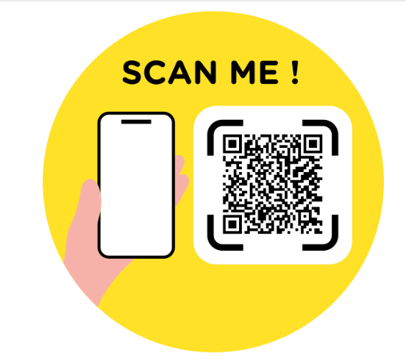
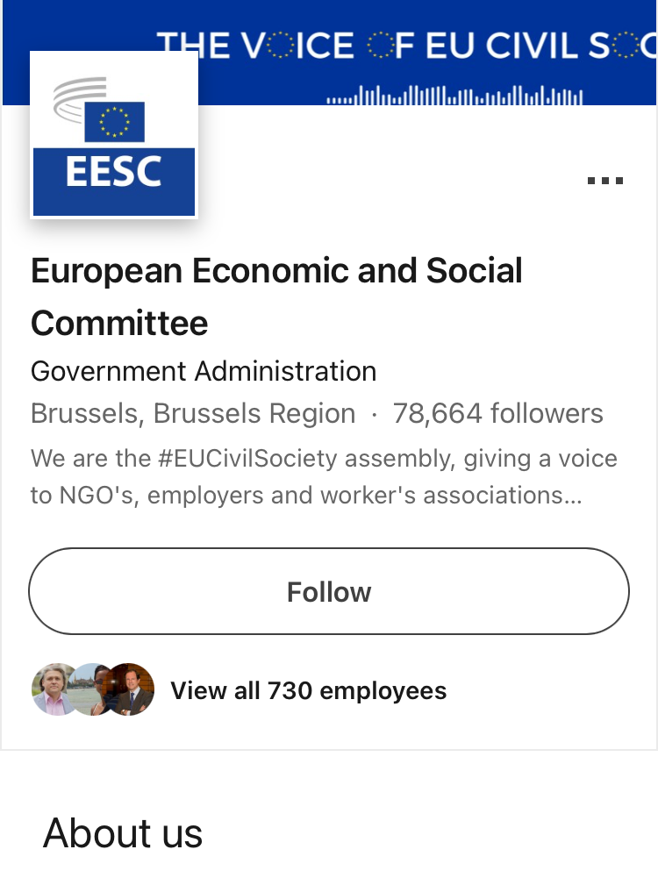
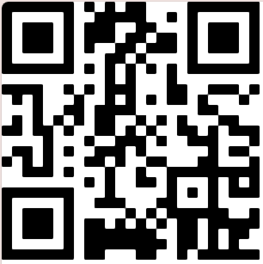
DO YOU HAVE ANY QUESTIONS?
Scan the QR for the evaluation form
Want to reach out? Email us at visitEESC@eesc.europa.eu
Follow us for more:
European Economic and Social Committee
@eu_civilsociety
@eesc.bsky.social
Keep in touch!
EESC - European Economic and Social Committee
@EU_EESC
@EurEcoSocCommittee

Slide 13
Members Page
Follow-up on Opinions
Full list of the current EESC Members and CCMI delegates
Actions taken on the EESC opinions
Annex: Additional information
EESC Opinions
Plenary sessions
Opinions currently in the spotlight
How to follow an EESC Plenary Session
Work with us!
CESlink
Twice a year, the EESC offers 5-month paid traineeship in various fields
Online community of the national Economic and Social Councils
The lifecycle of an opinion
What Europe does for me
How the EESC opinions are drafted (video)
Impact of the EU actions on the everyday life of its citizens

Slide 14
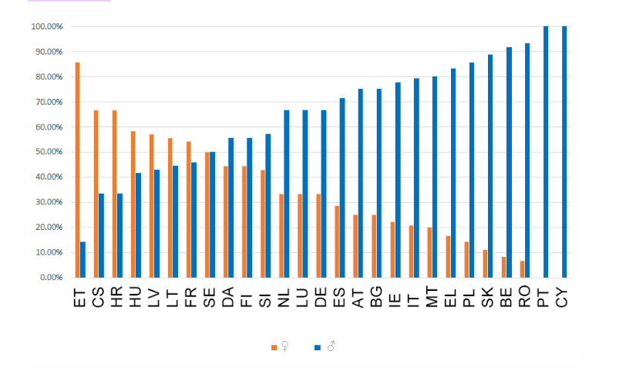
MEMBERS BY COUNTRY
As with other European institutions, the committee’s geographical representation is proportional, meaning that more populous countries are allocated a greater number of members to represent them.
Therefore, France, Germany, and Italy have the most members (24), while Malta has the fewest (5).
GENDER BALANCE
The EESC's 2020-2025 term of office has the highest number of female members since statistics on membership began in 2010.
There is a higher percentage of women at the Committee than ever before: 33% compared to 28% in 2015 and 24.70% in 2010.

Slide 15
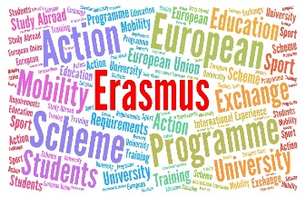
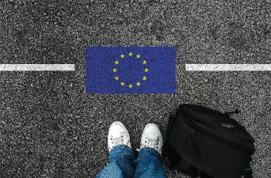
WHAT DOES THE EU DO FOR YOUNG PEOPLE?
Explore
Thinking about a job in the EU institutions or another EU country?
Each year, the EU offers paid traineeships to young university graduates.
Speak
You can take part in youth events like the EU Youth Dialogue, the European Parliament's European Youth Event (EYE), and Your Europe, Your Say! at the European Economic and Social Committee.
There, you can make your voice heard!
Work
You can apply for jobs within the European Union when you are 18 years old. The EURES scheme connects you with employers across EU, Norway and Iceland.
Study
You are entitled to study at any EU university under the same conditions as nationals of that country.
The ERASMUS programme allows you to do part
of your university studies abroad.
Travel
The border-free Schengen Area gives 400 million EU citizens free movement between countries. For instance, the INTERRAIL train pass allows you to reach over 40 000 destinations in 30 countries.

Slide 16
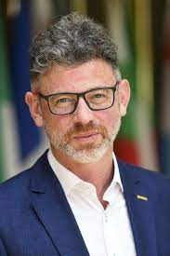
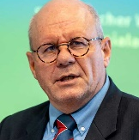
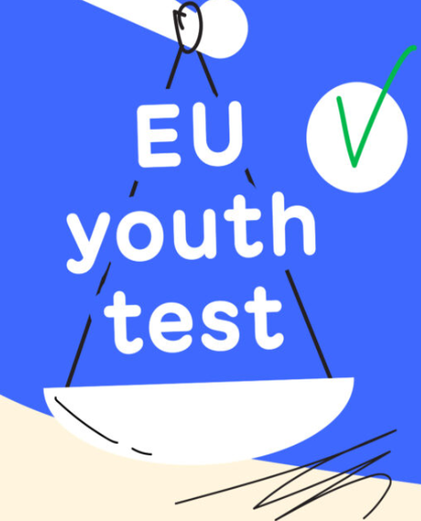
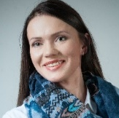
EESC YOUTH INITIATIVES
Youth Delegate ​ to COP​
Youth Climate and Sustainability Round Tables
Your Europe, Your Say!
Study on youth participation at various levels
EESC Youth Group
EU Youth Test at the EESC
Notes:
For some years now, the EESC has been working on how to better integrate the voice of young Europeans in its work and in the EU decision-making process in a structured and meaningful way

Slide 17
THE EU YOUTH TEST AT THE EESC
The Youth Test is a tool designed to strengthen youth participation and youth mainstreaming in policy-making. At the EESC, it means that youth representatives can participate in the preparation of the EESC policy recommendations:
Participate in meetings and hearings
Provide written contributions
Follow the uptake of the opinion

Slide 18
The European Parliament, the Council of the EU and the European Commission are legally obliged to consult the EESC when passing new laws on a wide range of topics in the following domains:
Industry
Energy
Transport
Investment
Environment
Public health
Non-discrimination and citizenship of the Union
Health and Safety
Agriculture and Fisheries
Education, vocational training, youth and sport
Social Policy
Employment
Research and technological
development and space
Nuclear common
market
Trans-European Networks
Common rules of competition,
taxation and approximation of laws
Economic, social and territorial cohesion
Consumer protection
Free movement of persons, services and capital
European Social Fund

Slide 19
TITLE
EMPTY TEMPLATE
ADD your text

Slide 20
REX
SOC
NAT

Slide 21
REX
SOC
NAT

