Slide 1
Savings and Investment Union
The rôle of stakeholders - How to mobilise private investment in the EU
EECS June 11 2025
Notes:
Simon, La finance durable : un atout stratégique de differentiation. Opportunité de mettre un peu d’ordre et de cohérence. Erreur d’opposer compétitivité et durabilité.
Mirela: regagner des parts de marché face à des acteurs américains qui renoncent à l’ESG. Cela montre où mènent les excés.
Arnaud : assumons d’être européen. SFDR n’aurait jamais dû être CSRD. Beaucoup d’incertitude et de confusion.
Stéphane : mandats idem. En Asie et au UK, plusieurs mandats gagnés sur l’ESG. On ne peut jamais préjuger à moyen terme mais à court terme c’est favorable. Ce n’est pas parce que l’on détricote. Au contraire, on garde le cap. Opportunité de se distinguer.
C’est quoi la simplification: simplifier ce n’est pas réhausser les seuils mais revenir à un reporting opérationnel. 250 indicateurs.
Christophe Peronin ; finance durable un axe de développement. Simplification n’est pas égale à dérèglementation. On atteint un niveau de règlementation trop élevé. Simplifier seulement n’est pas suffisant.
11:15
The role of stakeholders – how to mobilise private investment in the EU
Delphine de Chaisemartin, Deputy CEO, Association française de la gestion financière (AFG)
Sebastien Commain, research and policy officer, Better Finance
Priscille Szeradzki, President, European Association of Cooperative Banks (tbc)
Q&A and debate

Slide 2
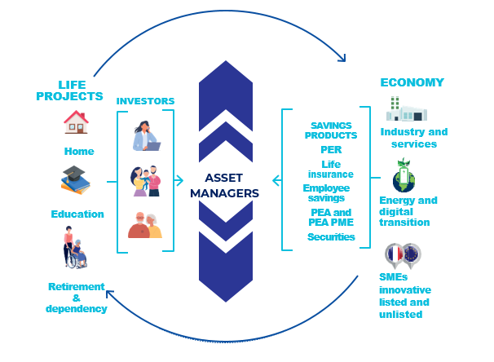

SIU is not just about savings or investment – it’s about connecting the two strategically.
Let’s rebuild a competitive, empowered EU ecosystem
SAVINGS PRODUCTs

Slide 3
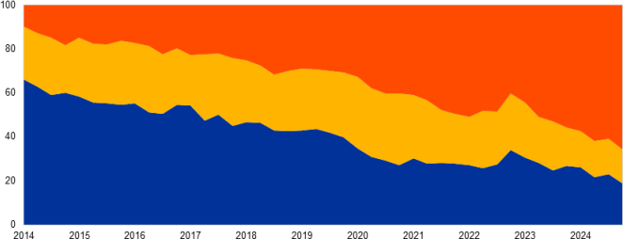

EUROPE’s PARADOX: HIGH SAVINGS, LOW INVESTMENT in the EU
High savings
€33 trillion in EU household financial assets (Eurostat 2023). ~ 12% household savings (vs ~7% US)
But ~17% of EU household financial wealth in equities, vs ~40% in the US (OECD)
Low Investment in the EU…ever more invested outside the EU with poor diversification & concentration on a few non-EU issuers
Geographical allocation of issuers in EU portfolios
Weighting of top 25 issuers in portfolios
Source « ECB – Financial Stability Review »

Slide 4
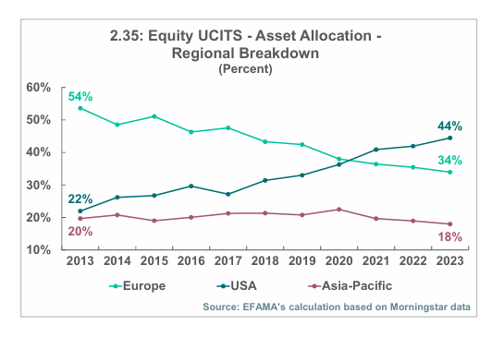
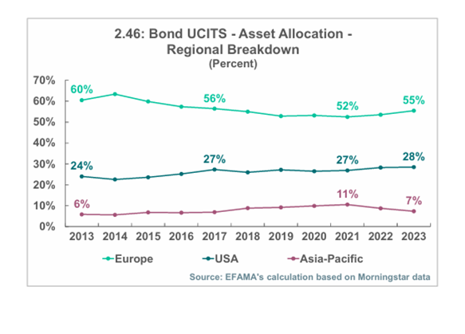
EUROPE’s PARADOX: HIGH SAVINGS, LOW INVESTMENT in the EU
Low Investment in the EU comes at a cost
EU capital markets accounts for only 13% of global equity market cap (vs 42% US – IMF)
IPO volumes in the EU dropped by 90% between 2021 to 2023 (Euronext)
Although EU investment managers allocate 15 pts more to EU than non-EU peers, offering local expertise, essential for financing SME but they are losing market share.
Source « EFAMA»
Europe has the capacity – but underuses it. SIU aims to unlock this potential

Slide 5
Retail Investors: Unlocking Untapped Potential
Bridge the Financial literacy gap
Only 18% of EU adults can correctly answer three basic finance questions (OECD)
But a recent study in France (ELABE) show that they are eager to learn starting at school!
65% say Yes to bring financial education at school and 80% of 18-24 years old
In % - All French people
TOTAL YES: 65%
Source ELABE 2025

Slide 6
Retail Investors: Unlocking Untapped Potential
Levers to encourage Investment: What would motivate French people to Invest more in the medium to Long Term? In % - All French people
Achieve high return potential on investments
Receive personalised support and advice from a professional
Be better informed about all aspects of financial investment
Better tax incentives
A system of automatic payments into savings products
Greater simplification of the customer process (questionnaires and regulatory information) and financial product documentation
Controlled management of your savings (allocations are automatically made according to your age)
Source ELABE 2025

Slide 7
Retail Investors: Unlocking Untapped Potential
Who or what do you trust most for information on savings management or financial advice? In % - All French people
TOTAL
CONFIDENCE
TOTAL
NO CONFIDENCE
Your bank (in person, online or by telephone)
Your family and friends
Public bodies (Banque de France, Autorité des Marchés Financiers)
A financial adviser (asset management company, CGP, CIF, broker)
Associations, universities
Discussions with artificial intelligence (ChatGpt, Copilot, etc.)
Influencers on social networks
62
55
54
51
36
16
9
26
29
30
32
42
68
79
Source ELABE 2025

Slide 8
Retail Investors: Unlocking Untapped Potential
Which of the following factors contribute to your confidence in the financial information and advice you receive? In % - All French people
The fact that the information is certified by public bodies (Banque de France, Autorité des Marchés Financiers)
The fact that the person has professional certification or approval issued by a recognised body (for example, the Autorité des Marchés Financiers)
The fact that the person has a large number of subscribers
Source ELABE 2025

Slide 9
SIU is not just about savings or investment – it’s about connecting the two strategically.
Unlock the EU Investment Potential
Empower retail investors
Connect Savings and investment
Channel Savings in the EU Economy

Slide 10
SIU is not just about savings or investment – it’s about connecting the two strategically.
Empower Retail Investors
Develop financial education early
Improve client journey: streamline PRIIPs
Replace misleading “performance scenario” with past performance
Remove unmeasurable “implicit transaction” costs
Unlock the EU Investment Potential: Enable an attractive, competitive framework
Simplify EU regulation for asset managers
Prioritize global competitiveness: ensure level playing field
Ensure stronger oversight of data service providers (e.g., ESG, ratings, benchmarks) to prevent dependency and ensure data quality and reliability.
Strengthen the role of asset managers in financing the economy

Slide 11
SIU is not just about savings or investment – it’s about connecting the two strategically.
Connecting Savings & Investment – Ensure Trust, Clarity, and Competitiveness
Avoid one-size-fits-all “low-cost” bias
MiFID & UCITS: already deliver clarity and comparability
Protect UCITS brand: no product cannibalization
No regulatory push for “low-cost”: risk of standardization, overconcentration, limited diversification
Channel Savings into the EU Economy
Relaunch IPOs with “Bonus IPO” incentive
Revive securitization to boost financing capacity
Create an EU Label: long-term horizon, SME focus, auto-enrolment & best-in-class national tax treatment

