Slide 1


Shaping the future of a
sustainable, safe and secure
shipping industry.

Slide 2

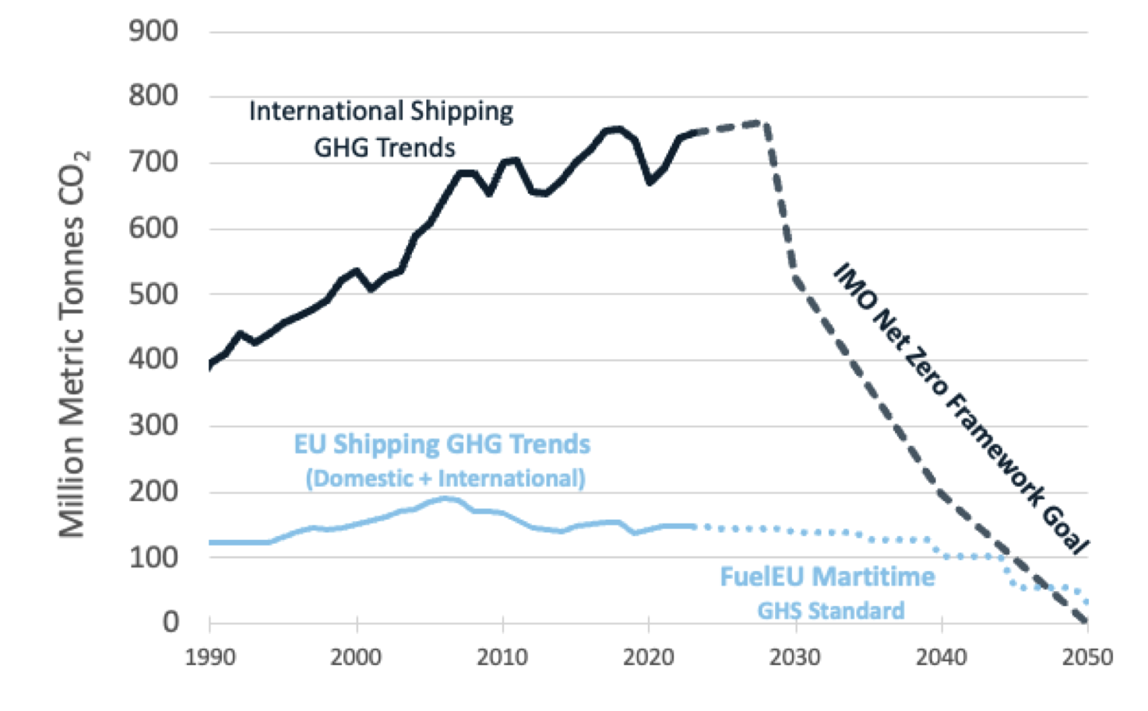
IMO policy will lead global GHG reductions
IMO Net Zero Framework is turning point
Global, clear, unified requirements to 2050
Well-to-wake GHG pricing + incentives
IMO applies to ~750 million tons CO_{2e}
Consider 2035 requirements:
IMO reduces GHG intensity by 30-43%
GHG pricing: $380+ Tier 2, $100 Tier 1
IMO policy reduces ~12x more GHGs than EU policies on a global scale
IMO reduces double or triple GHGs within EU geographic scope

Slide 3
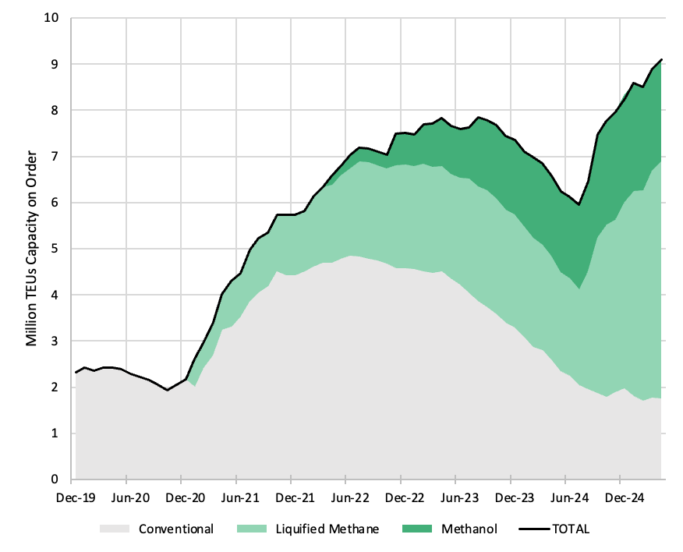
Liner sector investing more than $150 Billion in GHG transition
About 1000 ships on the water by 2030, dual-fueled and renewable ZNZ capable
2020: order book was 100% conventional
Today, ~80% of liner ships on order are designed for zero/near-zero fuels
Renewable marine fuels and ZNZ rewards could enable the fleet to transition 8-10% of global fuel consumption by 2030
This isn’t theory—it’s happening.
With IMO adoption of Net Zero Framework in October 2025, considerable work remains.
Fleet demand potential (order book/retrofits)
Renewable fuel production supply and scale
Policies that close cost gap so that ZNZ fuels are available at a competitive price

Slide 4
IMO alignment support EU goals
Coordinated leadership by EU nations helped IMO reach global GHG agreement
IMO sets well-to-wake GHG pricing tied to lifecycle performance
Global standard prevents inequitable competitive distortions among nations
Motivations to improve EU ETS policy design
  Regional pricing design can impact competitiveness with double burden to EU trade
  Tank-to-Wake pricing does not align with IMO Net Zero Well-to-Wake GHG pricing
  Collecting high-seas revenue for regional coffers contradicts JET efforts at IMO
Remedy available: Remove regional policy design flaws and align with IMO
  EU ETS includes in Reporting and review a requirement to avoid double burden

Slide 5
Thank you
Discussion welcome
Shaping the future of a
sustainable, safe and secure
shipping industry.

