Slide 1
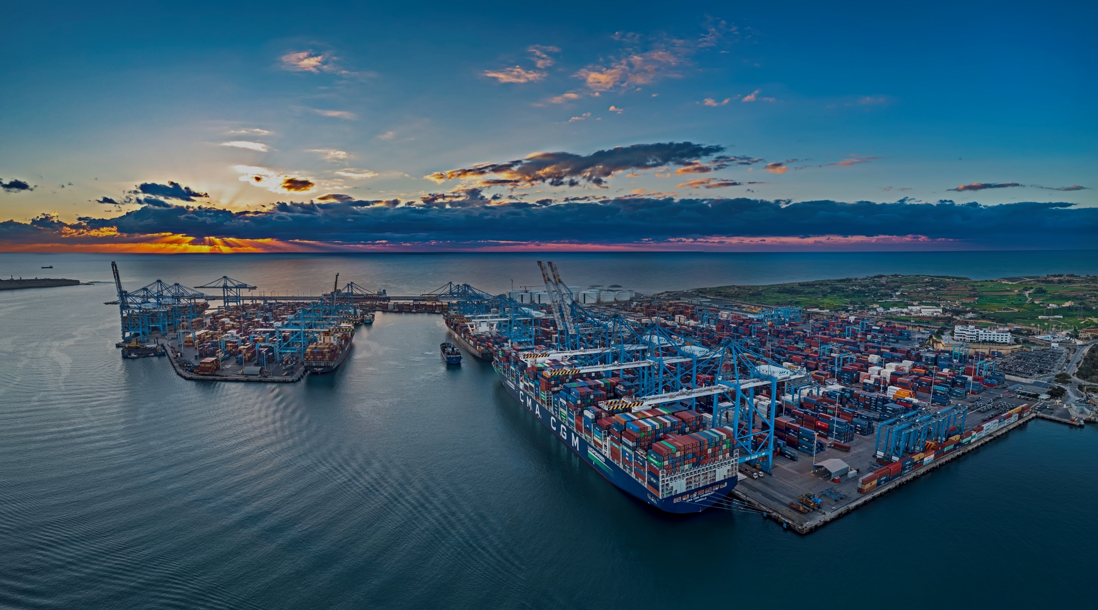




'Economic Impact of the Implementation of the EU Emissions Trading System (ETS)’
10th June 2025
Kevin J Borg

Slide 2

CONTEXT
The principals and objectives of EU ETS on Shipping are valid and commendable in terms of C&E (Climate & Environment).
The implementation of ETS, resulted in (a) business and
(b) carbon leakage as well as a disincentive to invest in EU ports.
Notes:
IMO carbon Levy
the implementation of ETS seems to be mis-aligned with other EU principles and objectives dealing with
Fair competition
Security of supply chains
De risking
Shift towards more multi-modal forms of transport
Solidarity amongst MS
The generation of growth and jobs
Carbon leakage

Slide 3
CONTEXT
REASONS
There is no global market-based measure, so ETS raised serious unfair competitive terms between ports located in EU MS and nearby competing ports in 3rd Countries.
Technology is not ready to serve the shipping industry. Uncertainty about the fuel of the future. High percentage of orders for new builds are dual-fuel.
https://www.reuters.com/sustainability/climate-energy/container-shippers-hedging-green-transition-with-dual-fuel-vessel-orders-2024-11-21/
Notes:
EU acted beyond its remit
IMO carbon Levy – carbon neutral by 2050 – action by 2027
AMMONIA, HYDROGEN, METHANOL/BIOFUELS, LNG
Container shipping companies had pending orders for 522 dual-fuel new vessels as of Oct. 31, according to data from DNV. Of those, 303 are designed to run on liquefied natural gas (LNG), 216 are meant to burn methanol, two would use hydrogen, and one would be equipped to use ammonia, according to the data.
Rebecca Galanopoulos, senior content analyst at maritime software and services provider Veson Nautical, said 65% of container vessel orders in 2024 were for dual-fuel engines versus just 4% in 2018.

Slide 4
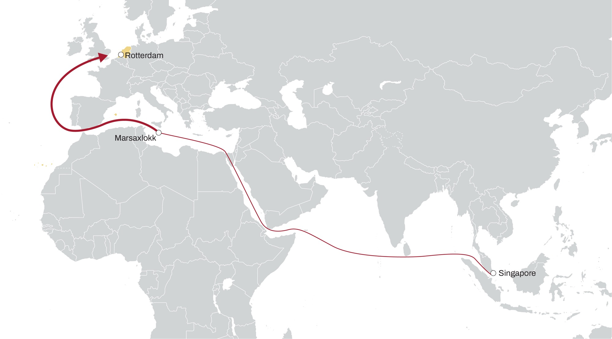

THE MECHANICS OF ETS
Scenario 1: Singapore (non-EU) → Marsaxlokk (EU) → Rotterdam (EU)
50% → 100%
100%
Leg | Total Distance (Miles) | CO2 | ETS Level | ETS CO2 | Cost
1 | 6010 | 5573 | 50% | 2786 | € 250'776
2 | 2424 | 2254 | 100% | 2254 | € 202'896
 | 8434 | 7827 |  | 5041 | € 453'672
Annual cost € 23'590'944
50%
Non-EU

Slide 5
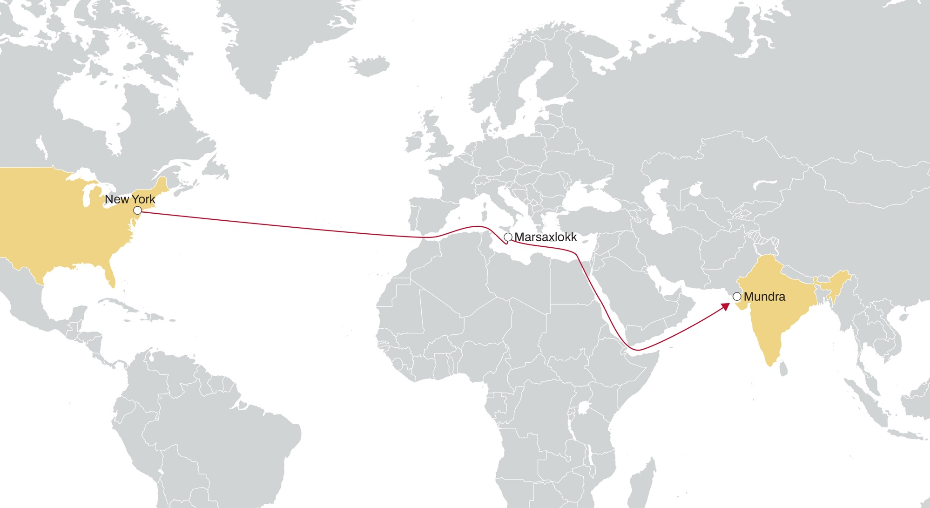
THE MECHANICS OF ETS
Scenario 2: Mundra (non-EU) → Marsaxlokk (EU) → New York (non-EU)
50% → 50%
Leg | Total Distance (Miles) | CO2 | ETS Level | ETS CO2 | Cost
1 | 4212 | 2911 | 50% | 1456 | € 131'000
2 | 3903 | 2693 | 50% | 1347 | € 121'194
 | 8115 | 5604 |  | 2802 | € 252'194
Non-EU
50%
Annual cost € 13'114'062
Non-EU
50%
Notes:
According to the ETS a non-EU (Mundra) to an EU port (Marsaxlokk) voyage carries 50% of carbon emissions.
Once again, there is another 50% charge from the EU port (Marsaxlokk) to a non-EU port (NY)

Slide 6
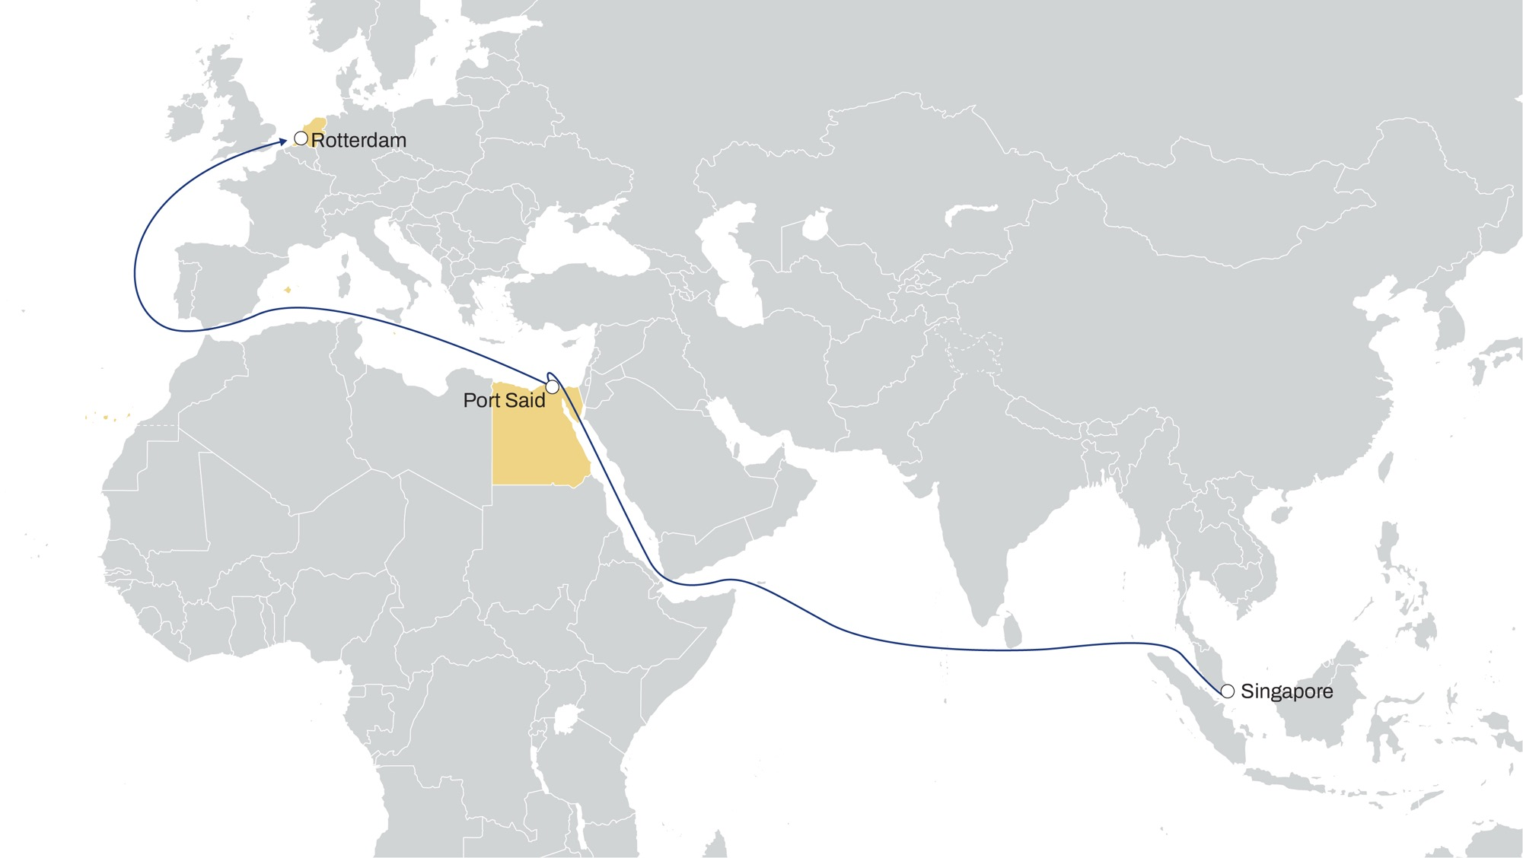
TRANSHIPMENT RULE
Scenario 3: Singapore (non-EU) → Port Said (Neighbouring Port) → Rotterdam (EU)
50% → 50%
Leg | Total Distance (Miles) | CO2 | ETS Level | ETS CO2 | Cost
1 | 5073 | 4704 | 50% | 2352 | € 211'680
2 | 3340 | 3104 | 50% | 1552 | € 139'671
 | 8413 | 7808 |  | 3904 | € 351'351
Notes:
As Port Said is a Neighbouring Port and the subsequent destination is an EU Port (Rotterdam) according to the Transhipment Rule, the call at Port Said is not counted and instead (according to the ETS rule that a non-EU to EU port voyage carries 50% of carbon emissions) there is a 50% of the carbon emissions charge from Singapore to Rotterdam
A port that is located less than 300 nautical miles from an EU port can be identified as a neighbouring container transhipment port if transhipment of containers at that port exceeds 65% of its total container traffic.

Slide 7
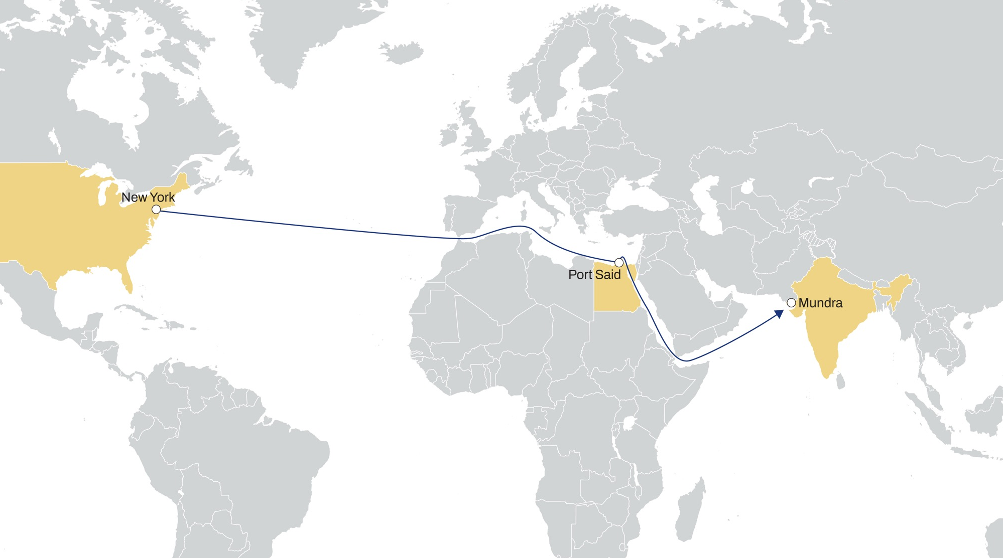
TRANSHIPMENT RULE
Scenario 4: Mundra (non-EU) → Port Said (Neighbouring Port) → New York (non-EU)
0% → 0%
Non-EU
Leg | Total Distance (Miles) | CO2 | ETS Level | ETS CO2 | Cost
1 | 5128 | 3543 | 0% | 0 | € -
2 | 2966 | 2047 | 0% | 0 | € -
 | 8094 | 5590 |  | 0 | € -
0%
Annual cost € -
Non-EU
Non-EU - neighbouring container transshipment hub
0%
Notes:
This is where the transhipment rule is most harmful to EU ports.
A ship sailing from non-EU (Mundra) to non-EU (NY) with a transhipment call at Port Said instead of Marsaxlokk, Gioia Tauro or any other EU Mediterranean port, is charged 0% all the way,

Slide 8

EVASIVE PRACTICES
The ramping up of investments by major shipping lines in
ports located in other continents left no doubt that these
were intended to prepare alternatives to bypass EU ETS.
Notes:
ETS is essentially a positive initiative of the EU and one that in principle no one can fault
Its objectives are very valid and commendable from a sustainability and climate change point of view but it has raised enormous issues from an implementation point of view. The issues are mainly related to business leakage because in the absense of a global (market-based) measure driven or imposed by the IMO, it is driven by the EU which has limited jurisdiction over other continents.
So ETS has raised unfair competition between EU ports and ports in other continents which is placing us a very serious risk. Besides that the implementation of ETS seems to be mis-aligned with other EU principles and objectives dealing with
Fair competition
Security of supply chains
De risking
Shift towards more multi-modal forms of transport
Solidarity amongst MS
The generation of growth and jobs
Carbon leakage

Slide 9
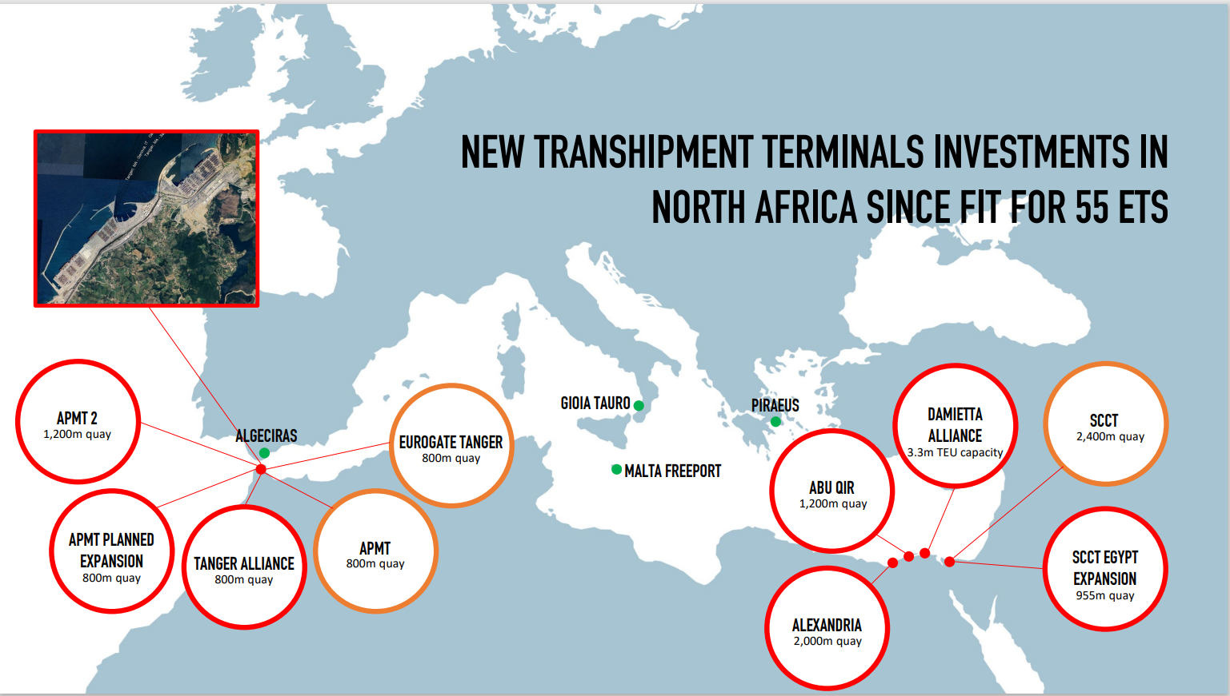

Slide 10

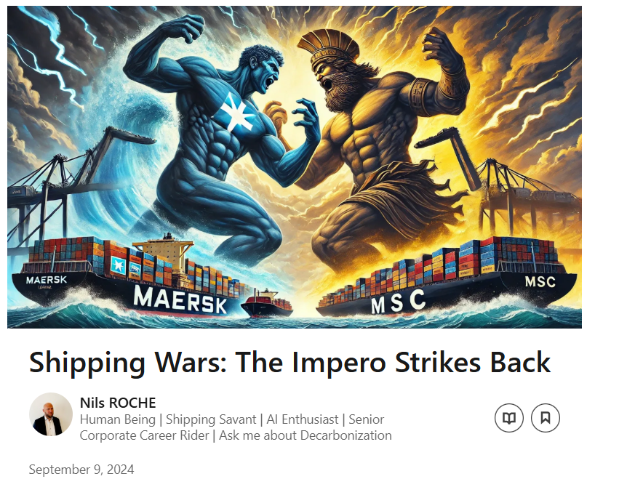

CONSEQUENCES
(17) Shipping Wars: The Impero Strikes Back | LinkedIn
From reliable market sources it has been confirmed that as of January 2025, the service of One calling at Malta will cease. Instead Malta will participate in the service calling at Egypt.
Notes:
Shipping companies choosing ports in other continents for transhipment services will achieve substantial savings, leading to a cost differential which, in a highly competitive market, those companies choosing not to follow suit will not be able to sustain.
This resulting scenario will penalize those terminal operators which (as opposed to some competitors) decided to invest in EU ports.
This trend will lead to de-localized investments, favouring neighbouring non-EU countries, and discourage future investment in EU transhipment ports and activities.

Slide 11
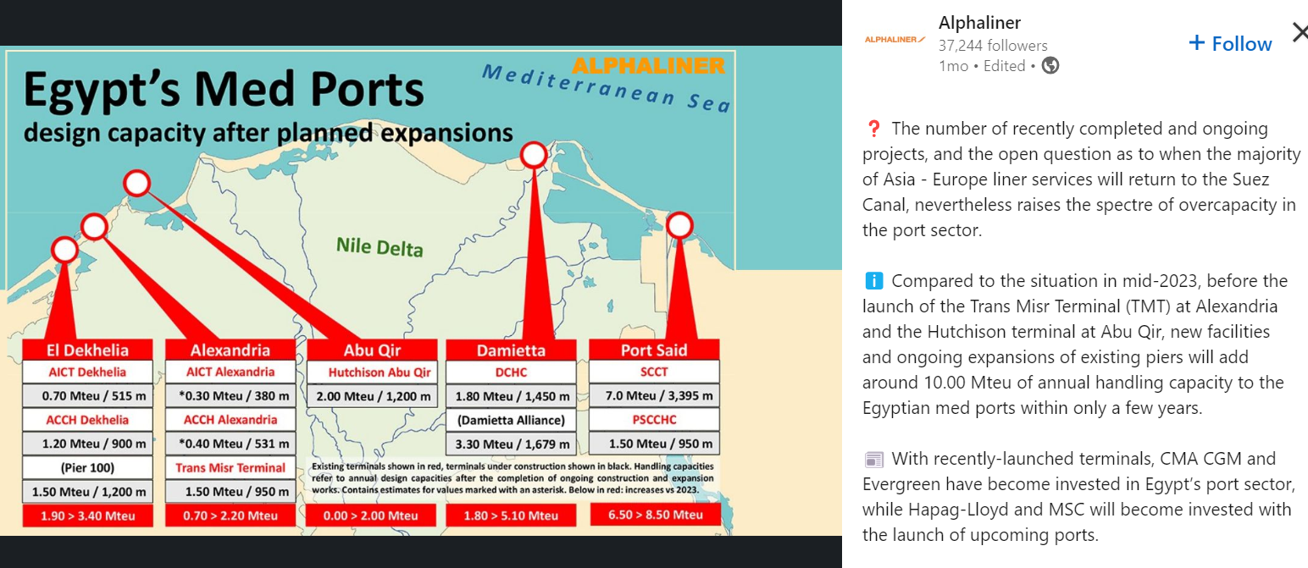
CONSEQUENCES
https://www.linkedin.com/feed/update/urn:li:activity:7247221414217273346/ | LinkedIn
Notes:
Shipping companies choosing ports in other continents for transhipment services will achieve substantial savings, leading to a cost differential which, in a highly competitive market, those companies choosing not to follow suit will not be able to sustain.
This resulting scenario will penalize those terminal operators which (as opposed to some competitors) decided to invest in EU ports.
This trend will lead to de-localized investments, favouring neighbouring non-EU countries, and discourage future investment in EU transhipment ports and activities.

Slide 12
CONSEQUENCES
BUSINESS LEAKAGE
Neighbouring ports in other continents already enjoy more competitive labour costs and state-aid arrangements.
The cost of Emission Unit Allowances is too prohibitive for EU Med ports to absorb in terms of efficiency and other advantages currently enjoyed over neighbouring ports.
Cost differentials are leading to irreversible evasive transfer of business particularly in light of new investment in extra-EU ports
This is discouraging further new investment in EU transhipment terminals with catastrophic economic repercussions which have been described as leading to a “desertification” of transhipment terminals within EU Member states.
Notes:
Shipping companies choosing ports in other continents for transhipment services will achieve substantial savings, leading to a cost differential which, in a highly competitive market, those companies choosing not to follow suit will not be able to sustain.
This resulting scenario will penalize those terminal operators which (as opposed to some competitors) decided to invest in EU ports.
This trend will lead to de-localized investments, favouring neighbouring non-EU countries, and discourage future investment in EU transhipment ports and activities.

Slide 13
CONSEQUENCES
BUSINESS LEAKAGE - MFT
The average annual volume of containers transhipped at MFT amounts to 3 million TEUs.
Of this only 134,000 TEUs (excl trailers) is domestic cargo.
These volumes do not economically justify a stop-over at MFT using mega carrier.
Malta stands to lose direct connections to 165 ports worldwide provided by the world’s top 5 container carriers calling at MFT.
This translates in a loss of 11 Mainline Services per week could potentially be impacted with the introduction of ETS.

Slide 14
CONSEQUENCES
BUSINESS LEAKAGE - MFT
Loss of connectivity assumes far more serious consequences for a small island MS like Malta whose economic survival and success depends solely on export-led activity, generated, not least by the logistics sector and the manufacturing industry.
Malta-based factories will be hit by :
  Higher freight costs (20-25% due to additional feeder leg)
  Longer transit times (by as much as 8-10 days)
  Irregular and unpredictable service (dependent on efficiency of N African transhipment hubs).

Slide 15
CONSEQUENCES
CARBON LEAKAGE
This catastrophic business leakage and major economic disruption will still generate a commensurate carbon leakage because the ships that
will be kept out of EU ports will still transit the Med.
It may be argued that carbon emissions would be higher because:
mega-carriers will need to deviate from the most efficient navigation course to call at North African ports instead of central Med terminals located in the EU (Malta and Gioia Tauro)
ships may need to increase power under sail to compensate for deviation delays
extra voyages required by feeder ships to transport EU-destined cargo from N African transhipment hubs to southern EU ports

Slide 16
CONSEQUENCES
MISALIGNMENT WITH EU PRINCIPLES
Situation impinges on the very basic principle of the European Union to guarantee free movement of goods because transhipment hubs in southern Europe will be completely by-passed, thus disadvantaged and discriminated by competing nearby non-EU ports.
EU De-risking policy will also be compromised
Backward step to an integrated multi-modal system in countries like Italy and Spain.

Slide 17

CONSEQUENCES
MISALIGNMENT WITH EU PRINCIPLES
Further fuelling of inflationary pressures augmenting the effects of COVID-19 and the war in Ukraine.
Significant job losses in maritime industry and other industries where shipping and logistics are a prime enabler (eg manufacturing) – to prevalently hit less developed regions in the EU.
Undue risks on supply chains and loss of tracking/enforcement control systems as a result of new dependencies on N African transhipment hubs.

Slide 18

CONCLUSIONS
The objectives of the ETS Directive are essentially positive.
Its application is causing unfair distortions in the fair competitive conditions between EU and Neighbouring non-EU ports
in the Med compromising solidarity and Just Transition objectives.
This impact is not being captured in the ex-post reviews of the EC which are not future-looking and fail to identify risks posed by new investments.
The socio-economic risks from loss of direct connectivity for Malta as a small Island Member State are too catastrophic to contemplate.
ETS & FuelEU regulations must align with IMO net zero framework once in place to avoid prolonging of business & carbon leakage through x2 tax.
Notes:
Equal EUA treatment of containerised cargo voyages that start or finish in an EU port.
The IMO said it was simply living up to the pledge it made last year to decarbonize the entire shipping industry by 2050. Its member countries have agreed that they need to start charging the shipping industry for emissions of heat-trapping gases in 2027.

Slide 19




THANK YOU
admin@mmf.org.mt admin@maltaemployers.com
ceo@mmf.org.mt kjborg@maltaemployers.com
chair@mmf.org.mt president@maltaemployers.com
mmf.org.mt maltaemployers.com
linkedin.com/company/malta-maritime-forum/
linkedin.com/company/malta-employers-association/

