Slide 1


EESC Hearing
on the
Economic Impact of EU ETS
Faïg Abbasov
10/06/2025

Slide 2
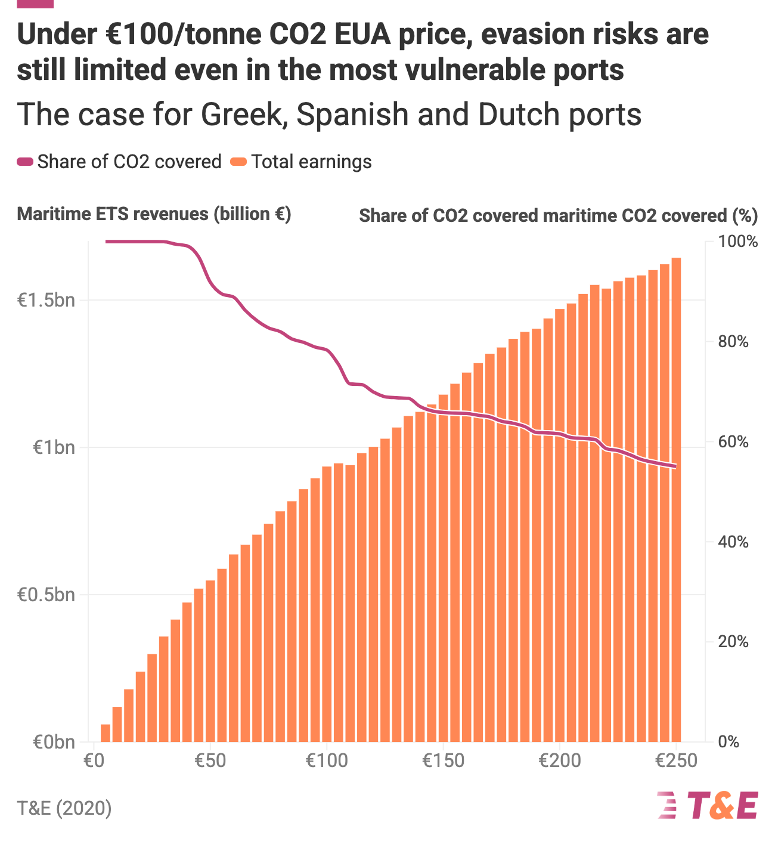
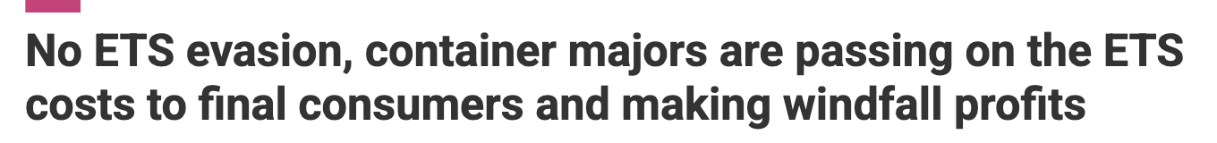
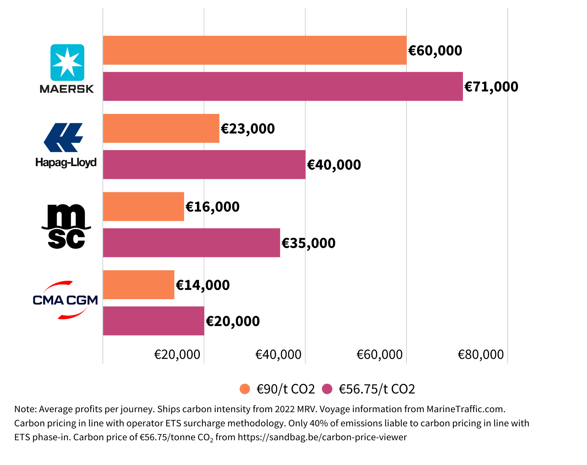

Slide 3
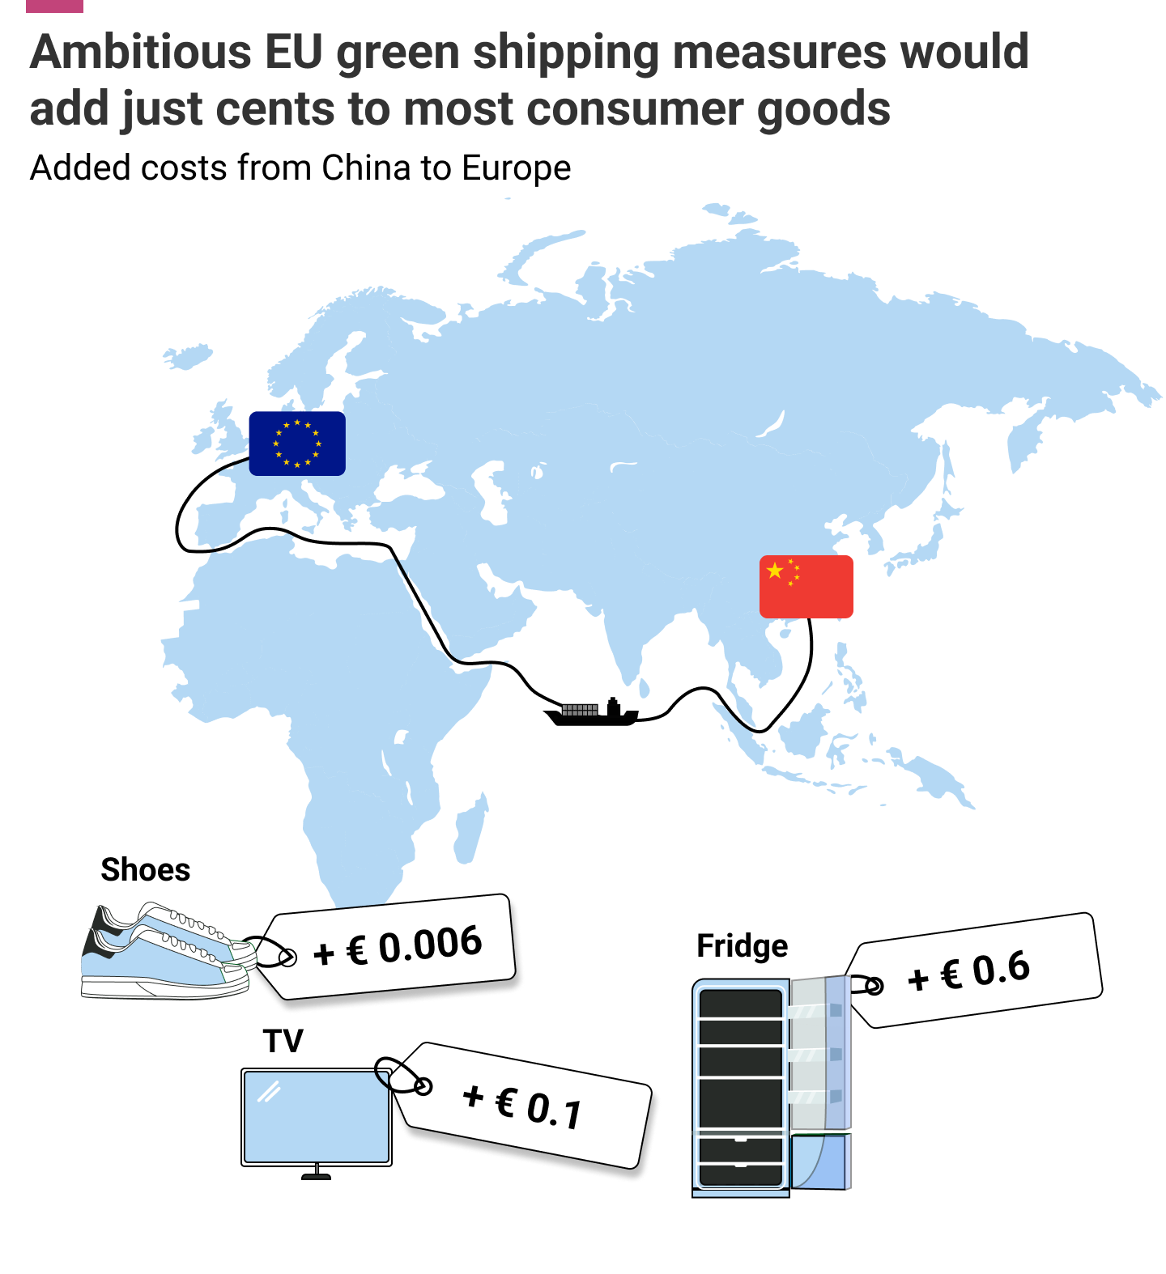
How much will it cost?
For most consumer goods < €1.
Costs negligible compared to normal market fluctuations.
EU legislation enables pass through of regulatory costs to reduce impact on shipowners

Slide 4
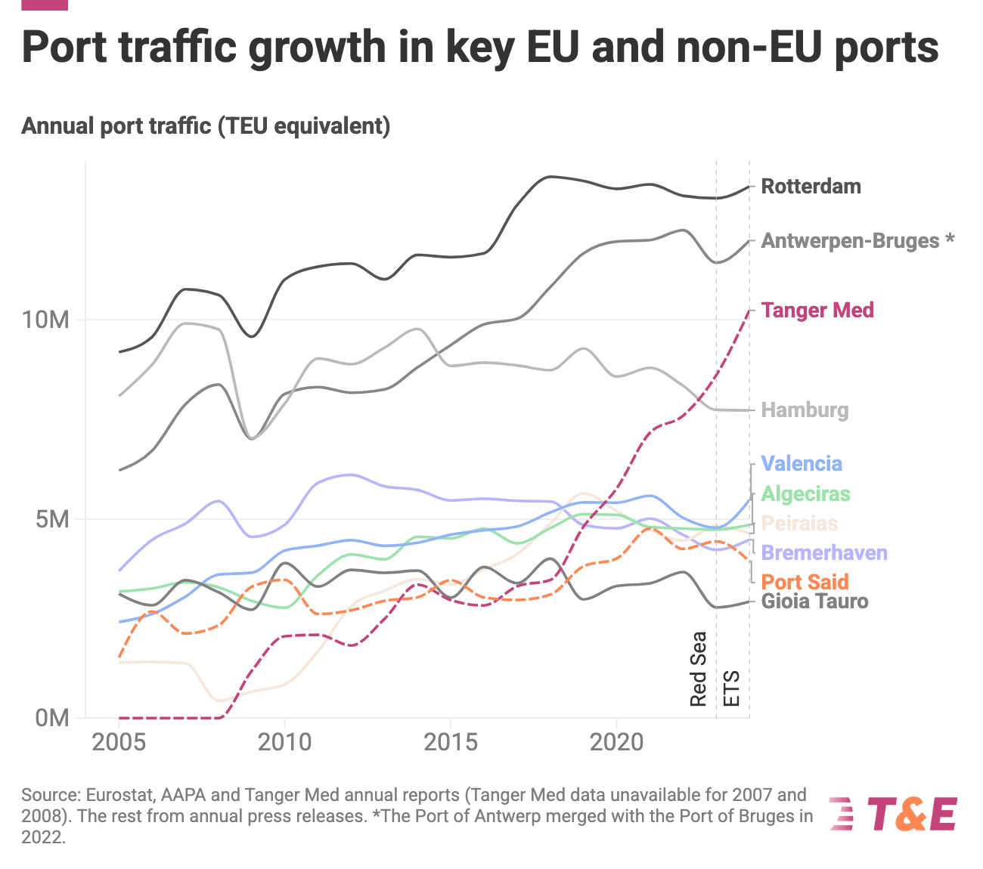
Impact on ports?
Historical traffic shows no causal link between growth in N.African port traffic and EU ETS.
Red-Sea crisis likely to blame for the decline in traffic in 2023.
Despite EU ETS, port traffic bounced back in 2024 in nearly all evasion sensitive EU ports.

Slide 5
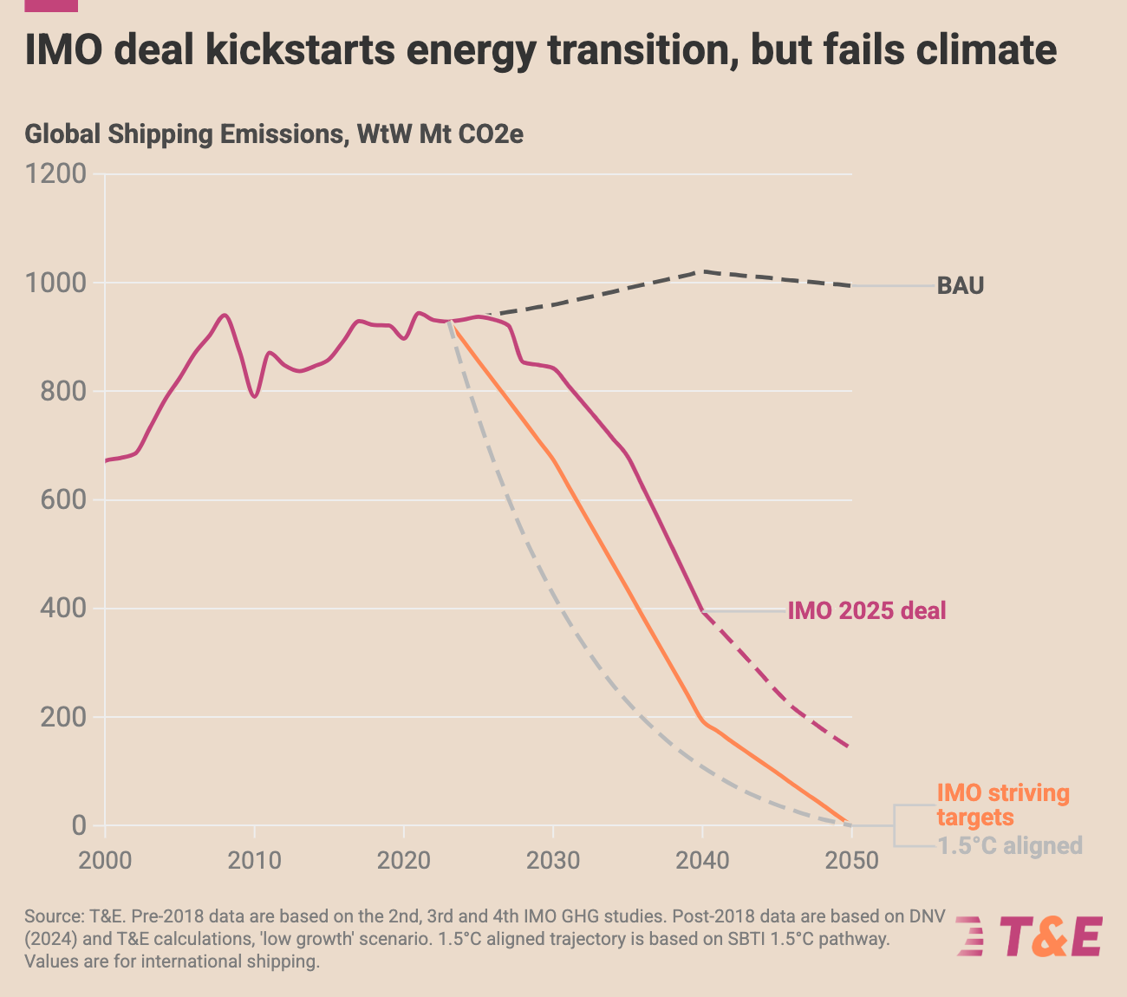
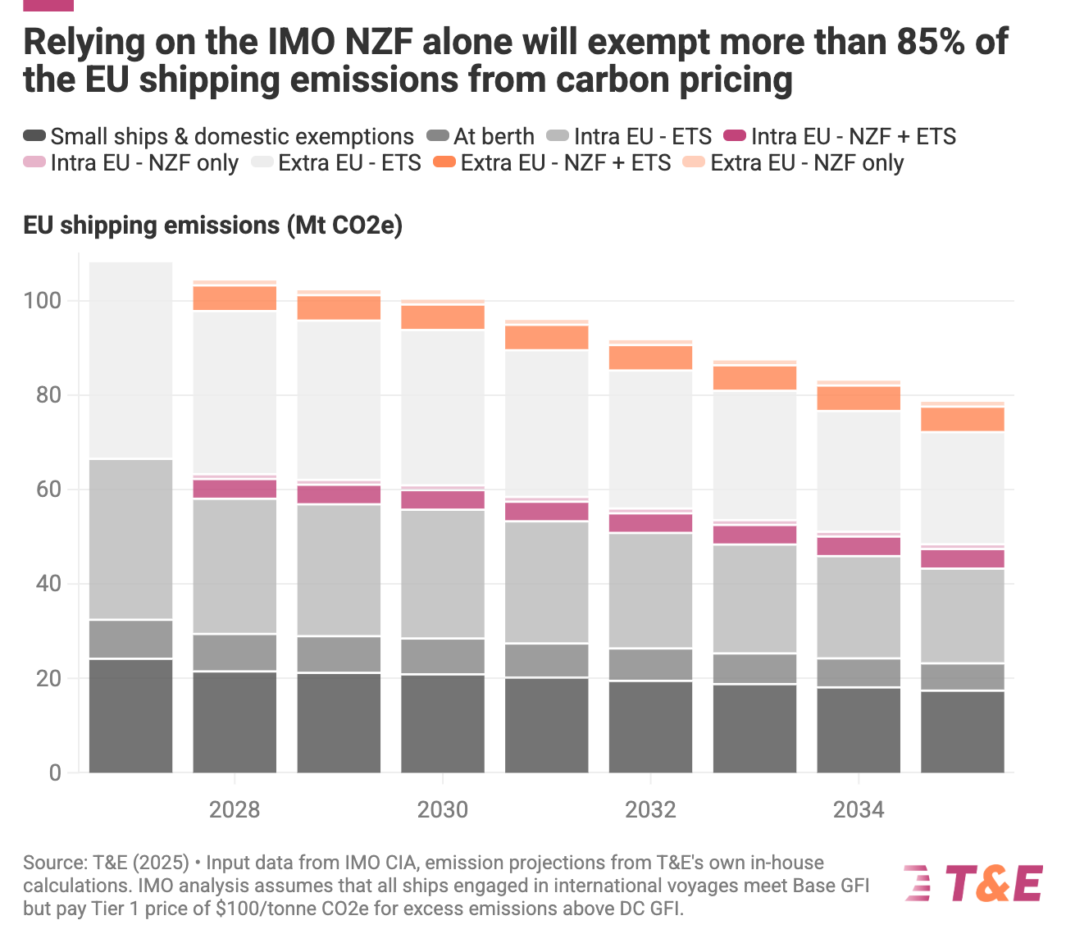


IMO Net-zero frame represents progress in global climate negotiations.
But it will miss IMO’s own clime targets.
While it has a carbon pricing element, it exempts above 85% of the EU shipping emissions from the polluter pay principle.
Maritime ETS is essential to ensure all emissions are paid for and generate revenues to support Clean Industrial Deal.
Maritime ETS will generate ~ €8 billion/a in Europe alone, which is nearly as much as the global ~€10 billion/a revenues from the IMO system with a fraction of the revenue accrued to Europe.

Slide 6


Thank you
Faïg Abbasov,
Director, Shipping
faig.abbasov@transportenvironment.org
| 2025

