Slide 1
Financial literacy and education for Europeans
The view of civil society organisations and good practices
Public Hearing, European Economic and Social Committee
Karolin Schriever
Member of the Executive Board, German Savings Banks Association
6 June 2025

Slide 2
I. Responsibility and commitment to financial literacy
Financial education as a core competence of the DSGV
Responsibility for citizens' financial literacy
Financial education for over 60 years
Strengthening financial resilience through education

Slide 3



II. Award-winning financial education made by Sparkasse
Consumer Consulting Service
„Beratungs-dienst Geld und Haushalt“
Awarded with vzbv Material Kompass
1958
Savings Banks School Service
„Sparkassen-Schulservice“
Awarded with Comenius EduMedia Siegel
1975
Awarded by UNESCO
  European Stock Market Learning
  „Planspiel Börse“
1983

Slide 4


1. “Beratungsdienst Geld und Haushalt” –
Consumer Consulting Service (Money and Budgeting)
annually:
1 million
users
700
educational partners
350,000
budget planner users
1,200
lectures / workshops
60
qualified speakers
Associations,
clubs, foundations
Debt counseling services
Sparkassen
General and vocational schools
700 educational partners
Networks
for women
Ministries, public authorities
Consumer
organizations
Universities,
research institutes
Charities and
social facilities
Family education centers, community colleges

Slide 5



2. “Sparkassen-Schulservice” – Savings Banks School Service
annually:
1.2 million
reached pupils
50,000
teachers
71,000
retrievals of educational media
200
teaching materials

Slide 6
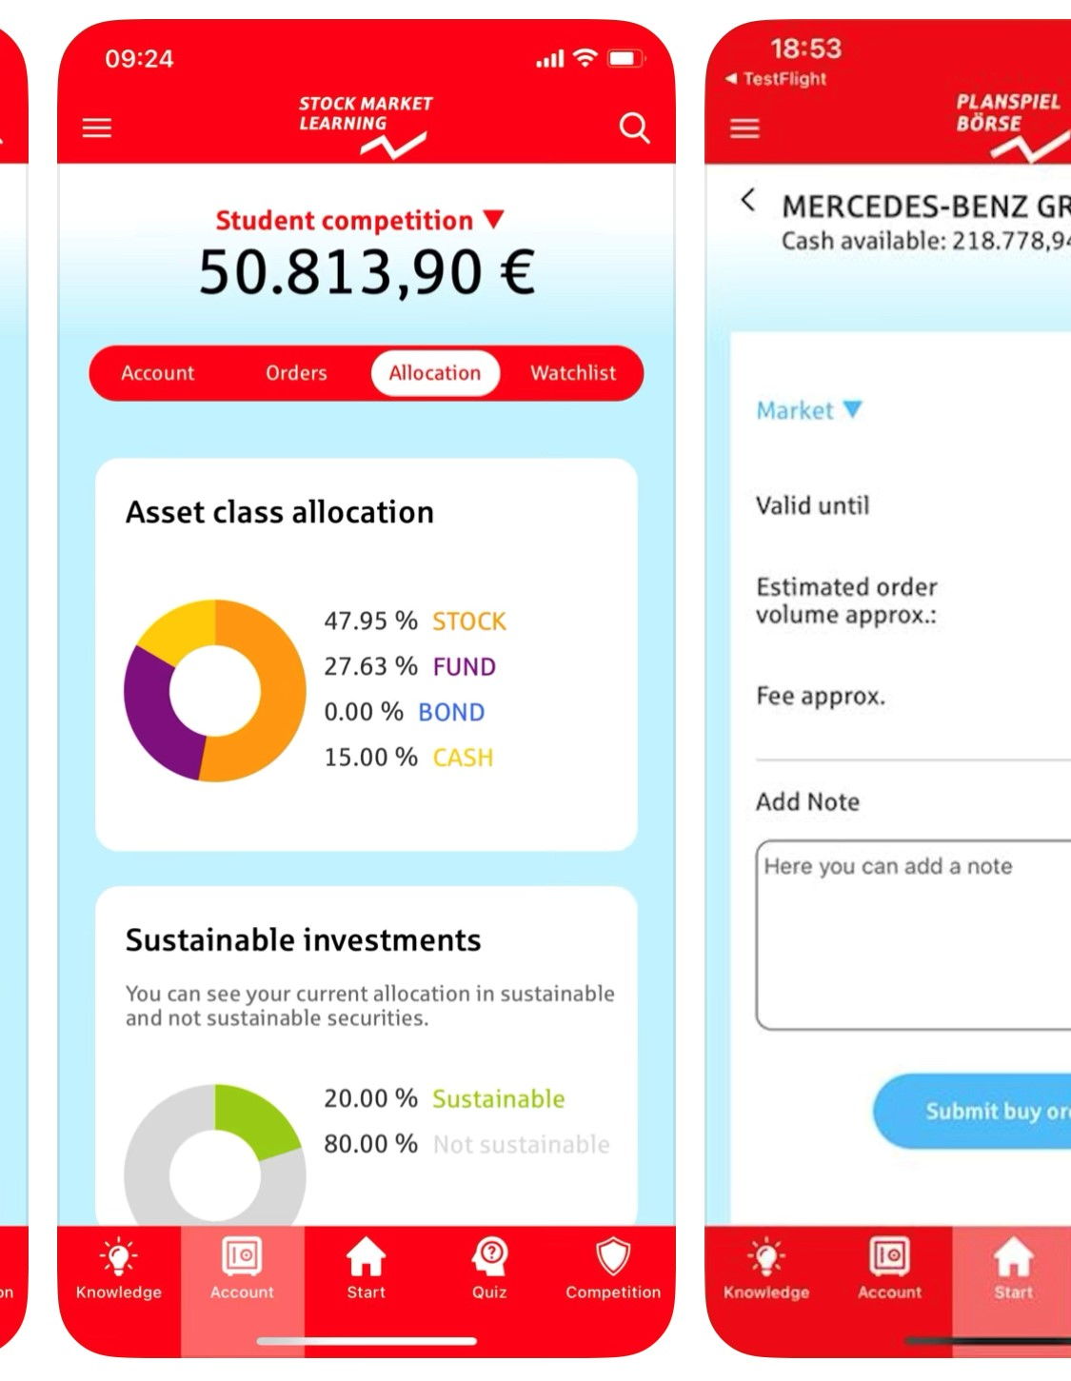
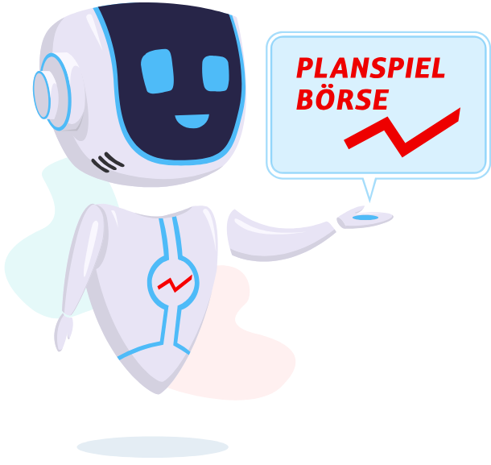
3. “Planspiel Börse” – European Stock Market Learning (ESML)
2024:
113,000
participants
2,700
participating schools
280
participating savings banks
5
countries

Slide 7
III. From National Practice to EU Strategy – What we have learned:
DSGV’s key principles for a successful EU Financial Literacy Strategy
From practice for practice
Targeted: not one-size-fits-all
Enable lifelong learning
Good practices should feed directly into and inspire the EU strategy
Tailored to children, youth, families, older citizens
Support scalable non-formal tools like digital apps, self-paced modules, and counselling
Partnerships matter
Into the classroom and beyond
Ministries of education, central banks, consumer organizations, welfare associations and the financial sector must collaborate
Include financial education in school curricula with teacher trainings and resources

Slide 8
Thank you for your attention.
I look forward to your questions.
Karolin Schriever
Member of the Executive Board
German Savings Banks Association
Charlottenstraße 47
10117 Berlin

