Slide 1



Slide 2
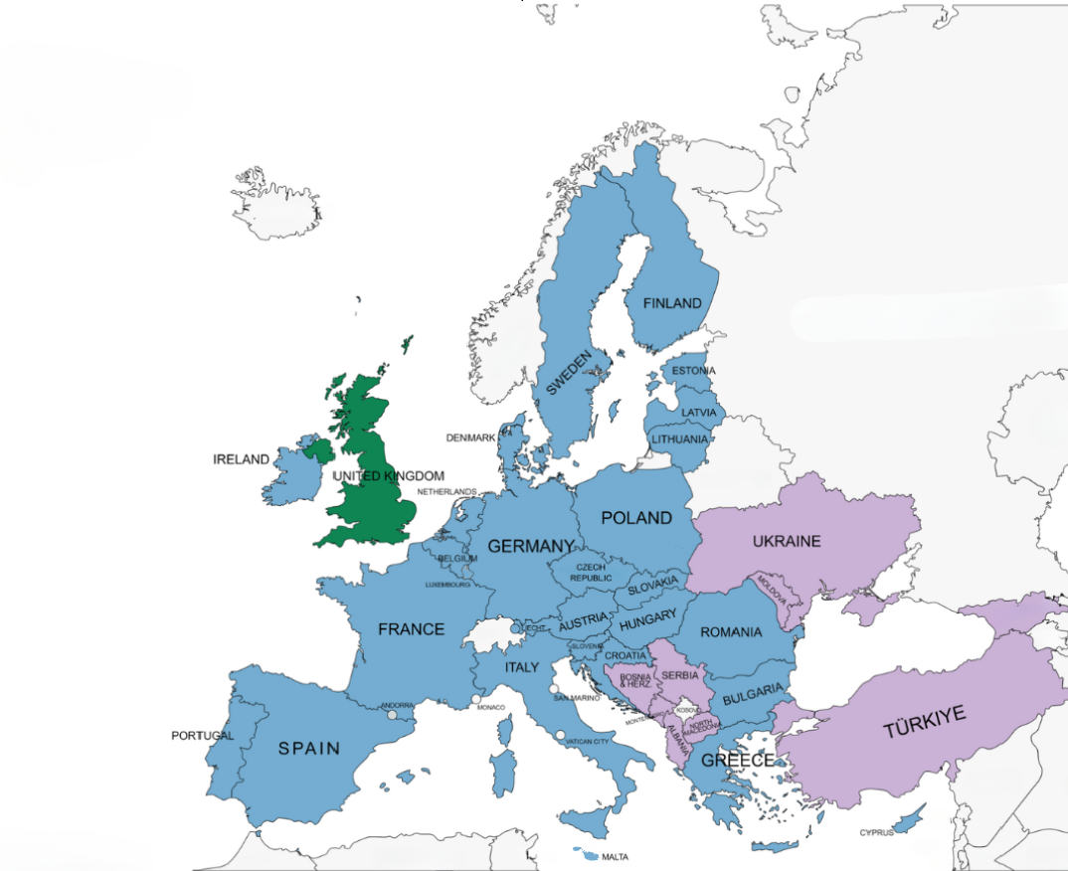
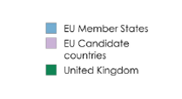

About the EU
27 Member States
9 candidate countries
Around 450 million citizens live in the EU.

Slide 3

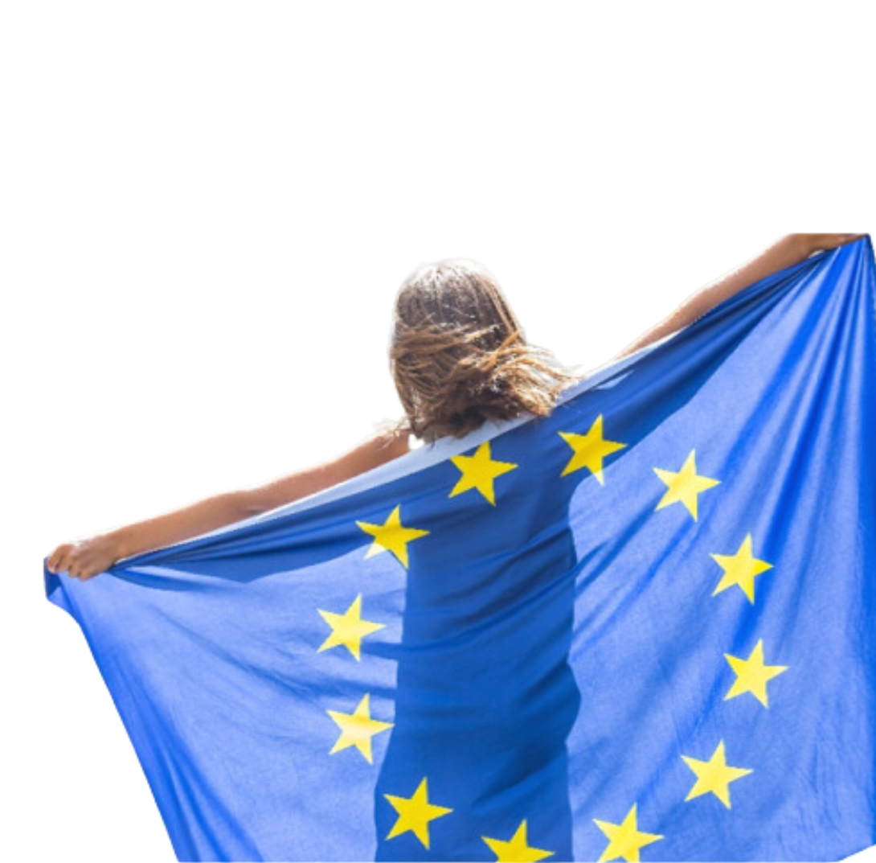
What does the EU do?
promotes peace, its values and the well-being of its citizens.
offers freedom, security and justice without internal borders.
ensures its citizens have the right to move and reside freely within the Union.
enhances economic, social and territorial cohesion and solidarity among EU countries.
The EU’s motto: United in diversity
Source: europa.eu/!DncVGU

Slide 4
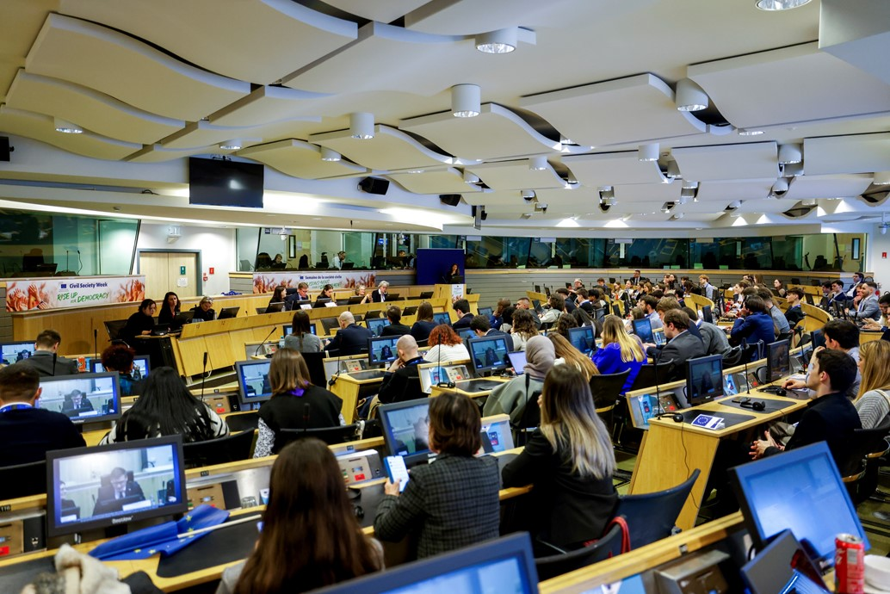

What is the European Economic and Social Committee? (EESC)

Slide 5




The EESC is…
An advisory body set up by the Treaty of Rome (1957).
It helps shape laws and policies by giving advice to decision-makers in the European Commission, the European Parliament and the Council of the European Union. It ensures that adopted laws consider the needs and opinions of different groups with diverse backgrounds. It represents European organised civil society, comprised of groups and organisations in which people work cooperatively.
Its main role as an advisory body is to help EU institutions by providing opinions that reflect civil society's views into EU policies and decisions.
Council of the European Union

Slide 6


Who composes the EESC?
3 Groups: Employers, Workers and Civil Society Organisations.
329 members (appointed for 5 years) representing the
27 EU Member States.
EESC Members are not politically affiliated and are not based full-time in Brussels.
± 200 opinions adopted per year.
Employers (107)
Workers (112)
Civil Society Organisations (106)
Employers’ federations,
Chambers of Commerce,
SME organisations…
Trade unions
Farmers, consumers,
NGOs, youth, professions, disability organisations, academics, cooperatives …

Slide 7
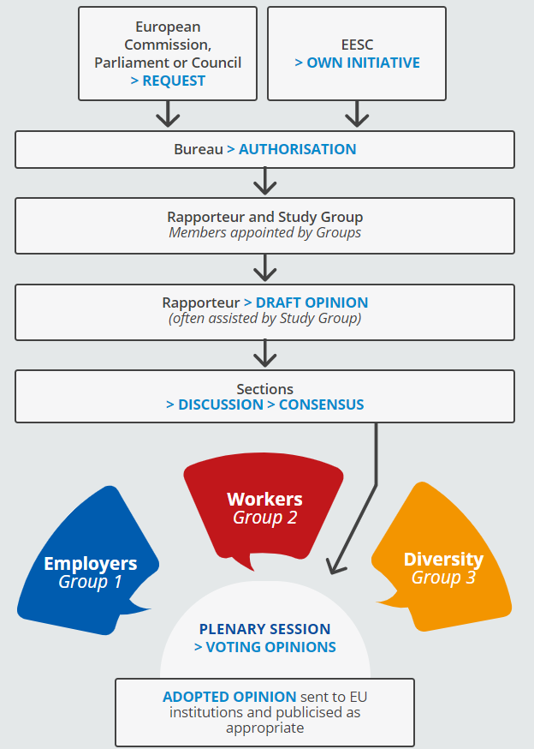
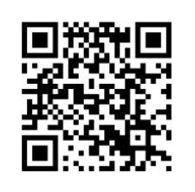


What is an opinion?
The European Parliament, the Council of the EU or the European Commission can ask the EESC for recommendations regarding legislation on a particular topic.
The EESC members, representing all 3 Groups, draw up a single document, called an “opinion”, on the proposed legislation.
After a consensus is reached, the EESC opinion is sent to the EU institutions to be discussed and published in the EU’s Official Journal (24 languages).
The rapporteur presents key findings and promotes the opinion at EU, Member State and local level.
Scan the QR code to find out more!

Slide 8
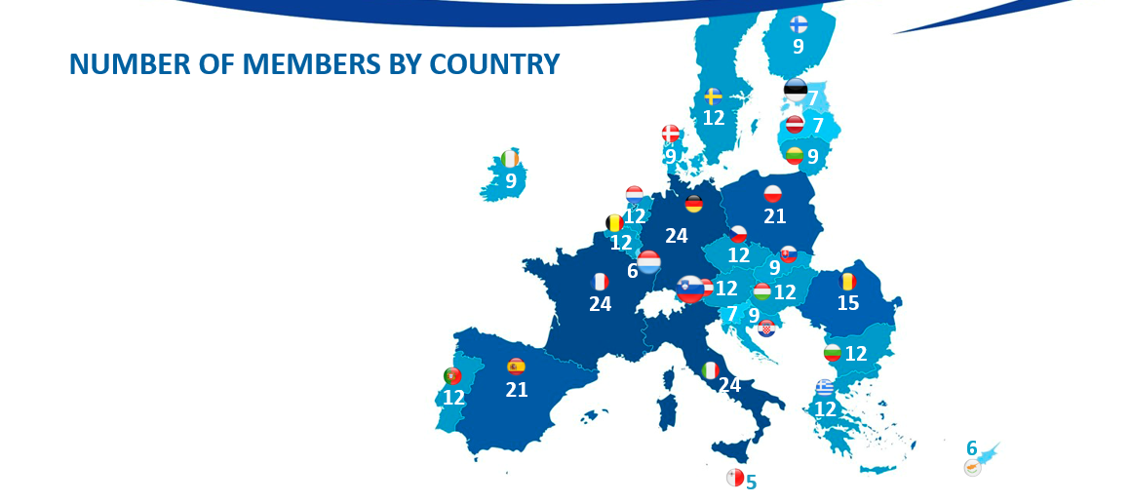
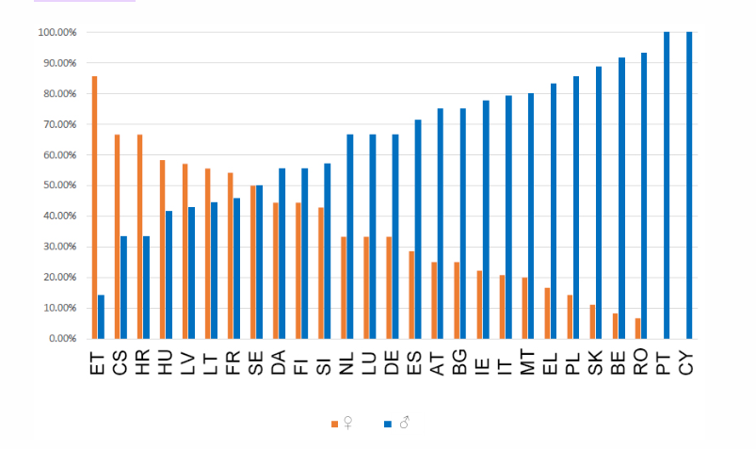

Useful information
Number of members by country
As with other European institutions, the committee’s geographical representation is proportional, meaning that more populous countries are allocated a greater number of members to represent them.
Therefore, France, Germany, and Italy have the most members (24), while Malta has the fewest (5).
Gender balance
The EESC's 2020-2025 term of office has the highest number of female members since statistics on membership began in 2010.
There is a higher percentage of women at the Committee than ever before: 33% compared to 28% in 2015 and 24.70% in 2010.

Slide 9



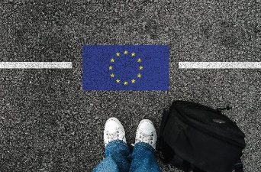


What does the EU do for young people?
Explore
Thinking about a job in the EU institutions or another EU country?
Each year, the EU offers paid traineeships to young university graduates.
Speak
You can take part in youth events like the EU Youth Dialogue, the European Parliament's European Youth Event (EYE), and Your Europe, Your Say! at the European Economic and Social Committee.
There, you can make your voice heard!
Work
You can apply for jobs within the European Union when you are 18 years old.
The EURES scheme connects you with employers across EU, Norway and Iceland.
Study
You are entitled to study at any EU university under the same conditions as nationals of that country.
The ERASMUS programme allows you to do part
of your university studies abroad.
.
Travel
The border-free Schengen Area gives 400 million EU citizens free movement between countries.
For instance, the INTERRAIL train pass allows you to reach over 40 000 destinations in 30 countries.

Slide 10

EESC’s Youth Offer
In September 2022, the EESC adopted the opinion The EU Youth Test, a tool designed to strengthen youth participation and mainstream youth perspectives in policy-making.
Following this, in July 2023 the EESC Youth Group was established, whose mandate is to:
explore ways for young people to actively contribute to the Committee’s work;
foster open dialogue between EESC members and youth organisations.

Slide 11
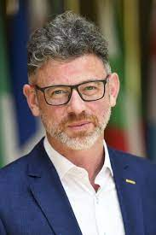
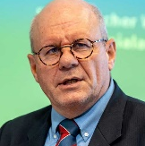


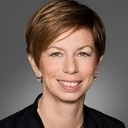


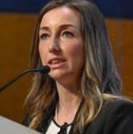


EESC Youth Initiatives
Youth Delegate ​ to COP​
Youth Climate and Sustainability Round Tables
Your Europe, Your Say!
Study on youth participation at various levels
EESC Youth Group
EU Youth Test at the EESC
Notes:
For some years now, the EESC has been working on how to better integrate the voice of young Europeans in its work and in the EU decision-making process in a structured and meaningful way

Slide 12






Your Europe, Your Say! (YEYS!)
13 - 14 March 2025
Brussels, Belgium
133 delegates from:
Secondary schools from 37 countries: 27 Members States, 9 candidate countries, the UK
National Youth Councils
Youth organisations
European Youth Forum

Slide 13



What to expect?
Step 1. You will be divided into groups and take part in interactive workshops and inspiring talks by keynote speakers.
Step 2. Facilitators will guide sessions to help you articulate your vision and expectations for Europe’s future.
Step 3. The event will culminate in a final plenary session where participants will translate their ideas into concrete recommendations.
Teachers will also have the opportunity to visit the House of European History, network with colleagues, and follow dedicated training and information sessions from other EU institutions with a concrete youth offer to share.
Outcome
The EESC's Youth Group will follow up by sharing the recommendations as potential input for advisory and political work carried out by the EESC, and explore how to integrate them in the selected opinions going through the EU Youth Test.

Slide 14
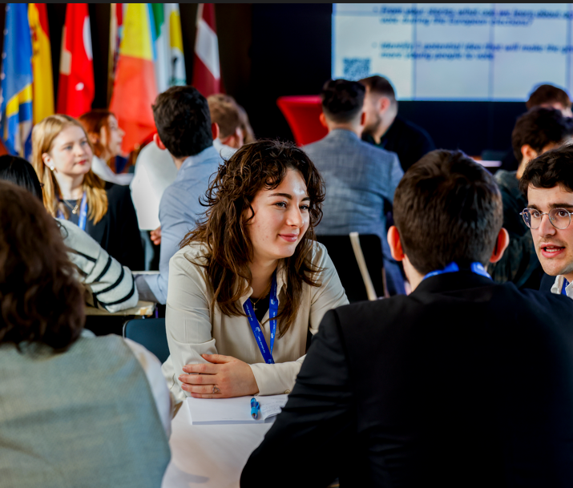

#YEYS2025 objectives
The EESC is hosting the 16th edition of the Your Europe, Your Say! youth event.
This year, YEYS will:
Empower youth and equip the participants with tools for participatory democracy.
Encourage young participants to voice their concerns on EU issues.
Inspire future civic engagement with the EU and their communities.
#YEYS2025 #GivingYouthAVoice

Slide 15
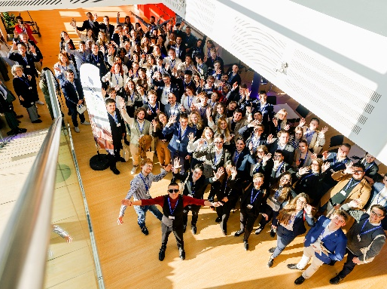

What will you gain from this experience?
You will have fun and inspiring exchanges with other students and young people from across Europe.
Together with other participants, you will be invited to explore and come up with creative solutions to empower youth engagement and strengthen participatory democracy.
After YEYS!, you will also receive a YEYS! diploma.
You will be provided with educational materials to share with your class, friends and family.

Slide 16
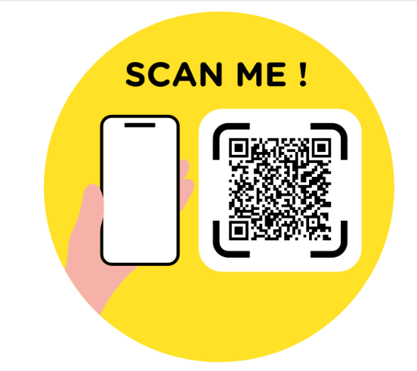




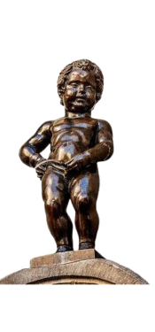
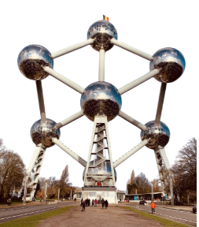


Stay in touch!
Scan the QR code, visit the webpage and stay tuned in with the event!
Want to reach out? Email us at youreurope@eesc.europa.eu
Follow us for more:
Your Europe, Your Say
@youreuropeyoursay
See you soon in Brussels!

Slide 17


