Slide 1
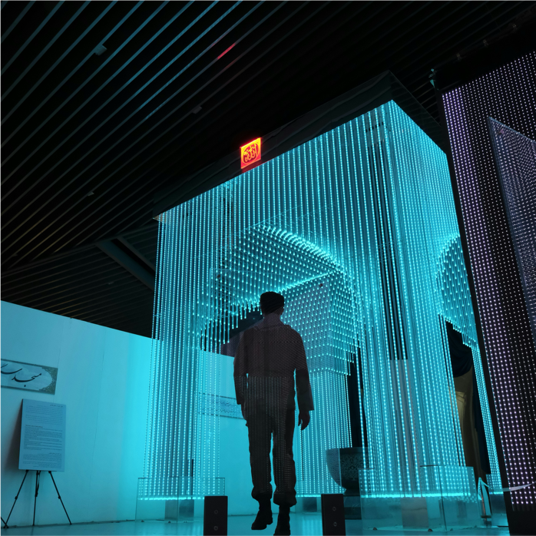

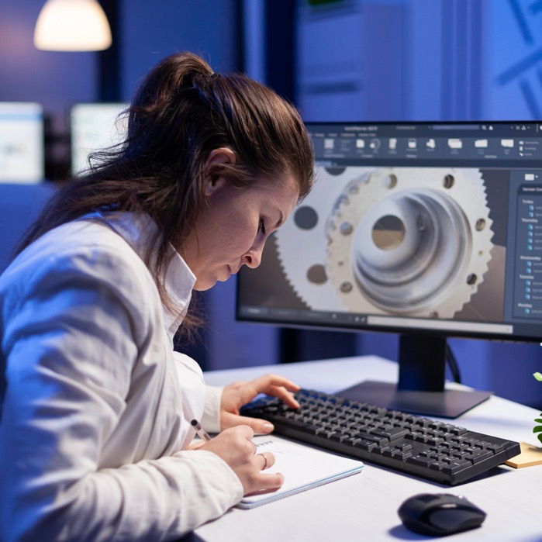
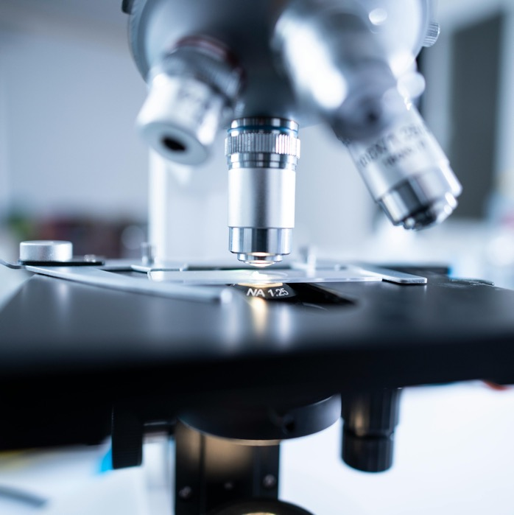
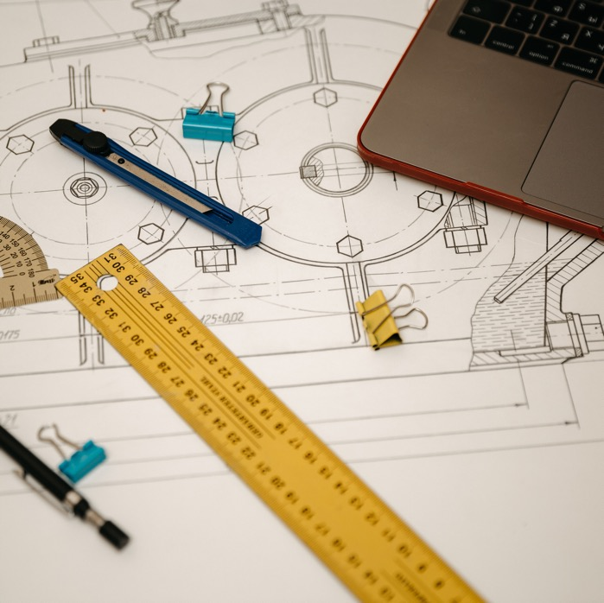

Collaborating between university, government and industry to advance research and workforce development
Priit Ilomets
Head of Hydrogen Technologies Unit
12.11.2024

Slide 2





AS Metrosert
National Metrology Institute
Accredited Technical Assessment Body
Research and Technology Organisation
Services
Metrology services: calibration and verification
Certification of management systems
Precious metals analyses
Maintainer of national measurement standards
Research and development activities
Applied research (2023)

Slide 3
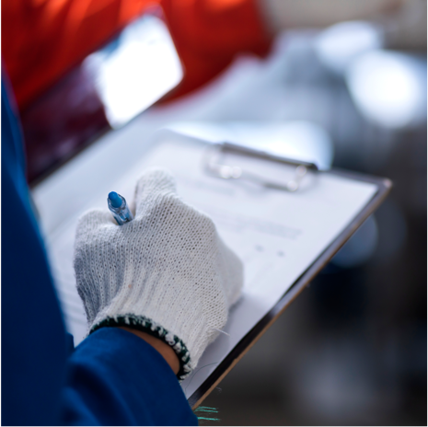





Elevate your production quality and efficiency with Metrosert
Metrosert's services ensure accuracy and compliance of your measurement process with international standards, enabling you to:
Ensure the highest quality of products
Reduce regulatory risks
Increase cost effectiveness
Protect and enhance your company’s reputation
Strengthen competitiveness

Slide 4
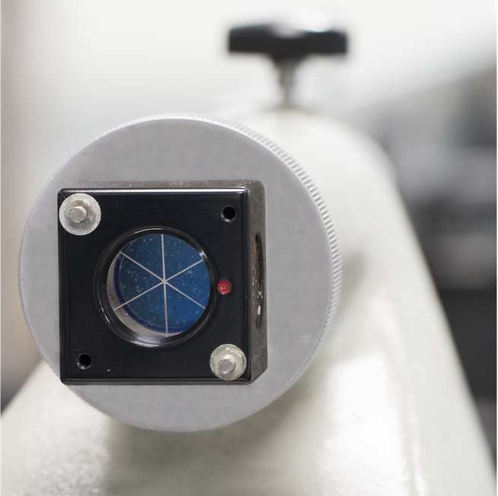
Research and Development Division
R&D division's main mission is to support the development and implementation of new technology through accurate measurements
Main activities:
Research and development projects in the field of metrology, including international projects funded by the EU (Horizon, Digital Europe, etc)
R&D services for companies and organisations spanning from consultations in measurements to construction of measurement devices
In-house production of measurement devices (multi-photodiode detectors in reflection-type and transmission-type configuration for high-accuracy optical power measurements)

Slide 5
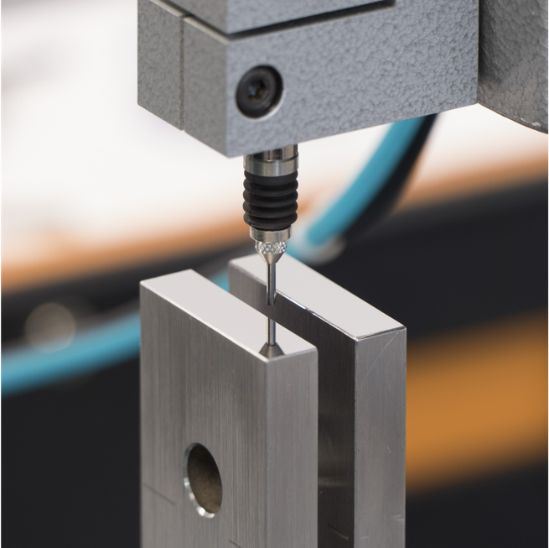
Research and Development Division
National Metrology Institute (NMI) of Estonia​
Our main tasks and responsibilities as NMI:​
Maintenance and development of Estonian national measurement standards​:
Maintenance of standards for length, mass, temperature and electrical quantities​
Development of measurement capabilities and methods for new national measurement standards for time and frequency, optical quantities and electrical power
Representation of Estonia in international metrology organisations (BIPM, EURAMET)​
Coordination activities within Estonia in the field of fundamental metrology​
Calibration, measurement and testing services based on national standards, trainings in principles of metrology and dissemination activities.

Slide 6
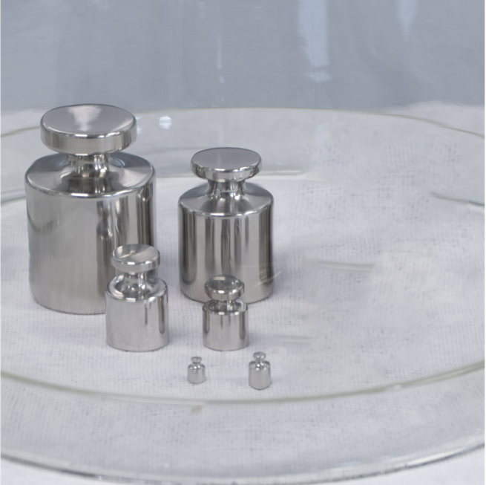

Metrology Division
A reliable measurement process ensures quality
Metrosert's goal is to support the entire measurement process within an organization—from setting measurement objectives, selecting methods, and understanding requirements to presenting measurement results. Metrosert ensures that measuring instruments are suitable for use and compliant with standards.
Main activities of Metrology Division:
Calibration and verification of measuring instruments
Measurement of testing services
Consultation
Precious metals analysis and sample certification
Training on metrology fundamentals and measurement management
Online customer platform for managing measuring instruments

Slide 7
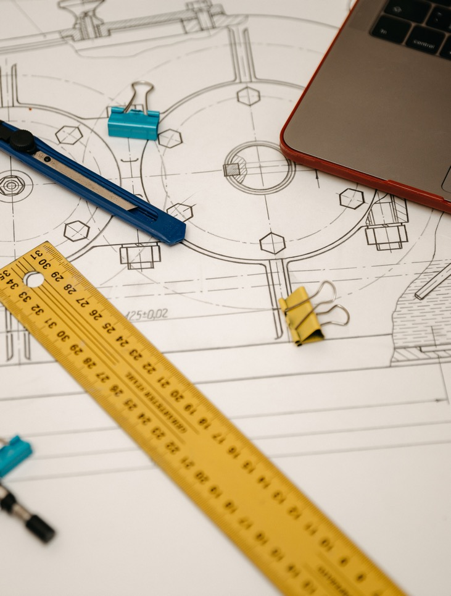
Metrology Division
Metrosert's Metrology Services are Favored for Their High Quality
Reliable and Independent Services
Our calibration and measurement services are accredited by the Estonian Accreditation Centre (EAK) according to the international standard ISO 17025, and our verification services are accredited according to ISO 17020.
Through mutual recognition arrangements (MRA) under ILAC (International Laboratory Accreditation Cooperation), Metrosert's services are recognized worldwide.
All metrology services from one reliable competence center
Metrosert is the largest calibration laboratory in the region with three facilities across Estonia. Annually, we perform nearly 16,000 calibrations, 11,500 verifications, and 1,000 measurements and tests.
Our services encompass all measurement areas critical to industry, service providers, and regulators: length and angle, mass, pressure, force and torque, volume, temperature, electrical quantities, time and frequency, optics, physico-chemical quantities, fluid flow, and thermal energy.

Slide 8

Certification Division
ISO 9001
ISO 14001
ISO 45001
ISO 22000
Benefits of the ​ Metrosert management ​ system certification
E-märgis
AQAP-2110
EMAS
Certification services include:
Differentiation in the Market - Demonstrates a commitment to quality, helping to stand out from competitors
Expanded Business Opportunities - Improves position in both domestic and international markets, opening up new business opportunities.
Optimized Processes - Enhances efficiency by reducing production costs.
Higher Quality - Ensures the quality of products/services, increasing customer satisfaction and loyalty.
Certification of Quality Management Systems (ISO 9001)
Certification of Environmental Management Systems (ISO 14001)
Certification of Occupational Health and Safety Management Systems (ISO 45001)
Certification of Food Safety Management Systems (ISO 22000)
Certification of Pre-packaged Products Quantity Control Systems (e-mark)
EMAS verification
Product and Service Certification (translation services, etc.)
AQAP-2110

Slide 9









Quality infrastructure
recognition
ACCREDITATION
Applicable to all products, processes and services
ISO/IEC 17021 ISO/IEC 17065
ISO 9000/14000 HACCP etc.
CERTIFICATION
product certification CE etc.
national/international standards
harmonization
STANDARDIZATION
testing/analysis
ISO/IEC 17025
TESTING / INSPECTION
research inspection
ISO/IEC 17020
ISO/IEC 17025
calibration of equipment reference materials / verification
traceability
METROLOGY
National value chains
recognition
International system

Slide 10
Applied Research Center
Applied Research Center’s performance on the TRL scale
The Scope of Applied Research Centre
Applied Research Center in cooperation with RD institutions and their infrastructure​
Universities
Applied Research Center with its infrastructure
Enterprises
TRL 1
TRL 2
TRL 3
TRL 4
TRL 5
TRL 6
TRL 7
TRL 8
TRL 9
Basic research
Applied research
(laboratory prototype)
Experimental dev. (industrial prototype)
Product development

Slide 11






Applied Research Center
Applied Research Center’s focus fields
Health Data
Hydrogen technologies
Drone technologies
Autonomous vehicles
Biorefining

Slide 12
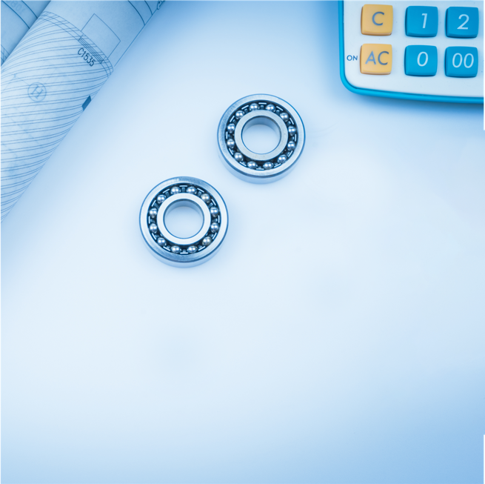





Applied Research Center
Research Technical Organization (RTO)
Key capabilities:
Research and development (R&D)
Applied research - new knowledge, develop innovative technologies, solve complex problems​
Technology transfer and commercialization
Transfer of research findings and technologies to the market​
Collaborative research projects​
Initiatives with industry partners, academic institutions, and government agencies
Innovation support services​
Offering resources, funding opportunities, and incubation support ​
Consultation and advisory services
Expert advice and analysis on technology adoption, innovation strategy, and regulatory compliance​
Notes:
Hydrogen Day – with University of Tartu
Hydrogen Week – w. Baltic States, rotating embassy
Hydrogen Hubs - local great hubs with potential such as Pärnu, or Paldiski
Hydrogen Valley Estonia – PPP
Scholarships
Certification? Standardization TK80 EVS

Slide 13


Applied Research Center
Hydrogen technologies
Global challenge:
Energy security and independence
Energy storage and grid stability
Decarbonization of energy systems
Global hydrogen market size (2023): USD 180 billion
Growth rates (CAGR):
Electrolysers: 24-33%
Fuel cells: 20-34%
PLANNED SERVICES :
Unit cells testing for materials R&D
Fuel cells
Electrolyzers
Semi-industrial scale testing at stack level:
Fuel cells
Electrolyzers
Complex energy systems
Technical consulting services
POTENTIAL CLIENTS:
Companies developing and applying hydrogen technologies:
Electrolyzers
Fuel cells
Complex energy systems
Hydrogen derivatives industry
Developers of energy storage systems

Slide 14

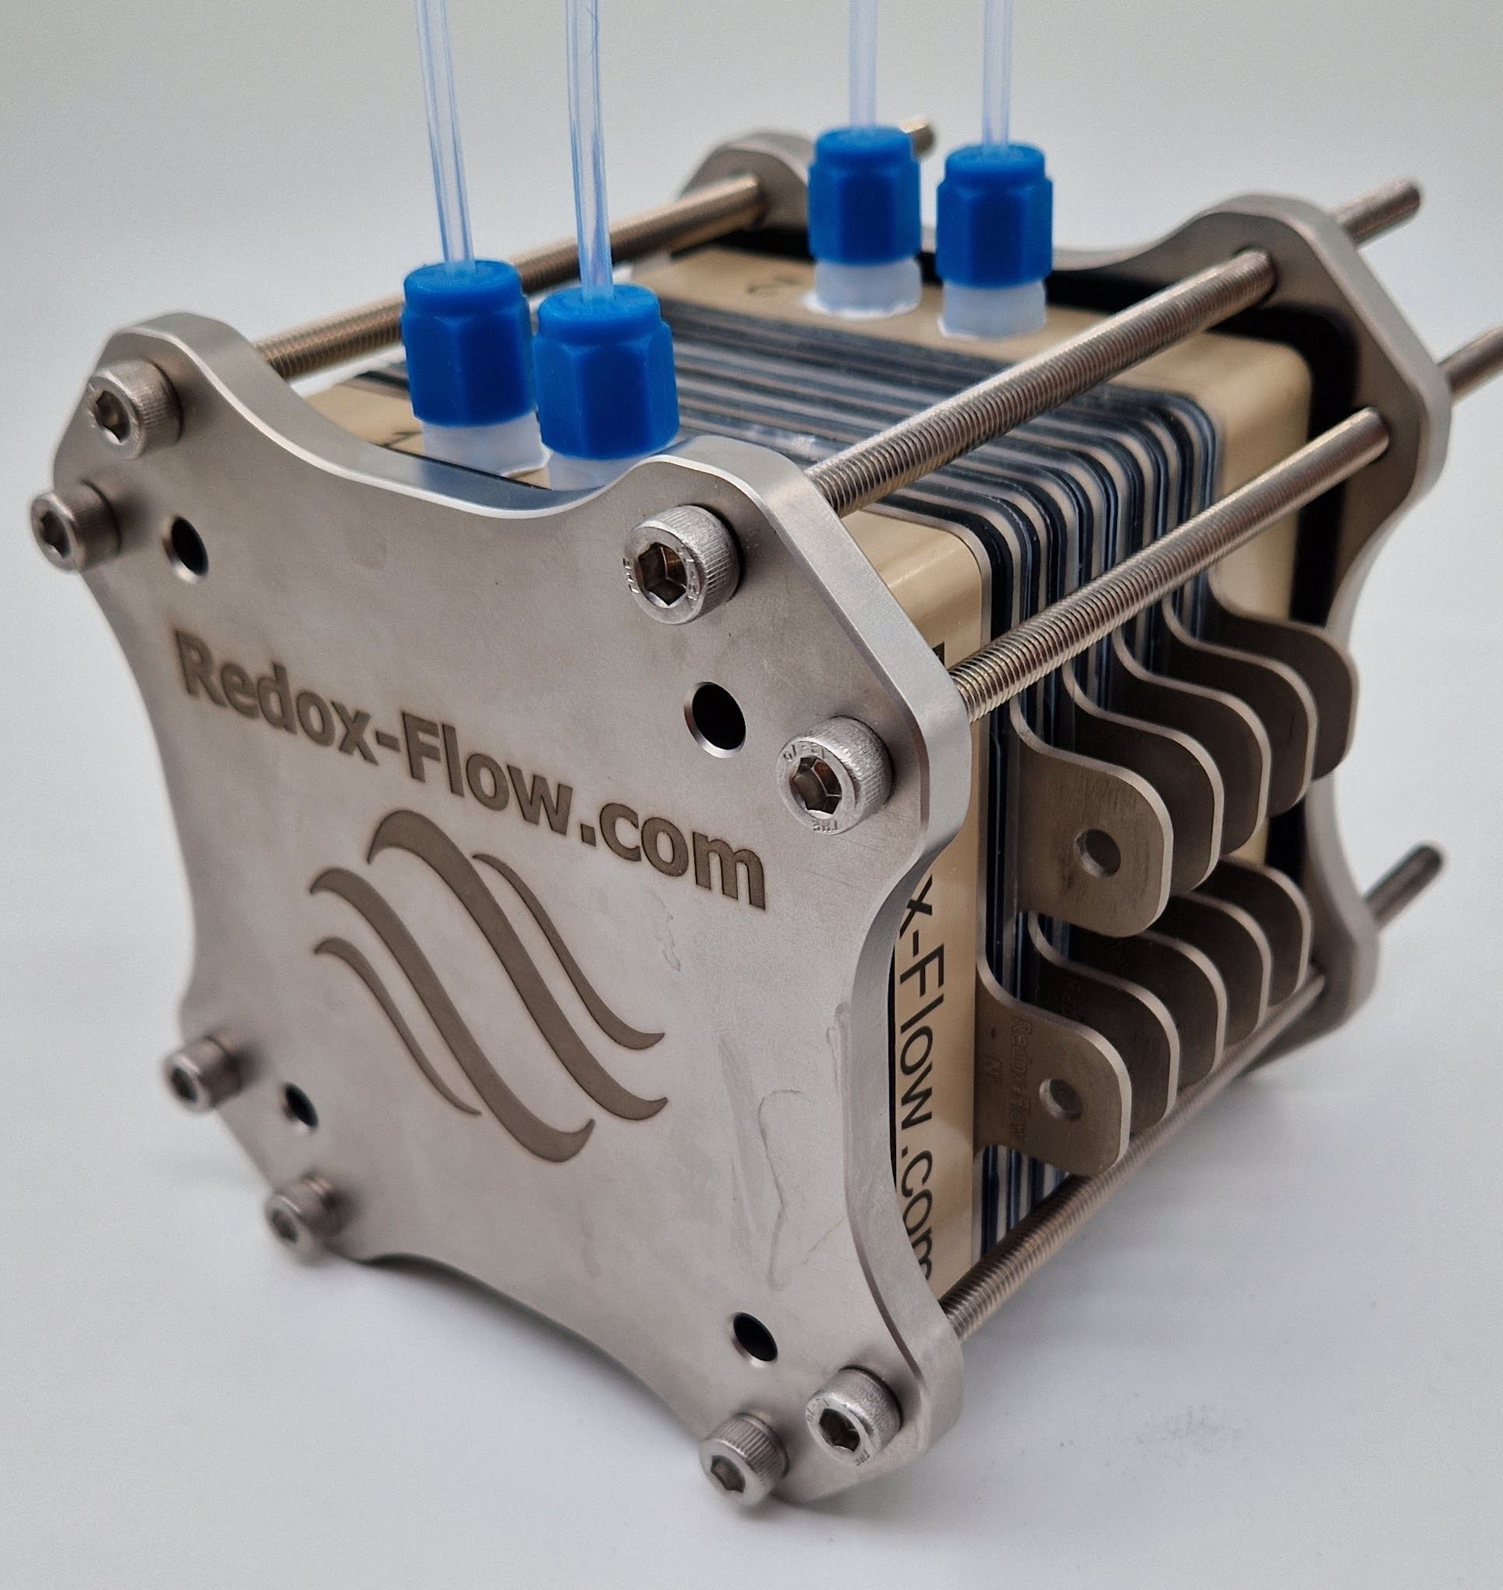
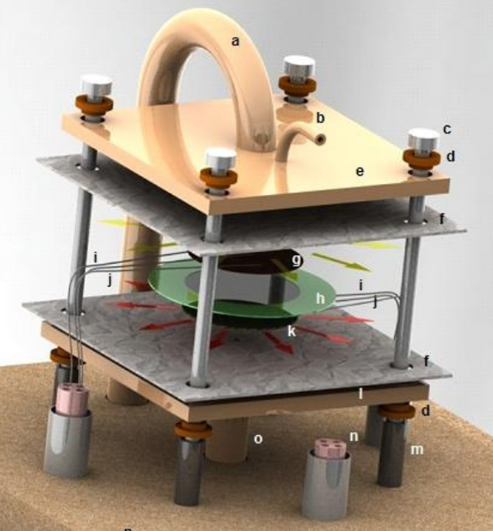
Services
Lab-scale testing of unit cells
Electrolyzers – Lab scale stack capability (5x5cm cells, ambient pressure, room temperature)
- Commercial provider of equipment.
- In-house modification solution for elevated temperature operation (80 °C).
High temperature FC / SOEC unit cell testing system (open perimeter cell design) for materials research.
- Test system components from commercial providers.
- In house system set-up and design for each test-case.

Slide 15
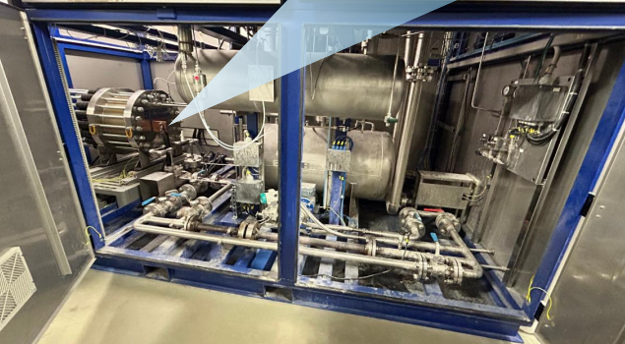
Services
Semi-industrial scale testing at stack level
Alkaline Electrolyzers
- Operating temperature 80 °C
- Output pressure 30 bar
- Power up to 80 kW
- Commercial components
- Outsourced engineering and construction of custom components
+ in-house engineering and set-up
SOFC / SOEC test stations
- up to 10 kW
- modular design and flexible stack set-up capability
- commercial test-stations
- in house engineering and set-up
Low temperature FC (PEM) testing capability
- planning stage
Laboratory requirements
CapEx 5.5 MEUR
1.2 MEUR for building the laboratory
4.3 MEUR for testing equipment
Room size: ~300 m2
ATEX certification
H2 infrastructure

Slide 16
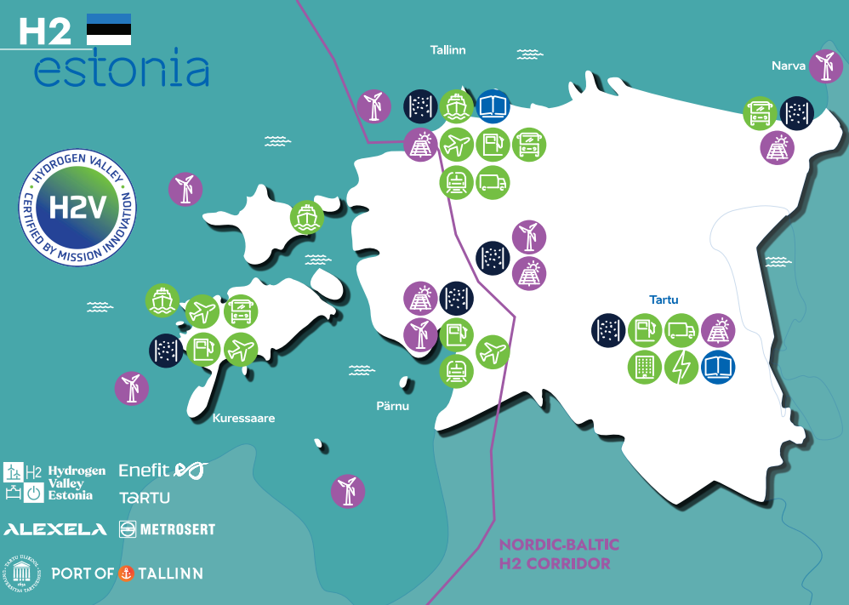
Applied Research Center

Slide 17
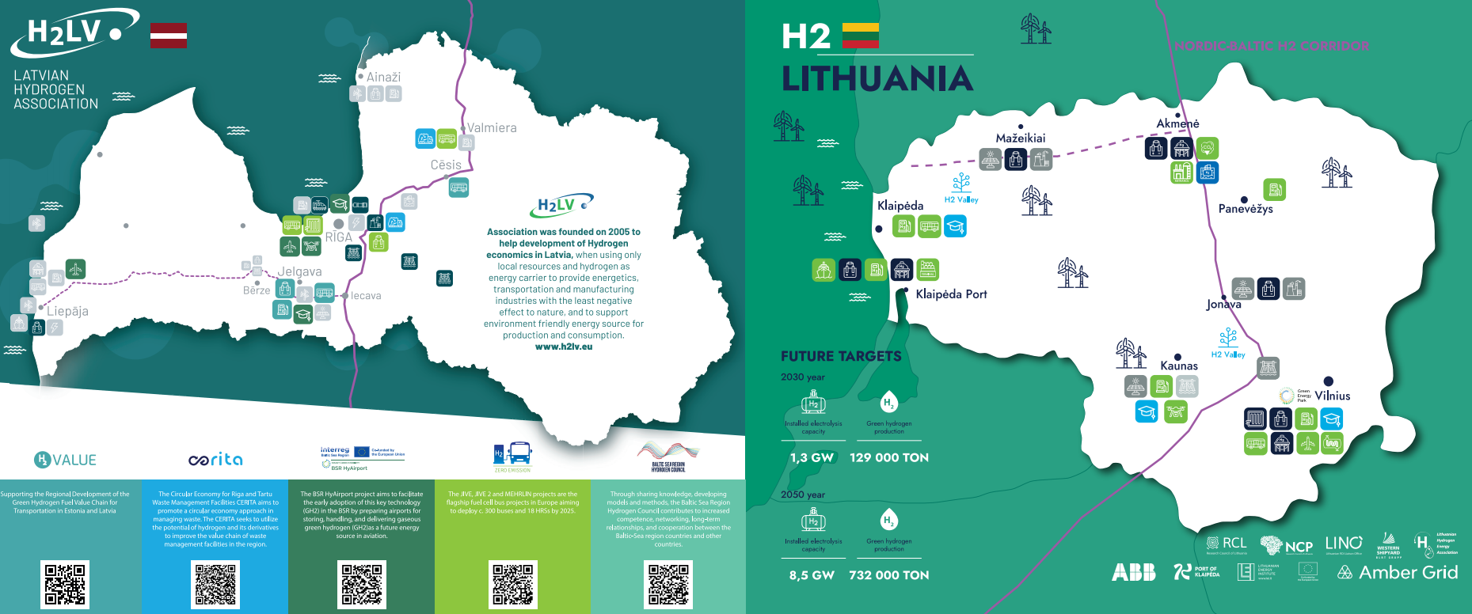
Applied Research Center

Slide 18
Thank you!
Priit Ilomets
Head of Hydrogen Technologies Unit
priit.ilomets@metrosert.ee, LinkedIn Priit Ilomets
www.metrosert.ee

