Slide 1
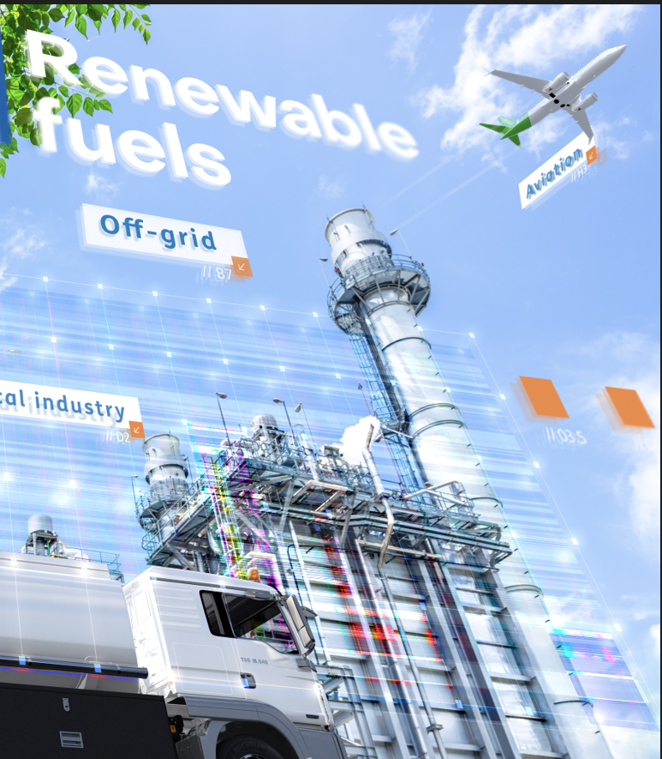

Offshore Power for e-Fuels: boosting the new hydrogen economy Estonia
Jan-Willem Könemann
12 November 2024

Slide 2
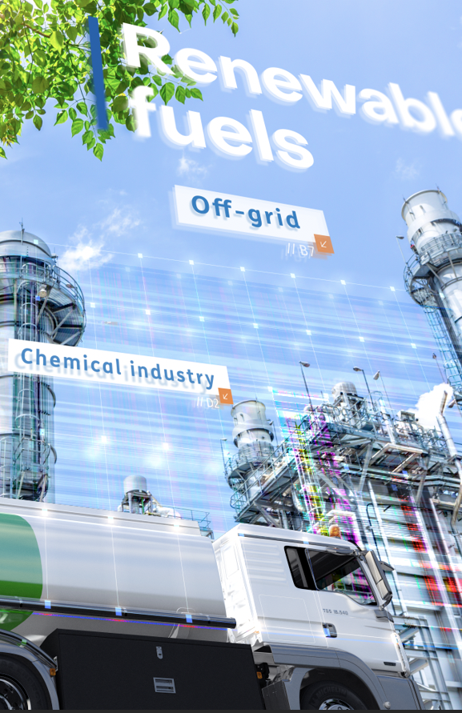
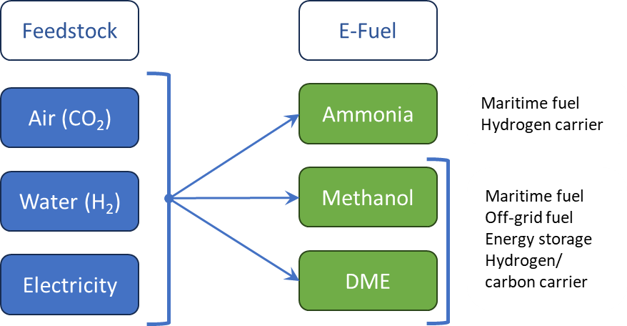
E-Fuels are important for the energy transition
Synthetic Fuels & Chemicals
TNO develops technology with which e-fuels can be converted from captured CO₂ and green H₂ in one robust process step, highly selective and highly efficient.

Slide 3
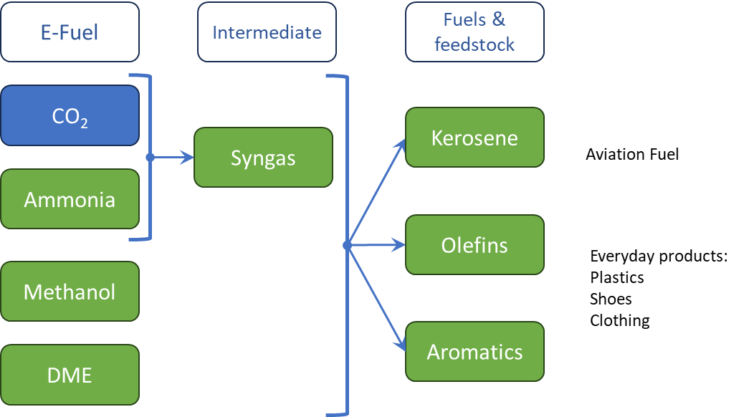
E-Fuels, a sustainable feedstock for industry
Synthetic Fuels & Chemicals
TNO develops technology with which e-fuels can efficiently be connected to industry, effectively replacing fossil feedstock.

Slide 4


TNO’s expertise
Synthetic Fuels & Chemicals
Process intensification
Processes and reactor technology with:
Higher conversion to eliminate or reduce recycles
Higher selectivity to eliminate or reduce separation and purification steps
Higher efficiency
Examples:
Sorption enhanced processes (syngas, DME, olefins)
Membrane enhanced processes (syngas, MeOH)
Process Integration
Connect processes:
That enforce each other
To eliminate process steps
To reduce footprint and economy of scale
Examples:
Ideally connect SOEC technology with advanced e-fuel production to reach high efficiencies and maximal flexibility
CLARA, chemical looping to integrate ammonia cracking with rWGS to produce syngas from ammina and CO₂

Slide 6

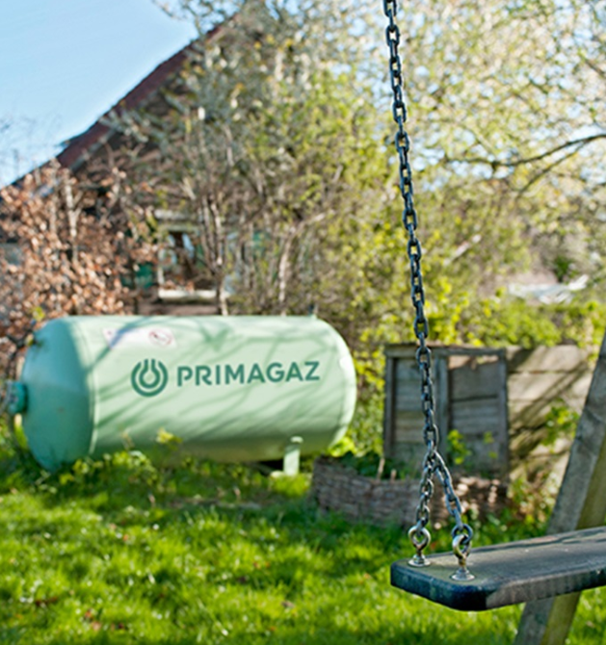
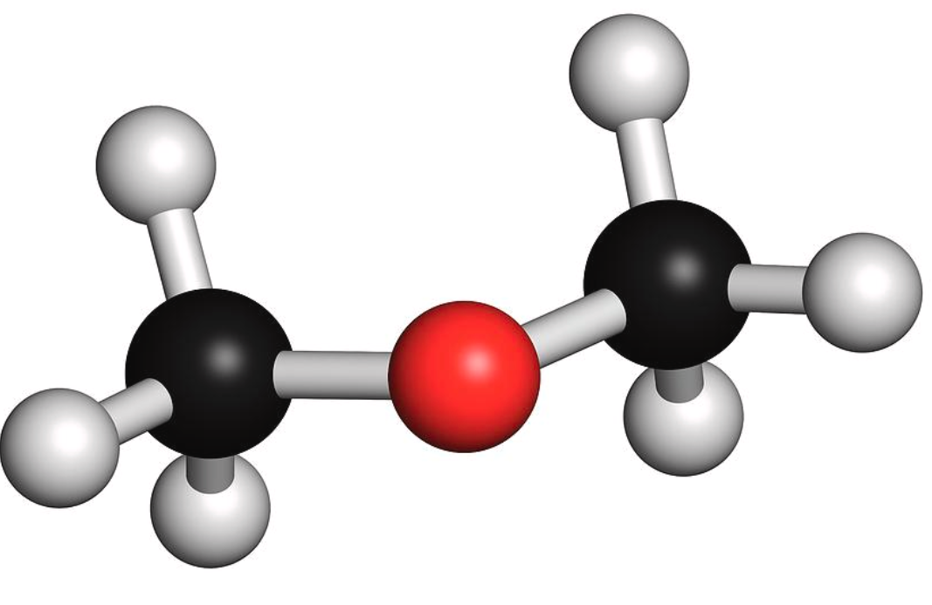
An example: production of dimethylether (DME)
Synthetic Fuels & Chemicals
In everyday life in Europe, DME is “known” as the propellent in hairspray, deodorant or spray paint.
DME is a non-toxic gas, that is easily liquified under mild pressure, making it the ideal sustainable replacement of fossil LPG for the off-grid market. DME can use the LPG infrastructure.
In addition DME combust like diesel and can therefore be an alternative for existing diesel engines.
Last but not least, DME is dehydrated methanol, further dehydration will result in olefins (ethylene, propylene), feedstock for industry and intermediate to sustainable aviation fuel “SAF”.

Slide 7
TNO’s expertise: Process integration & intensification
Synthetic Fuels & Chemicals
95%
5%

Slide 8
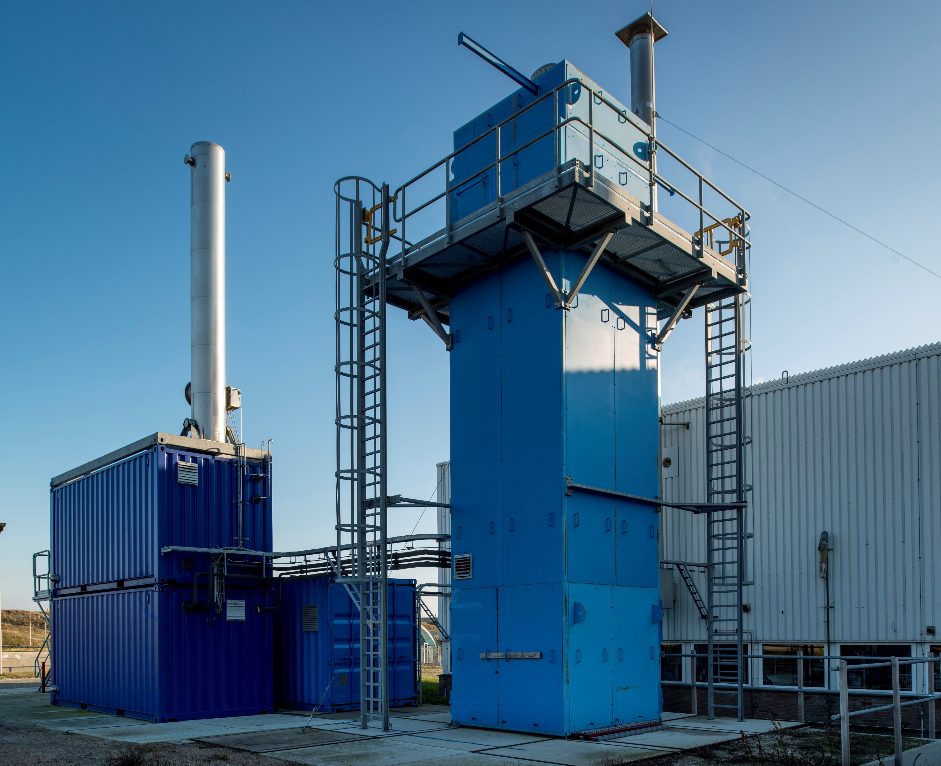
SEDMES: Sorption Enhanced DME Synthesis
Synthetic Fuels & Chemicals
The reduction of CO₂ hindered by the production of water (3 moles of water per mole of DME).
1 Step DME production from CO₂ has therefore a conversion efficiency of ~5-10%.
Removing the water in-situ, SEDMES technology, can improve the conversion efficiency to ~85% .
An improvement with a factor 15!

Slide 9

Thank You !

