Slide 1

Financing Strategies
Better coordination between Member States and the EU
12th November 2024, Pärnu

Slide 2





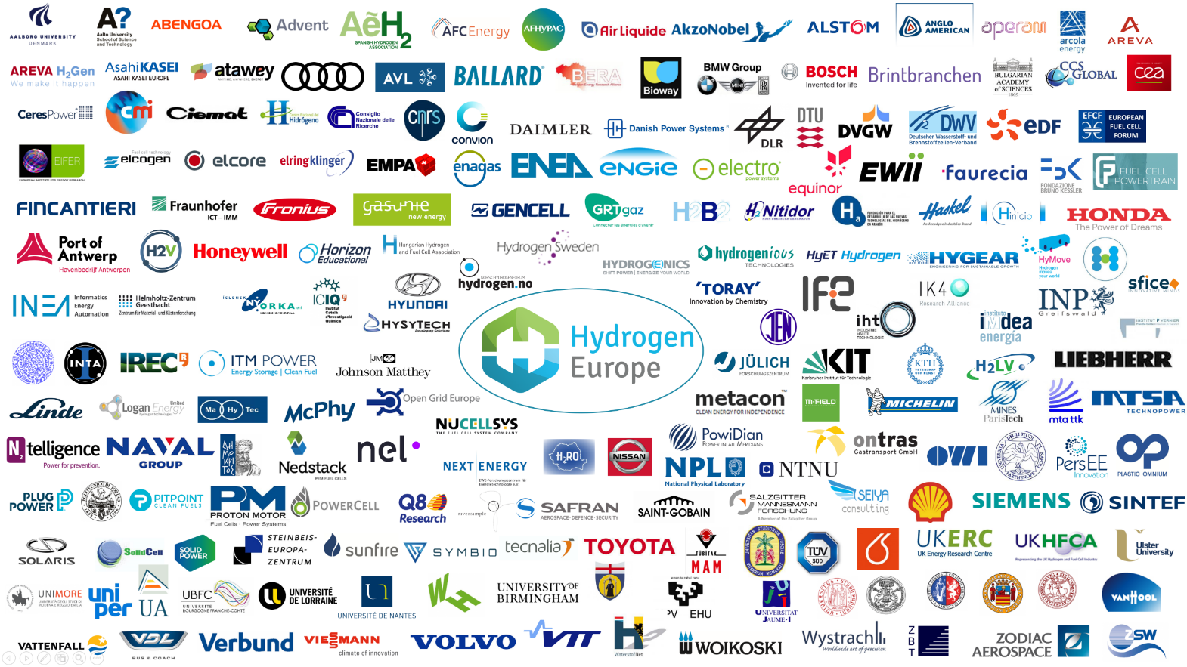
Clean Hydrogen Joint Undertaking
A portfolio of clean, efficient and competitive solutions based on fuel cells and hydrogen technologies in energy and transport
European Union represented by the European Commission
592 members

Slide 3
Clean Hydrogen Joint Undertaking

Slide 4
Clean Hydrogen Joint Undertaking

Slide 5
Clean Hydrogen Joint Undertaking

Slide 6
Clean Hydrogen Joint Undertaking
New business models

Slide 7
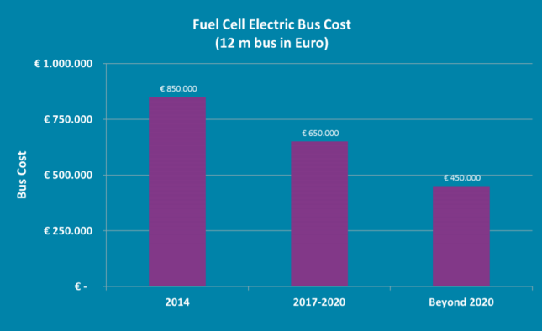
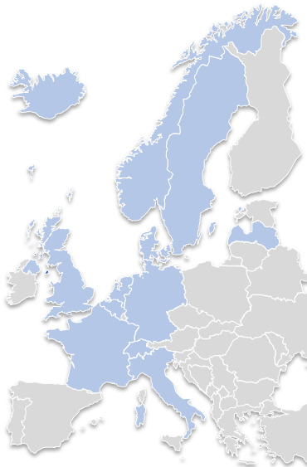
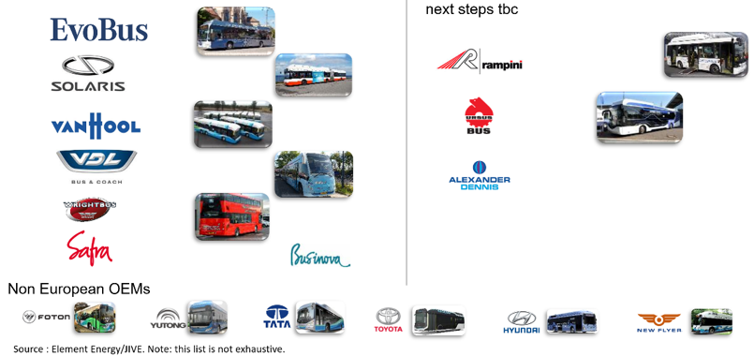
Clean Hydrogen Joint Undertaking
EU-funded projects
CHIC
(36 buses, plus 20 in Canada)
  Aargau, CH;
  Bolzano, IT; London, UK;
  Milan, IT; Oslo, NO;
  Cologne, DE*; Hamburg, DE*
  High V.LO-City
  (14 buses)
  Antwerp, BE; Aberdeen, UK; Groningen, NL; San Remo, IT
  HyTransit
  (6 buses)
Aberdeen, UK
3Emotion
(21 buses)
London, UK
Aalborg, DK; Pau, FR;
Rome, IT; South Rotterdam, NL; South Holland; Versailles, FR
National/regional-funded
projects
Karlsruhe, DE; Stuttgart, DE;
Frankfurt, DE;
Arnhem, NL; North Brabant, NL; Artois Gohelle, FR
JIVE
(142 buses)
Aberdeen, UK – 25 buses
Birmingham, UK – 20 buses
Bolzano, IT – 12 buses
Cologne region, DE – 35 buses
Gelderland, NL – 10 buses
London, UK – 26 buses
Wiesbaden, DE – 10 buses
Wuppertal, DE – 10 buses
JIVE 2
(156 buses)
Auxerre, FR – 5 buses
Barcelona, ES – 8 buses
Brighton, UK – 20 buses
Cologne region, DE – 15 buses
Emmen, NL – 10 buses
Groningen, NL – 20 buses
South Holland, NL – 20 buses
Pau, FR – 9 buses
Toulouse, FR – 5 buses
Wuppertal, DE – 10 buses
Legend
Countries with (upcoming) FC buses
In operation
Planned or operation ended
National funding
Source: JIVE/JIVE2

Slide 8
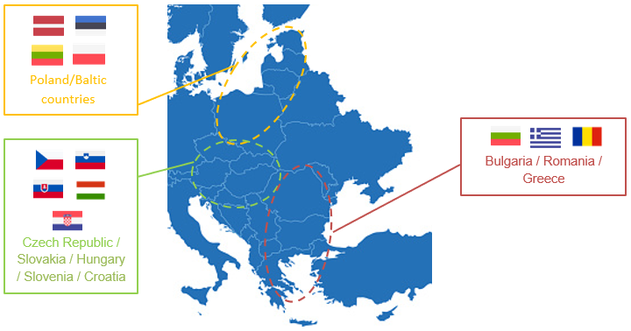
Clean Hydrogen Joint Undertaking
JIVE CEE Bus Roadshow aims to organize FCE bus test drives on public transport routes across cities interested in the technology but cannot access the infrastructures due to their location. The objective is to have the relevant local actors test a demonstration bus to build regional capacity to deploy fuel cell bus technology to expand the sector in the short/medium term.
1st Roadshow - mid-November 2022 till end of January 2023
Countries – Slovenia, Croatia, Czech Republic, Slovakia, Hungary
2nd and 3rd roadshows organized 2023 / 2024

Slide 9

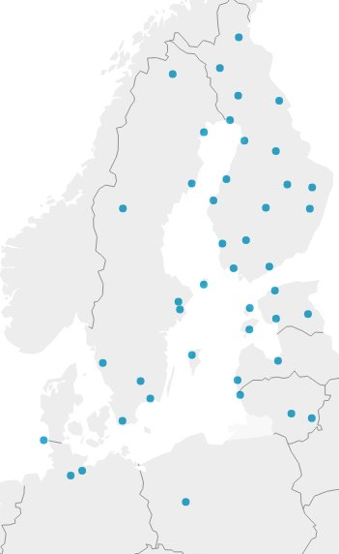
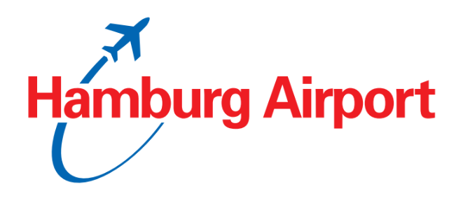
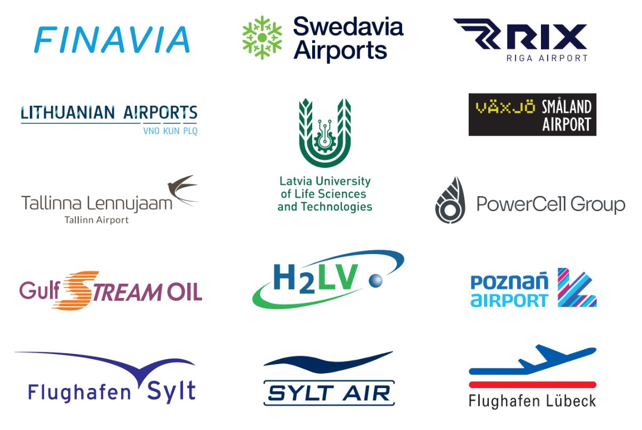
Project Partnership operated airports

Slide 10
Thank you! Questions?
Contacts | Aivars Starikovs
Hydrogen Europe | Member of the Board
Avenue Marnix 23 | E-mail: aivars@h2lv.eu
1000 Brussels | Tel.: +32 2 540 87 75
Belgium | www.hydrogeneurope.eu

