Slide 1
UNDRR's Momentum Towards Inclusive Disaster Risk Reduction: A Transformative Journey in implementing the Sendai Framework
Stefanie Dannenmann-Di Palma, External Relations Officer & UNDIS Focal Point
15 Oct 2024

Slide 2
2023 Global Survey on persons with disabilities and disasters – Europe and Central Asia findings
The majority (91 per cent) of persons with disabilities in Europe and Central Asia do not have a personal preparedness plan for disasters.
43 per cent reported a lot of difficulty or being unable to evacuate immediately without assistance, whereas the percentage dropped to 22 per cent in case of sufficient early warning.
There is a large gap in dissemination of risk information in accessible formats, with only 10 per cent respondents confirming its existence.
The awareness and accessibility of national and local DRR plans remain low, with only 9 per cent of respondents being aware at national level and 11 per cent at local level.
There are designated government leadership roles for disability inclusion in the region as reported by 22 per cent of respondents. However, organizations were rarely staffed by disability-inclusive emergency management experts.
Participation in decision-making and community-based DRR remains a challenge, with a majority (88 per cent) remaining excluded, whereas 62 per cent expressed willingness to participate.
There is a lack of mechanisms for the participation of persons with disabilities in community-based DRR, as reported by 76 per cent of respondents.
Notes:
The survey was conducted between January and March 2023 and resulted in a total of 6,342 responses from 132 countries. For comparison, the 2013 survey resulted in 5,717 responses from 137 countries.

Slide 3
Sendai Mid-Term Review findings and recommendations
Data collection and analysis gaps exist at subnational and national levels, with few countries providing sex, age, and disability disaggregated data to the Sendai Framework monitor.
Challenges persist in participation, especially in data collection, leading to significant gaps in information on women, older persons, persons with disabilities, and children, hindering effective policy solutions.
Most at risk groups such as women, persons with disabilities, rural residents, Indigenous Peoples, and others are often excluded from early warning systems and post-disaster recovery efforts.
Efforts towards disability-inclusive disaster recovery have been initiated, focusing on principles, data requirements, policies, institutional mechanisms, and financing. However, the establishment and implementation of inclusive disaster response mechanisms are limited.
Prioritizing data production and risk assessment that promotes the participation and leadership of women, girls, and persons with disabilities is essential.
Member States should integrate gender and disability considerations into agencies responsible for disaster risk data collection, analysis, and risk information development.
National disaster risk reduction platforms play a vital role in facilitating broad-based participation, including women and persons with disabilities.
© UNDRR – United Nations Office for Disaster Risk Reduction

Slide 4
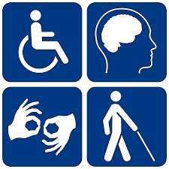
Disability disaggregated data collected, analysed and utilised, and evidence generated for greater socio-economic understanding and decision-making
66 countries report on disaggregated data and out those 25 countries report disaggregation on disability within the Sendai Framework Monitoring
National Disaster Risk Reduction plan/strategy includes actions and indicators related to disability limited process as of today
© UNDRR – United Nations Office for Disaster Risk Reduction

Slide 5
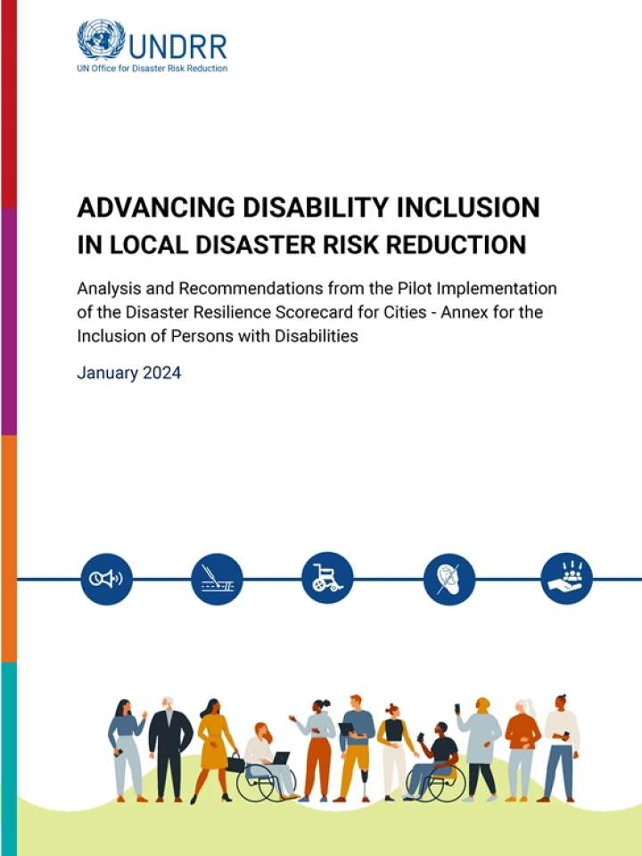
Develop local DRR strategies and plans that are gender-responsive and protect and promote the rights and inclusion of persons with disabilities
Disaster Resilience Scorecard for Cities – Annex for the Inclusion of Persons with Disabilities under the MCR2030 initiative
Translated in all UN languages
Rolled out 21 cities across 10 countries:
Bhutan (Gelephu Thromde, Phuentsholing Thromde, Samdrup Jongkhar Thromde, Thimphu Thromde),
Brazil (Barcarena, Rio de Janeiro),
Chile (Pudahuel),
Colombia (Cali, Pereira),
Costa Rica (Santa Ana),
El Salvador (Santa Tecla),
Kazakhstan (Astana),
Philippines (Baguio City, Quezon City),
Uganda (Kampala),
Uruguay (Bella Union, Minas de Corrales, Ciudad del Plata, Vichadero, Villa Constitución, Young)
https://mcr2030.undrr.org/disability-inclusion-scorecard
© UNDRR – United Nations Office for Disaster Risk Reduction

Slide 6
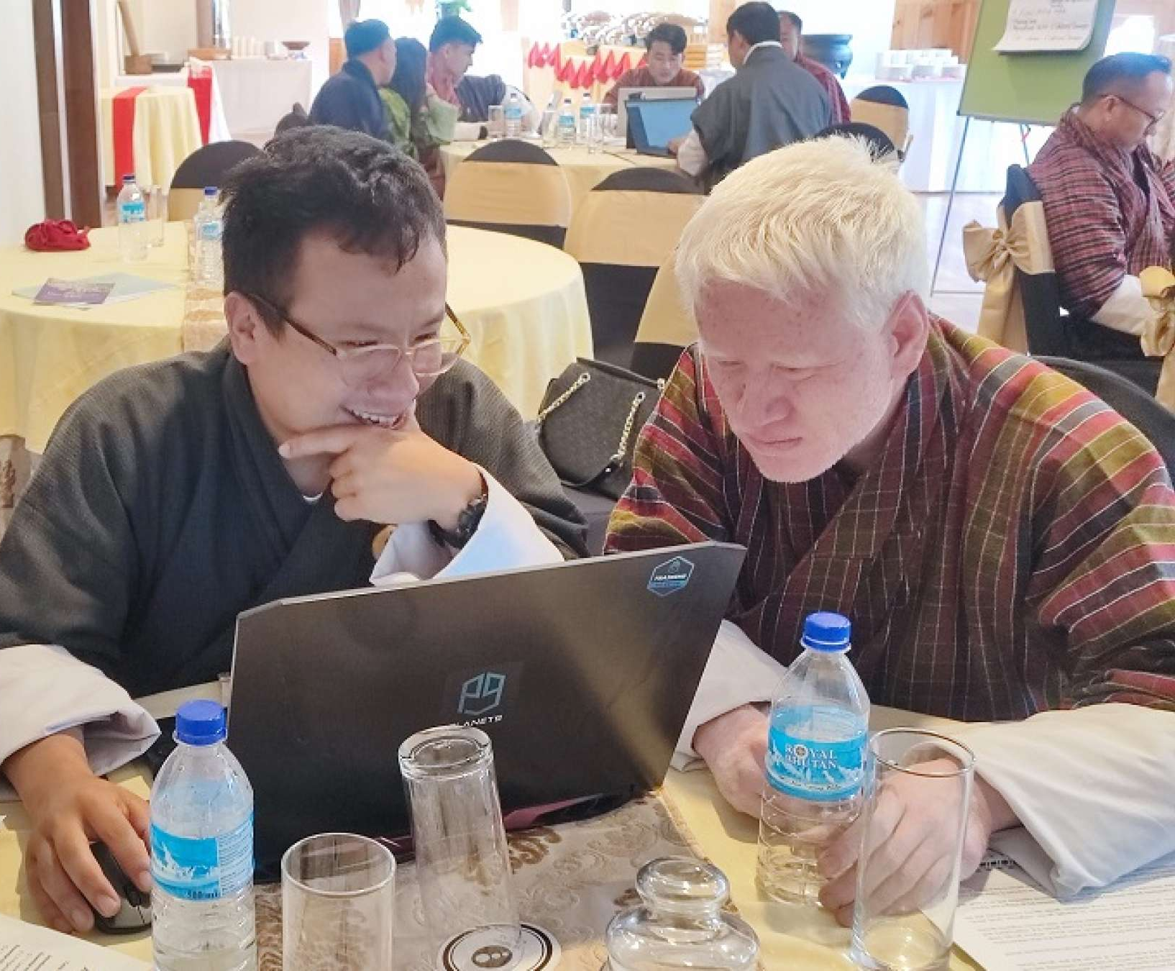
Develop local DRR strategies and plans that are gender-responsive and protect and promote the rights and inclusion of persons with disabilities
In Phuentsholing, Bhutan, disability-inclusive risk assessments supported by UNDRR training led to improved action plan enhancing their resilience and ensuring their inclusion in disaster preparedness efforts.
In Kisumu, Kenya, UNDRR's collaboration with the disability community facilitated the first-ever inclusive International Day for Disaster Risk Reduction (IDDRR) and the national Disaster Risk Reduction (DRR) Symposium. Additionally, the appointment of a disability advisor by the Governor of Kisumu County marked a historic move in Kenya, signaling a commitment to prioritize the needs of persons with disabilities in disaster risk reduction legislation and policies.
© UNDRR – United Nations Office for Disaster Risk Reduction

Slide 7
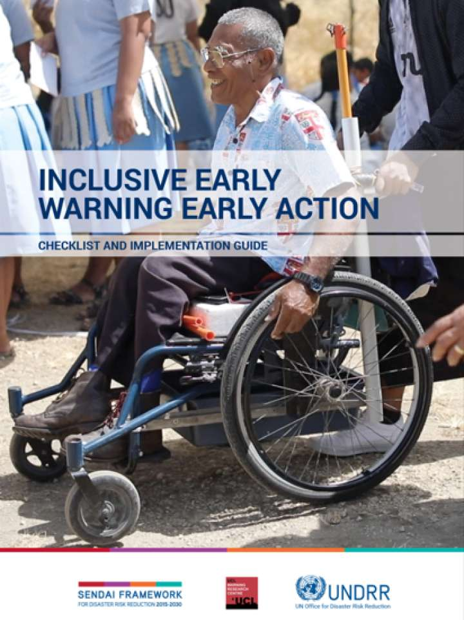
Gender and disability inclusive early warning early action: checklist and implementation guide
Developed under Climate Risk and Early Warning Systems (CREWS) Programme in Pacific
Currently under implementation: Fiji, Kiribati, Solomon Island, Tonga
Next countries in line: Caribbean, Comoros, Djibouti, Madagascar, Maldives, Mauritius, Nepal, Niger
https://www.undrr.org/publication/inclusive-early-warning-early-action-checklist-and-implementation-guide
© UNDRR – United Nations Office for Disaster Risk Reduction
Notes:
The purpose of the checklist and implementation guide is to ensure that the key elements of early warning systems (governance; disaster risk knowledge; detection, monitoring, analysis, and forecasting; dissemination and communication; and preparedness to respond) are gender-responsive and disability-inclusive. They provide support and direction for systematically integrating and monitoring gender and disability inclusivity across all actions related to warnings.

Slide 8



Thank you
For more information, please contact dannenmann@un.org
https://www.undrr.org/partners-and-stakeholders/disability-inclusion-disaster-risk-reduction
© UNDRR – United Nations Office for Disaster Risk Reductio
n

Slide 9
2023 Survey on Persons with Disabilities and Disasters
10-year follow-up to 2013 survey done by UNDRR
Purpose: Are persons with disabilities involved in planning and decision-making processes as requested by the Sendai Framework
The survey was available in Arabic, Chinese, English, French, Russian and Spanish. Partners submitted a version in Arabic, Bangla and Hungarian.
The survey was conducted between January and March 2023 and resulted in a total of 6,342 responses from 132 countries. For comparison, the 2013 survey resulted in 5,717 responses from 137 countries.
Survey outcomes: https://www.undrr.org/report/2023-gobal-survey-report-on-persons-with-disabilities-and-disasters
© UNDRR – United Nations Office for Disaster Risk Reduction

Slide 10
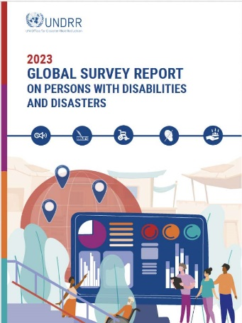
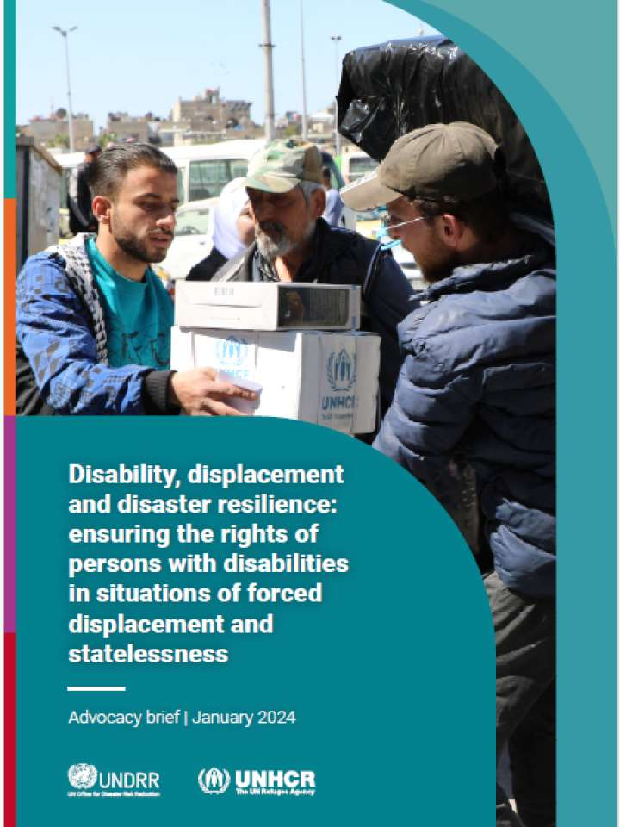
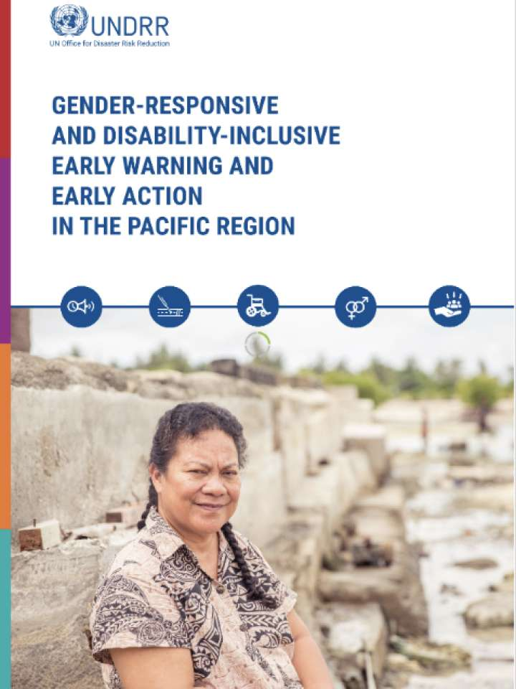
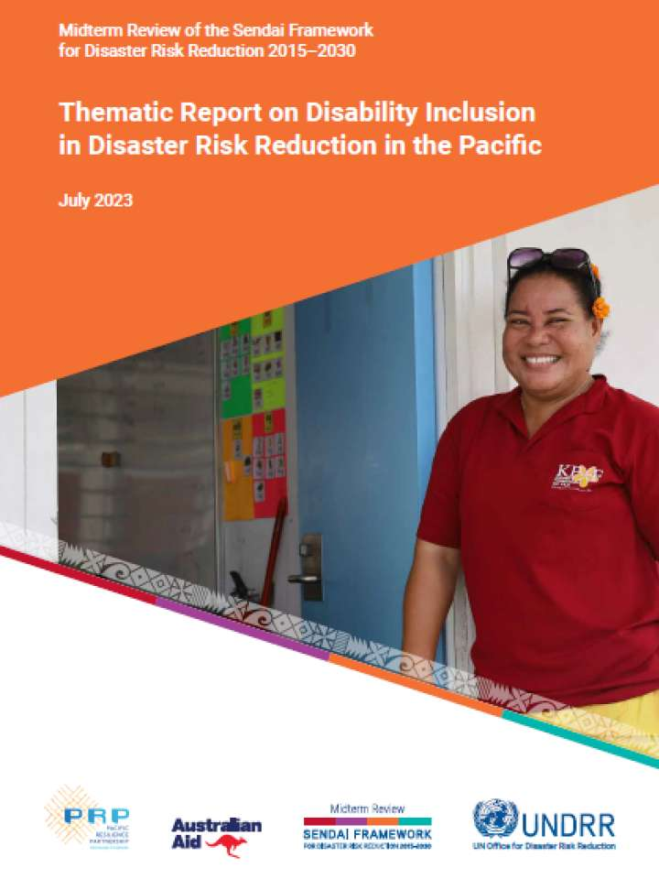
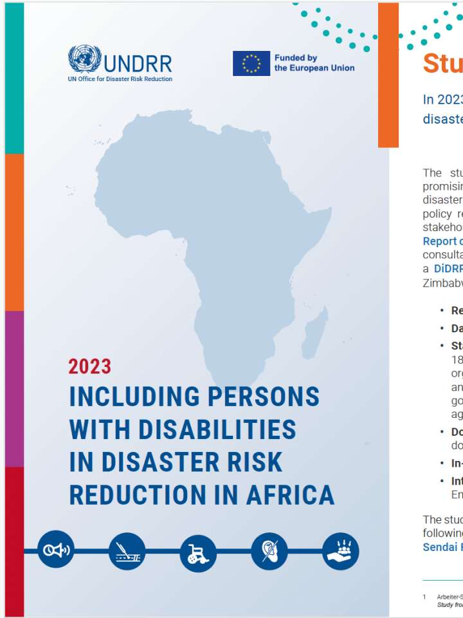
Stocktaking and assessment of the situation of persons with disabilities since the adoption of the Sendai Framework for Disaster Risk Reduction.
Thematic report on disability inclusion in the Pacific
Gender-responsive and disability-inclusive early warning and early action in the Pacific region
Including persons with disabilities in disaster risk reduction in Africa: Snapshot
Including persons with disabilities in disaster risk reduction in Africa
2023 Global survey report on persons with disabilities and disasters
Disability, displacement and disaster resilience: Ensuring the rights of persons with disabilities in situations of forced displacement and statelessness
Review on disability inclusive disaster risk reduction strategies within the Arab Region

