Slide 1

PERSONS WITH DISABILITIES AND CIVIL PROTECTION IN LITHUANIA: POLITICAL STRATEGIES AND PROMISING CASES/PRACTICES
Dovile Juodkaite
Lithuanian Disability forum

Slide 2
International standards
UN CRPD 11 art.: Situations of risk and humanitarian emergencies
Sendai Disaster Risk Reduction Framework 2015-2030.
UN Security Council Resolution on the Situation of Persons with Disabilities in Armed Conflicts and Humanitarian Crises (2019)
Inclusion standards for humanitarian action
IASC Guidelines for the Inclusion of Persons with Disabilities in Humanitarian Action (2019)

Slide 3
International standards on disability-inclusive humanitarian response
All humanitarian measures must be accessible to persons with disabilities, including persons with intensive assistance needs
Ensure that persons with disabilities are provided with accessible information on safety and emergency protocols, evacuation procedures and assistance
Ensure that persons with disabilities would have full access to basic services, including water and sanitation, social services, education, health care, transport and information
Ensure that no one would be left behind, i.e. all measures would cover both people with disabilities living in institutions or children's care homes, as well as in families; and relocation and evacuation measures would not result in institutionalisation
Ensure participation of disability organizations in all humanitarian actions

Slide 4
Lithuanian case
Since 2019 various risks/hazards ...
Disability NGO initiatives
COVID-19
War in Ukraine
Astravets
...
Request for disability inclusive responce
LDF Resolution (2023)
Participation in State level exercises
Training for Fire and Rescue Services officers

Slide 5
Recommendations (LDF Resolution, 2023)
Improving data collection
Education and training of all society groups (not only officers) regarding disability-inclusive emergency response
Risk reduction measures
Improving evacuation systems regarding the needs of persons with disabilities (including accessible transport)
Prepare Collective Protection Buildings (KAS) accessible to persons with disabilities; to carry out their registration, consistent adaptation of the infrastructure and acquisition of the necessary equipment
Consult with representatives of disability NGOs when creating event plans, preparing training programs for representatives of emergency and rescue services and volunteers, preparing public education plans in case of emergency situations, creating plans for the construction or renovation of shelters and planning evacuation measures

Slide 6
POLITICAL STRATEGY ON PROTECTION OF PERSONS WITH DISABILITIES
Before 2022
Since 2023
No provisions regarding protection of persons with disabilities in the:
Law on Civil Protection
Public Security Strengthening and Development Programme for 2015–2025
New Law on Crisis Management and Civil Protection came into force. It states that:
Civil protection education measures need to be adapted to persons with disabilities;
Warning messages need to be adapted to persons with disabilities;
Entities have to plan measures to provide persons with disabilities necessary help in the event of emergency;
Civil Protection Strengthening and Development Programme for 2024–2030 was adopted. It takes into account the needs of persons with disabilities
Information from Fire and Rescure department, Lithuania

Slide 7
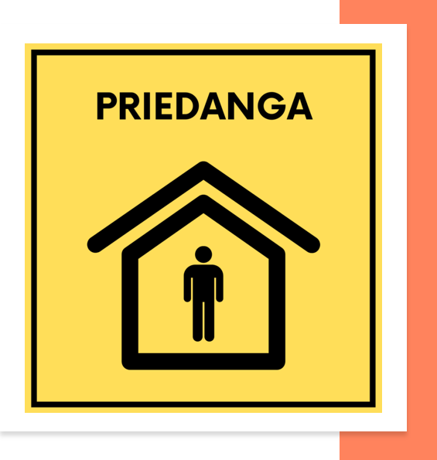
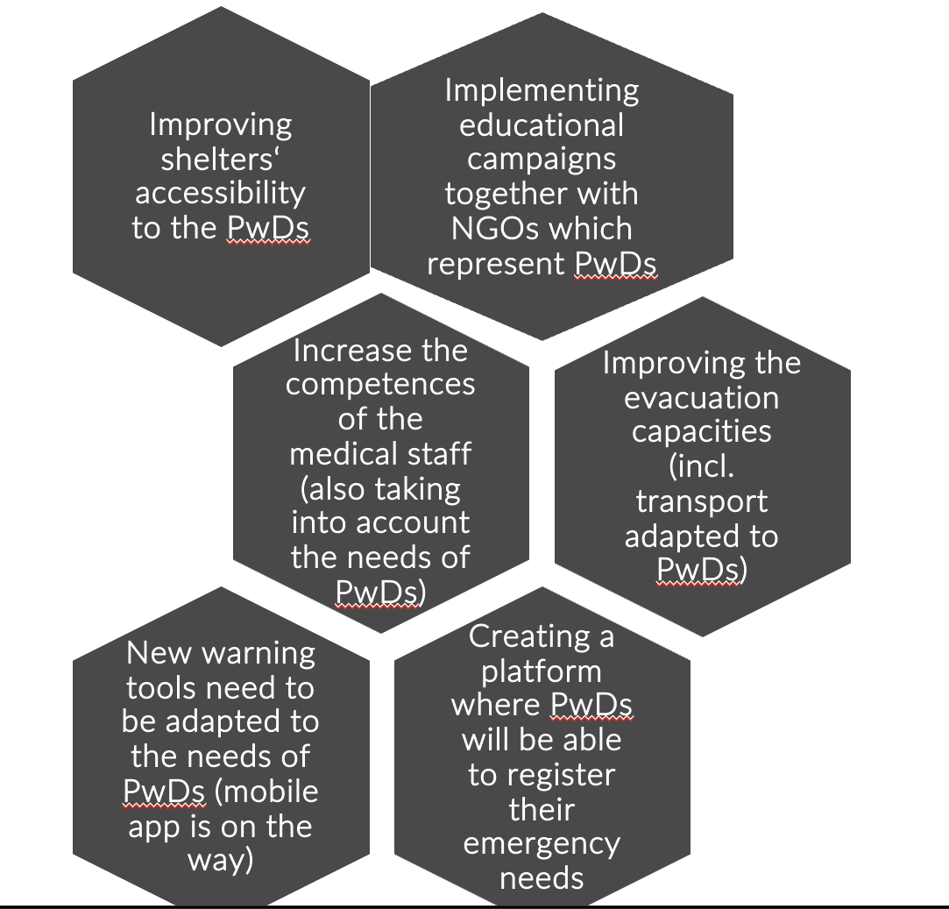
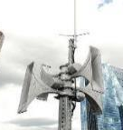
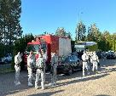

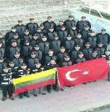
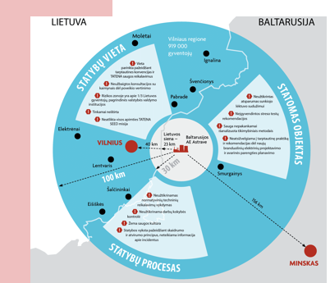
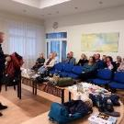
CIVIL PROTECTION STRENGTHENING AND DEVELOPMENT PROGRAM
7 PRIORITIES
MAIN ACTIVITIES TO INCREASE THE SAFETY OF PERSONS WITH DISABILITIES (PwDs)
1. Development of the infrastructure of shelters
2. Improvement of the public warning and preparedness
3. Increasing the preparedness and resilience of institutions
4. Strengthening the resilience of health care system
5. Development of civil protection assistance teams
6. Strengthening the preparedness for CBRN threats
7. Strengthening civil protection training capacities
Information from Fire and Rescure department, Lithuania

Slide 8









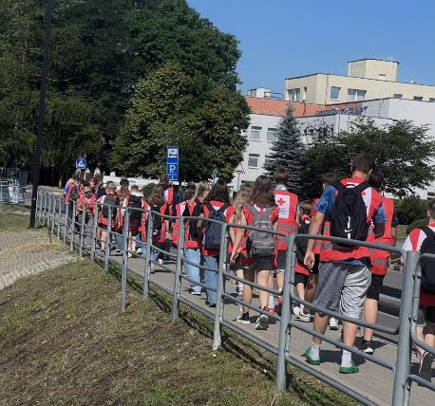
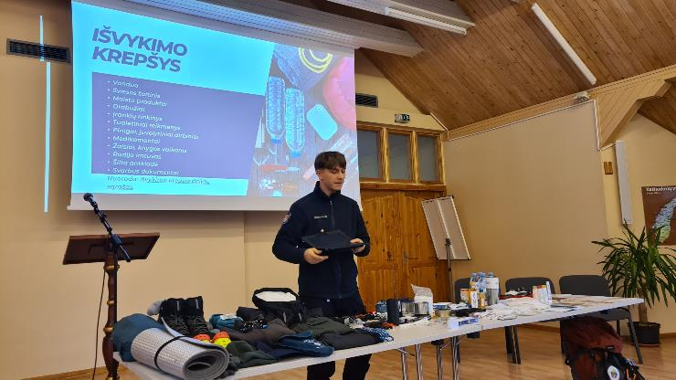
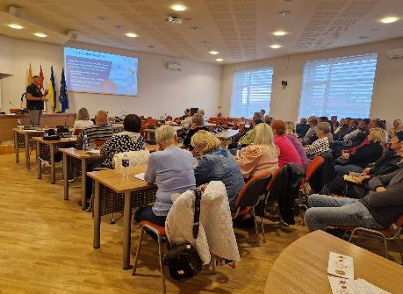
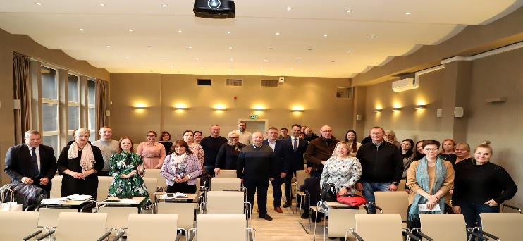
INVOLVEMENT OF LOCAL NON-GOVERNMENTAL INSTITUTIONS
PREVENTION PHASE (JOINT ACTIVITIES):
Civil protection exercise
Civil protection trainings
Other (selection of shelters, education for the population)
RESPONSE PHASE (NGOs PROVIDE ASSISTANCE):
Informing the population
Humanitarian aid
Food and water distribution for affected population
Support in evacuation process
Medical and psychological help
Information from Fire and Rescure department, Lithuania

Slide 9
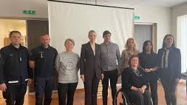
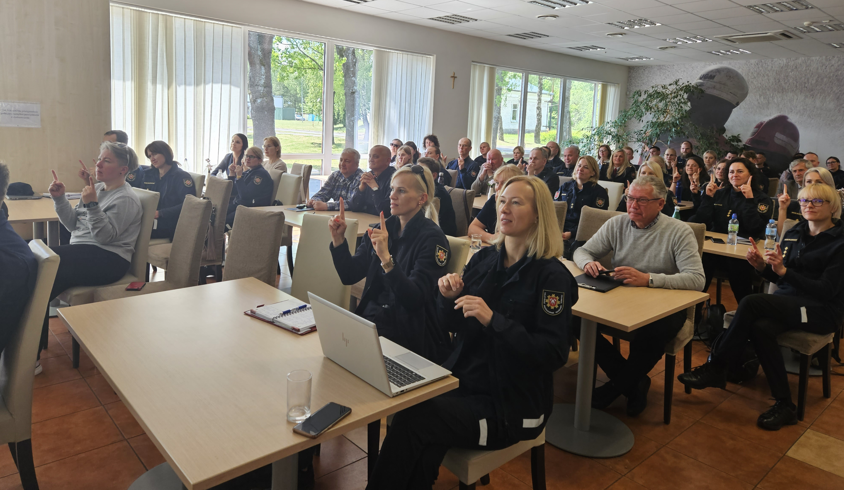

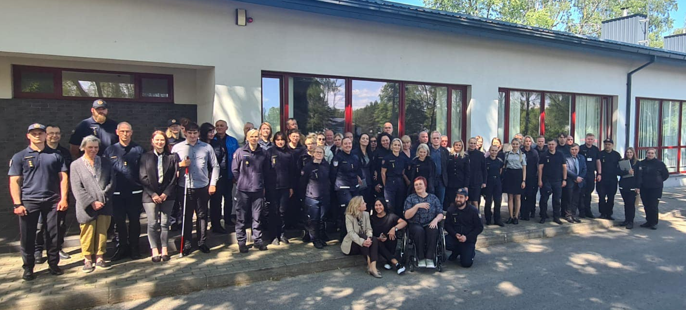
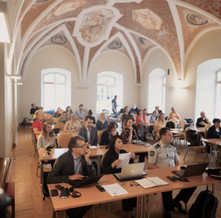

Slide 10








PUBLIC PREPAREDNESS
RESULTS OF 2022 SURVEY OF PwDs
EDUCATION AND AWARENESS RAISING CAMPAING
LT72
% of PwDs | Would know how to act in case of:
33 | Nuclear accident
39 | War
44 | Flood
57 | Tornado
72 | Fire
National website for emergency preparedness
WE ARE THE TEAM. WE HAVE THE PLAN.
TV and radio
Press
HTTPS://LT72.LT/
Personal preparedness!
only 16% have prepared survival kit (backpack)
only 15% have a family plan
54% have necessary supplies for 72 hours (food, water, medicine)
Social media
Contact activities
Campaign reached
> 2 mln. of people
GOAL FOR 2030
Population risk awareness
and preparedness – ≥65%
Information from Fire and Rescure department, Lithuania

Slide 11
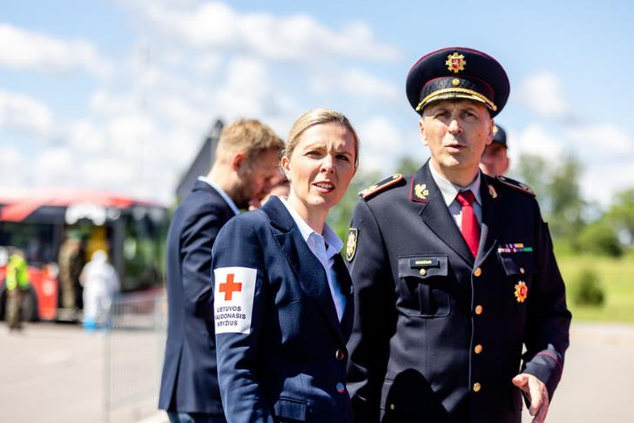
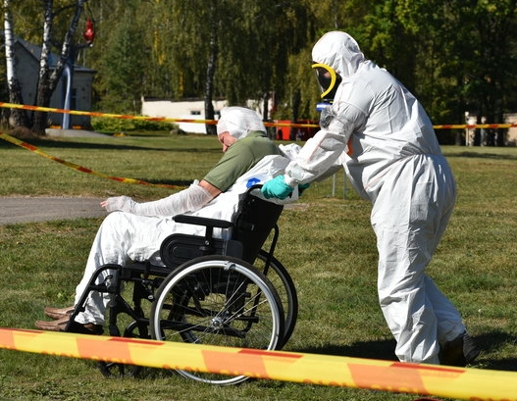
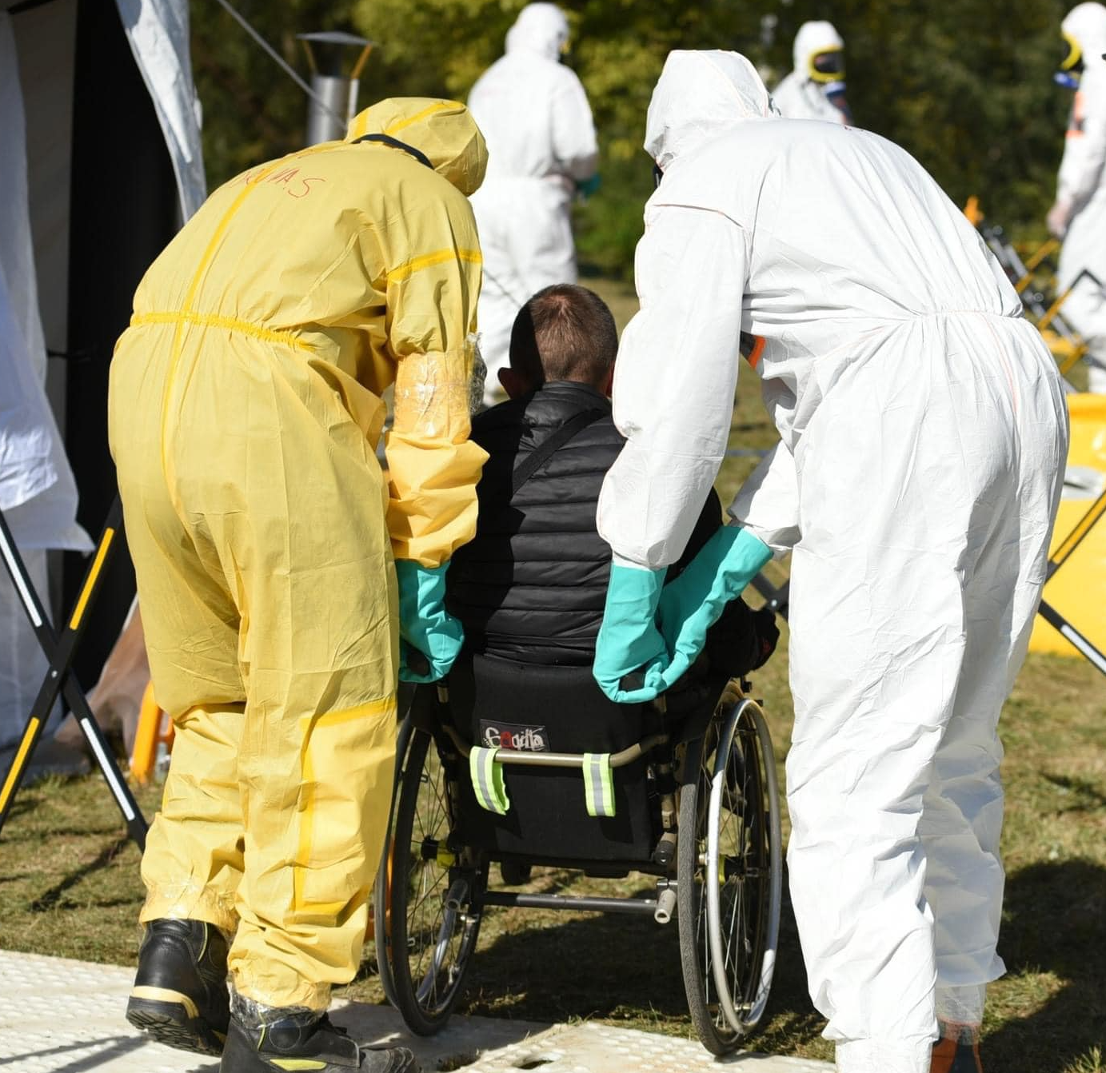
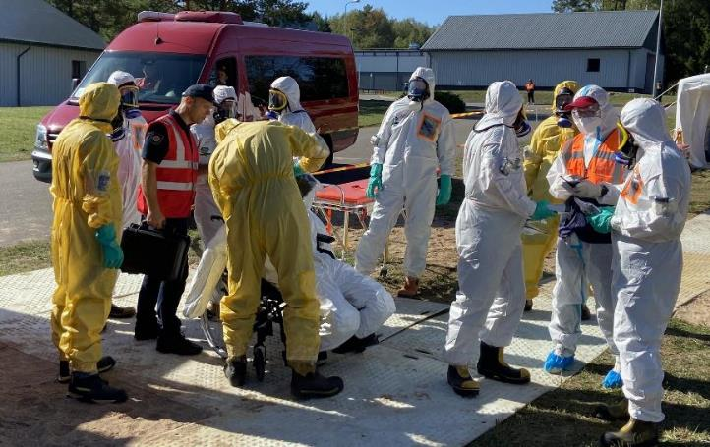
PROMISING CASES/PRACTICES:
CIVIL PROTECTION EXERCISES
State level exercises:
 | 2023 | 2024
TYPE | Functional | Full scale
TOPIC | Nuclear accident in Belarus Nuclear Power Plant
PARTICIPATS:
INSTITUTIONS | 44 | 73
NGOs | 5 | 7
RESIDENTS | 177 of whom 12 PwDs | 120 of whom 45 PwDs
Information from Fire and Rescure department, Lithuania

Slide 12
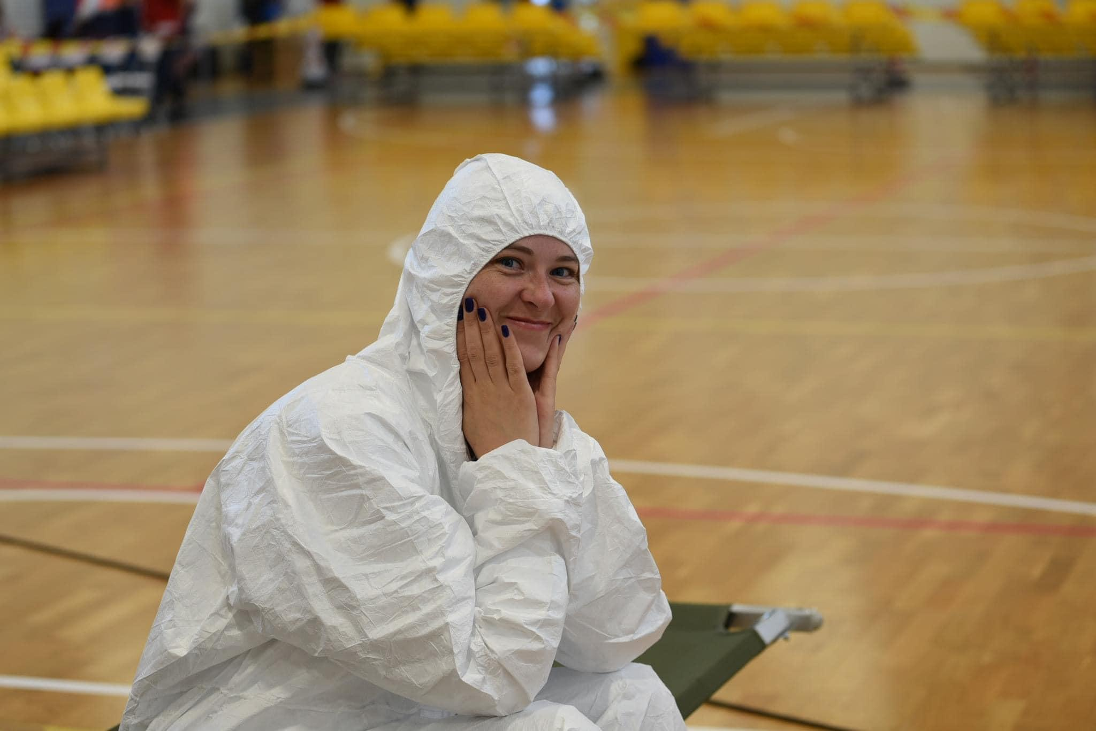
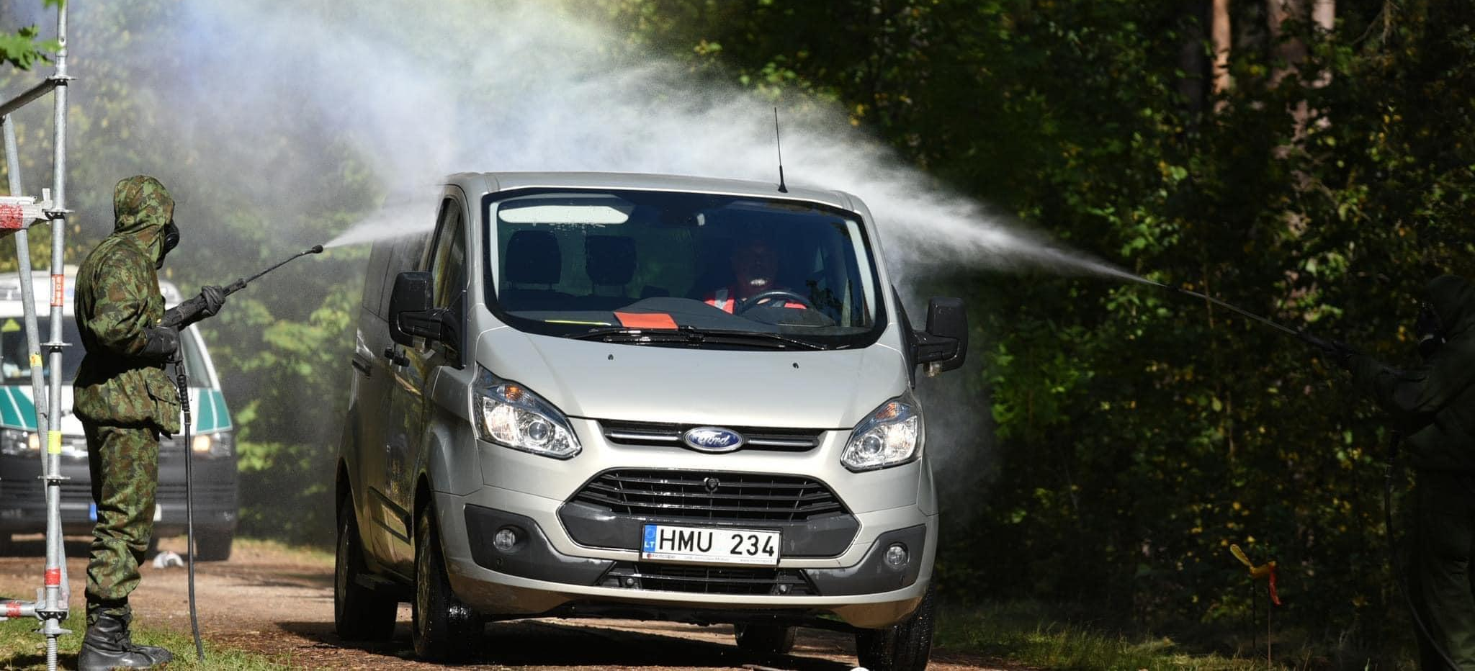
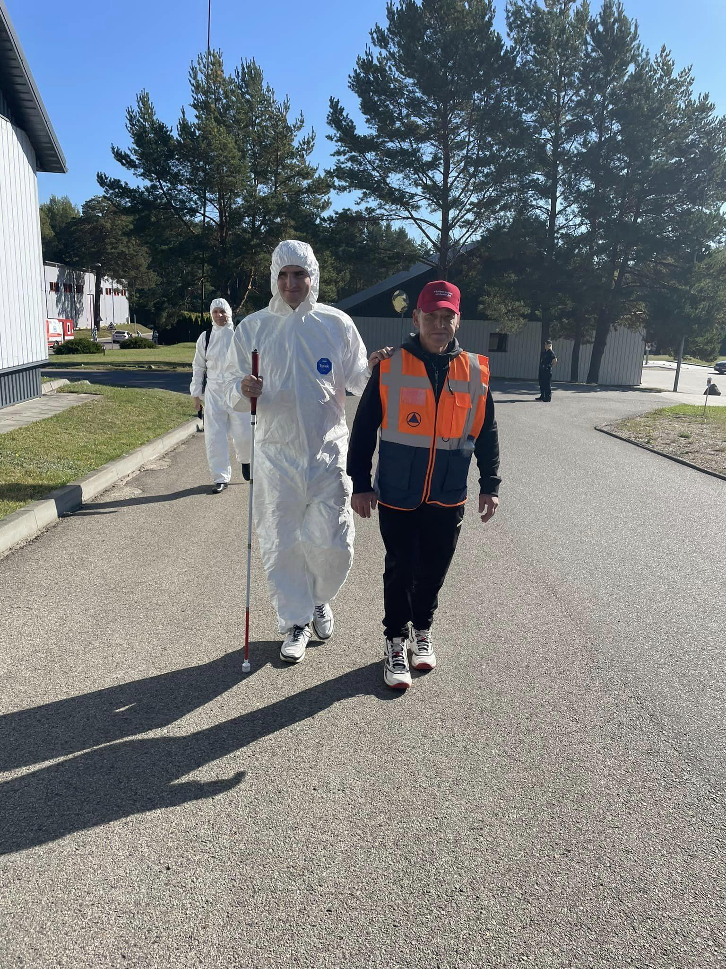
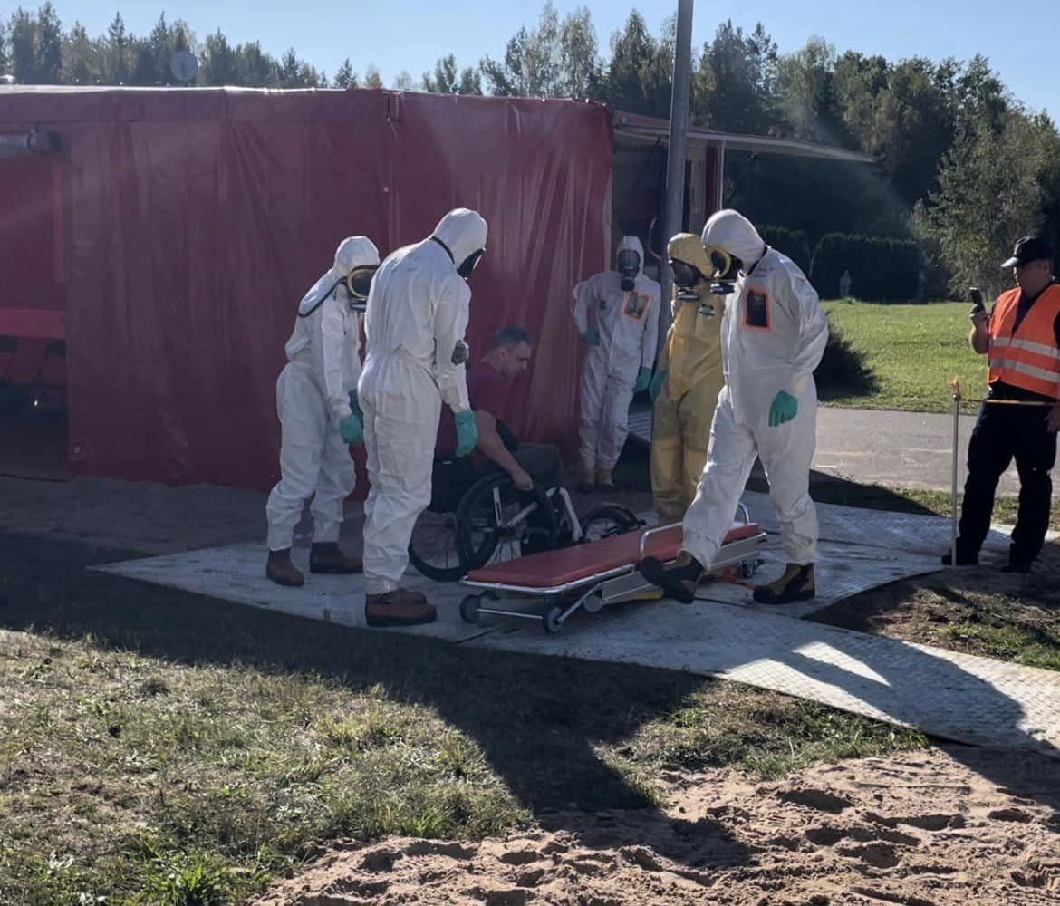
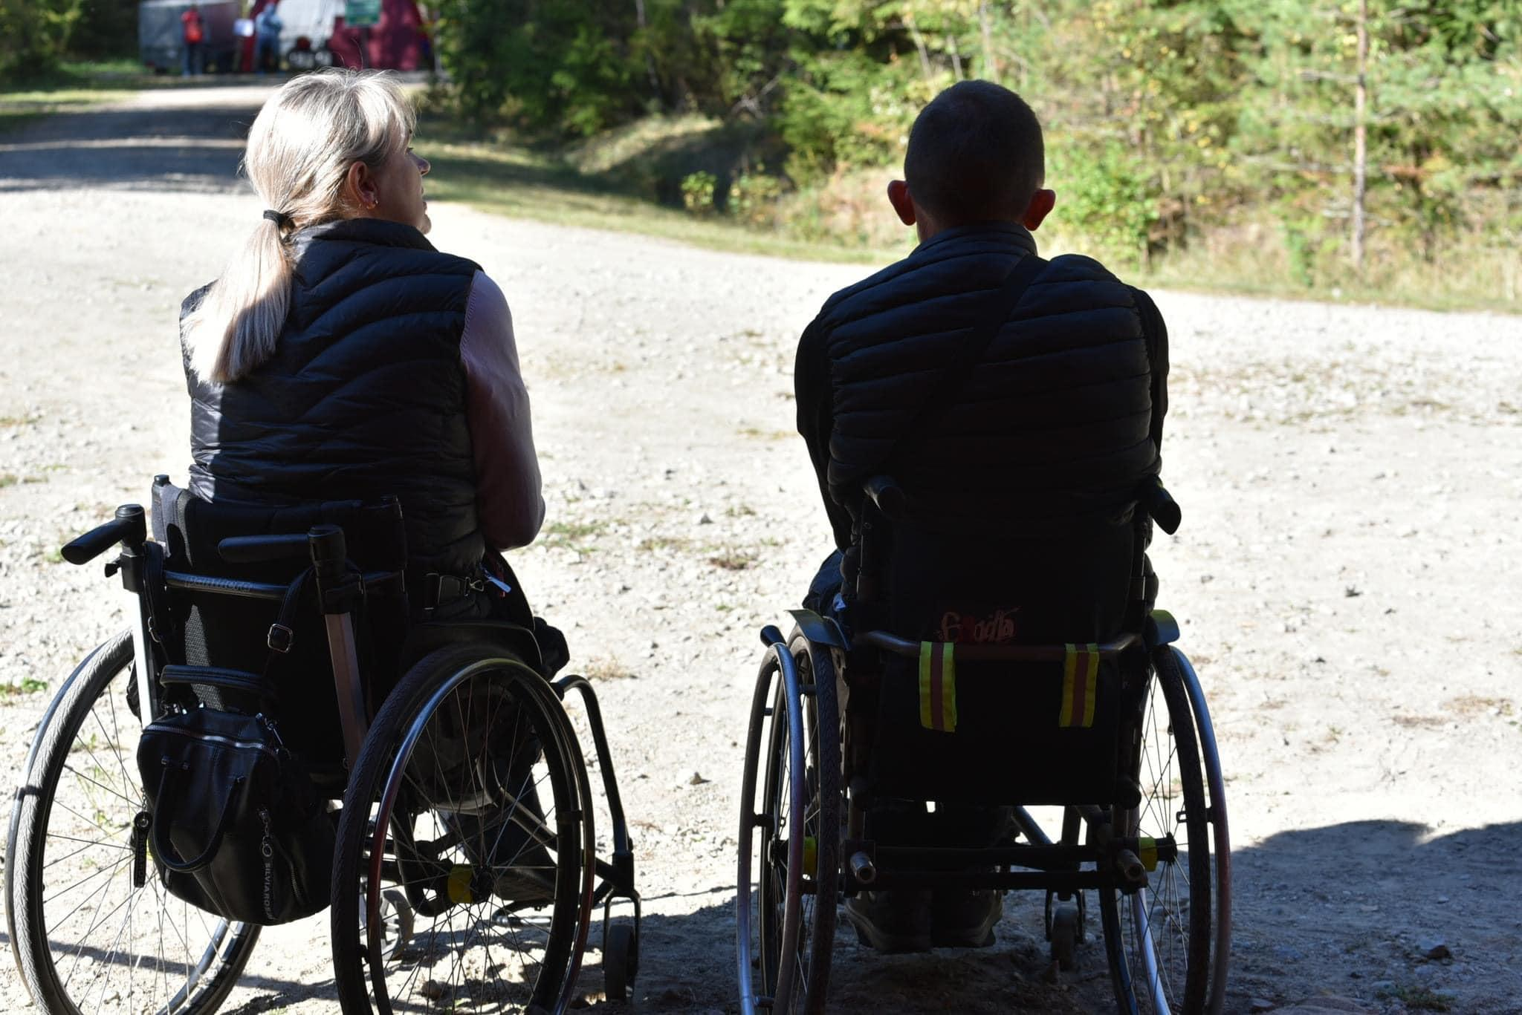
Exercise: Accident in Astravets nuclear power plant
2023 September

Slide 13
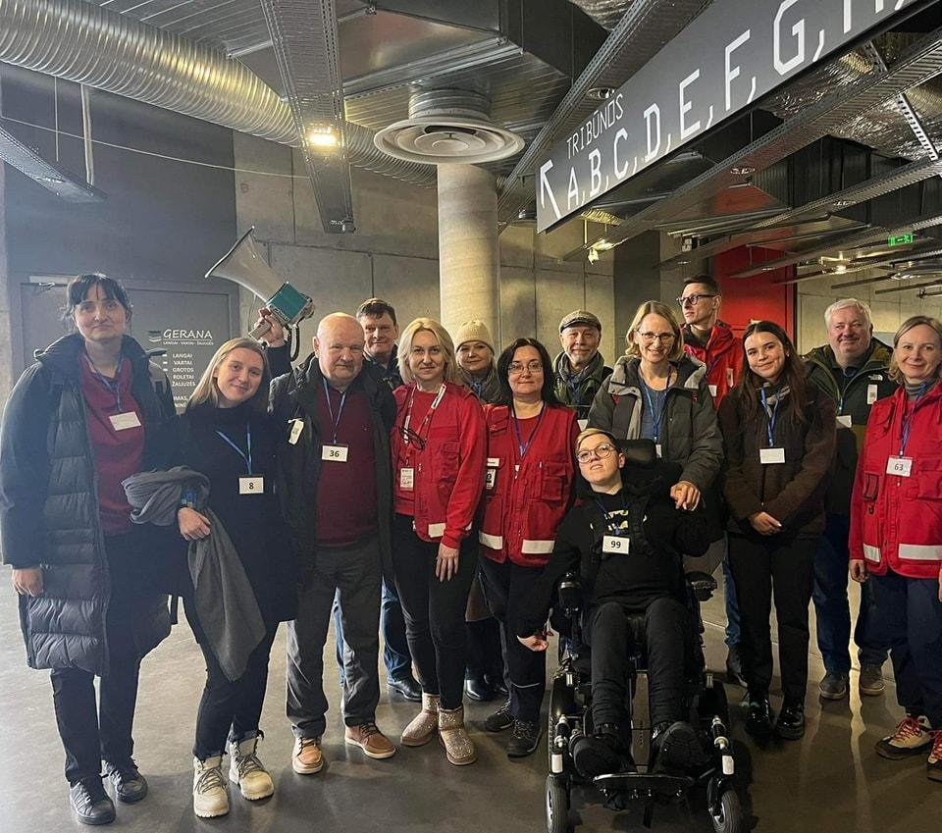
Evacuation exercise: Astravets 2024

Slide 14



PROMISING CASES/PRACTICES: PROJECT UNDER
EU CIVIL PROTECTION MECHANISM
PROJECT: „Development of strategic framework that incorporates the needs of persons with disabilities into whole disaster management cycle“
PROJECT MANAGER: Fire and Rescue Department
AFFILIATED ENTITIES:
Lithuanian Disability Forum
Agency for the Protection of the Rights of Persons with Disabilities under the Ministry of Social Security and Labour
The Ministry of the Interior of the Republic of Lithuania
TIMELINE: 2024–2025
1. Creating a platform where PwDs will be able to register their emergency needs
2. Develop the recommen-dations on the needs of PwDs during the emergency and ways to communi-cation
3.
Carry out civil protection exercise to test the developed tools
PLANNED OUTCOMES OF THE PROJECT:
Information from Fire and Rescure department, Lithuania

Slide 15
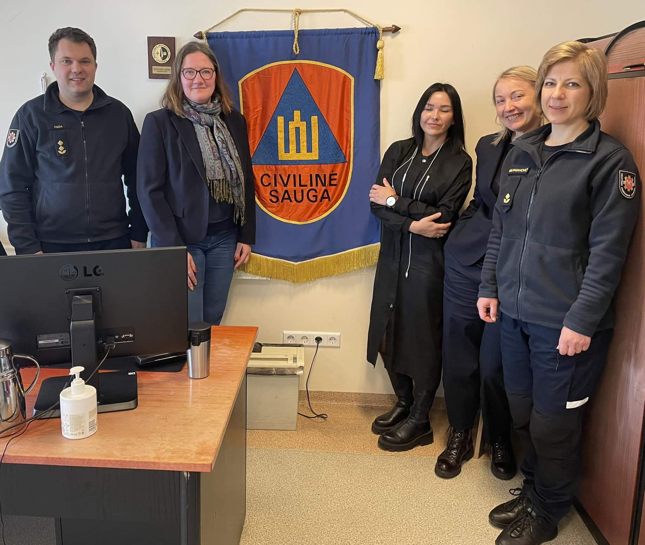
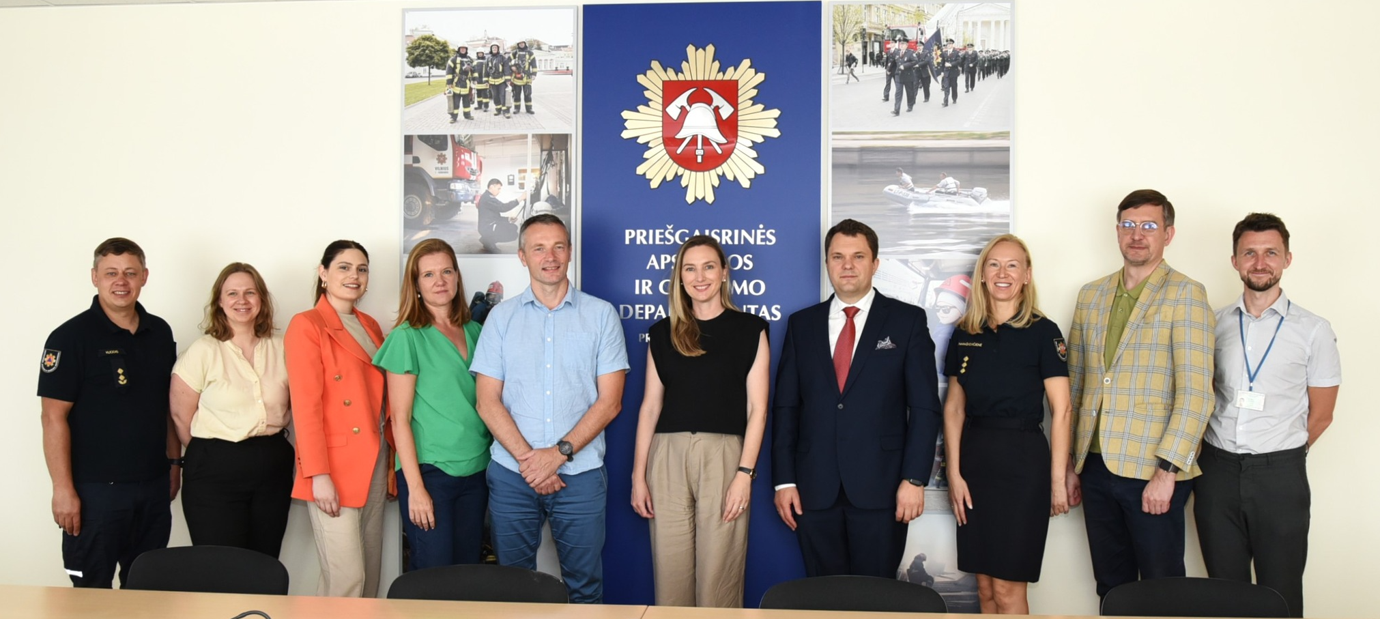
Continues close cooperation between national authorities responsible for civil protection and Disability NGOs

Slide 16
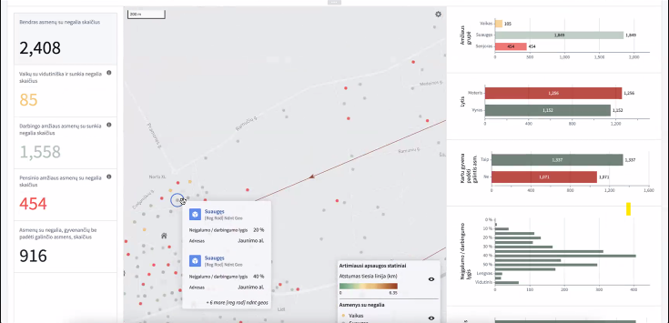
Pilot model of gathering info about PwD in 1 municipality

Slide 17
Remaining challenges
Implementation:
There is a lack of disaggregated data on persons with disabilities and families at the municipal level
There is a lack of representation, partnership and inclusion of disability organisations in planning and coordination actions, especially at the municipal level
lack of accessibility of critical infrastructure (Collective Protection Buildings, shelters) and essential humanitarian services

Slide 18
Lessons learnt
Good will and personal engagement from state institution – was initial step forward
But it needs legal framework and concrete obligations for continues cooperation with PwD NGOs
Involvement of persons with disabilities from the very first stage
Mutual learning and sharing

