Slide 1
Civil Protection and disability inclusion
Anna Battistutta
Policy Officer DG ECHO
Disaster Risk and Resilience

Slide 2
Ongoing actions in DG ECHO - CP
Building resilience of civil protection through:
UCPM funding programmes
Awareness raising
Inclusion in CP capacities
Operations and exercises
DRGs flagship initiatives
Action 1
Action 2
Action 3
Action 4
Action 5

Slide 3
Action 1: UCPM funding programmes
Over the period 2014-2023, UCPM has co-funded 20 cross-border projects* which had some ‘vulnerable groups component’, for a total EU support of more than EUR 10 million.
The projects included awareness raising actions, exercises, capacity building to assist people with disabilities in disasters, development of standards for response capacities (e.g. shelter), etc.
An example is the 2021 project Safe and Equal in EMErgencies (SEE ME), and which aims to contribute to equal opportunities for persons with disabilities in emergency situations.
* The 2023 proposals have not all been signed yet.

Slide 4
Action 1: UCPM funding programmes
Recently funded* projects involve:
SEE ME 2 (HR) - aiming to contribute to the equalization of opportunities for persons with disabilities in emergencies. It is a continuation of the SEE ME project and leans on the activities started during its implementation
Enable-DMC (LT) – creation of information on pwd managed at the national level, such as the number of persons with disabilities, the nature of their disability, their contact details, etc.
ENOTICE-2 (BE) - building up on CBRN decontamination, including conventional and new emerging threats while considering vulnerable people, and focusing on decontamination of prosthetic and orthotics used by disabled people.
* The 2023 proposals have not all been signed yet.

Slide 5
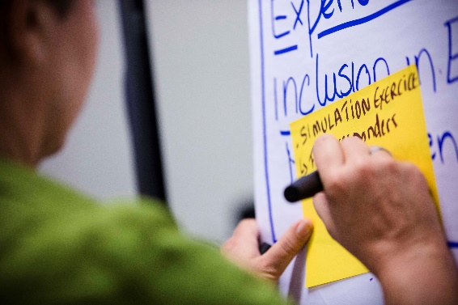
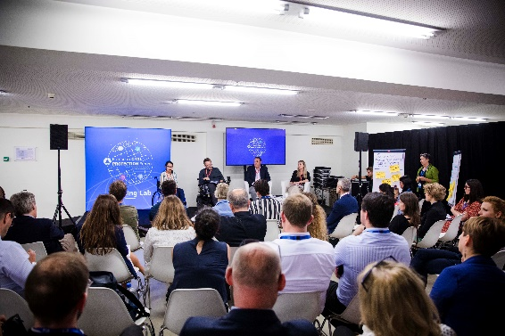
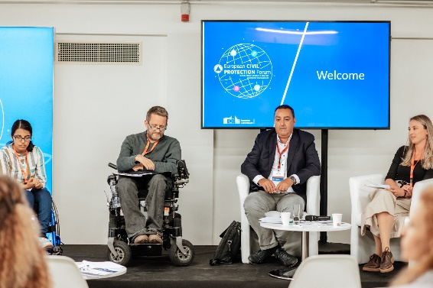
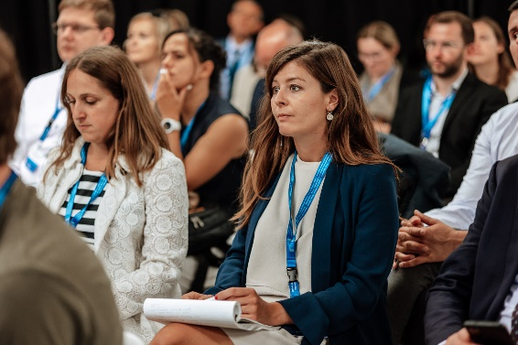
Action 2: Awareness Raising
Through the past and upcoming Civil Protection Forum
Through the Knowledge Network (UCPKN)
To raise awareness of the principles of non-discrimination and inclusiveness in prevention, preparedness and response operations in the context of civil protection.
Regarding the Knowledge Network online platform: designed to comply with the technical standard for websites zoom up to 200% without problems, navigate most of the website using a modern screen reader and speech recognition software (on your computer or phone)

Slide 6
Action 2: Awareness Raising
UCPM Evaluation Communication
To raise awareness of the principles of non-discrimination and inclusiveness in prevention, preparedness and response operations in the context of civil protection.
Regarding the Knowledge Network online platform: designed to comply with the technical standard for websites zoom up to 200% without problems, navigate most of the website using a modern screen reader and speech recognition software (on your computer or phone)
Outcomes of Scenario building
To raise awareness of the principles of non-discrimination and inclusiveness in prevention, preparedness and response operations in the context of civil protection.
Regarding the Knowledge Network online platform: designed to comply with the technical standard for websites zoom up to 200% without problems, navigate most of the website using a modern screen reader and speech recognition software (on your computer or phone)

Slide 7
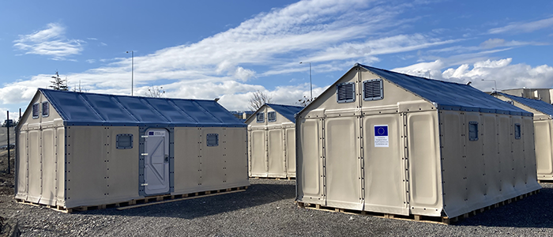
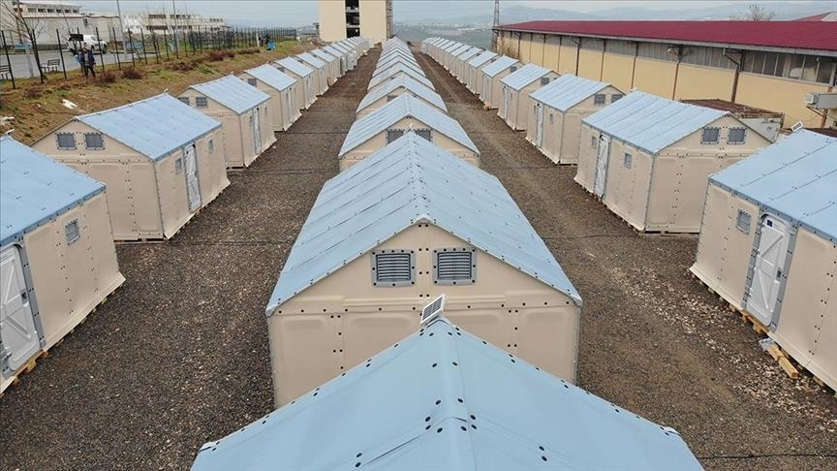
Action 3: Inclusion in CP capacities
European Civil Protection Pool (ECPP) and rescEU capacities
DG ECHO is committed to ensure better accessibility to all affected population.
Example: 15% of rescEU shelter capacity should be accessible to people with some form of disability
  Accessible shelter units and tents – zips and/or Velcro in a bright colour.
  Accessible WASH units
  Accessible eating spaces
  Accessible infirmary

Slide 8
Action 4: ERCC operations and exercises
The ERCC has successfully coordinated several evacuations of people with physical and mental disabilities ensuring a safe transfer of patients to other countries.
Example: in the current context of Russia’s invasion of Ukraine, the ERCC evacuated a group of 110 Ukrainian psychiatric patients through the UCPM.
The needs of people with disabilities are considered in exercise scenarios and evaluated during training and exercise activities. Two examples in 2022:
EU MODEX USAR Austria’s search and rescue exercise included the evacuation of children with special educational needs from their school in an earthquake scenario.
As part of the EU MODEX Romania on flood response, the scenario included evacuation procedures for people with physical disabilities in a major flooding event.

Slide 9




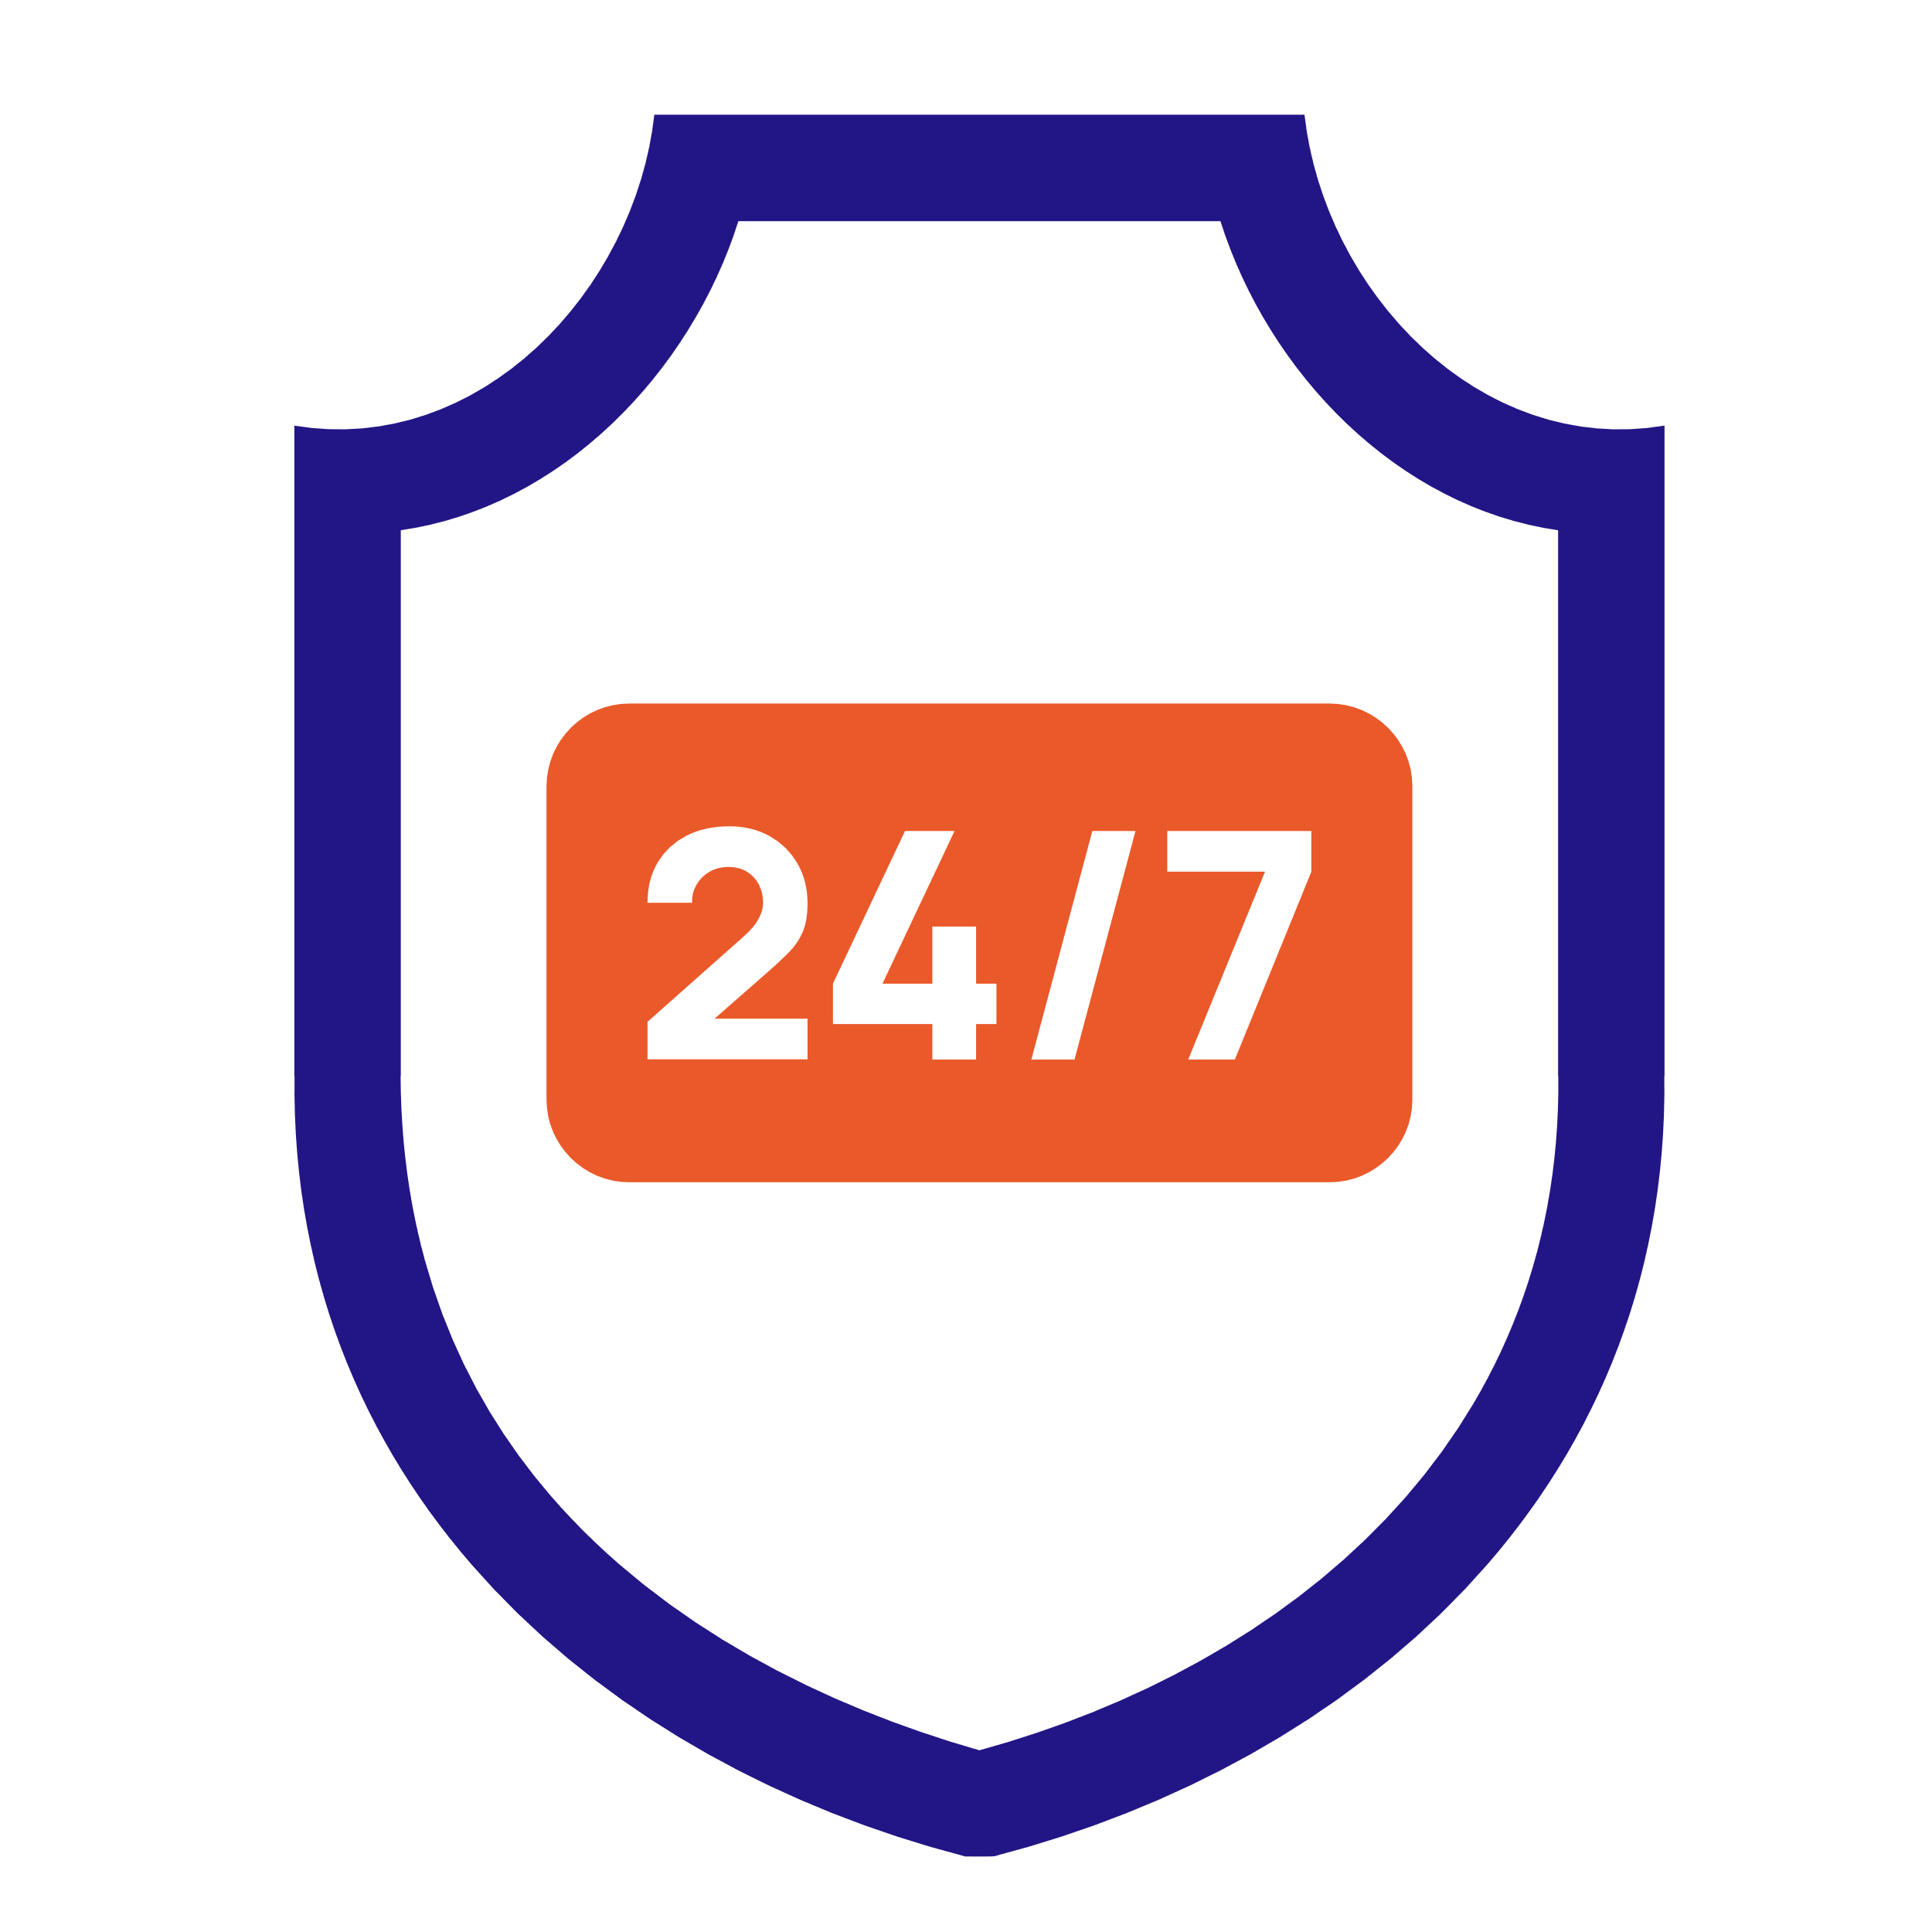
Action 5: DRGs flagship initiatives
Enhancing inclusiveness as a key horizontal principle for disaster risk management, set out in the first Commission Recommendation on Union Disaster Resilience Goals adopted in February 2023.
It considers risk assessment and planning, public risk awareness and early warning call for specific attention for the needs of people with disabilities.
Anticipate
Prepare
Alert
Respond
Secure
Improve risk assessment, anticipation and risk management planning
Enhance the Union Civil Protection Mechanism response capacity
Increase risk awareness and preparedness of the population
Ensure a robust civil
protection system
Enhance early
warning

Slide 10
Action 5: DRGs flagship initiatives
Goal No. 1 “Anticipate”
Goal No. 2 – “Prepare”
Goal No. 3 – “Alert”
Europe-wide disaster scenarios
Risk assessment: at EU level, improve the identification and analysis of vulnerable groups
Planning: Commission and Member States should consider the specific needs of vulnerable groups in risk management plans for cross-border risks
‘preparEU'
a pan-European awareness raising programme
All members of a community, including people with vulnerabilities, should be actively engaged in preparedness and prevention efforts
Linking global early warning with local action in Europe
Public warning: Member States should ensure that public warning is inclusive and adapted to the specific needs of vulnerable groups, including of persons with disabilities

Slide 11
Thank you

