Slide 1
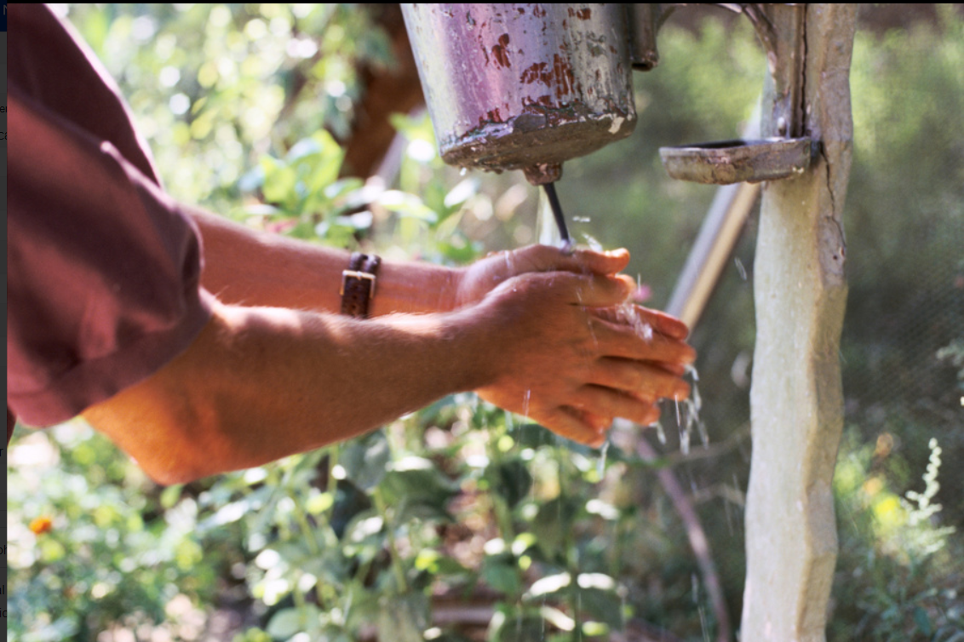

Trends of climate migration & prediction: MENA and Central Asia regions
Tajikistan, IOM (1995)
Susanne Melde, PhD
Global Thematic Specialist Climate Action
Global Office for Brussels
Notes:
3 main messages: 1. mostly internal or immobile, 2. climate impacts drivers of mobility, including conflict, 3. support countries and actors in the region and foster regular pathways and protection

Slide 2
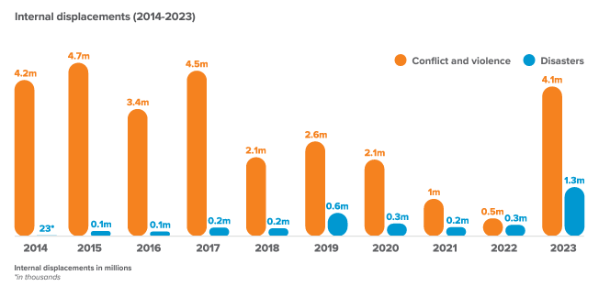
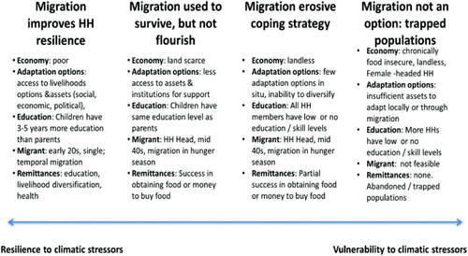
Climate and human mobility – the big picture
MENA region
Climatic and environmental factors are a driver of human mobility – mostly internal, and intraregional
…but migration can also be part of adaptation strategies in the context of environmental and climate change
Source: IDMC, 2024
Source: Warner at al., 2012
Notes:
Europe and Central Asia: Mostly earthquake Turkiye 2023, Ukraine. Some displacement in Russia 60 K conflict, 15 K disasters – 2 storms far east in Aug 23
MENA: region dominated by protracted conflict displacement (Palestine, Syria, Israel, Yemen), but also disasters (Syria, Yemen – floods, storms, Morocco – earthquake 8 Sept – not climate, Iran earthquakes, Libya storm Daniel 10 Sept) - not included: Sudan (IDMC diff region from IOM)
Intraregional and Russia and Ukraine – links with conflicts in both regions

Slide 3

Central Asia: Key trends
Likely to be most affected by climate change via droughts, heatwaves and rainstorms affecting livelihoods and water scarcity (IPCC, 2022) (not included: glacial melt)
Conflicting interests over water control has recurrently led to violence in Central Asia
Environmental factors are already contributing to shaping a number of human mobility patterns within and beyond the Central Asian region
May exacerbate existing vulnerabilities and drivers of migration within and beyond the region (Scissa and Martin, 2024)
This used to be the fishermen's market place in Al Fao, Basrah, southern Iraq. It is now dried up due to low levels of water in the Tigres and Euphrates caused by decreased rainfall; the construction of dams; and an absence of sustainable management of water resources locally.
© IOM 2023
© IOM 1995
Notes:
Landlocked
Currently, more than 500,000 people in more than 1,500 villages in Kazakhstan have no access to drinking water, while many only have water access for a few hours a day (CABAR, 2022)
The Aral Sea, which used to be the fourth-largest lake globally, is progressively shrinking down, further decreasing water availability in the whole region
in terms of displacement, evacuation, planned relocation, pastoralism and (seasonal) labour migration, among others.
Severe impacts that climate change will have on decreasing the already scant availability of land and water resources as well as on increasing mean temperature

Slide 4
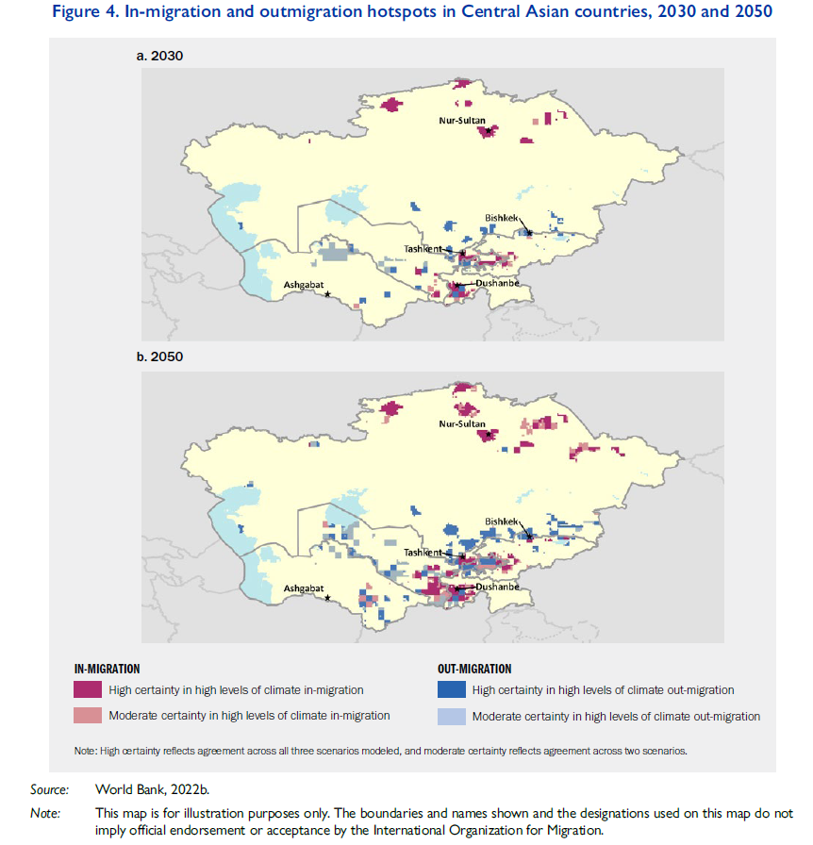
Central Asia: Migration
Climate migration mostly internal
Apart from Kazakhstan, emigration is more common in Central Asia than immigration, particular via the migration corridor to the Russian Federation, Ukraine, Belarus and other Commonwealth of Independent States (CIS) countries
Lack of regular pathways: People from Central Asia also migrate, mostly through irregular channels, to Western and Central Europe, especially the EU, often via first entering Kyrgyzstan and Tajikistan and are then smuggled through Kazakhstan and the Russian Federation to Western Europe (UNODC, 2015)
The number of female labour migrants has been rising in and from Central Asian countries. Men have historically been more likely to migrate for work, with 1 in 3 working-age men being abroad in the case of Tajikistan (Laruelle, 2013).
This used to be the fishermen's market place in Al Fao, Basrah, southern Iraq. It is now dried up due to low levels of water in the Tigres and Euphrates caused by decreased rainfall; the construction of dams; and an absence of sustainable management of water resources locally.
© IOM 2023
© IOM 1995
Notes:
Kazakhstan (Astana), Uzbekistan (Tashkent), Turkmenistan (Ashgabat), Tajikistan (Dushanbe), Kyrgyzstan (Bishkek),
the likely destinations of internal migrants who will be exposed to these impacts
Emigration=Common part of life

Slide 5
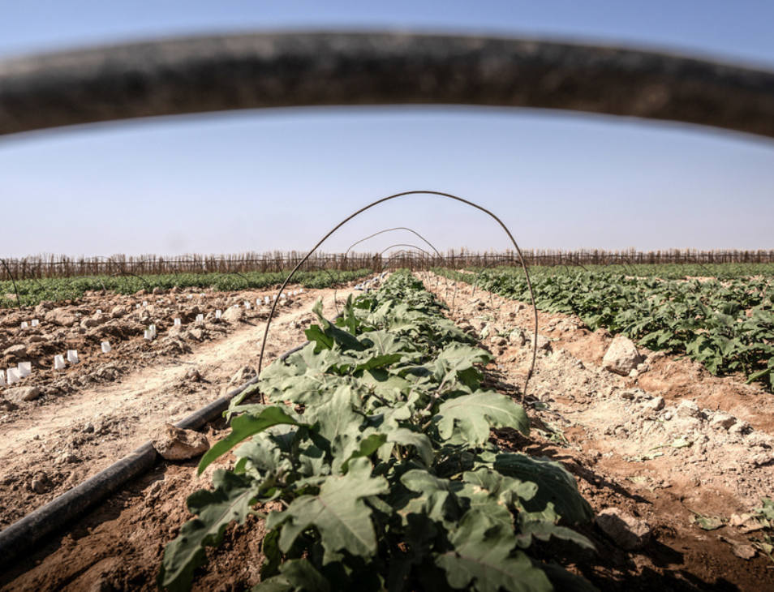

Middle East and North Africa: Key trends
The MENA region is highly vulnerable to climate change due to its arid climate, water scarcity, rapid urbanization and reliance on fossil fuels, leading to significant food security, health and migration challenges
Implications for peace and stability in the region, and combining climate vulnerability with fragility and insecurity (IOM, 2023)
Climate change in the MENA region creates specific risks for women and girls, who face higher mortality during disasters and difficulties accessing relief. Their vulnerability is influenced by factors like age, disability, and socio-economic status; more reliant on climate-sensitive livelihoods like agriculture, yet receive inadequate support to adapt
Migration can be an adaptation strategy under certain conditions. But climate stress also leads to immobility of women and girls left behind, not having access to migration options
Iraq, Credit: Raber Aziz © IOM 2023
Women in the MENA region are already leading efforts to reduce vulnerabilities and increase resilience, demonstrating their capacity to adapt and resolve conflicts, yet often underrepresented in dialogue and consultations (IOM, 2024)
Lack of legal pathways and protection for climate migrants, including in EU (see Central Asia) (IOM, 2023)
Growing demand for green jobs and the importance of skilled mobility partnerships for green transition in countries like Tunisia and in the EU in line with EU Green Deal
Notes:
projected to be severely affected by climate change, leading to increased disasters like floods, droughts, and wildfires¹.
Rural urban migration due to impacts on rural livelihoods, potential conflicts in new areas of destination
Due to the combination of water and precipitation scarcity, demographic pressures and population concentration, These stressors combined with demographic pressure make MENA the most waterstressed area in the world with 14 out of 25 extremely high water stressed countries located in the region (World Resources Institute, 2023)
Higher vulnerability of women and girls, Like lack of access to land for women
They face compounded risks due to inequitable social, economic, and political systems, such as lack of access to land and many occupations, also at destination, gender-based violence and exploitation
and left with more farming responsibilities and less other income
Local knowledge n. Many women already engage in climate-sensitive agriculture practices and natural resource management and possess local knowledge that can help tailor climate change actions to their context
Water Wise Women and the Women and Water Diplomacy in the Nile (WIN) Network

Slide 6
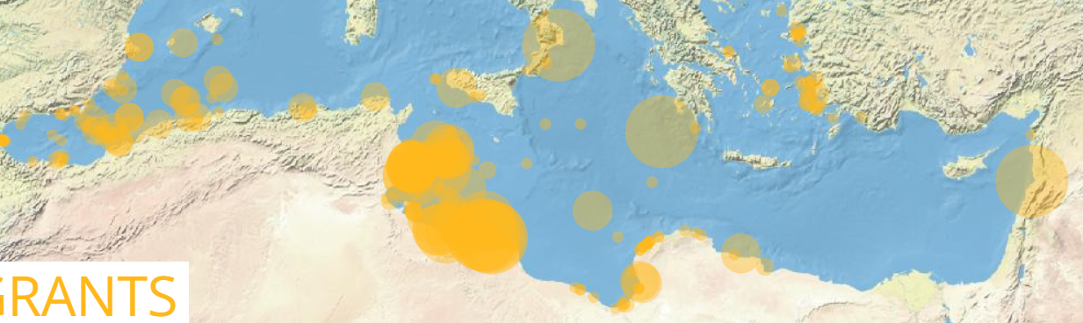
Migration and links to the EU
Central Asia
Impact of war in Ukraine – as Russian Federation is key destination for migrants from Central Asia, either return or migrate to other countries – so EU may become a more important destination
Volatile economic projections combined with ramping inflation and prizes and decreasing food supplies may drive poor people in Central Asia into further poverty, exacerbating their vulnerability to loss of livelihood, which in turn may also be negatively affected by impacts of climate change
Regular pathways to enter the European Union may become more popular in the near future for a number of reasons, including family reunification, language (Latvia and Estonia for Russian speakers).
First residence permit figures for 2023 (Eurostat, 2024), increasing in recent years:
Uzbekistan about 16,000
Kazakhstan around 15,000
Kyrgyzstan around 9,500
Tajikistan about 3,800
Turkmenistan around 3,300
MENA
Region dominated by protracted conflict displacement internally (Palestinian territories, Syrian Arab Republic, Israel, Yemen), but also disasters (Syria, Yemen, Morocco, Libya storm) (IDMC, 2024)
Importance of irregular transit migration and hosting refugees in protracted situations
Europe important destination region for migrants generally, in addition to Northern America and Asia (UN DESA, 2021). Deadliest route worldwide – more than 30,240 missing and dead migrants recorded since 2014 (IOM MMP, 2024)
First residence permit figures for 2023 (Eurostat, 2024):
Syrian Arab Rep. Around 167,000
Morocco about 150,000
Tunisia about 34,500
Iraq about 25,000
Egypt about 21,000
Lebanon about 13,000
Sudan about 5,000
Libya around 2,600
Notes:
Currently, the Russian Federation and Kazakhstan are the principal destination countries for international migrants from Central Asia
devaluation of Russian currency and job losses
however, such a consolidated trend may change according to the conflict dynamics and its potential repercussions on the economy.
In light of the plausible change in migration corridors within and from Central Asia, the European Union and its Member States need to be prepared to address increased movements, also in the context of climate and environmental changes. Hungary and Poland important destinations lately
MENA: region dominated by protracted conflict displacement (Palestine, Syria, Israel, Yemen), but also disasters (Syria, Yemen – floods, storms, Morocco – earthquake 8 Sept – not climate, Iran earthquakes, Libya storm Daniel 10 Sept)
Syrian Arab Rep important origin of refugees worldwide

Slide 7
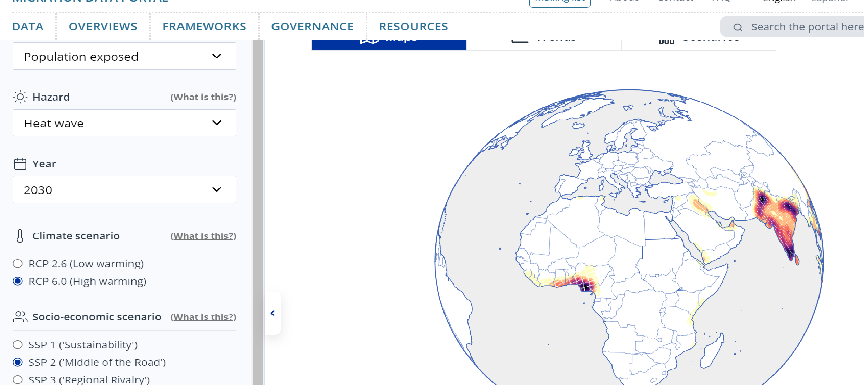



Climate change and future human mobility
The biophysical impacts of climate change are increasingly well understood
Climate impact models informs us where and when humans will be exposed to hazards relevant for mobility
However, the likely human mobility response to these hazards is largely unclear and forecasts tend to be inconsistent, e.g.
Groundswell Model (World Bank, 2021): Global warming will increase internal mobility in Africa
Africa Climate Mobility Model (2023): Global warming will decrease internal mobility in Africa
Notes:
Migration data no very good, disaggregated

Slide 8
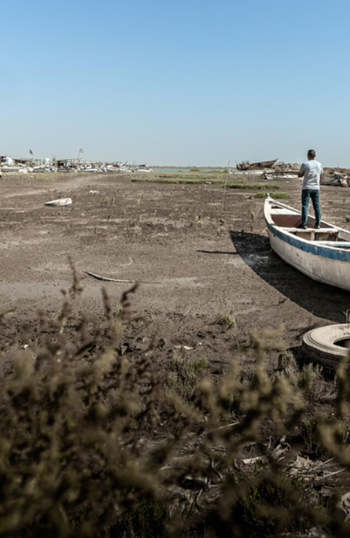
World Bank (2021) Groundswell report
Projections of internal climate migration by 2050 with no action
13 million in North Africa
2.4 million for Eastern Europe & Central Asia
Projections by 2050 with climate and development actions
4.5 million in North Africa
1.7 million for Eastern Europe & Central Asia
This used to be the fishermen's market place in Al Fao, Basrah, southern Iraq. It is now dried up due to low levels of water in the Tigres and Euphrates caused by decreased rainfall; the construction of dams; and an absence of sustainable management of water resources locally.
© IOM 2023
Notes:
6% of pop in North Africa
There will be mobility, but hard to predict exactly as current in particular mobility data is limited - at global level are typically not disaggregated by socio-economic and demographic factors (age, sex, education)
Difficulty of predicting fast-onset disasters affecting food security and mobility/displacement
Multicausality of human mobility

Slide 9
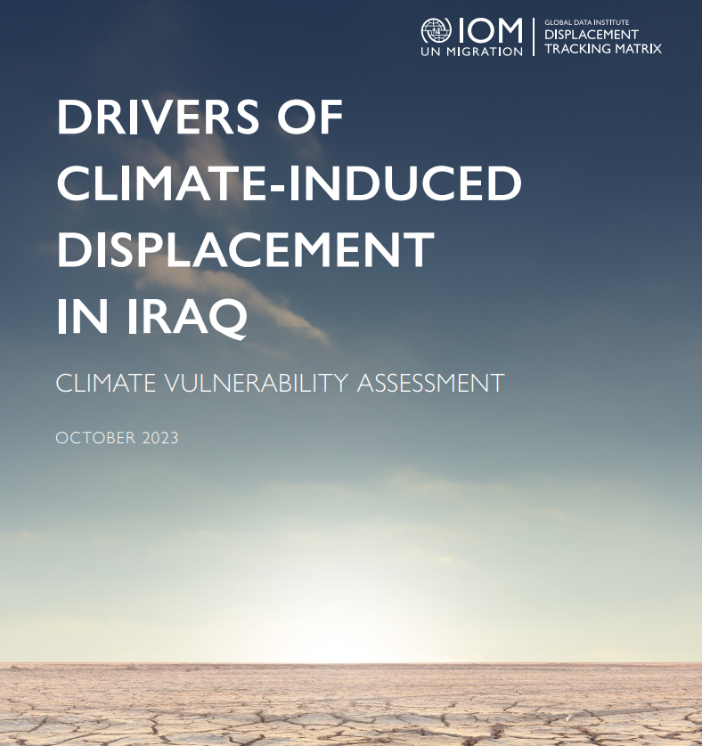
Recommendations
Evidence base and data: invest in gender and age disaggregated data collection and analysis capacity related to climate mobility, interaction with peacebuilding, share good practices
Notes:
According to pillars of IOM’s road map – save lives and protection, solutions to displacement, regular pathways
since climate change impacts are likely to undermine human security and this could have significant implications for peace and stability
BP climate assessment Iraq:
The main factors include water-related issues, food insecurity, lack of access to services, and reliance on land for livelihoods.
Vulnerable Groups: Families relying on land and water resources for income, those struggling to access basic services, and those experiencing tensions over natural resources are most affected¹.
Recommendations: Address water-related challenges, support livelihood diversification, improve basic services, and develop systems for monitoring water scarcity and conflict resolution.
joint problem-solving committees, inclusive governance and adaptation policies and programmes, non-violent conflict resolution and justice mechanisms and understanding local histories of conflict dynamics can all contribute to successful conflict resolution and migration management. Additionally, violence, intercommunal clashes, environmental degradation and resource-related conflicts pose significant threats to peace, stability and livelihoods

Slide 10

Recommendations – time to act is now
Strategic partnerships and resource mobilization
Support Central Asian and MENA governments, international and local NGOs, youth and women groups, and other partners increase their capacity to respond to climate and other environmentally induced migration, displacement and planned relocation, advocate for and invest in green jobs in the 2 regions
Advocacy and Policy: foster inter-regional cooperation to enhance effective adaptation and mitigation strategies
Legal pathways: Few EU Member States adopted protection measures on environmental grounds. Crisis and force majeure regulation of the Pact on Migration and Asylum could provide an entry point, as well as support of related assessments
Build on European Union Central Asia Strategy et al. to enhance and reinforce cooperation and partnership among the parties
Support capacity of governments to respond to, minimize climate and environmentally-induced mobility
Sectoral and cross-sectoral sustainable solutions for prevention, adaptation, mitigation, Loss & Damage – gender-responsive, human rights-based, child-sensitive, focus on youth, inclusion – link to conflict resolution, justice solutions in local context, support women leadership
Notes:
According to pillars of IOM’s road map – save lives and protection, solutions to displacement, regular pathways
The crisis and force majeure regulation has entry points for IOM (see attached internal document) as "force majeure" may include disasters: "through an advisory capacity support to EUAA (EU Asylum Agency) and the European Commission (EC) in shaping the monitoring mechanism for crisis situations and its implementation in compliance with fundamental rights. IOM may also support the EC, as per Article 3 of the Regulation, with assessments of the crisis situations that would feed the EC implementing decision on the situation of crisis and force majeure." IOM is directly mentioned in the regulation. The focus of the Pact is in ensuring that the European asylum and migration systems aren't overwhelmed with incoming movements (see background on 2015/2016 influxes below), so it doesn't include a focus on movements happening within or among other regions.
European Union remains Central Asia’s biggest economic partner, accounting for 30 per cent of the region’s total trade and financing direct investments worth EUR 62 billion (European Commission, 2019c).
The 2019 European Union Central Asia strategy sees opportunities for cooperation and economic development in many sectors, including environmental protection and climate policy. In particular, renewable energy, environmental governance and ecological tourism are considered essential parts of a new approach aimed at strengthening Central Asia’s resilience. The European Union is already playing a role in supporting Central Asia’s environmental protection via European Union development aid and loans and may consider extending partnership and cooperation in interconnected sectors, such as educational exchange programmes and vocational training.

Slide 11

QUESTIONS?
Dr. Susanne Melde
Global Thematic Specialist Climate Action
INTERNATIONAL ORGANIZATION FOR MIGRATION
GLOBAL OFFICE IN BRUSSELS
smelde@iom.int

