Slide 1

Climate change and its impacts on the economy
EESC public hearing
18 July 2024
Vicky Pollard
DG CLIMA

Slide 2
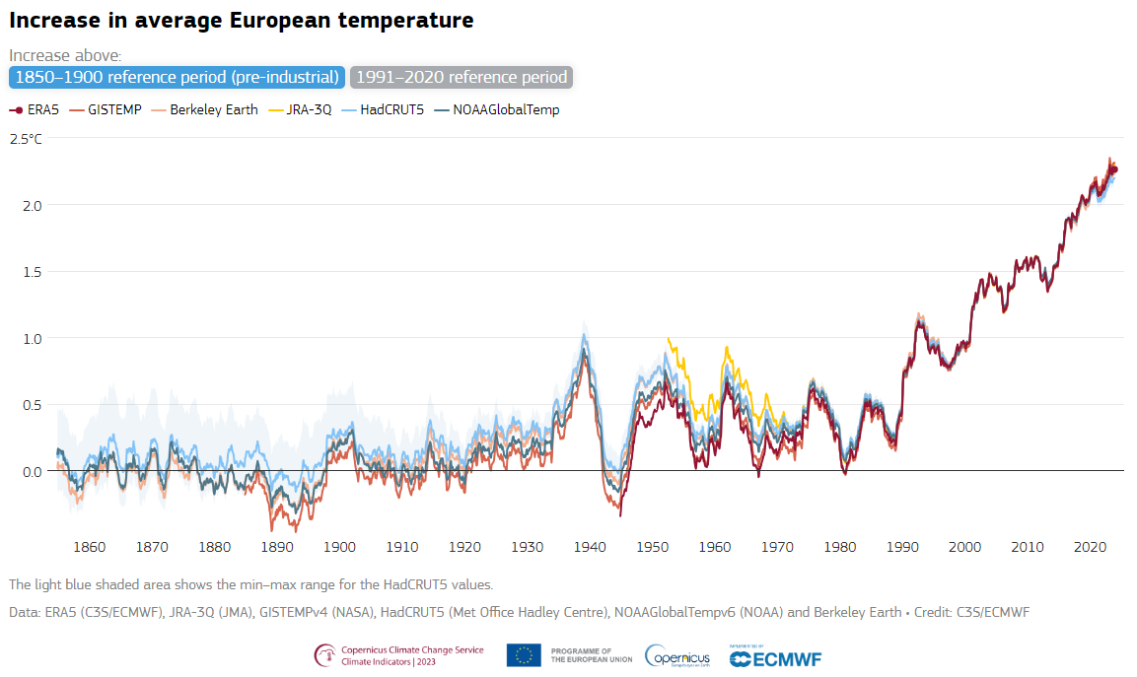
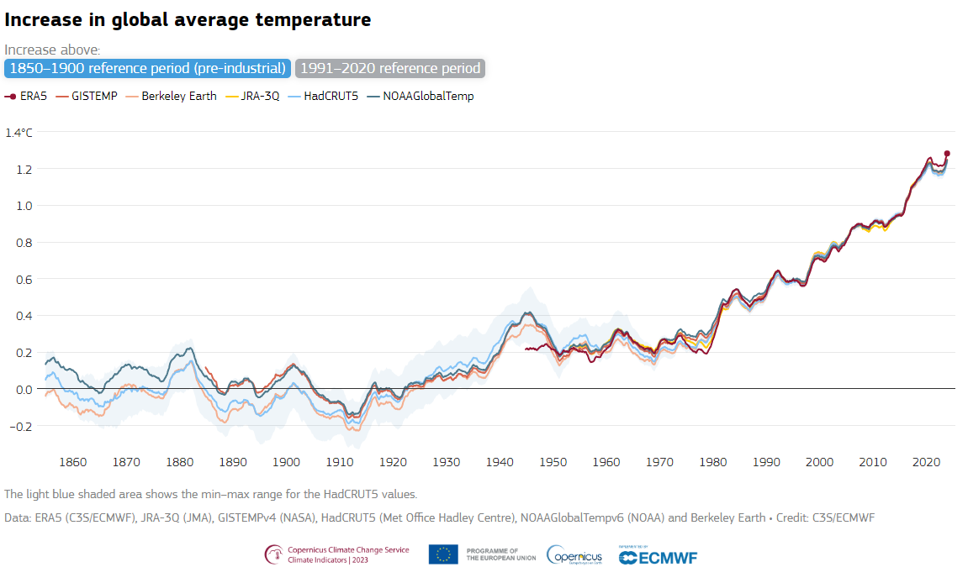
Our planet is warming fast - Europe is on the frontline

Slide 3
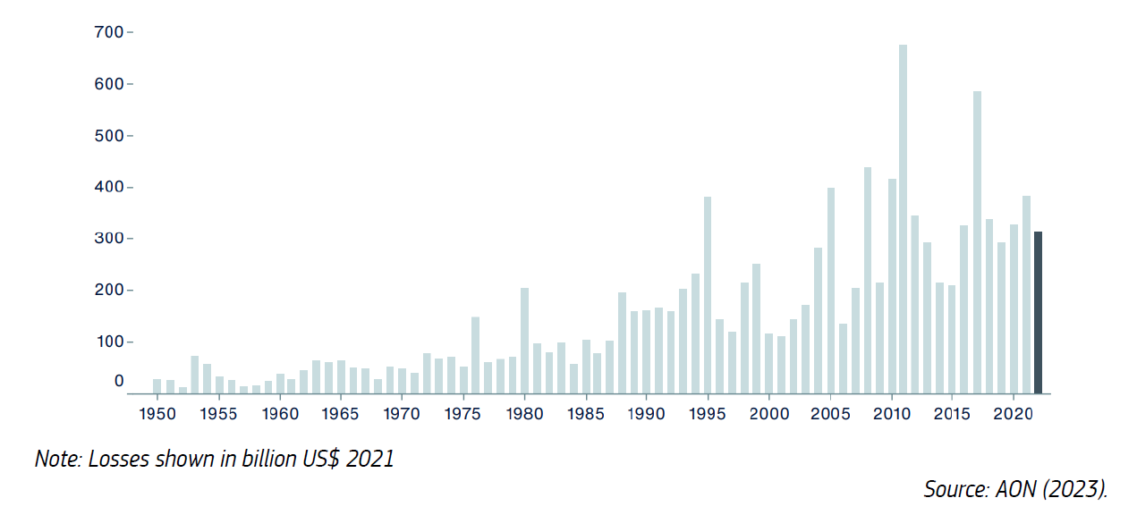
Global costs of climate disasters are rising
Insured and uninsured losses from catastrophes, 1970-2021 (billion US$ 2021)
Source: Swiss Re Institute (2023).
Global economic losses from natural disasters, 1950-2021 (billion US$ 2021)

Slide 4

2040 Target Communication & Impact Assessment
  Recommends 90% net GHG reduction by 2040- intermediate target towards climate neutrality by 2050, as called for by European Climate Law
  Launches a political debate
  Informs the preparation of the post-2030 policy framework
  Next EU NDC; Re-affirms the EU’s global climate leadership

Slide 5
Projected GDP impacts for the EU are very large
EU GDP losses from climate hazards (RCP7.0 vs RCP 1.9)
Regional GDP losses from climate hazards by 2100
(RCP7.0 vs RCP 1.9)
Note: measured as a % deviation relative to a baseline without costing of hazards

Slide 6
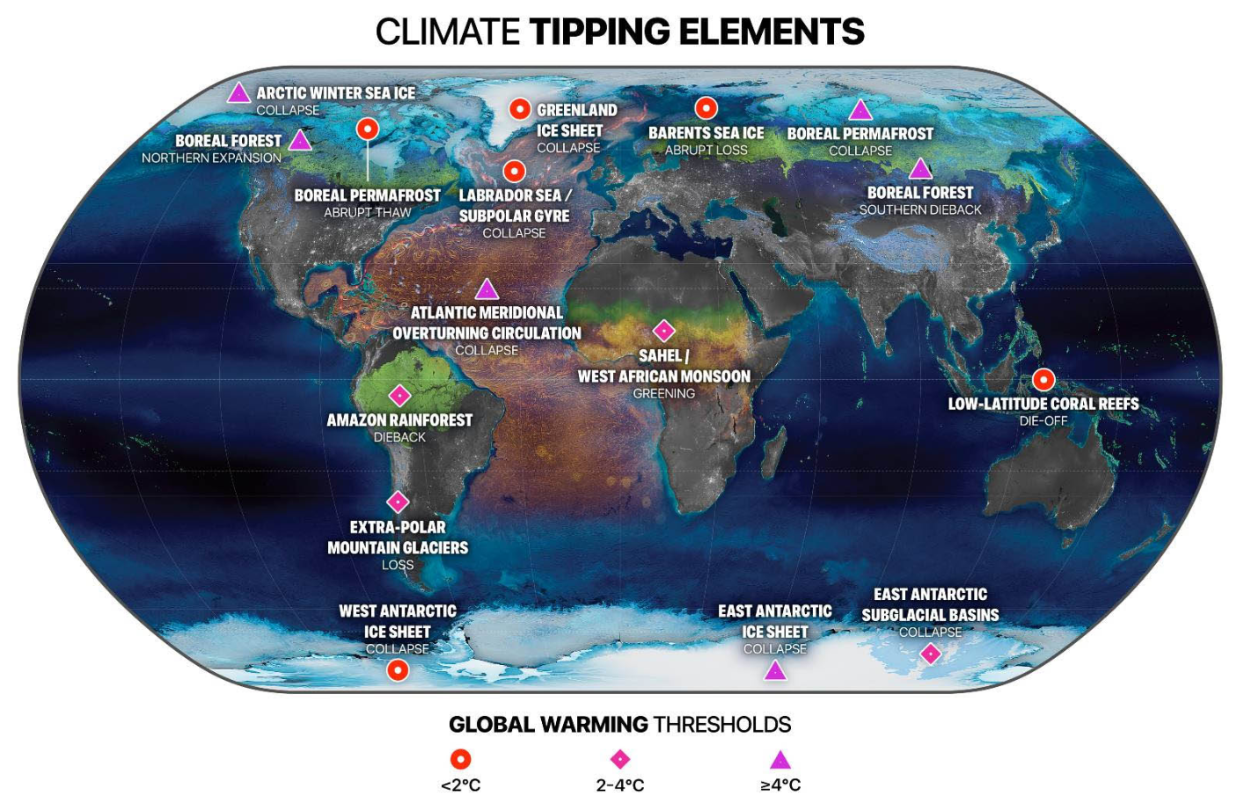
Tipping points add to risks and uncertainty

Slide 7
Costs of inaction vs. costs and benefits of mitigation in the balance
Costs of climate change are rising quickly, risks are high
  EUR 650 billion and 220,000 deaths in 1980-2020
  Conservative estimates of 7% loss of GDP by end of century
Co-benefits of GHG mitigation are large
  Lower morbidity, mortality & health care costs, improved wellbeing
  Open strategic autonomy, energy security and affordability, lower fossil fuel imports (€2.8 trillion saving in 2031-2050) and economic resilience
  Business and job opportunities from green tech
  Lower economic costs of climate change

Slide 8
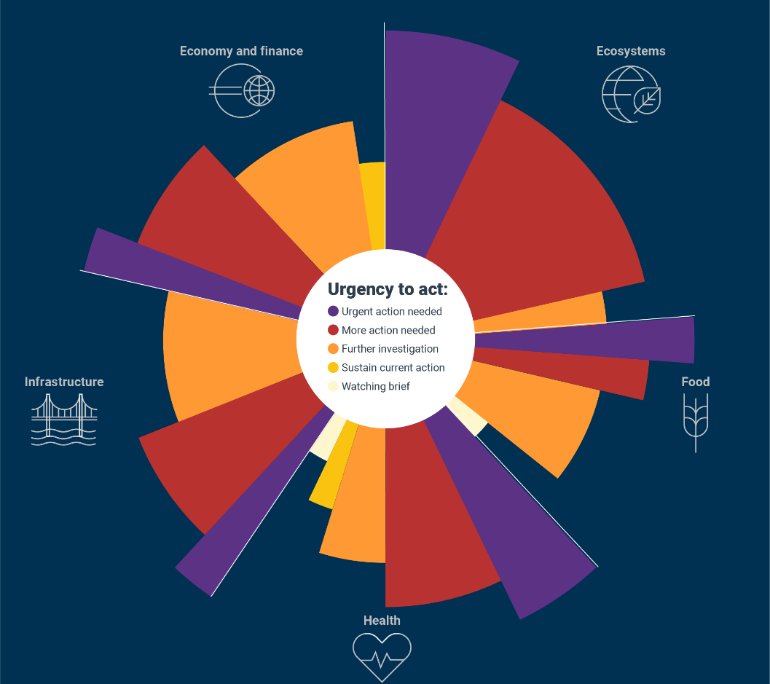
EUCRA – first comprehensive assessment of risks and urgency to act for the EU

Slide 9
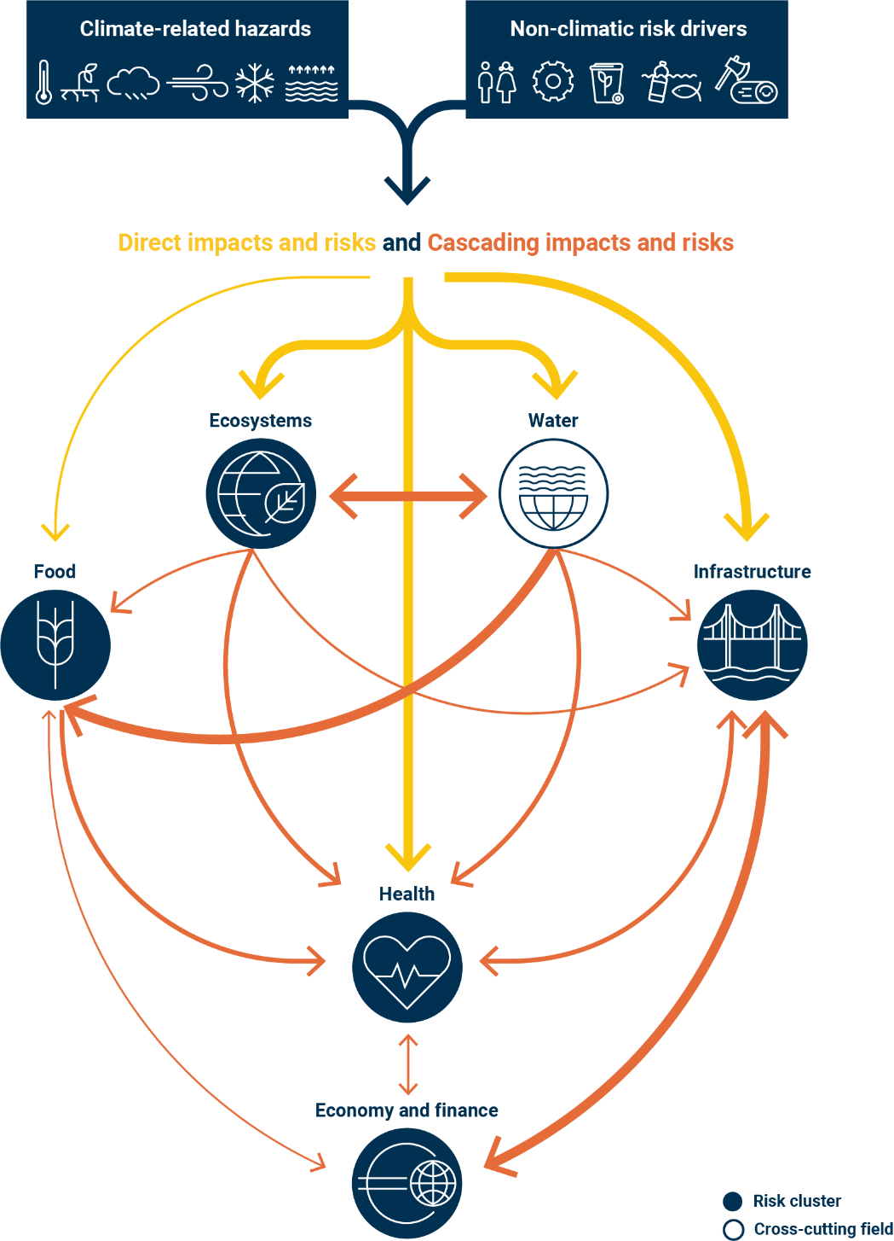
Climate risks cascade from one system to another
Climate change is a risk multiplier that can exacerbate existing risks and crises
Cascading climate risks can lead to system-wide challenges affecting whole societies, with vulnerable social groups particularly affected
For example, climate change driven mega-droughts can lead to water and food insecurity, spread of diseases, disruptions of critical infrastructure, and threats to financial markets and stability

Slide 10
The transition as an investment agenda
High level of investment in the energy system needs to be sustained over several decades:
  +1.5 pp of GDP vs. 2011-2020
  €660 billion / year in 2031-2050
I/GDP ratio not exceptional for the EU, and investment needed in any case
Investment means returns and benefits
Average annual energy system investment needs, excluding transport
Ratio of gross fixed capital formation to GDP and GDP growth (5-year backward moving average)
Source: PRIMES

Slide 11
Conclusion
Climate change is an existential threat to our societies and economies
The costs of inaction are becoming increasingly evident and large
A high warming pathway entails huge risks and costs
Many risk factors are still insufficiently understood, e.g. tipping points
Rapid and sharp cuts in GHG emissions are critical, in the EU and globally
The EU must lead the way
The costs of inaction far outweigh the mitigation costs
The climate and energy transition also generates large co-benefits
Some further increases in global warming are unavoidable
Investing in resilience and climate adaptation is critical

Slide 12

Thank you
© European Union 2023
Unless otherwise noted the reuse of this presentation is authorised under the CC BY 4.0 license. For any use or reproduction of elements that are not owned by the EU, permission may need to be sought directly from the respective right holders.
Slide xx: element concerned, source: e.g. Fotolia.com; Slide xx: element concerned, source: e.g. iStock.com

Slide 13
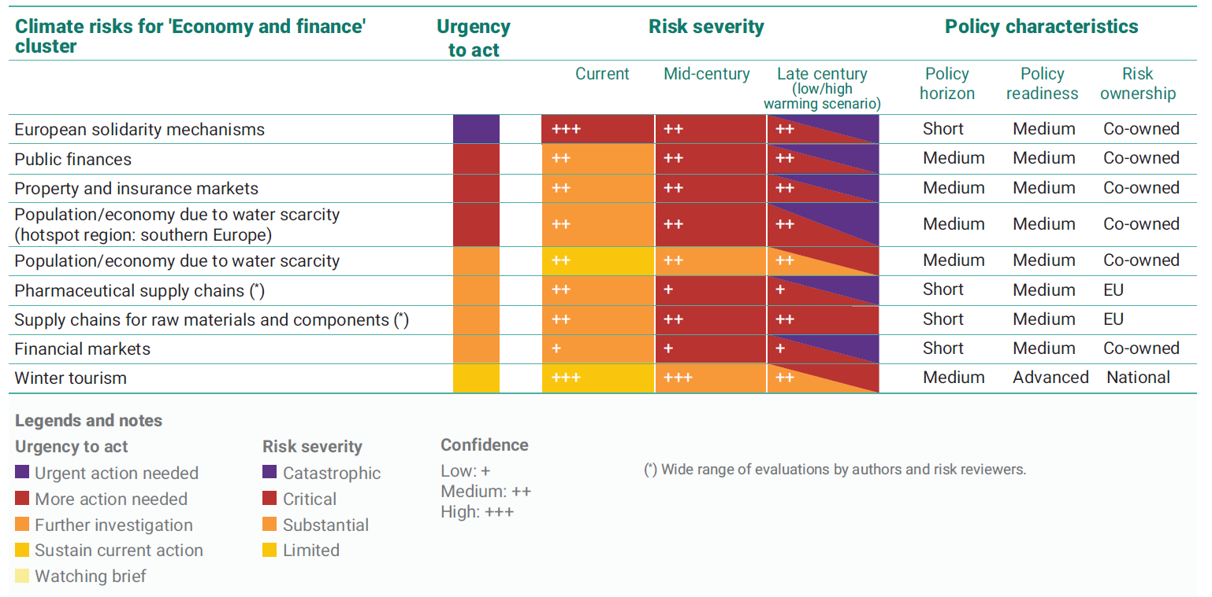
EUCRA - climate risks for “economy and finance”

Slide 14
The transition as an investment agenda
Average annual energy system investments needs (billion EUR 2023)
 | S2 - S3 average
EU27 | 2031-2050
Supply | 310
Power grid | 85
Power generation | 142
Other | 82
Demand excluding transport | 356
Industry | 35
Residential | 239
Service | 62
Agriculture | 19
Transport | 871
Total | 1536
Total excluding transport | 665
Memo:
Real GDP (period average) | 20906
Source: PRIMES (IA Annex 8, table 26) (simplified)

Slide 15
Key actions relating to the economy
Resilience of EU firms
Need to strengthen fiscal sustainability: (1) new economic governance framework; (2) developing the projection of climate impacts on debt sustainability
COM to support Member States in mainstreaming climate risk budgeting and adaptation investment needs estimates
Relevant risks to be appropriately reflected in the prudential frameworks to provide the basis to embed climate risk in the banks and insurers’ frameworks
Assessments of wealth and economic activity should include natural capital

