Slide 1
How could/should a future Industrial Deal look like?
Sylvie Lemoine
Deputy Director General Cefic
9 July 2024

Slide 2






We need a comprehensive, integrated industrial policy package
Costs
Demand
Sustainable production
Sustainable products
Energy
Administrative
Raw materials
Labour
Innovate &
Invest
X 6
2

Slide 3
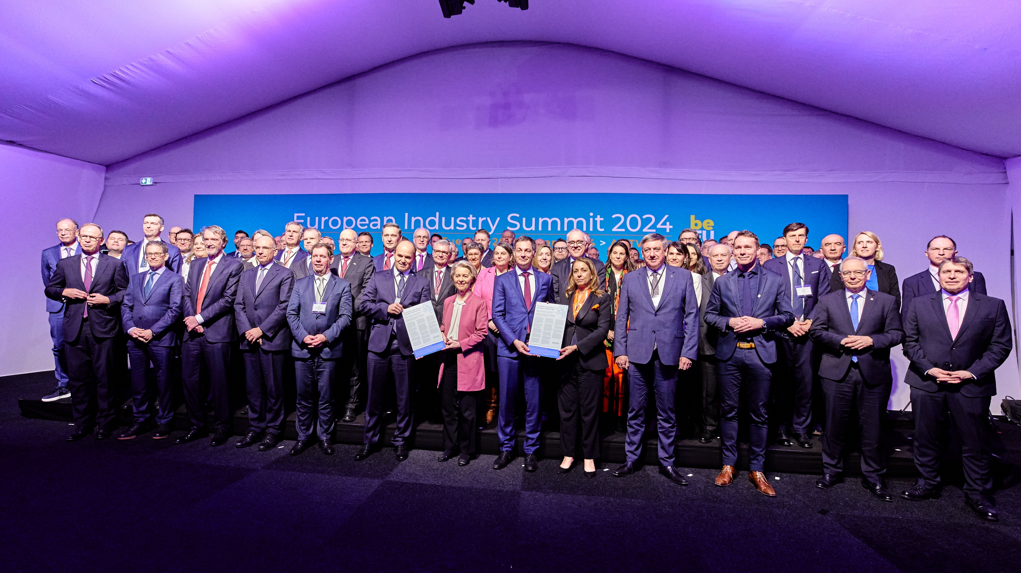
20 February 2024

Slide 4
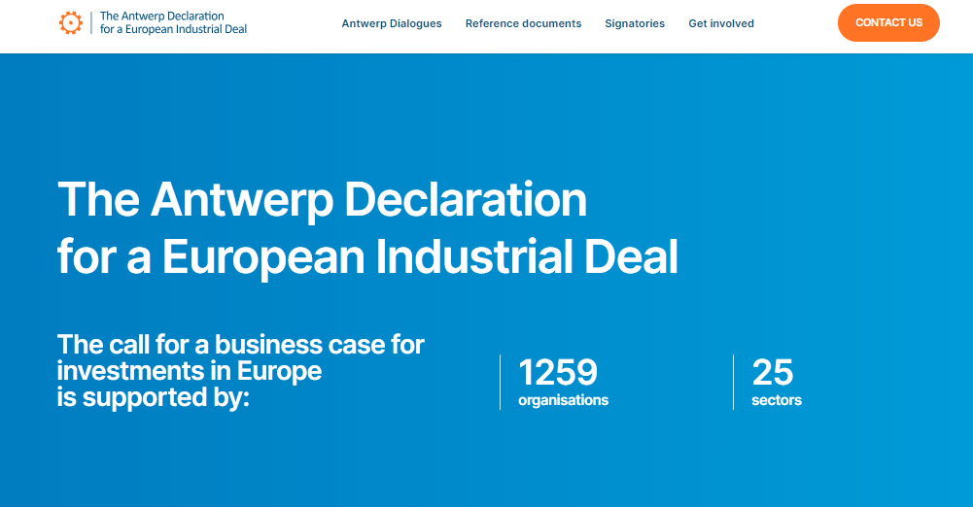
Declaration website
The Antwerp Declaration for a European Industrial Deal (antwerp-declaration.eu)

Slide 5
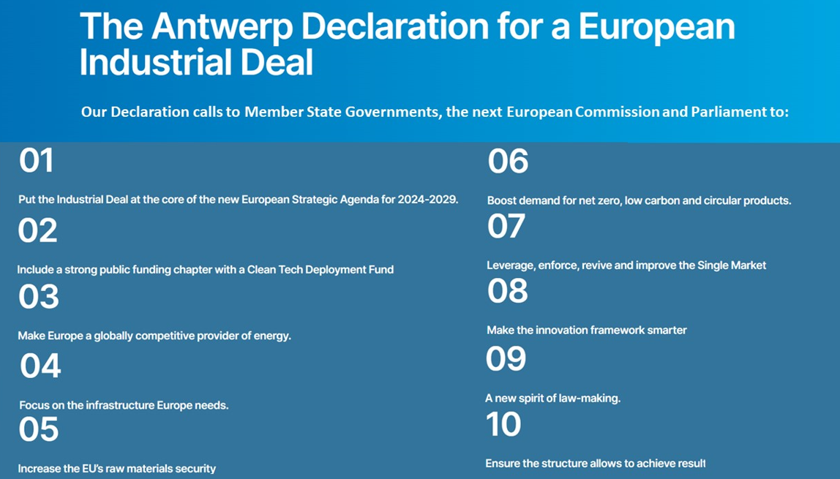
The Antwerp Declaration calls to support the business case for investments in Europe, to complement the EU Green Deal goals and safeguard quality jobs in Europe.

Slide 6
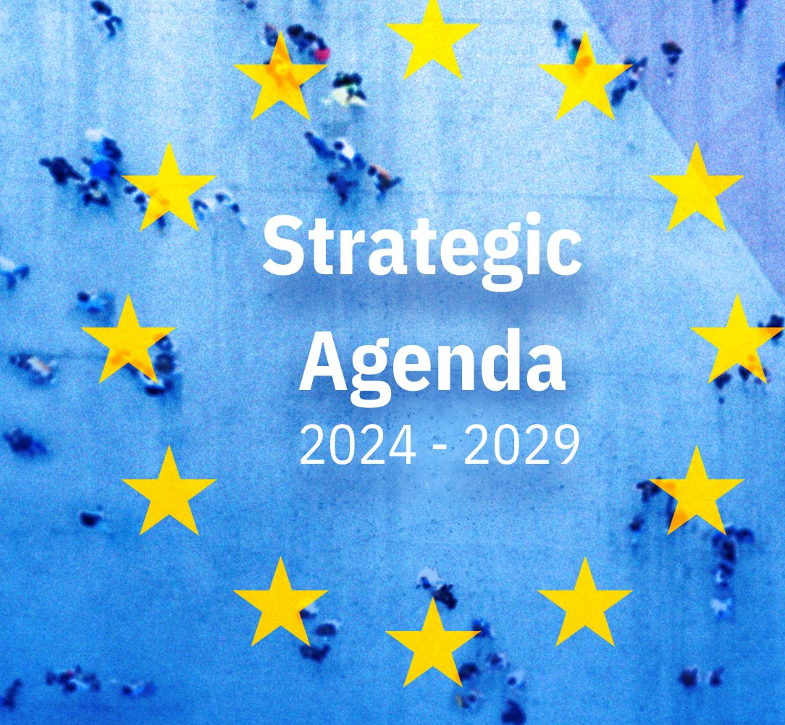
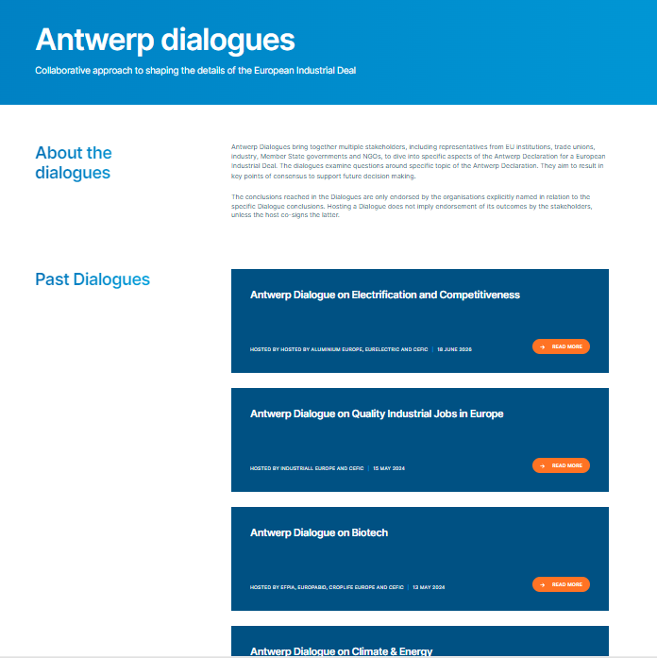
Two highlights
On our path towards climate neutrality by 2050, we will be pragmatic and harness the potential of the green and digital transitions […]
Europe will accompany, nurture and grow its businesses and […] remain an attractive location for investment.
[….]This requires a significant collective investment effort, mobilising both public and private funding, including through the European Investment Bank
We will build up our own capacity in sensitive sectors and key technologies of the future, [list…]

