Slide 1
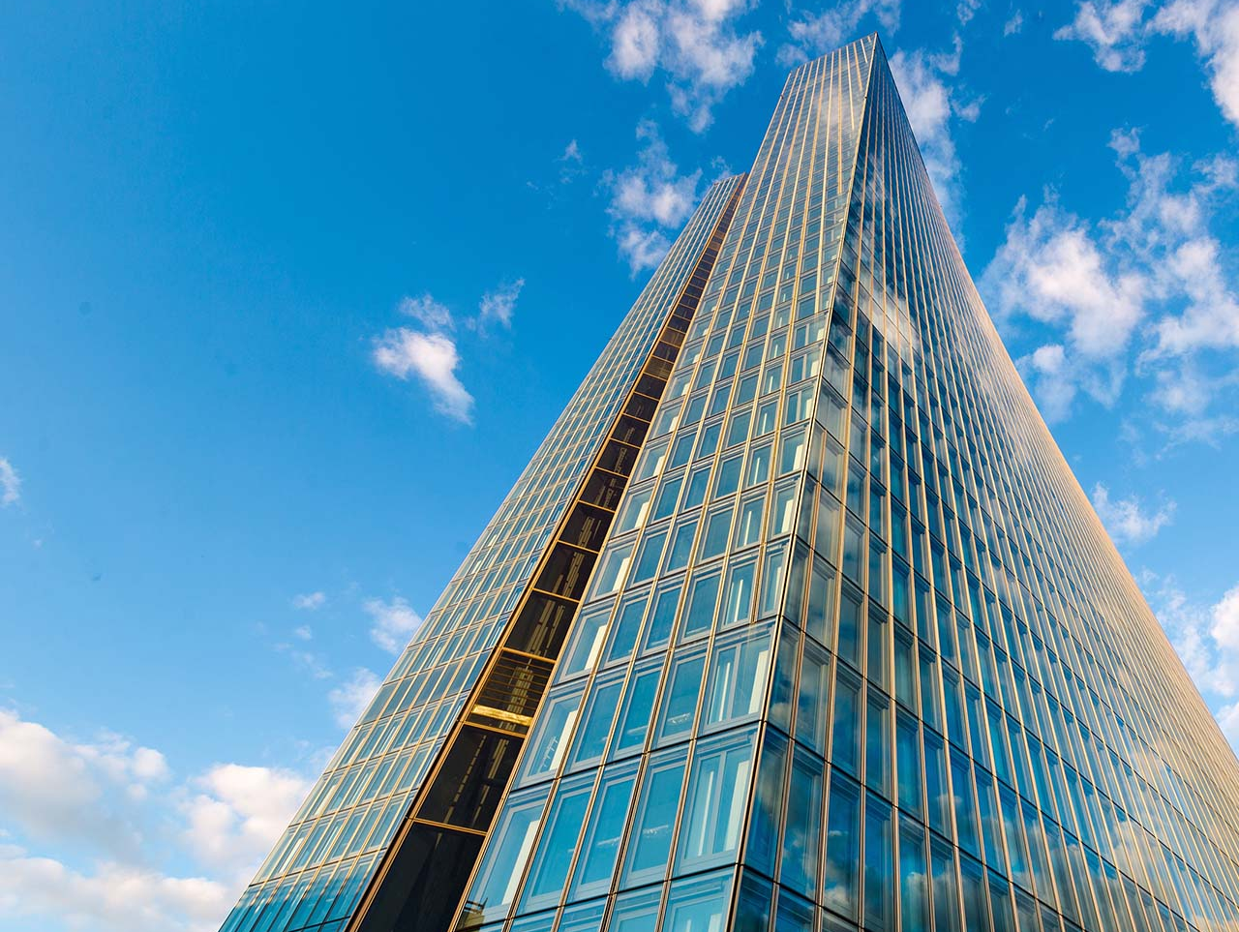
Climate change and the impact on the economy
DRAFT
ECB-PUBLIC
Some insights from recent ECB research
18/07/2024
Friderike Kuik, European Central Bank
The views expressed are those of the presenter and should not be reported as representing those of the European Central Bank

Slide 2
How climate change matters for central banks’ price stability mandate
Climate change
Continued changes in climate and more frequent and intense extreme weather events
Structural transformation of the economy, driven by climate policies
Productivity and potential output, supply chains, impacts over the business cycle
Policy transmission
(equilibrium rate, financial markets and financial stability)
Direct inflation impact:
rates, volatility, heterogeneity
Price stability

Slide 3
Climate change impacts on output
 | Capital | Labour supply | Total factor productivity
Extreme weather and climate events | Destruction of capital Opportunity to replace old, destroyed capital with new technology Greater uncertainty reduces willingness to invest over long run | Higher mortality / sickness Disaster-induced migration Loss of education and skills | Bankruptcies / lack of finance cause reallocation, for better or worse Rebuild distracts management
Long-run climate change | Sectoral impacts e.g. agriculture, tourism Regional impacts (heat, coastal) |  | Adaptation capital less productive, diverts resources from innovation Reduced labour efficiency
Source: Parker (2023)

Slide 4
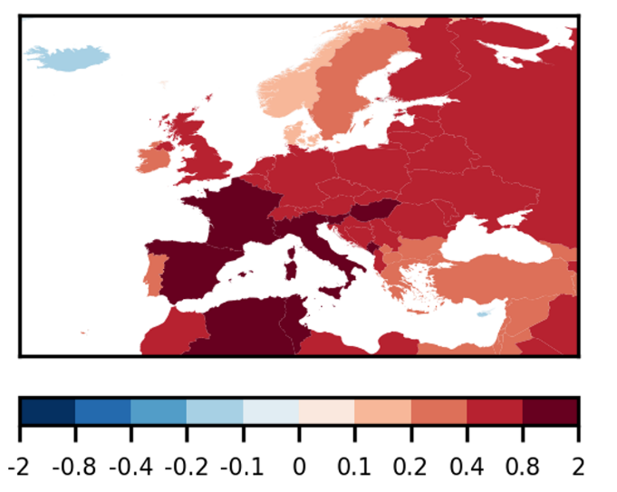
Climate change impacts on inflation
Impact of the 2022 summer heatwave on food price inflation
(percentage points)
Impact of extreme summer heat on food price inflation in Europe
(percentage points)
Source: Kotz et al. (2024)
Notes: Estimated with global panel regressions. Cumulative deviation of food inflation from baseline after 12 months due to extreme June/July/August temperatures are shown. Charts are based on combining elasticities of a 1°C increase in temperatures with 2022 realised summer temperatures (LHS) and results from 21 global climate models (RHS). Projected temperatures of a 2022-like summer (i.e., in the upper tail of the temperature distribution) in future climates are retrieved from climate model results under different emission scenarios. Impacts could be reduced through ambitious adaptation to warmer climates.

Slide 5
Conclusions and open questions
Climate has measurably changed, and will continue to do so: macroeconomic effects no longer a question for the long term
Climate change and the green transition have substantial implications, with impacts…
  Structurally and over the business cycle
  On key macroeconomic variables, e.g., output, inflation, and public finances
  On trade and competitiveness
  Characterised by non-linearities; risks due to climate tipping points
ECB analysis shows that the costs of transitioning will be lower than the long-term costs of unabated climate change
Key open research questions remain…
  Overall size of impacts on output, globally and regionally
  Relative price vs. inflation impacts
  Heterogeneity of impacts, interconnections and non-linearities
  Risks through global supply chains
  Role of nature capital and ecosystem services

Slide 6
Background

Slide 7
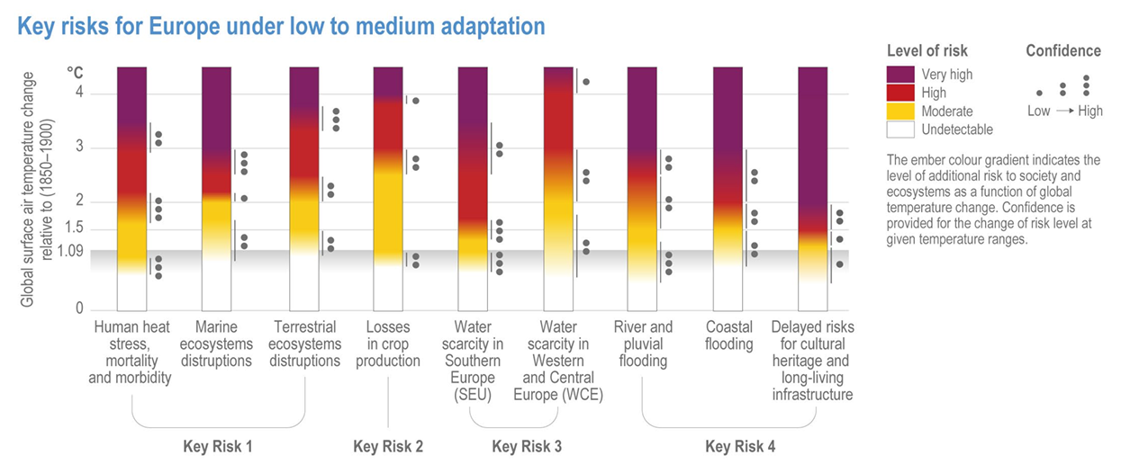
IPCC: Key risks for Europe
Mortality and morbidity of people and changes in ecosystems due to heat
Heat and drought stress on crops
Water scarcity
Flooding and sea level rise
Source: IPCC (2023), WG II, Chapter 13 (Europe)
IPCC: Intergovernmental Panel on Climate Change

